Slide 1

Customer Service Management
Session Six
Customer Service
  Skills for Success – 7th Edition
    Robert W. Lucas; McGraw-Hill Education; New York, NY 2019
      ISBN: 978-1-259-95407-8

Slide 2

Part Three: Building and Maintaining Relationships
Chapter Eight: Customer Service in a Diverse World
  “Diversity is the one true thing we all have in common. Celebrate it everyday.” - Anonymous

Slide 3
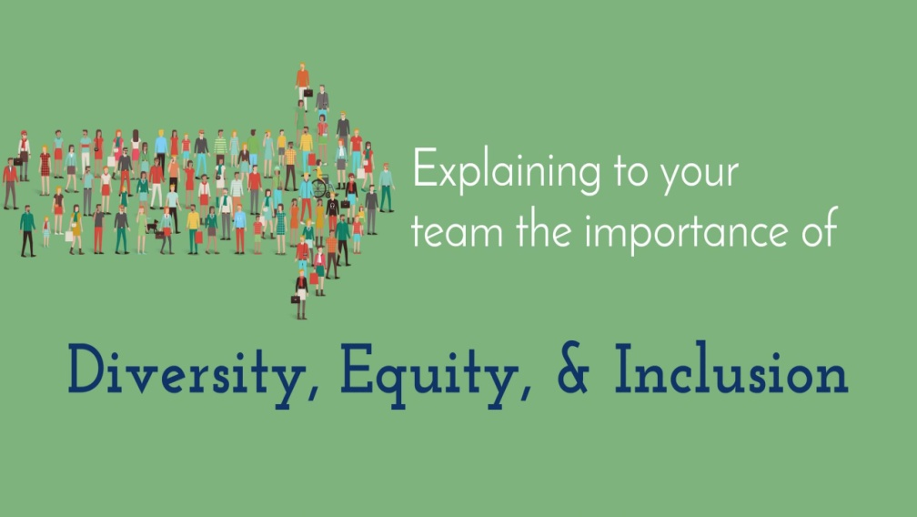
The Impact of Diversity
Diversity is encountered everywhere and is an important aspect of everyone’s life.
  As the world grows smaller economically and otherwise, the likelihood that you will have contact on the job and/or in your personal life with people from other cultures, or who are different from you in other ways, increases significantly.

Slide 4

The Impact of Diversity
Encounters with others give us an opportunity to expand our knowledge of others.
  Although it presents challenges in making us think of differences and similarities, it also enriches our lives – each encounter we have with another person gives us an opportunity to expand our knowledge of others and build relationships, while growing personally.

Slide 5

The Impact of Diversity
    One significant impact that diversity has on customer service is that people from varied backgrounds and cultures bring with them expectations based on the “norm” of their country or group.
      Whether this diversity pertains to cultural or ethnic differences, beliefs, values, religion, age, gender, ability, or other factors, a potential breakdown in customer satisfaction can occur if people get other than what they want or expect.

Slide 6
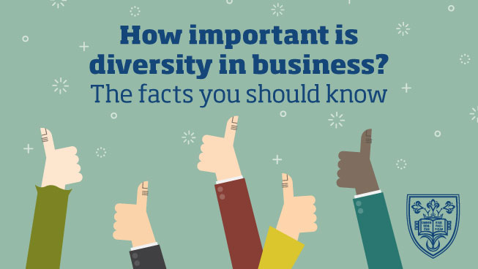
The Impact of Diversity
Part of creating a positive diverse customer business environment is to train each service provider in the nuances of dealing with people who have backgrounds that are different from their own.
  Additionally, this effort involves each employee taking ownership for enhancing their knowledge and skills related to working with a diverse customer base.
    By taking such initiative and expanding their understanding of others, employees become a valued asset for their organization.

Slide 7

The Impact of Diversity
As you begin your journey through the concept of dealing with diverse customers, stop and think about the following questions:
  How do you define diversity?
  What do you already know about diverse cultures around the world?
  In what ways do your cultural beliefs and values differ from those of cultures with which you have contact as a service provider?
  In what ways are your cultural beliefs and values similar to those of cultures with which you have contact as a service provider?
  How do the beliefs and expectations of people from a gender other than your own affect your ability to serve them effectively?
  What is your personal interest in learning about cultures or diverse groups?
  What training or research have you done on diversity and how has that influenced your views or perspectives toward others different from you?

Slide 8

Defining Diversity
“Diversity” encompasses a broad range of differences. Many people associate the term with race or color of skin.
  However, it also encompasses a variety of other individual and group characteristics such as cultural diversity.
    Cultural diversity refers to the different racial, ethnic, and socioeconomic varieties, based on factors such as values, beliefs, and experiences, that are present in people grouped together in a given situation, group, or organization.

Slide 9

Defining Diversity
Start your journey to better understanding of diversity by being fair to people and keeping an open mind when interacting with them.
  People from varying groups and geographic locations bring with them special knowledge, experience, and value.
  Even though people may have differences or may look different, they also have many traits in common. Their similarities form a solid basis for successful interpersonal relationships.
    If you are knowledgeable and think of people as individuals, you can then capitalize on their uniqueness. Contrarily, if you cannot think of the person instead of the group, you may stereotype people – lump them together and treat them all the same. This is a recipe for disaster, service breakdown, and organizational failure!

Slide 10
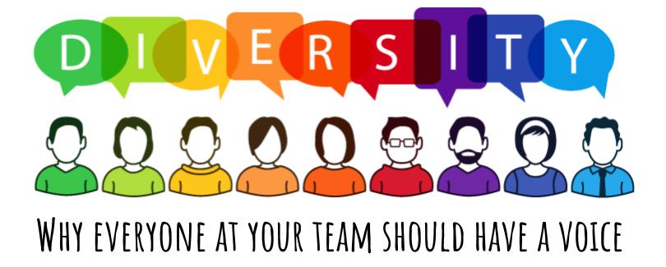
Defining Diversity
Some factors that make people different are innate, that is, they are born with them, such as height, weight, hair color, gender, skin color, physical and mental condition, etc. All these factors contribute to our uniqueness and either help or inhibit us throughout our lives, depending on perceptions we have.
  We gain or learn other factors that make us unique through our environment and our life experiences, such as, religion, values, beliefs, economic levels, lifestyle choices, profession, marital status, education, and political affiliation.
    Often we use these factors to assign people to categories.
    Use caution when considering any of these characteristics, since grouping people can lead to stereotyping and possible discrimination.

Slide 11

Defining Diversity
The bottom line is that all of these factors affect each customer encounter.
  Your awareness of differences and of your own preferences is crucial in determining your success in each instance.

Slide 12
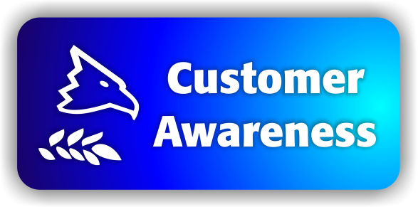
Customer Awareness
Applying your own cultural practices and beliefs to a situation involving someone from another culture can result in frustration, anger, poor service, and lost business.
  No two people are alike, no two generations are alike, and no two cultures are alike. In addition, each customer has needs based on his or her own perceptions and situation.
    The diverse nature of your customer population requires you to be aware of the various ways people from different cultures or groups interact in the business setting.

Slide 13

Customer Awareness
A changing customer world brings potential differences in the way some people perceive factors such as time, communication style, gender roles, religion, dress, and members of other countries and cultures.
  By better understanding other cultures and contexts, you have an opportunity for building a solid customer-provider relationship. You also significantly reduce the chance for communication and service breakdowns due to differing perspectives and expectations.
    Cultural awareness training is crucial to your success.

Slide 14

The Impact of Cultural Values
Values often dictate which behaviors and practices are acceptable or unacceptable.
  Values may or may not have direct bearing on serving the customer, but they can have a very powerful influence on what the customer wants, needs, thinks is important, and seeks or accepts. Values can also influence your perceptions and actions toward others.
    Being conscious of differences can lead to a better understanding of customers and potentially reduce conflict or misunderstanding.

Slide 15


The Impact of Cultural Values
Values are the “rules” that people use to evaluate issues or situations, make decisions, interact with others, and deal with conflict.
  As a whole, a person’s value system often guides thinking and helps them determine right from wrong or good from bad.
  From a customer service prospective, values often strongly drive customer needs and influence the buying decision.
    Values also differ from one culture to another, depending on its views on ethics, morals, religion, and many other factors.
    Values come from deeply held beliefs, and are powerful.

Slide 16

The Impact of Cultural Values
To be effective in dealing with others, service providers should not ignore the power of values and beliefs, nor should they think that their value system is better than that of someone else.
  The key to service success is to be open-minded and accept that someone else has a different belief system that determines needs.
    Your goal is to provide excellent service to the customer, and in order to achieve success in accomplishing this goal, you must be sensitive to, tolerant of, and empathetic toward customers.

Slide 17

Modesty
Modesty refers to the way that cultures view propriety of dress and conduct.
  In some cultures (i.e. Muslim and Quaker), conservative dress by women is one manifestation of modesty.
  In other cultures, nonverbal communication cues send messages (i.e. eye contact).
    Be aware of your work environment and nonverbal communication to ensure you are not offensive to others.

Slide 18

Expectations of Privacy
Based on your personality and prior life experiences, you may be more or less likely to disclose personal information, especially to people you do not know well.
  You should be aware that disclosing personal information about oneself is often a cultural factor and expectations of privacy vary.
    Being congenial and welcoming is a good thing during a customer interaction; however, if you tend to be gregarious and speak freely about virtually any topic, you should curtail this tendency in the customer service environment. Be cordial but don’t talk excessive.

Slide 19

Expectations of Privacy
A good rule of thumb is to stay focused on the business of serving your customer in an expeditious and professional manner. Keeping your conversations centered on satisfying the customer’s needs can accomplish this.
  This does not mean that you should avoid “small talk”; just keep it under control and watch customer reactions closely.
    Talking about the weather, traffic, or some other impersonal topic might be fine, but avoid controversial topics that might be emotional hot buttons or sensitive to other people (i.e. politics and religion).

Slide 20

Forms of Address
Although North Americans often pride themselves on their informality, people from other countries may see informality as rudeness, arrogance, or over-familiarity.
  For example, if you were from the U.S. doing business in another country and failed to greet the customer appropriately (i.e. with a slight bow, sign of the wai, namaste, or other traditional greeting) or called customers from a more formal culture by their first name without their permission, you might possibly irritate or anger them.
    When meeting someone from another culture who has not been acculturated into your own, you might greet the customer according to their cultural background. This demonstrates sensitivity and respect.

Slide 21

Respect for Elders
In most cultures, some level of respect is paid to older people. This stems from a belief that with age come knowledge, experience, wisdom, authority, and, often, higher status.
  You must be careful to pay appropriate respect when speaking to older customers. Further, you should be sensitive to the fact that if the customer demands to speak to a senior person or to the manager or owner, they may simply be exhibiting a customary expectation for their culture and generation.
    If you can assist without creating conflict, do so; if not, honor the request when possible.

Slide 22

Importance of Relationships
Before business is conducted in many cultures, the building of a strong interpersonal relationship is very important.
  Interpersonal relationships focus on the need for service providers to build strong bonds with customers.
    In many cultures, having a number of informal meetings with people in an organization to build a relationship is often expected before coming to an agreement.

Slide 23
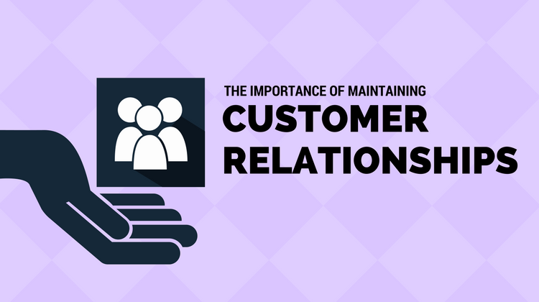
Importance of Relationships
Failure to establish rapport or an environment of trust could lead to a breakdown in service and/or lost customers. This does not mean that you should hesitate to assume a quicker familiarity with customers from such cultures, as this could also alienate them.
  Instead, when you will be having ongoing contact or doing repeat business, follow the customer’s lead.
    Get to know them and share information about your organization and yourself that could lead to mutual trust and respect.

Slide 24
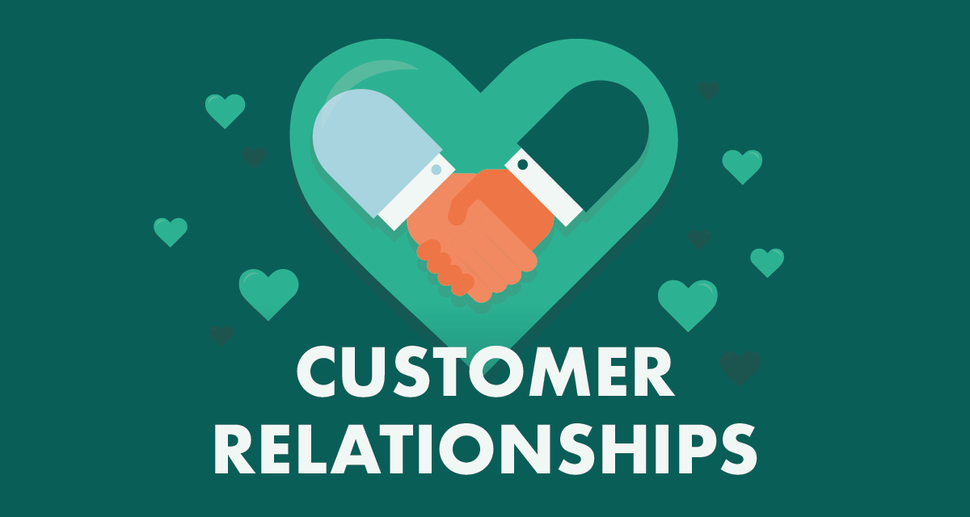
Importance of Relationships
Relationship building may also involve presenting gifts to persuade various people in the organization that you are a friend and have their interests at heart. Only then can you proceed to determine needs and provide service.
  People from many countries view this as an appropriate form of etiquette, while others may label such gratuities as bribes.
    Whatever your belief, if the practice is a cultural norm, you may do well to follow it when dealing with customers from other regions.

Slide 25

Gender Roles
Culturally and individually, people view the role of men and women differently.
  Although gender roles are continually evolving throughout the world, decision-making and authority are often clearly established as male prerogatives within many cultures, subcultures, and families.
    You do not have to agree with these practices, but you will need to consider them when facing them in some customer encounters.

Slide 26
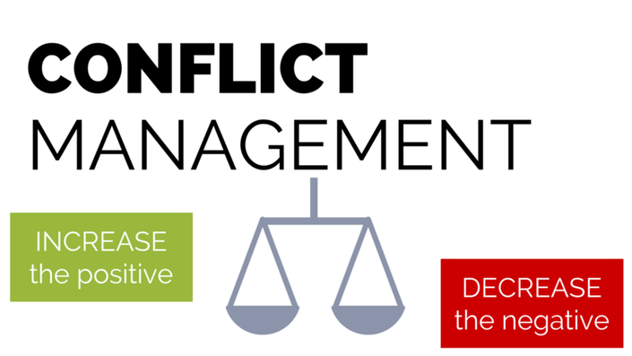
Attitude Toward Conflict
By recognizing your biases and preferences, and being familiar with other cultures, you can reduce the potential for disagreement.
  Certainly, there will be times when a customer initiates conflict. In such instances, all you can do is remain positive.
    If necessary, you may need to ask for assistance to resolve the conflict.

Slide 27
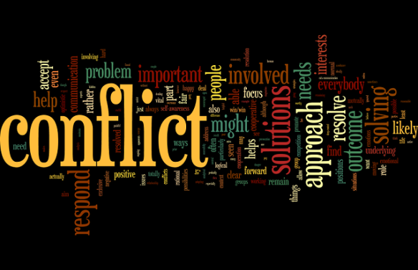
Attitude Toward Conflict
Many times, attitudes toward conflict are either rooted in the individual’s culture or subculture or based on personal behavioral style preference.
  Some cultures are individualistic cultures where the emphasis is placed on individuals’ goals as in Western countries.
  Some cultures are collective cultures where emphasis is placed on group goals as in Japan or in Native American cultures.
    Members of individualistic cultures are likely to take a direct approach to conflict, whereas people whose culture is collective may address conflict indirectly, using a mediator in an effort to prevent loss of face or embarrassment for those involved.

Slide 28

Attitude Toward Conflict
Depending on the individuals you encounter and their cultural background, you and your customers may deal differently with conflict. Regardless of culture or group, people choose different conflict resolution styles based on personality style preferences.
  If you use the wrong strategy, emotions could escalate and customer dissatisfaction could follow.
    The key is to listen and remain calm, especially if the customer becomes agitated.

Slide 29

The Concept of Time
In relation to time, people and societies are often referred to as being either monochronic or polychronic.
  Monochronic refers to the perception of time as being a central focus with deadlines being a crucial element of societal norms.
    People from these societies tend to do one thing at a time, take time commitments seriously, are often focused on short-term projects or relationships, and adhere closely to plans or timelines.
  Polychronic refers to the perception of time as a fluid commodity that does not interfere with relationships and elements of happiness.
    People from these societies are used to distractions and juggle multiple things simultaneously without feeling stressed. They consider time as a guide and flexible commodity, work toward long-term deadlines, and view relationships as more important than deadlines.

Slide 30

The Concept of Time
People from the U.S. are typically very time-conscious (monochronic). You often hear of the phrase “time is money,” which stresses their impatience and need to maximize time usage and to be punctual/efficient.
  Many North Americans tend to expect people from other cultures to be as time-conscious as they are; however, this is not always the case. Arab, Asian, and Hispanic cultures tend to be polychronic and are often late for meetings or miss them altogether.
    Such tardiness is not viewed as disrespect for the time of others or rudeness; it is simply indicative of a cultural value or way of life.

Slide 31
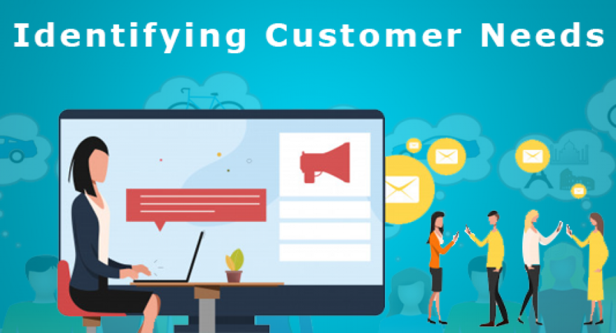
Ownership of Property
People have differing levels of needs. Ask customers what their needs are and listen to their responses.
  Do not persist in upgrading a customer’s request to a higher level or more expensive product if they decline your suggestion. You may offend and lose a customer.
    Of course, if you are in sales, you must make a judgment on whether an objection is one that you should attempt to overcome or whether it is emphatic or culturally based and means “no”.

Slide 32
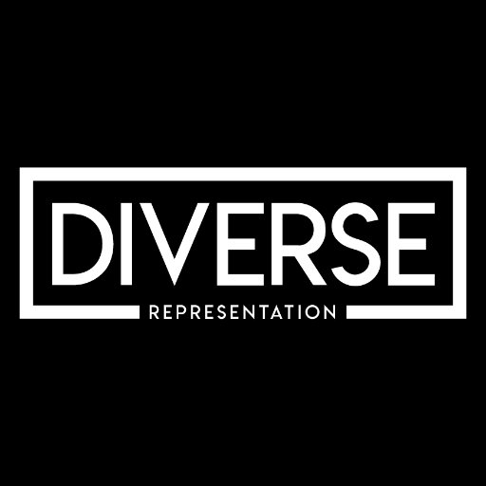
Providing Quality Service to Diverse Customer Groups
As a service provider, you should become proficient in working with customers with language differences and disabilities; you also need to work with young and elderly customers.
  Given the potential diversity of your customer base, it may be impossible to establish a service strategy for each group.
    However, you should think of what you might do to address the needs of some of the larger categories of customers you will meet.

Slide 33
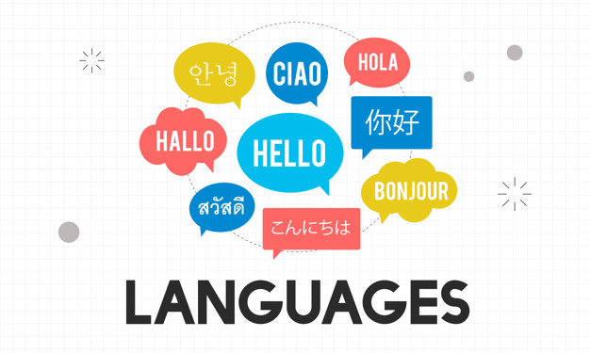
Customers with Language Differences
One major obstacle for service providers in the U.S. is that many adults believe that most of the world’s population speaks English.
  In actuality, English is the third most spoken language behind Mandarin Chinese and Spanish.
    However, if you combine the number of native English speakers and nonnative people who speak English as a second language, English moves up to first or possibly second behind Chinese.

Slide 34

Customers with Different Languages
The key to effectively serving all customers, and particularly people from different cultures, is flexibility.
  You are likely to encounter customers from virtually any country in the world when you speak in today’s business environment, so you need to be prepared. You need to have a way to use alternative methods or strategies for providing service.
    Some organizations have employees who can speak multiple languages, or use an on-call list of translators. Others may have important information readily translated for customers.

Slide 35

Customers with Different Languages
If a customer speaks a little English, or has a heavy accent, try the following strategies:
  Let Your Customer Guide the Conversation
  Be Flexible and Open to Their Experience and World View
  Listen Patiently and Focus on Their Message
  Speak Clearly and Slowly
  Speak at a Normal Volume and Tone
  Use Open-End Questions
  Pause Frequently to Allow for Feedback
  Use Standard English
  Use Globally Understood References
  Be Conscious of Nonverbal Cues

Slide 36
Customers with Different Languages (Cont.)
If a customer speaks a little English, or has a heavy accent, try the following strategies:
  Paraphrase the Customer’s Message
  Try Writing Your Message
  Try a Different Language
  Avoid Humor and Sarcasm
  Look for positive Options
  Use Questions Carefully
  Use a Step-by-Step Approach
  Keep Your Message Brief
  Check Frequently for Understanding
  Keep Smiling

Slide 37

Customers with Disabilities
According to the “Disabled World,” approximately 10% of the world’s population has some type of disability.
  This is not just an issue in the U.S. Around the world, populations are aging.
    The future impact on societies is going to be huge because these numbers are projected to continue to grow as populations age.

Slide 38

Customers with Disabilities
From a customer service perspective, you will certainly encounter someone in the workplace who has a disability and that may require your assistance in serving them.
  Some service professionals are uncomfortable working w/ customers with disabilities. This is because they have had little prior exposure to people w/ special needs, they are uniformed about disabilities, or they have an unfounded fear or anxiety in relating to them.
    Even though you may be unfamiliar with how people with disabilities adapt to life experiences, strive to provide excellent service to them.

Slide 39

Customers with Disabilities
In most cases, customers who have disabilities have learned to accommodate their own personal needs and do not want to be treated differently; they want to be treated equally.
  Related to this, a point to remember is that many people with disabilities will not disclose the fact out of concern that they might be treated differently or discriminated against.
    In reality, their disability is the norm for them and they do not see it as big of an issue as someone who does not share their disability or have knowledge about it.

Slide 40

Customers with Disabilities
Do not assume that just because someone has an obvious disability that they require or want your assistance.
  Offer assistance, if appropriate, and follow your customer’s lead in offering assistance.
    Unsolicited assistance can be offensive and even dangerous if it is unexpected and causes person to lose balance or distracts them.

Slide 41

General Strategies for Servicing Customers with Disabilities
In addition to the suggestions offered in this chapter for serving customers with specific disabilities, the following are some general guidelines for success:
  Be Prepared and Informed
  Be Careful Not to Patronize
  Treat Them Equally, Not Differently
  Refer to the Person, Not the Disability
  Offer Assistance, but Do Not Rush to Help Without Asking
  Be Respectful

Slide 42

Elderly Customers
As the population ages there will be a greater need for services – and service providers – to care for elderly people and allow them to enjoy a good quality of life.
  The following are strategies for better serving these customers:
    Be Respectful
    Be Patient
    Answer Questions
    Try Not to Sound Patronizing
    Remain Professional
    Guard Against Biases

Slide 43

Younger Customers
When providing customer service to someone close to your age be sure not to make the mistake of being overly familiar with them in delivering service.
  And, don’t treat younger customers as your children, condescend, or talk down to them.
    Remember when you were young and felt that adults did not understand or care about your wants or needs? Consider that younger customers may feel the same way about you.

Slide 44

Younger Customers
An additional point to remember when dealing with younger customers is that they may not have the product knowledge and sophistication in communicating that older customers might have.
  Decrease confusion and increase communication effectiveness by using words that are appropriate for their age group and by taking the time to explain and/or demonstrate technical points.
    Keep it simple without being patronizing if you are older than your customers and make sure not to allow any frustration to show in your tone of voice.

Slide 45
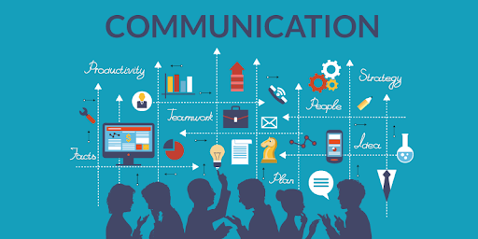
Communicating with Diverse Customers
Many considerations need to be taken into account when you are delivering service to diverse customers. Appropriate language usage is a meaningful tool that you should master for good customer service.
  Consider the following basic guidelines for communicating with all types of customers:
    Be Careful with Your Remarks and Jokes
    Make Sure that Your Language is “Inclusive”
    Respect Personal Preferences when Addressing People
    Use General Terms
    Recognize the Impact of Words
    Use Care with Nonverbal Cues

Slide 46
Customer Service Management

Slide 47

Part Three: Building and Maintaining Relationships
Chapter Nine: Customer Service Via Technology
  “In the world of Internet customer service, it’s important to remember that your competitor is only one mouse click away.” - Doug Warner

Slide 48

The Role of Technology in Customer Service
Customer service is a 24/7 responsibility, and technology can assist in making it effective.
  Computers and other forms of technology are continually becoming smaller, more complex, and more powerful; we have only started to see the impact that technology will have on shaping the future. Most businesses in the U.S. are technologically dependent in some form.
    We have become a 24/7/365 society – we access technology 24 hours a day, seven days a week, 365 days a year – and can communicate at any time and in many places throughout the world.

Slide 49
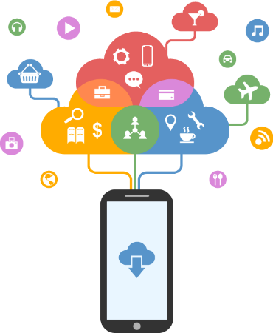
The Role of Technology in Customer Service
More people are accessing telephone-related customer service. This is significantly influencing the economies of many countries via technology-based customer services.
  More than ever, people are using their smartphones and other electronic mobile applications, devices, and computers to surf the Internet and place orders.
    This is especially true of younger consumers, in particular members of the millennial generation, who make up ¼ of the U.S. population and spend over $200 Billion a year.

Slide 50

The Role of Technology in Customer Service
As a result, more people have opted to do their shopping and business from the comfort of their own home.
  With access to products and services at almost any time through telephones, smart phones, mobile devices, and the Internet, customers are in a position of power as never before.
    Companies that are not prepared to meet the future using technology will lose business as customers migrate to providers that are better prepared.

Slide 51
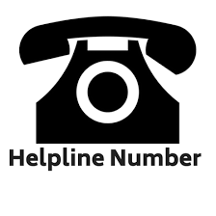
The Customer Contact/Call Center or Help Desk
Electronic commerce is an expanding and powerful way to employ technology to conduct business.
  The growing trend of customer care center or call center expansion that provide technology-based service has resulted in reduced staff and costs, while maintaining or increasing service effectiveness.
    Most organizations now have free 800 or 888 numbers that customers can use to call the organization to get information, place orders, receive service, and for a variety of other functions. Organizations are also employing fee-based 900 numbers through which customers and others can call for information and service (i.e. computer tech support).

Slide 52
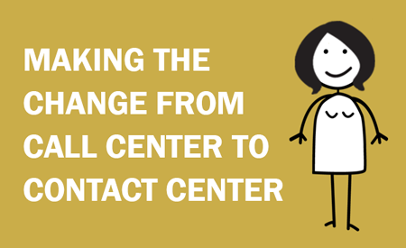
The Customer Contact/Call Center or Help Desk
In the past, operations that used technology were seen as labor-intensive (because of the need to maintain and operate equip.) and behind-the-scenes or “back-office” functions.
  They were not seen as a strategic initiative related to the overall operation of the organization. Instead, they typically supplemented the frontline service providers.
    Savvy customers who are comfortable with technology, along with qualified computer-trained employees, have made customer contact centers an integral part of organizations.

Slide 53
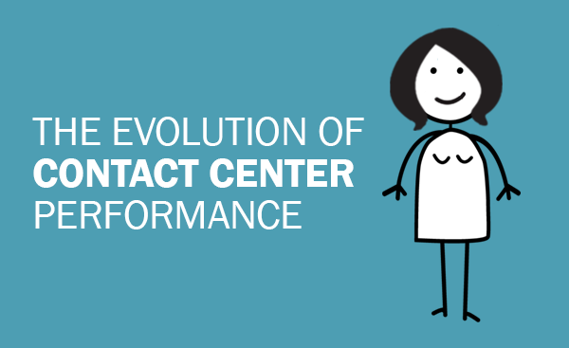
The Customer Contact/Call Center or Help Desk
Customer contact centers, or help desks, are more powerful and complicated than ever before. They also provide more functions than their rather ineffectual predecessors did.
  Additionally, because of changing expectations from customers and new regulatory guidelines related to how technology can be applied, traditional business metrics and approaches to interacting with customers and potential customers need to be reexamined by organizations.

Slide 54

The Customer Contact/Call Center or Help Desk
Any technology application considered today must incorporate a real-time solution for all customer interactions, while effectively monitoring EE performance and productivity results and tying directly to workflow processes that best satisfy customer needs.
  Additionally, such systems should provide opportunities for creating future business opportunities (i.e. gathering customer needs data that can potentially lead to additional sales).
    Will maximize profit potential by positioning the organization to generate new revenue while reducing staffing costs through technology usage.

Slide 55
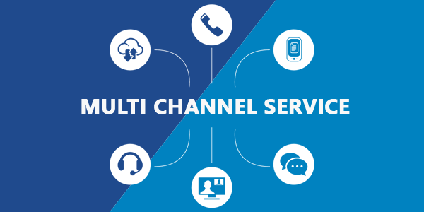
The Customer Contact/Call Center or Help Desk
Even with all the technological advances, one thing remains clear: Many customers still appreciate old-fashioned personalized customer service.
  Factors such as a customer’s age, socioeconomic and educational background, comfort level with technology, access to technology, and behavioral style preference can influence whether or not a customer would rather deal with a person or technology.
    Successful service organizations realize that each customer is unique and provide multichannel customer support that offers a variety of means for customer access (i.e. telephone, e-mail, live chat, or face-to-face).

Slide 56

The Customer Contact/Call Center or Help Desk
Some people are “high touch” (preferring assistance) while others are “low touch” (preferring to serve themselves); therefore, offering a variety of service delivery systems is smart business.
  Whether you deliver service face-to-face or via technology, there is often no substitute for a dedicated, knowledgeable, and well-trained employee to assist when needed.
    You and your customer service peers are the lifeline of your organization.

Slide 57
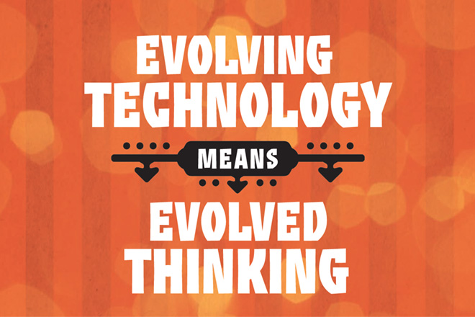
Call Center Technology
Call centers have been around for years. During that time, representatives or agents have used traditional technology to access data and communicate with customers in order to provide a standardized level of service.
  Today, customer service representatives have a vast amount of technology at their disposal and the industry and regulations governing it are continuing to evolve.

Slide 58

Tapping into Web-Based and Mobile Technologies
Evolving technology is changing the way businesses and organizations of all sizes around the world do business.
  Web-based and mobile technologies continue to multiply and expand on a daily basis, and so do ways in which businesses are rapidly learning to harness their power. Everything from organizational branding, sharing information, introducing new products, and communicating and helping satisfy customer needs is possible on technology that is rapidly evolving.
    While service representatives do not typically use all of the technology approaches identified, a familiarity with terminology and technical capabilities is important to professional success.

Slide 59

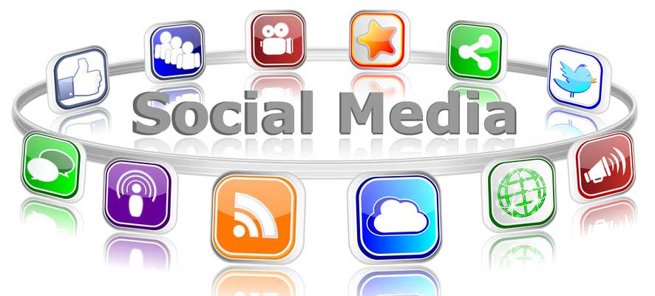
Tapping into Web-Based and Mobile Technologies
The following are some ways that organizations are tapping into today’s evolving web-based and mobile technology to better serve potential, new, and existing customers:
  Websites and Social Media

Slide 60

Websites
Websites are a series of electronic “pages” that are hosted on a web server and provide vital organizational, product, and service information, and multiple ways for consumers to get in touch with key company representatives.
  Websites provide organizations with a valuable tool for presenting a “face” to the entire world. They are a part of the organization’s professional brand.
    Few successful businesses can survive today without having a professional-looking and functional website.

Slide 61

Websites
These standards of technology are able to share information about a person or a company’s organization, products and services, contacts, service options, and much more.
  As part of their overall marketing strategy, they can offer informative blogs, advertising links, and important connections to their social media accounts. All of these can better promote the organizational brand, generate leads, identify potential customers, provide service to current customers, and create residual income streams.
    Small, one-person businesses and bloggers often capitalize on affiliate, banner, and other types of web advertising to generate income.

Slide 62

Websites
One key to website effectiveness is recognition and connections. People must know about the organization and be able to find its website in order to access information on it.
  Search engine optimization is crucial in positioning a company’s website link at the top of a search engine results page when people use Google, Yahoo, or other search engines to scour the Internet looking for information.
  By going to statistical tracking sites and using tools like Alexa and Google Analytics, owners and others can track valuable statistics related to the number of visitors to their sites, how long they stayed on a website, site ranking on the Internet, demographic data, referring websites, and more.
    With such valuable information, businesses are able to determine where they are getting leads and sales and how to better spend marketing dollars and target their marketing initiatives.

Slide 63
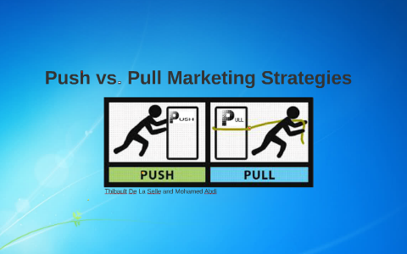
Websites
Websites are basically a “pull” mechanism. That means that site owners post info, provide service chat support, and encourage people to come to the site to retrieve information, use services and support, and make purchases.
  This is opposed to “push” technology, which proactively sends out information to customers and potential customers.
    Examples of push technology include e-mail and Twitter messages, blog articles, e-Newsletters, mailings, etc. These methods put information into the hands of customers.

Slide 64
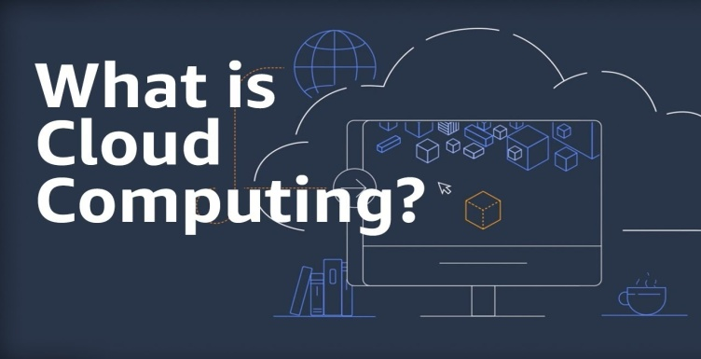
Cloud Computing
Cloud computing technology involves using hardware and software delivered over a network, such as the Internet.
  In effect, this form of computing allows end users (customers) to use mobile phones, tablets, computers, or laptops to access data through a mobile application on the device through a web browser such as Internet Explorer, Firefox, Opera, Safari, or Google Chrome.
    From a cost perspective it provides a means for individuals/organizations to access service & products w/out having to pay for additional equipment and infrastructure for the storage and operation of data and applications.

Slide 65

Cloud Computing
An example of how cloud technology works occurs whenever customers of Amazon or Apple order music, videos, or books. Customers can either download the purchased product to their device or they can store it on the organization’s server and access it when they want to read, listen to, or view it.
  The use of this cloud storage negates customers from using up internal storage space, which at some point may push them to their maximum capacity and require the purchase of additional memory or a new device.
    The only caveat is that they must have Internet access via a connection or Wi-Fi (wireless access) capability to access their application and data.

Slide 66

Social Media
The Internet has exploded with social networking websites (i.e. Facebook, Twitter, LinkedIn, Pinterest) that allow people and organizations a vehicle to post information about themselves, products, and services.
  Most of these sites were originally envisioned as a way to connect with old and new friends and relatives and to share personal messages or information.
    Social media has become so popular and available to consumers that businesses and other organizations are tapping into it to help establish their brand, share information, identify and connect with customers, and target specific demographic groups while keeping their name in front of millions of people.

Slide 67
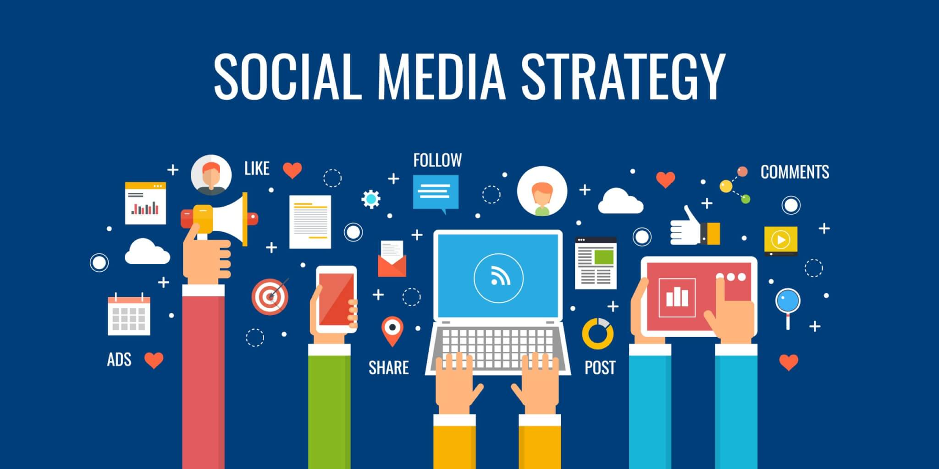
Social Media
Users connect on various social media sharing sites for a variety of reasons. This potentially provides a wealth of opportunity for companies that want to share their message about products and services with the world since there are hundreds of millions of visitors to these websites each year.
  Organizations hoping to tap this revenue-generating gold mine should develop a strategic marketing plan to target specific audience demographics and to determine what site users are looking for on each media site that is part of the plan.

Slide 68

Social Media
There are many factors to consider before moving forward into the social media arena. Part of the initiative should be to identify what is in it for site users and the organization.
  Five reasons that people are likely to follow your company brand on social media:
    To receive coupons and discounts
    To show their friends that they like your brand
    To receive entertaining or educational content
    To receive customer support
    To receive exclusive information and content

Slide 69
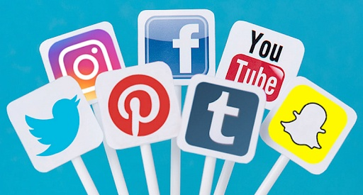
Social Media
One of the biggest advantages to using social media to get information out to current and potential customers is that the sites are almost exclusively free.
  As long as the organizations follow site guidelines, they are free to share information and benefit from the mass exposure.
    Since many of these sites focus on target demographics, they offer opportunities for organizations specializing or diversifying into a specific market to tap that resource.

Slide 70

Social Media
Imagine the simplicity of creating a short video that discusses your organization’s mission, vision, and value statements or provides an overview of products and services and then uploading it to a site like YouTube.
  This simple free tool could direct job candidates, vendors, consumers, and anyone else with an interest in the organization to your website link to view the content.
    Such vehicles could save companies time and money in their marketing effort or in orienting new employees to what the organization is all about.

Slide 71

Social Media
An important thing for companies to realize is that their employees are networking with other employees and possibly their customers directly or indirectly through social media.
  This impact can be either positive or negative on the company image depending on what is being shared. As employees discuss their job, talk about issues, or, in some cases, vent their frustrations, they may inadvertently or intentionally share private or proprietary info with others who do not have a need to know.
    This is why many organizations now have designated people in IT monitoring social media. Employees need to be professional.

Slide 72
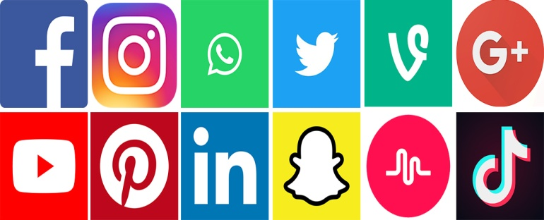
Social Media
The following are some of the popular social media websites and technology that individuals and organizations are using to share information or for promotion.
  YouTube
    The largest video-sharing website on the Internet, where users can upload, share, and view videos.
  Twitter
    An online social networking and micro-blogging service that enables its users to send and read text-based messages.
  Facebook
    This social networking site is open for use by anyone over the age of 13 to share information, send messages, and network socially.
  Pinterest
    A pin- or cork-board type of forum where users can share photos and images on various themes or interests.

Slide 73
Social Media
The following are some of the popular social media websites and technology that individuals and organizations are using to share information or for promotion.
  Podcasts (Portable On-Demand Broadcasts)
    With podcasts, service providers can share information (i.e. advertisements, product information, training program content, entertainment, or information updates) with potential and current customers in the community.
  Smartphones
    Mobile telephones that are built with a mobile operating system similar to a computer that allows them to perform a myriad of functions using what are called applications or apps.
  Tablets
    A personal computer (PC) that is a hybrid between a notebook or laptop computer and a personal digital assistance (PDA) and has a flat screen viewing panel.

Slide 74
Social Media
The following are some of the popular social media websites and technology that individuals and organizations are using to share information or for promotion.
  Text Messaging
    Text messaging or texting is the process of someone typing and sending a brief electronic message to another person over a phone network using a mobile phone or fixed or portable device.
  Wikis
    These sites provide a means of collecting and exchanging information and brainstorming ideas related to a project. This exchange of knowledge and ideas can facilitate harmony as well as enhance productivity if used effectively.
  Blogs
    Chronological “diaries” written by bloggers, and those within organizations, to provide updates, product or service commentary, and information and graphics or video to internal and external customers in the form of posts.

Slide 75
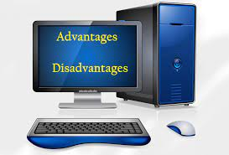
Advantages and Disadvantages of Technology
Like anything else related to customer service, technology offers advantages and disadvantages, particularly in the following areas:
    Organizational Issues
    Employee Issues
    Customer Issues
    Additional Issues

Slide 76
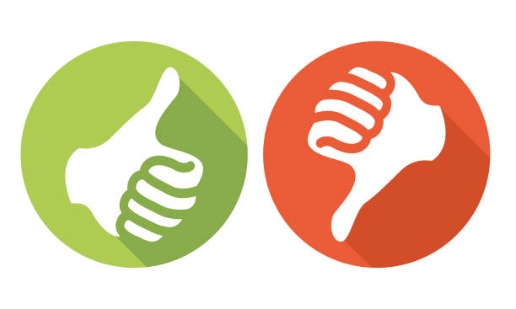
Advantages and Disadvantages of Technology
Organizational Issues
By using computers, software, and various telecommunications devices, a company can extend its presence without physically establishing a business site and without adding staff.
  Simply by setting up a website, organizations can become known and develop a worldwide customer base while helping to equalize the playing field with competitors worldwide.
    The challenge for the organization is to have well-maintained, state-of-the-art equipment with trained, qualified, competent, and customer-oriented people to operate it.

Slide 77
Advantages and Disadvantages of Technology
Employee Issues
Technology frees employees from mundane tasks such as taking information and mailing out forms, information, or other materials.
  Additionally, potential and existing customers can receive information through automated surveys sent to them to find out preferences, satisfaction levels, and other valuable information that can be used to market products and services and provide better service. Technology also allows employees to serve more people in less time, and do it better.
    The downside for employees is that many organizations see technology as a way to reduce staff costs and overhead, and they often eliminate positions. Additionally, new tech requires new training and skills.
    Another problem created by technology is an increase in stress levels of both employees and customers.

Slide 78
Advantages and Disadvantages of Technology
Customer Issues
In the age of technology, people contacting your organization typically expect immediate responses or assistance. They do not care about problems with your systems. They likely expect that issues related to services, phone systems, and other equipment are anticipated and an alternative is available.
  If you fail to meet their expectations regarding technology and services you may lose them as your customer.
    There should be a process in place to circumvent technical problems and meet customer expectations.
    From a customer standpoint, if service providers and organizations use it correctly and professionally, technology can be a blessing.

Slide 79
Advantages and Disadvantages of Technology
Additional Issues
Technology, especially the Internet, has spawned a new era of fraud and manipulation. This is a major concern for consumers and can create many challenges for you and your peers.
  Some of the biggest problems you must deal with are customer’s fears of fraud, violation of privacy, and concerns that their personal and financial information might be compromised, leading to future issues with their credit.
    You have a personal responsibility and vested interest to improve processes and procedures and systems in the organization in order to build and strengthen trust with your customers.

Slide 80

Reducing Customer Fears about Technology
Avoiding customer concerns is often as simple as communicating effectively. Try some of the following approaches to reassure your customers about the security of technology:
  Emphasize the organization’s policy on security and service.
  If customers voice concerns about providing a credit card number over the phone or on the Internet, you might respond with “This is not a problem. You can either fax or mail the information to us.”
  If your organization is a member, stress participation in consumer watchdog or community organizations (i.e. Better Business Bureau).
  Direct customers to areas on your website that show your digital certificate or security level logo from a certifying source that indicates the encryption of information entered into the order system and transferred electronically.
  Also, point to the “https” component of your domain name at the top of their screen which indicates that they are on a secure website.

Slide 81
Reducing Customer Fears about Technology (Cont.)
  Point out any website page that shows the organization’s history and shows how long you have been in business (if been in business for a while). The longevity of a company can soften fears and convince people that you have been around for a while and are not likely to go out of business tomorrow.
  Ask for only pertinent information.
  Answer questions quickly and openly.
  Avoid asking for personal and financial information when possible.
  Offer other options for data submission, if available. When using the telephone, smile and sound approachable in order to establish rapport (customers can “hear” a smile over the phone).
  Listen carefully for voice tones that indicate hesitancy or uncertainty and respond appropriately.
  Communicate in short, clear, and concise terms and sentences. Also, avoid technical or “legal” language that might confuse the customer.
  If calls are recorded, remind the customer of that and point to it as an added layer of security in case there is a question or concern later.
  Explain how your organization uses and stores personal information.

Slide 82
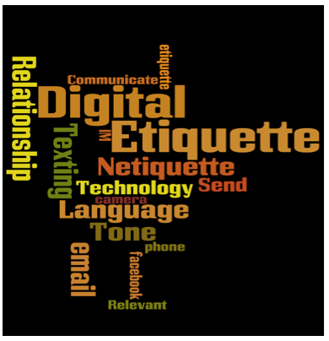
Technology Etiquette and Strategies
Using technology ethically and with correct etiquette is important.
  As with any other interaction with people, you should be aware of some basic do’s and don’ts related to using technology to interact with and serve your customers.
    Failure to observe some commonsense rules can cause loss of a customer and raise ethical concerns.

Slide 83
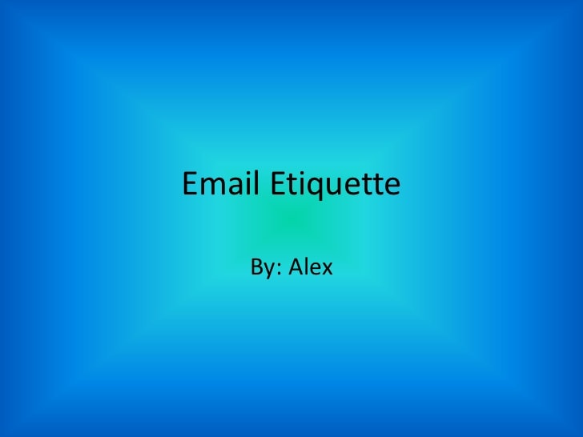
Technology Etiquette and Strategies
E-Mail
E-mail provides an inexpensive, quick, and effective way of communicating via the World Wide Web.
  It was never intended to replace form written correspondence. Even so, many organizations now use it to send things like attached correspondence and receipts. They use it to notify customers of order status, gather additional information needed to serve a customer, and for other business related issues.
    No matter what the function, e-mail has its own set of guidelines for effective usage. These guidelines help ensure that you do not offend or otherwise create problems when dealing with customers.

Slide 84

Technology Etiquette and Strategies
E-Mail
The following tips offer some e-mail etiquette guidelines for effective usage:
  It’s OK to use abbreviation and initials – just be sure receiver understands acronyms, etc.
  Proofread and check spelling before sending a message.
  Think before writing – do not respond when upset or emotional.
  Use short, concise sentences.
  Use both upper and lower case letters.
  Be careful with punctuation – limited use of exclamation marks.
  Use e-mail only for informal correspondence – (i.e. membership cancelation should be via written letter sent via U.S. mail).

Slide 85
Technology Etiquette and Strategies
E-Mail
The following tips offer some e-mail etiquette guidelines for effective usage:
  Use organization e-mail for business purposes only.
  Use blind courtesy and copies sparingly – do not break trust.
  Copy only necessary people – do not inundate others.
  Get permission to send advertisements or promotional materials – do not send unsolicited or junk e-mails.
  Be cautious in using emoticons as they may be inappropriate or misinterpreted.
  Fill your address line last – a safety mechanism to ensure you take the time to read the message before you send and to ensure message doesn’t send prematurely before completion.

Slide 86
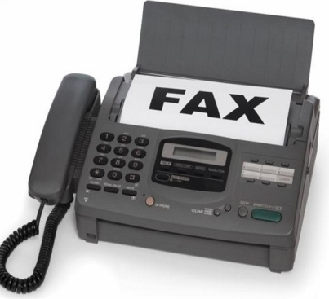
Technology Etiquette and Strategies
Facsimile
Facsimile (FAX) machines have been around for decades. Many companies now use computers with scanners to replace them. Even so, they are still used by some organizations, especially small businesses.
  As with any form of communication, there are certain do’s and don’ts to abide by when using a fax machine to transmit messages.
    Failing to adhere to these simple guidelines can cause frustration, anger, and a breakdown in the relationships between you and your customers or others to whom you send messages.

Slide 87
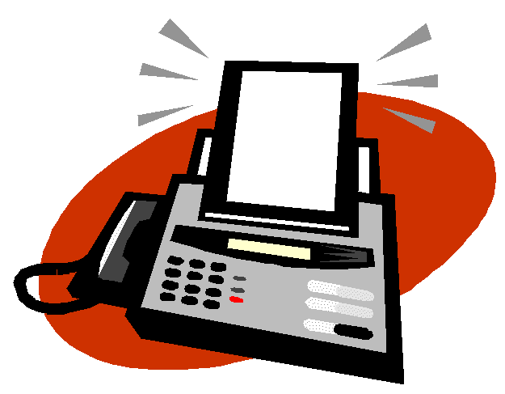
Technology Etiquette and Strategies
Facsimile
Be considerate of your receiver
  If you plan to send a multipage document to your customer, telephone in advance to make sure it is OK and a good time to send.
Limit Graphics
  If graphic images are unnecessary to clarify written text, eliminate them. They waste a receiver’s printer cartridge ink, tie up the machine, and can irritate your receiver.
Limit correspondence recipients
  As with e-mail and memorandums, limit the recipients of your messages. If someone does not have a need to know, do not send message copies to that person.

Slide 88
The Telephone in Customer Service
    The telephone is the second most important link in customer service. Modern businesses rely heavily on the use of telephones to conduct day-to-day operations and communicate with customers.
  Not all service via technology is delivered from a customer contact center. In smaller organizations, the responsibility for answering the telephone and providing service falls on anyone who is available and hears the telephone ring.
    Effective use of the telephone saves employee time and effort.

Slide 89
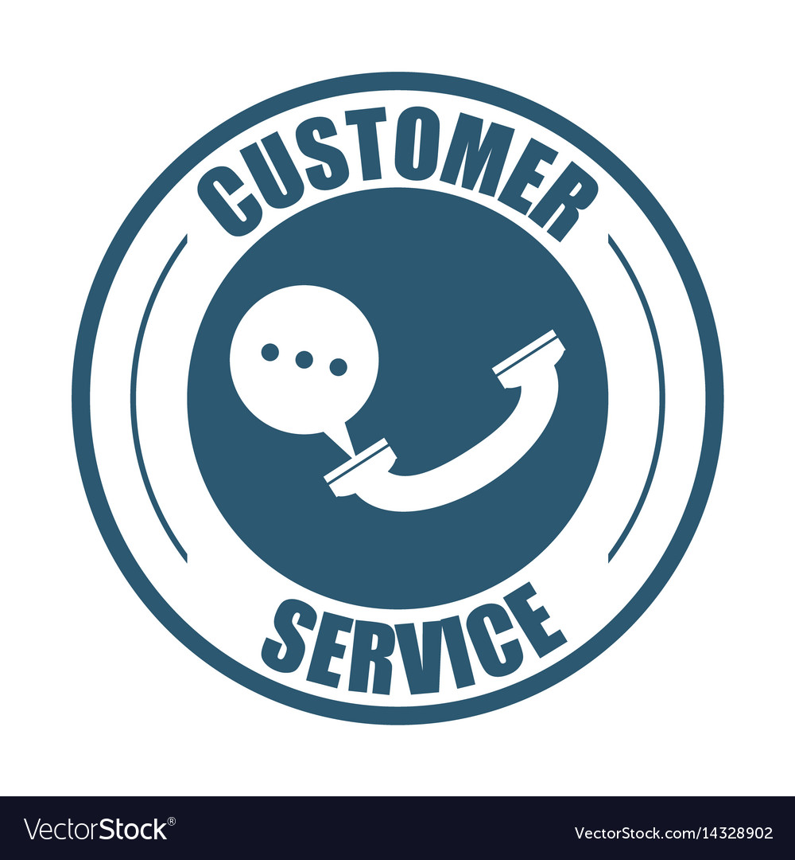
The Telephone in Customer Service
Advantages of Telephone Customer Service, include:
  Convenience
  Ease of Communication
  Economy
  Efficiency

Slide 90

Communication Skills for Success
Just as when you are delivering service face-to-face with a customer, the same skills apply to providing effective customer service over the telephone, especially the use of vocal quality and listening skills.
  Your customer cannot communicate with or understand you if they do not accurately receive your message.

Slide 91
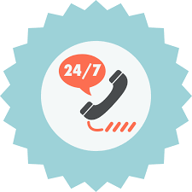
Communication Skills for Success
To reduce the chances of message failure, think about the following 11 communication techniques:
  Speak Clearly – Articulate
  Limit Jargon, Slang, and Colloquialisms
  Adjust Your Volume – Speak More Loudly or Softly as Needed
  Speak at a Rate that Allows Comprehension
  Use Voice Inflection – Raise and Lower Pitch and Tone
  Use Correct Grammar
  Pause Occasionally for Opportunities to Reflect and Provide Feedback
  Smile as You Speak – Project an Upbeat, Warm, Sincere Attitude
  Project a Positive Image and Attitude – Be Affirmative and Reassuring
  Wait to Speak – Do Not Interrupt
  Listen Actively – Focus on Customer’s Message

Slide 92
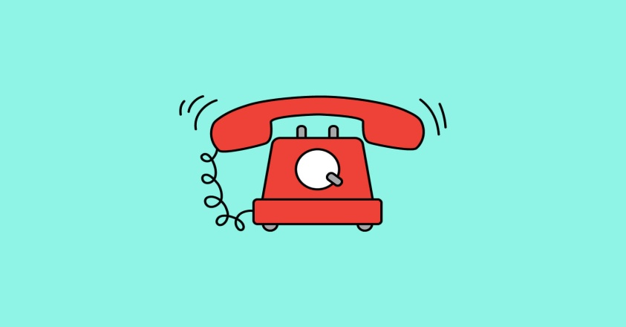
Tips for Creating a Positive Telephone Image
People quickly form an opinion of you and your organization in any interaction. The message they receive often determines how they interact with you during the conversation and in your future relationship.
  Keep in mind when you answer your organization’s telephone, or call someone else as part of your job, you represent yourself and the organization.
    Since many telephone calls are short, you have a limited opportunity to make a positive impression.

Slide 93

Tips for Creating a Positive Telephone Image
When you feel good about yourself, you normally project a naturally confident and pleasant image. On the days when things are not going so well for you, your self-image may tend to suffer.
  The following 8 suggestions will help serve your customers effectively and leave them thinking well of you and your organization:
    Continually Evaluate Yourself – Analyze Your Conversation
    Use Proper Body Posture – Sit Upright and Speak Clearly
    Be Prepared – Answer Promptly with Standard Greeting
    Speak Naturally in Conversational Tone – Do Not Read from Script
    Be Time-Conscientious – Prompt and Courteous Service
    Be Proactive with Service – Try to Assist the Customer and Meet Needs
    Do More than the Expected, especially after a Service Breakdown
    Conclude Calls Professionally and on an Upbeat Note

Slide 94
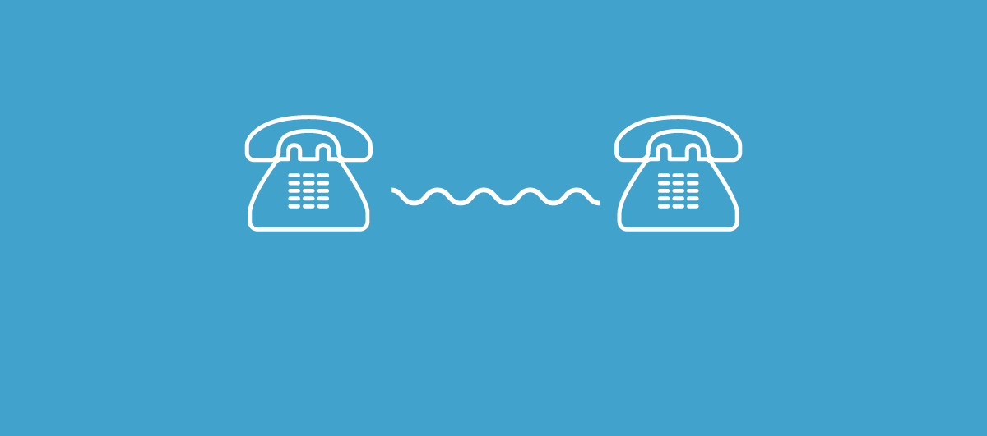
Tips for Creating a Positive Telephone Image
Additional tips for effective telephone Usage:
  Eliminate Distractions – No Food, Drink, other Tasks
  Answer Promptly – by 3rd or 4th Ring
  Use Titles with Last Names – Do Not Assume First Name Basis
  Ask Questions to Extract Information - Listen Carefully
  Use Speakerphone with Caution – Protect Confidentiality
  Use Call Waiting Sparingly – Get Permission to Take Call

Slide 95

Effective Telephone Usage
One basic strategy for successfully providing effective customer service over the telephone is to thoroughly understand all phone features and use them effectively.
  This may seem to be a logical and simple concept, but think of the times when you called a company and someone attempted to transfer you, put you on hold, or did not communicate clearly…
    Did it always work effectively…did it upset or frustrate you?

Slide 96
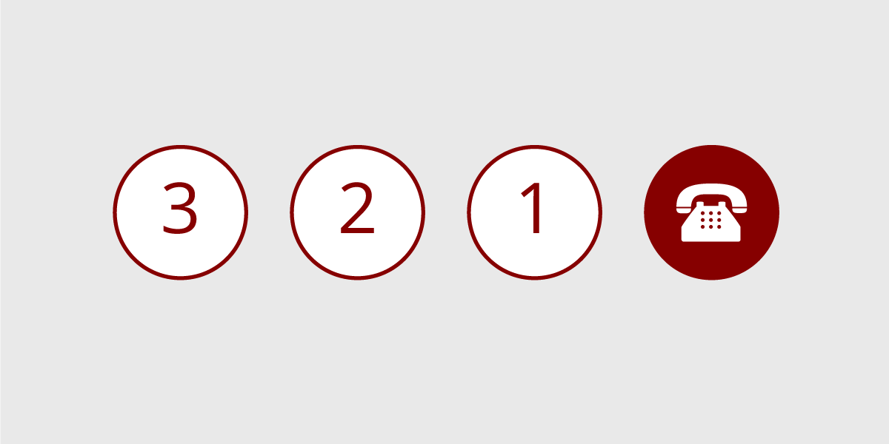
Effective Telephone Usage
Transfer Calls and Use the Hold Function Properly
  Always request permission before transferring a call.
  Once you successfully reach the intended person, announce the call.
  If the call taker is not available or is not the appropriate person, reconnect with the customer and explain the situation.
  You should avoid making a blind transfer. This practice is ineffective, rude, and not customer-focused.
  If you place someone on hold, it is a good idea to go back on the line every 30 seconds to let the person know that they are not forgotten.

Slide 97
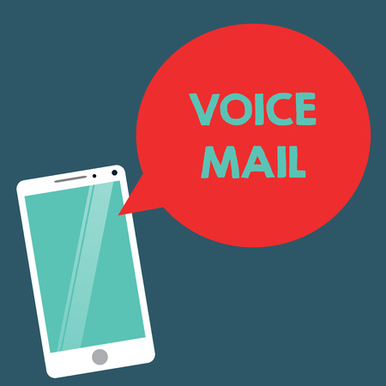
Voice Mail and Answering Machines or Services
Although voice mail is hailed by many people as a time-saver and vehicle for delivering messages, when an intended recipient is unavailable, many other people have difficulty dealing with this technology (including answering machines).
  Some people simply refuse to interact with a machine.

Slide 98

Voice Mail and Answering Machines
Managing Incoming Calls:
  In order to effectively use voice mail, you must first understand how your system works. A key to using voice mail effectively is to keep your message current, indicating availability, the type of information the caller should leave, and when the caller can expect a return call.
    If your system allows the caller the option of accessing an operator or another person, you should indicate this early in your outgoing message.

Slide 99
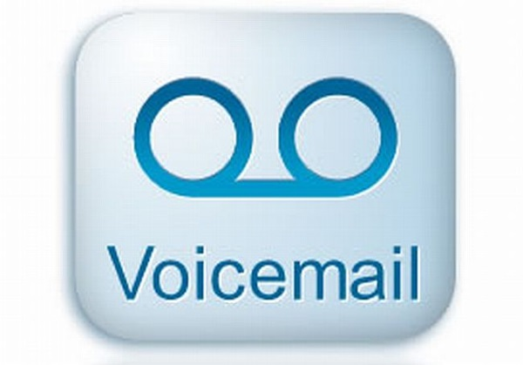
Voice Mail and Answering Machines
Placing calls to voice mail:
  Many normally articulate people cannot speak coherently when they encounter an answering machine or voice mail. One technique for success is to plan your call before picking up the phone.
    Have a 30 second or less “sales” presentation in mind that you can deliver whether you get a person or machine.

Slide 100
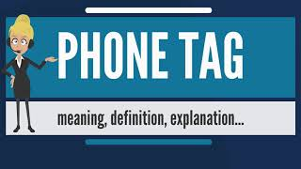
Voice Mail and Answering Machines
Avoiding Telephone Tag:
  You have probably played telephone tag. The game starts when the intended call receiver is not available and a message is left. The game continues when the call is returned, the original caller is not available, a return message is left, and so on.
    To avoid telephone tag, plan your calls and make your messages effective by giving your name, company name, phone number, time and date of your call, a succinct message, and indicate when you can be reached.
    If appropriate, emphasize that it is OK to leave the information you have requested on your voice mail or with someone else. In addition, you may suggest that your message recipient tell you a time when you can call or meet with them face-to-face. This ends game and you get what you need.

Slide 101
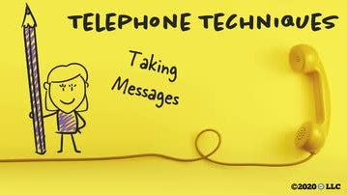
Taking Messages Professionally
At minimum when you take a message you should get the following information from the caller:
  Name – Correctly Spelled
  Company Name
  Phone Number with Area Code if Appropriate
  Brief Message
  When Call Should be Returned
  Time and Date of Call
    If you are answering someone’s phone while away, let caller know.

Slide 102
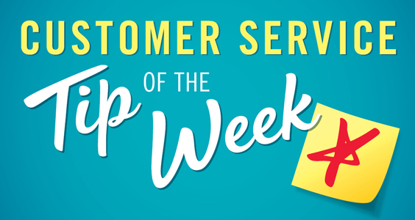
Customer Service Success Tip
When a customer calls or contacts your organization, you should personally accept responsibility and do whatever you can to help ensure that they get the finest level of service available.
  Remember that, to provide quality customer service, everyone in the organization has to take ownership for customer satisfaction. The first person interacting with a current or potential customer sends a powerful message about the organization and may be the only person with whom that customer ever deals.
    The way that person is treated will often determine the memory of the organization and whether the customer becomes a supporter or spreads the word about the poor service received.

Slide 103


