Slide 1
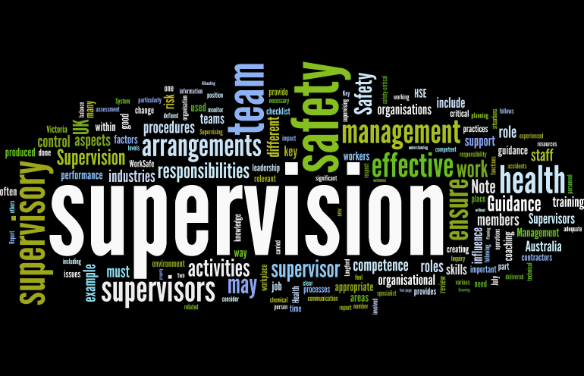
Supervision
Supervision
  Concepts and Practices of Management, 13th Edition
    Edwin C. Leonard, Jr., Ph.D. and Kelly A. Trusty, Ph.D. Cengage Learning, Boston, MA 2013
      ISBN: 978-1-285-86637-6

Slide 2

Part One: Supervisory Management Overview and Challenges
Chapter Two: The Managerial Functions
  After studying this chapter you will be able to:
    Identify the difficulties supervisors face in fulfilling managerial roles.
    Explain why effective supervisors should have a variety of skills.
    Define management and discuss how mgmt. functions are interrelated.
    Discuss the important characteristics of the supervisor as a team leader.
    Explain the difference between management and leadership.
    Discuss concepts of authority & power relating to being a good supervisor.
    Explain the need for coordination and cooperation and how they lead to good performance.
    Identify how labor unions affect the management functions.

Slide 3

The Person in the Middle
The supervisory position is a difficult and demanding role.
  Supervisors are “people in the middle” – the principal links between higher-level managers and employees.
    A supervisor is a first-level manager, that is, a manager in charge of entry-level and other departmental EEs.

Slide 4

The Person in the Middle
Employees may view their supervisors as the management of the organization, since the supervisor is their primary contact with management.
  Employees expect a supervisor to be technically competent and to be a good leader who can show them how to get the job done.

Slide 5
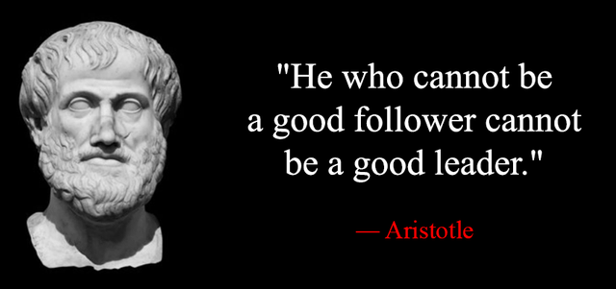
The Person in the Middle
The supervisor must also be a competent subordinate to higher-level managers.
  In this role, the supervisor must be a good follower.
    Moreover, the supervisor is expected to maintain satisfactory relationships with supervisors in other departments. Therefore, a supervisor’s relationship to other supervisors is that of a colleague who must cooperate and must coordinate their department’s efforts with those of others in order to reach the overall goals of the organization.

Slide 6
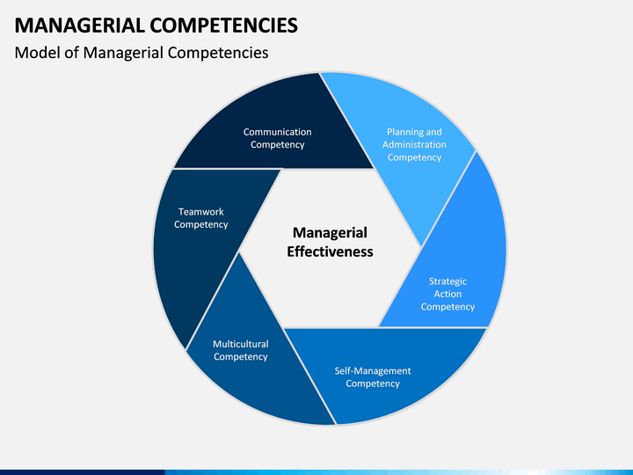
The Person in the Middle
In general, the position of any supervisor has two main requirements.
  First, the supervisor must have a good working knowledge of the jobs to be performed. Second, and more significant, the supervisor must be able to manage the department.
    It is the supervisor’s managerial competence that usually determines the effectiveness of their performance.

Slide 7

Managerial Skills Make the Difference
Effective supervisors manage their departments in a manner that gets the job done through their people instead of doing the work themselves.
  The difference is in their managerial skills and how they apply them.

Slide 8
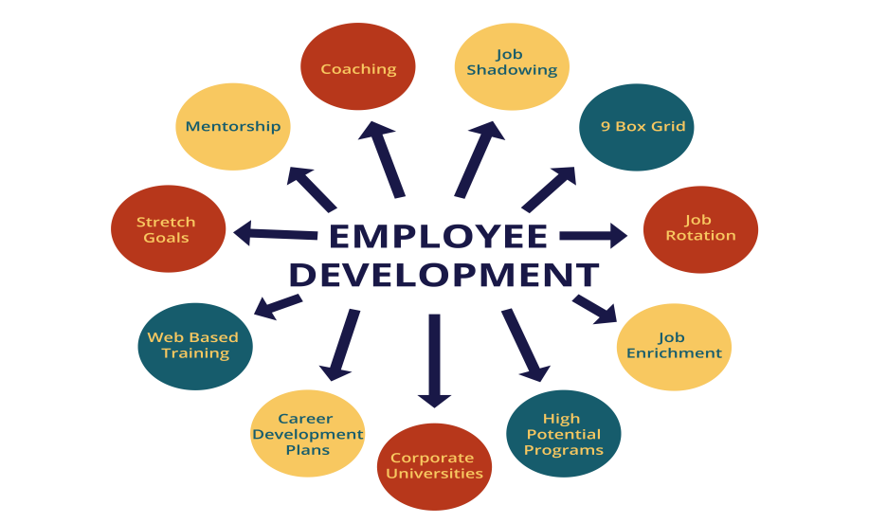

Managerial Skills Make the Difference
Mentoring and employee development is a key part of the job of a supervisor.
  Who are the people in your life that provide you with opportunities for growth by coaching and delegating tasks, which allowed you to add skills to your personal toolboxes?
    Have you thanked them for what they did?

Slide 9
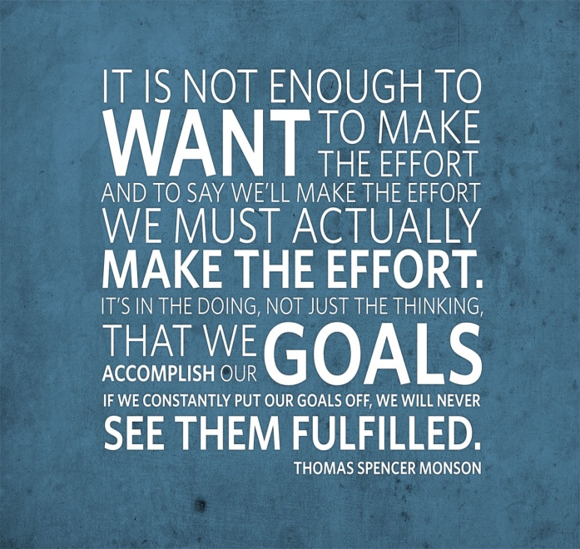
Managerial Skills Make the Difference
EEs wanting to move into supervisory or upper-level management positions must make a conscious effort to develop their managerial skills by learning from their own managers, by completing company training programs, and by taking other avenues available to them.
  Remember, in today’s economy, you must gain experience.
    Gain experience by getting involved in a student organization, complete and internship, and/or volunteer and serve your community.

Slide 10

Winning Moves a Supervisor Should Make
Get employee commitment to goals.
Uncover and build on SKAs.
Trust your people.
Be an enabler.
Engage, support, encourage, cheerlead and reward.
Focus on the target.
Learn what top management expects.
Set high but realistic goals.
Ask for help.
Manage up as necessary.
Create a vision of the future.

Slide 11

Winning Moves a Supervisor Should Make
Get acquainted with your team.
Ask questions and listen.
Learn to manage your workload.
Create lines of sight between individual and company performance.
Make sure EEs know what is expected and how it fits in to the big picture.
Carefully analyze situation, looking for opportunities to make a difference.
Start small and make the easiest changes first.
Be innovative.
Balance risk with rewards.
Maintain a positive attitude.
Reward behavior that contributes to the department’s success.
Stay neutral and don’t get drawn into political disputes.
Put other’s interests ahead of your own by being a servant-leader.
Periodically pause to check how you are doing.
Celebrate successes.

Slide 12

Managerial Skills Supervisors Need
Technical Skills
  The ability to perform the jobs in the supervisor’s area of responsibility.
Human Relations Skills
  The ability to work with and through people; these skills include open-mindedness and the ability to motivate team members.
Communication Skills
  The ability to give – and get – information.
Administrative Skills
  The ability to plan, organize, and coordinate the activities of a work group.
Conceptual Skills
  The ability to obtain, interpret, and apply the information needed to make sound decisions.
Leadership Skills
  The development of a leadership style that emphasizes collaboration, trust, and empathy; engages followers in all aspects of the organization; and helps followers to better themselves.
Political Skills
  The savvy to ascertain the hidden rules of the organizational game and to recognize the roles various people play in getting things done outside of formal organizational channels.
Emotional Intelligence Skills
  The “intelligent use of your emotions to help guide your behavior and thinking in ways that enhance your results. You can maximize your emotional intelligence by developing good communication skills, interpersonal relationships, and mentoring relationships.”

Slide 13
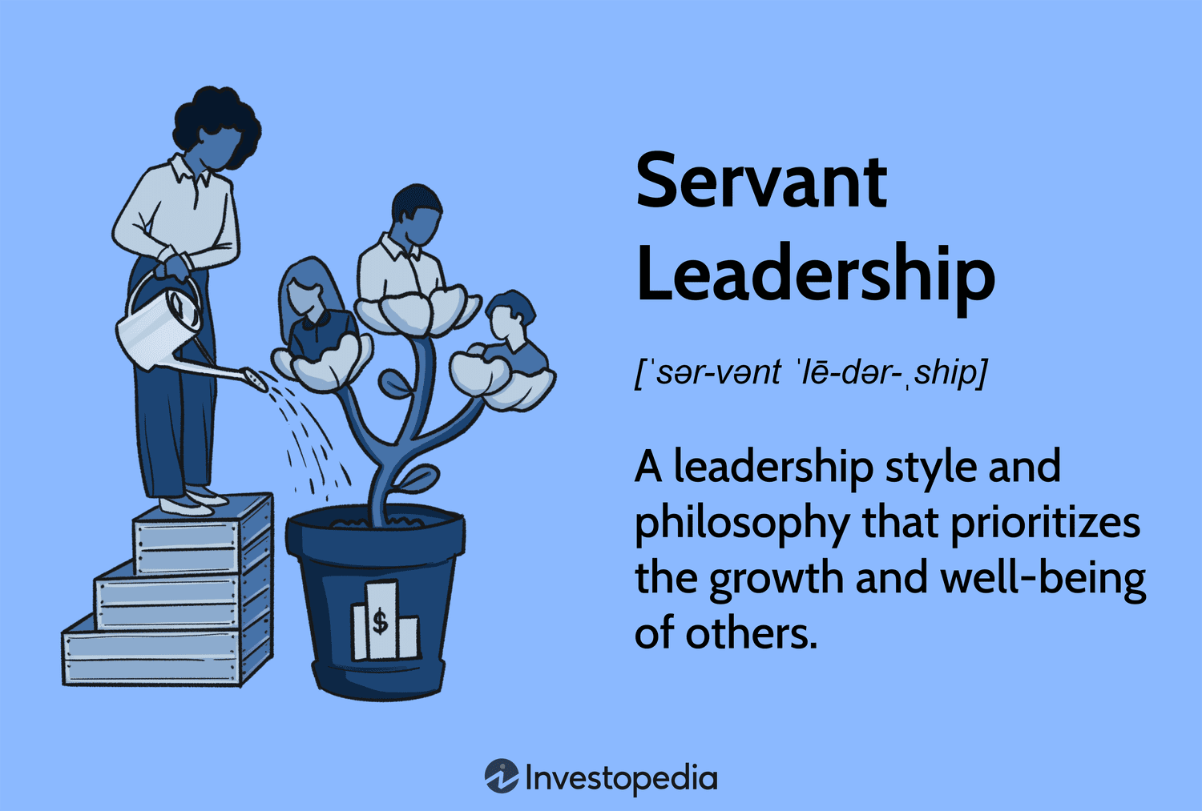
Be a Servant Leader
Servant Leadership
  Looking after the needs of followers so they can be the best they can be.

Slide 14

Managerial Skills can be Learned and Developed
Many people believe that good managers, like good athletes, are born, not made.
  Much research has proven this belief to be generally incorrect, even though it is true that people are born with different potentials and that, to some degree, heredity plays a role in intelligence.

Slide 15

Managerial Skills can be Learned and Developed
The skills involved in managing are learnable.
  It takes time, effort, and determination for supervisor to develop managerial skills.
    Supervisors will make mistakes, but people learn from mistakes as well as from successes.

Slide 16
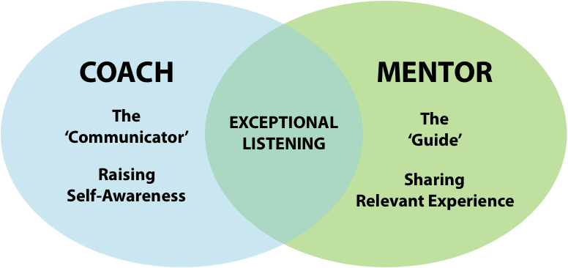
Managerial Skills can be Learned and Developed
To be great…take lessons from coaches who provide the best with solid fundamentals of leadership. Use multiple coaches as you develop through the years.
  Find someone who has the knowledge of the fundamentals and the ability and willingness to instruct.
    Select a coach or mentor who will help you uncover your desires and help you chart a course of action to achieve them.

Slide 17
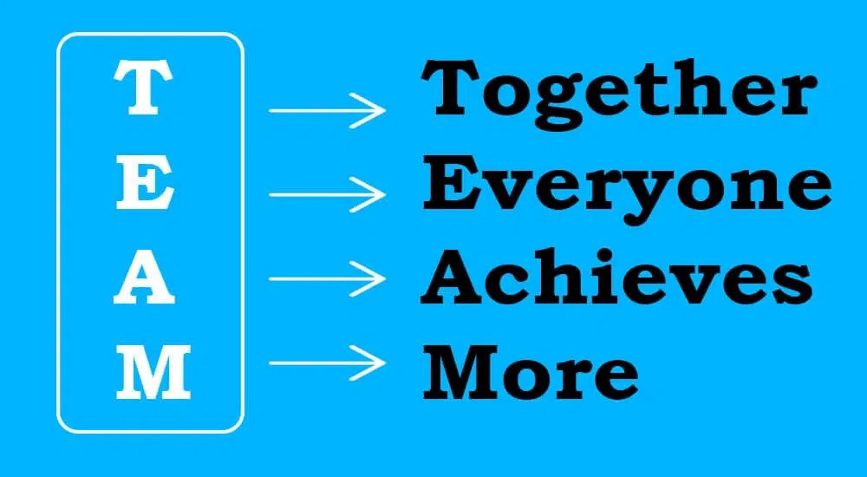
Functions of Management
Management is the process of getting things accomplished with and through people by guiding and motivating their efforts toward common objectives.
  Successful managers will assure you that their employees are their most important asset.
    Most successful managers recognize that they are only as good as the people they supervise. In most endeavors, one person can accomplish relatively little. Therefore, individuals join forces with others to attain mutual goals. In all organizations, top-level

Slide 18

Functions of Management
Those who hold supervisory positions significantly influence the effectiveness with which people work together and use resources to attain goals.
  In short, the managerial role of a supervisor is to make sure that assigned tasks are accomplished with and through the help of employees.

Slide 19

Functions of Management
The foundation for success is built when the manager clarifies what is expected in the way of performance and specifies the behaviors that are acceptable in the work group.
  Then the role of the supervisor is to do all those things that enable employees to be the best they can be (in other words, effectively and efficiently achieve organizational objectives).
    The better the supervisor manages, the better the departmental results.
    In addition, supervisors who manage well become capable of handling larger and more complicated assignments, which could lead to more responsibility and higher-paying positions in the organization.

Slide 20

Supervisory Tips
The E-Z Route for Supervisory Success
  Above all, supervisors should do all of the things necessary to Enable employees to be the best they can be at their assigned tasks.
  Supervisors must foster and sustain a commitment to Excellence.
  Employees need to know what is Expected in the way of performance.
  Supervisors should Establish common goals and purpose.
  Employees must be Educated; that is, they must acquire the requisite job skills through coaching and/or training.
  Employees must be Equipped with the necessary tools, supplies, and equipment to do the job.
  Employees need to be Encouraged to see things that need to be done and to do them.
  Employees should be Empowered so they have the authority & responsibility to achieve objectives.
  Supervisors should nurture an Exciting workplace where employees can find meaning and fulfillment of their individual needs.
  Employees should Experience a variety of tasks and thus become experienced in many areas that use a variety of skills.
  Supervisors should attempt to create a climate that fully Engages employees in the organization.
  Open, honest, two-way communication is essential.
  Supervisors should understand and manage their Emotions.
  Supervisors should possess Empathy; that is, they should understand their employees’ feelings, needs, and concerns.
  Supervisors should Enthusiastically Exalt employees when the job is done.

Slide 21
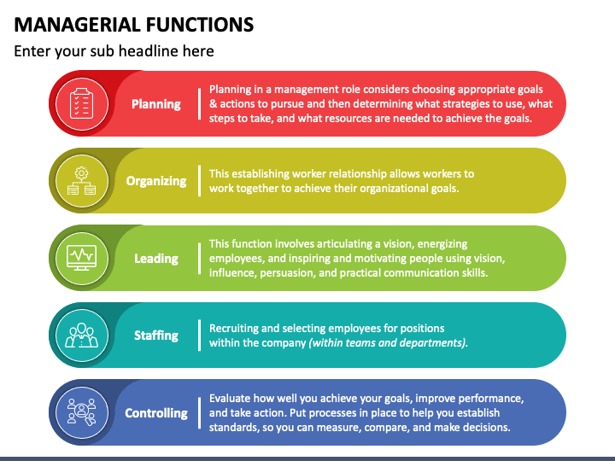
The Managerial Functions
Supervisors, as well as other managers, perform the same basic managerial functions in all organizations.
  These functions are classified as:
    Planning
    Organizing
    Staffing
    Leading
    Controlling

Slide 22

Planning
Planning consists of setting goals, objectives, policies, procedures, and other plans needed to achieve the purposes of the organization.
  In planning the manager chooses a course of action from various alternatives.
    Planning is primarily conceptual. It means thinking before acting, looking ahead and preparing for the future, laying out in advance the road to be followed, and thinking about how the job should be done.

Slide 23
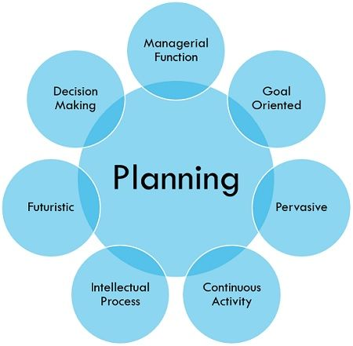
Planning
Planning includes collecting and sorting information from numerous sources and using that information to make decisions.
  Planning includes not only deciding what, how, when, and by whom work is to be done, but also developing what-if scenarios.

Slide 24

Planning
Planning is the managerial function that comes first.
  As the supervisor proceeds with other managerial functions, planning continues, plans are revised and alternatives are chosen as needed.
    This is particularly true as a supervisor evaluates the results of previous plans and adjusts future plans accordingly.

Slide 25
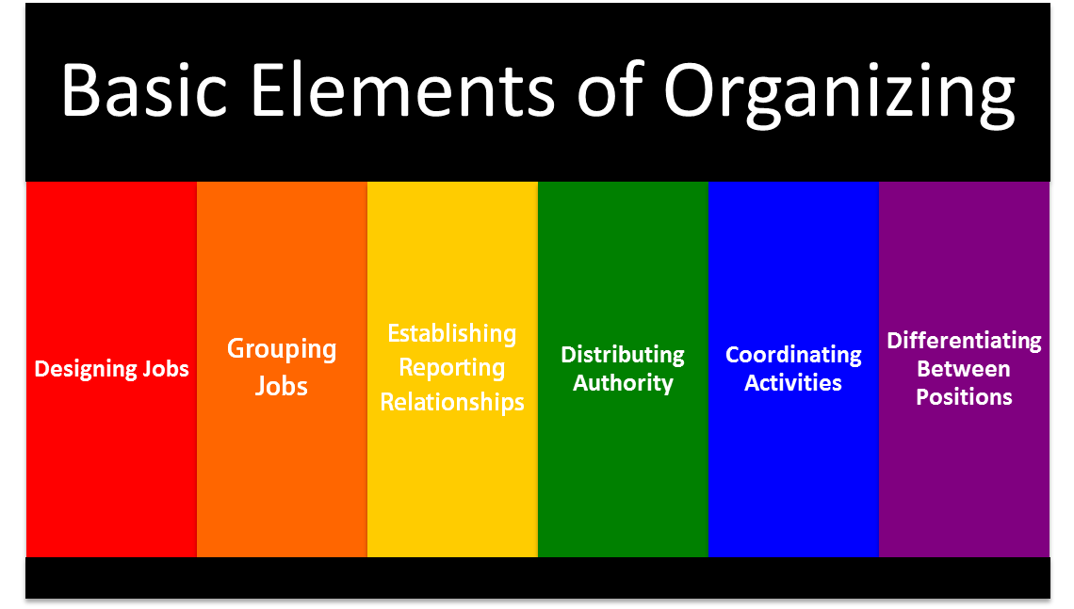
Organizing
Organizing means arranging and distributing work to accomplish the organization’s goals.
  Once plans have been made, the organizing function answers the question, “How will the work be divided and accomplished?”
    The supervisor defines various job duties and groups these duties into distinct areas, sections, units, or teams. The supervisor must specify the duties, assign them, and, at the same time, give subordinates the authority they need to carry out their tasks.

Slide 26

Staffing
Staffing involves the managerial tasks of recruiting, selecting, orienting, and training employees.
  This function includes appraising the performances of employees, promoting employees as appropriate, and giving employees opportunities to develop. In addition, staffing includes devising an equitable compensation system and rates of pay.
    In many companies, most activities involved in staffing are handled by the human resources (HR) department; however, day-to-day responsibility for the essential aspects of staffing remains with the supervisor.

Slide 27

Leading
Leading means guiding the activities of employees toward accomplishing objectives.
  The leading function of management involves guiding, teaching, and supervising subordinates.
    This includes developing employees to their potential by directing and coaching those employees effectively.

Slide 28

Leading
It is inefficient for a supervisor just to plan, organize, and have enough employees available.
  The supervisor must attempt to motivate employees as they go about their work.
    Leading is the day-to-day process around which all supervisory performance revolves.

Slide 29

Leading
Leading is also known as directing, motivating, or influencing because it plays a major role in EE morale, job satisfaction, productivity, and communication.
  It is through this function that the supervisor seeks to create a climate that is conducive to employee satisfaction and, at the same time, achieves the objectives of the department.
    Finding the ways to satisfy the needs of a diverse employee workforce is a significant challenge.

Slide 30
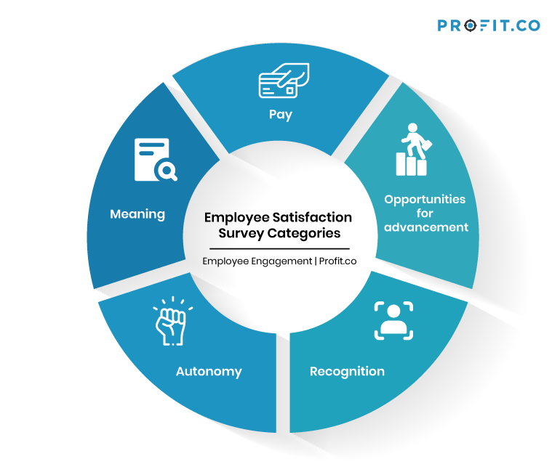
Drivers for Job Satisfaction
Job Security
Compensation and Pay
Opportunity to Use Skills and Abilities
Relationship with Immediate Supervisor
Organizations’ Financial Stability

Slide 31
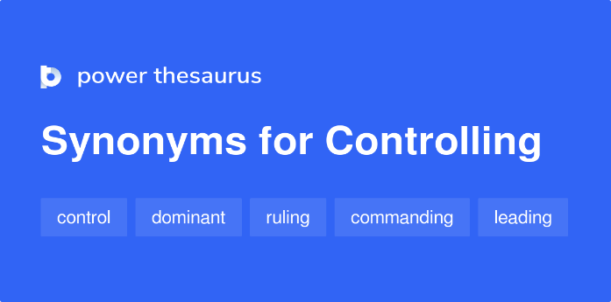
Controlling
The managerial function of controlling involves ensuring that actual performance is in line w/ intended performance and taking corrective action as needed.
  Here, too, the importance of planning as the first function of management is obvious. It would be impossible for a supervisor to determine whether work was proceeding properly if there were no plans against which to check. If plans or standards are superficial or poorly conceived, the controlling function is limited.
    The supervisor must have the wisdom and foresight to take corrective action when necessary to achieve the planned objectives.
    It also means revising plans as circumstances require.

Slide 32
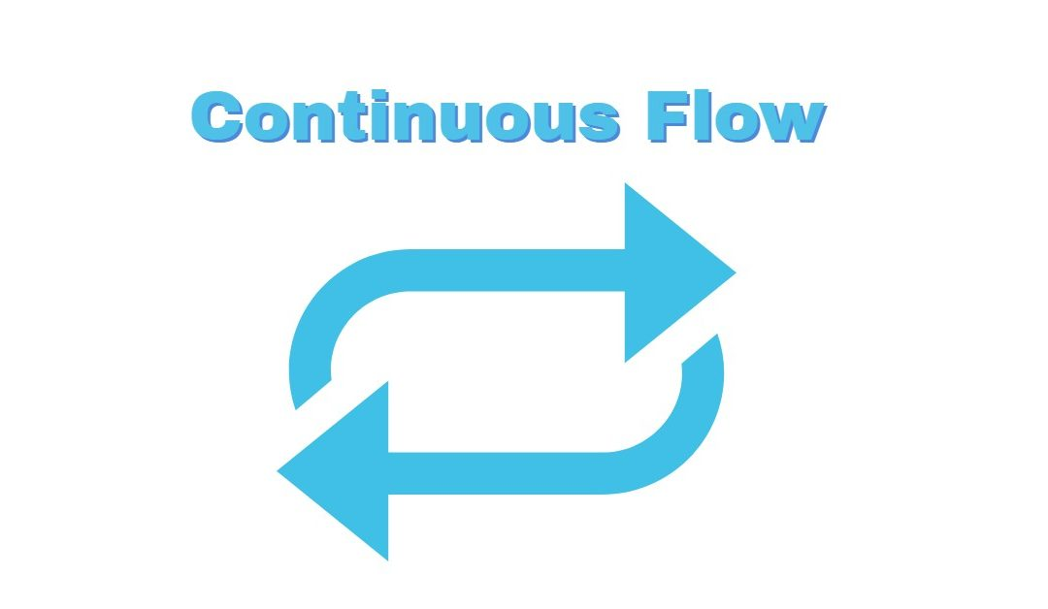
The Continuous Flow of Managerial Functions
The five managerial functions can be viewed as a circular, continuous movement. The functions flow into each other, and each affects the others. At times, there is no clear line to mark where one function ends and the other begins.
  It is impossible for a supervisor to set aside a certain amount of time for one or another function because the effort spent in each function varies as conditions and circumstances change.
    Undoubtedly, planning must come first. Without plans, the supervisor cannot organize, staff, lead, or control.

Slide 33
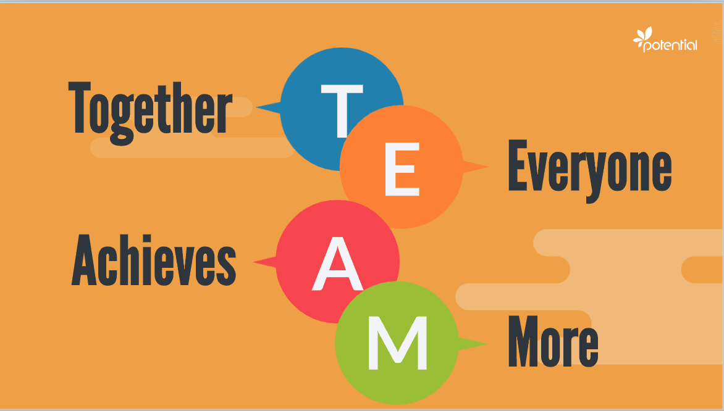
The Supervisor as Team Leader
Many organizations have implemented a team-based organizational structure focused on customer satisfaction, productivity, profitability, and continuous improvement.
  Teams are a means to an end, and that end is superior performance to what team members would achieve working as individuals.

Slide 34
The Supervisor as Team Leader
Author, trainer, and consultant Fran Rees identified several reasons for increasing use of teams:
  Given the complexity of jobs and information, it is nearly impossible for managers to make all the decisions. In many cases the person closet to the job is the one who should decide.
  The focus on quality and customer satisfaction has increased attention on the importance of each employee’s work.
  The shift from a homogeneous workforce to a diverse one requires managers to work effectively with multiple EE perspectives.
  There is a growing realization that an autocratic, coercive management style does not necessarily result in productive, loyal employees. The fact that people support what they help create is behind the team approach.
  People are demanding strong voices in their work lives, as well as meaningful work, respect, and dignity.

Slide 35
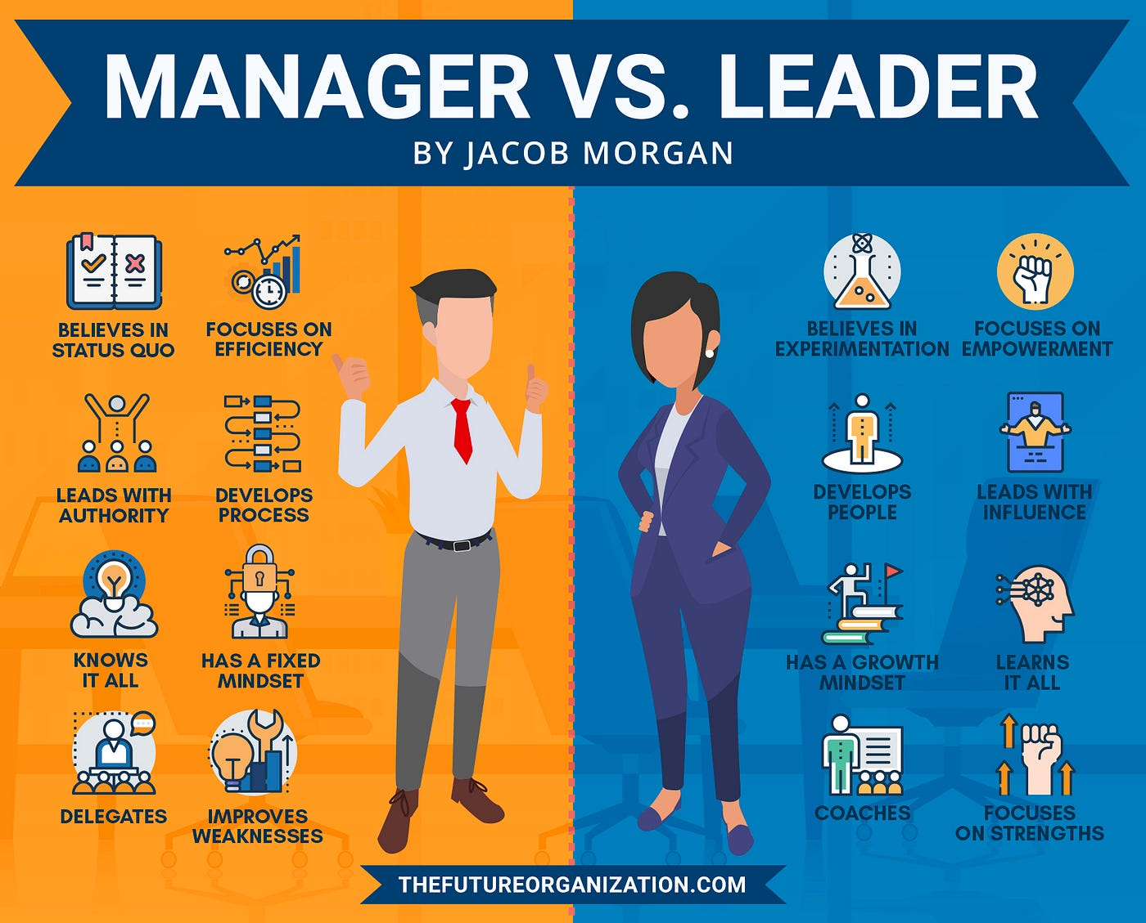
Managers and Leaders
Are They Different?
Author Stephen Covey wrote, “Leadership is not management.”
  Covey also proclaimed, “Management is efficiency in climbing the ladder of success; leadership determines whether the ladder is leaning against the right wall.”

Slide 36
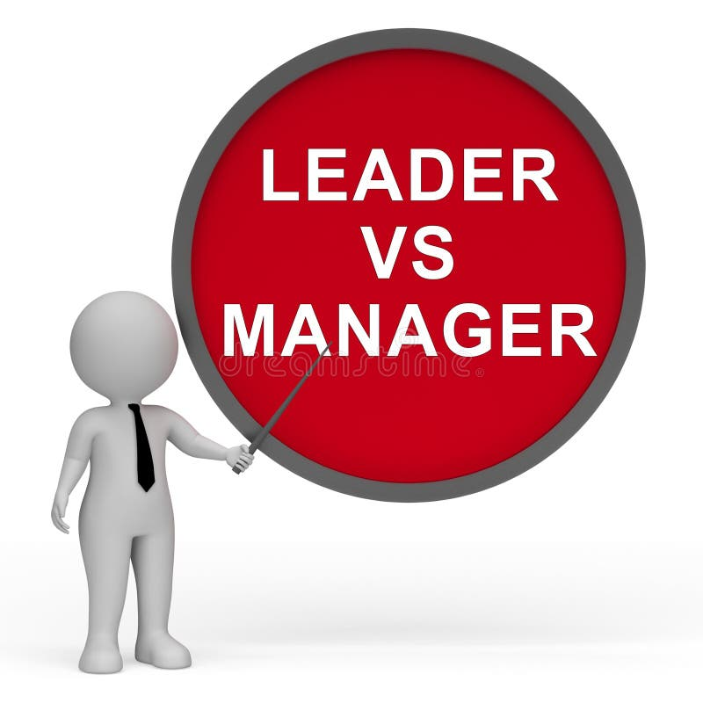
Managers and Leaders
Are They Different?
Warren Bennis, points out differences between managers and leaders:
  The manager does things right; the leader does the right thing.
  The manager relies on control; the leader inspires trust.
  The manager focuses on systems and structures; the leader focuses on people.
  The manager administers; the leader innovates.
  The manager asks how and when; the leader asks what and why.
  The manager accepts the status quo; the leader challenges it.

Slide 37
Managers and Leaders
Are They Different?
Harvard professor John P. Kotter contends that management involves keeping the current system operating through planning, budgeting, staffing, controlling, and problem solving, while leadership is the development of vision and strategies, the alignment of relevant people behind those strategies, and the empowerment of people to make the vision happen.
  Kotter states, “The point here is not that leadership is good and management is bad. They are simply different and serve different purposes. Strong management with no leadership tends to entrench an organization in a deadly bureaucracy. Strong leadership with no management risks chaos; the organization might walk off a cliff.”

Slide 38

Managerial Authority
Authority is the legitimate or rightful power to lead others, the right to order and act.
  It is the formal, positional right by which a manager can require subordinates to do or not to do a thing the manager deems necessary to achieve organizational objectives.
    Managerial authority is not granted to an individual, but rather to the position the individual holds at the time. When individuals leave their jobs or are replaced, they cease to have that authority. When a successor assumes the position, that person then has the authority.

Slide 39

Managerial Authority
Included in positional managerial authority is the right and duty to delegate authority.
  The delegation of authority is the process by which the supervisor receives authority from a higher-level manager and, in turn, makes job assignments and entrusts related authority to subordinates.
    Having managerial authority means the supervisor has the power and the right to issue directives in order to accomplish the tasks assigned to the department. This authority includes the power and right to reward and discipline, if necessary. Of course, this power, like all authority, is limited.

Slide 40
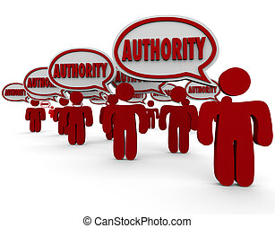
Managerial Authority
The Acceptance Theory of Authority states that a manager does not possess real authority until and unless the subordinate accepts it.
  A supervisor may instruct an EE to carry out a certain work assignment. The EE has several alternatives from which to choose.
    Although such a response is not likely, the employee can refuse to obey, thereby rejecting the supervisor’s authority.
    Alternatively, the EE my grudgingly accept the supervisor’s direction and carry out the assignment in a mediocre fashion.

Slide 41

Managerial Authority
The supervisor should expect to experience resistance from some of their employees.
  When some employees reject the supervisor’s authority, they will have no choice but to impose disciplinary action on those employees.
    When a new supervisor is announced to their team, their manager or top management should lay the foundation for their acceptance. Every manager requires the support of their boss.

Slide 42

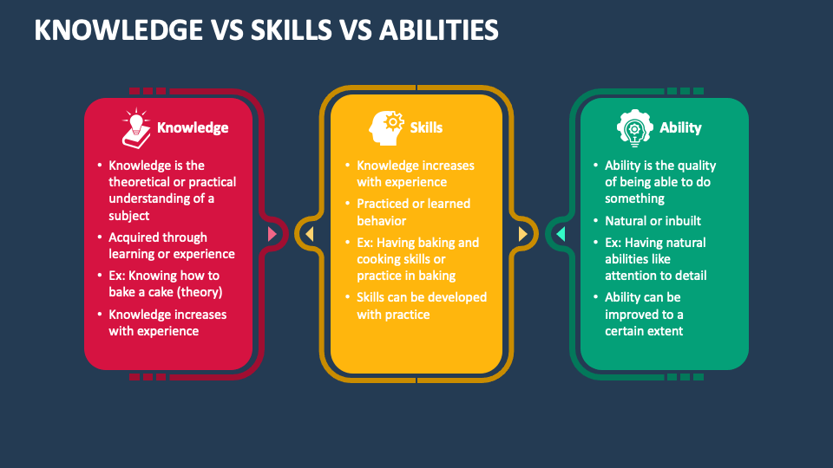
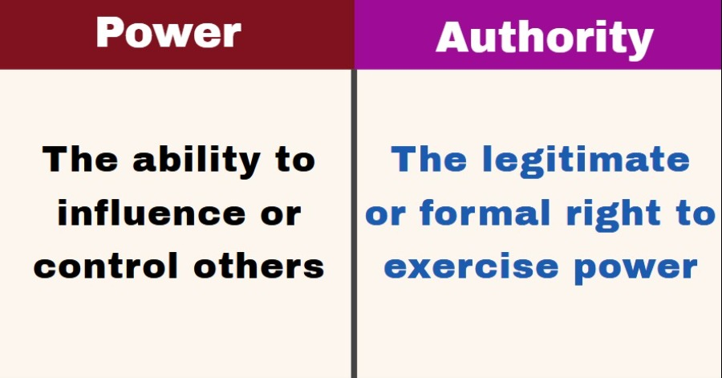
Managerial Authority
To be effective, a manager must be able to use the managerial functions and possess requisite SKAs, power and authority.
  Personal Needs
  Emotions
  Personal Values
  Employee Needs
  Organization Goals

Slide 43

Avoiding Reliance on Managerial Authority
Most successful supervisors know that to motivate workers to perform their duties, it is usually best not to rely on formal managerial authority but to employ other approaches.
  Generally, it is better for a supervisor not to display power and formal authority.
    Many supervisors prefer to avoid even speaking about their authority. Instead, they want to speak of their responsibilities, tasks, or duties.

Slide 44

Avoiding Reliance on Managerial Authority
We contend that employees are likely to perform better if they understand why the task needs to be done and have a voice in how to do it rather than simply being told to do it.
  Regardless of how a supervisor applies authority, the point to remember is that the supervisory position must have managerial authority.
    Without it, a supervisor cannot perform well as a manager.

Slide 45

Delegating Authority
The delegation of authority is the process by which the supervisor received authority from a higher-level manager and, in turn, makes the job assignments and entrusts related authority to subordinates.
  Just as the possession of authority is a required component of any managerial position, the process of delegating authority to lower levels in the hierarchy is required for an organization to have effective managers, supervisors, and employees.

Slide 46

Power
The Ability to Influence Others
Some behavioral scientists contend that a manager’s power comes from two sources:
  Position Power
    Derives from a person’s organizational position.
  Personal Power
    Emanates from the relationship a supervisor has with other people.
    A supervisor’s personal power depends to a greater extent on the follower’s perceptions of that supervisor’s knowledge, skill, and expertise.

Slide 47

Power
The Ability to Influence Others
Other theorists, such as John French and Bertram Raven, assert that power arises form the following five sources:
  Reward Power
    Supervisors have reward power if they can grant rewards.
  Coercive Power
    Supervisors who threaten punishment and discipline use this power.
  Legitimate Power
    Some supervisors gain compliance by relying on their position or rank (“I’m the boss, do as I say.”).
  Expert Power
    Knowledge or valuable information gives a person expert power over those who need that information.
  Referent Power or Charismatic Power
    People are often influenced by another person because of some tangible or intangible aspect of another’s personality.

Slide 48

Power
The Ability to Influence Others
Effective supervisors understand the effect their power has on others.
  Research indicates that reward power, coercive power, and legitimate power often force employees to comply with directives but do not get those employees’ commitment to organizational objectives.
    Accordingly, supervisors who use expert power and referent power effectively have the greatest potential for achieving organizational goals.

Slide 49

Power
The Ability to Influence Others
The Acceptance Theory of Authority is also relevant to the application of power.
  Therefore, two supervisors can hold the same title, occupy the same level in the hierarchy, and have equal authority, yet different degrees of power, depending on their abilities and how others perceive them.

Slide 50

Coordination
Management has generally been defined as a process of getting things done through and with the help of people by directing their efforts toward common objectives.
  In a sense, all levels of management could be broadly visualized as involving the coordination of efforts of all the members and resources of an organization toward overall objectives.
    Some writers have therefore included the concept of coordination a separate managerial function.

Slide 51
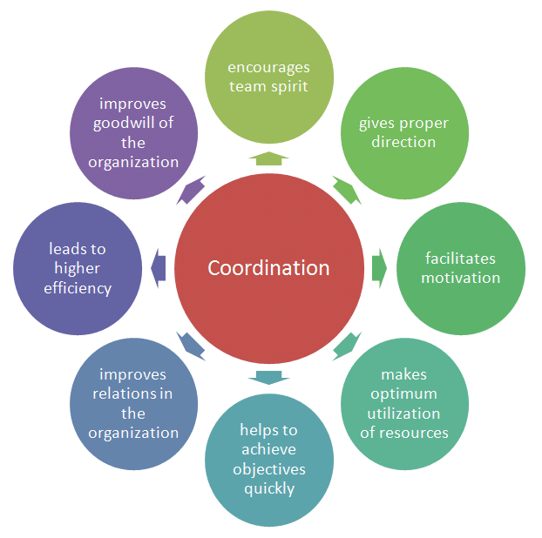
Coordination
Coordination is the orderly synchronization (or putting together) of efforts of the members and resources of an organization to accomplish the organization’s objectives.
  Coordination is not a separate managerial function; it is an implicit, interrelated aspect of the five major managerial functions previously cited. Coordination is fostered whenever a manager performs any of the managerial functions of planning, organizing, staffing, leading, and controlling.
    Coordination can best be understood as being a direct result of good management rather than as a managerial function in and of itself. The ability to communicate clearly and concisely is essential for coordination.

Slide 52
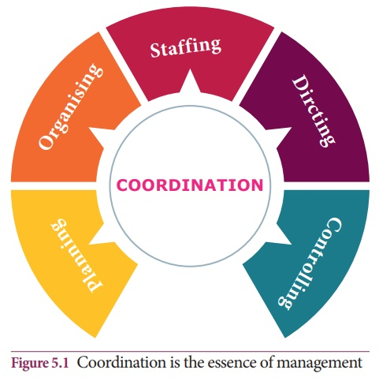
Coordination
Achieving coordination typically is more difficult at the executive level than at the supervisory level.
  Top management has to synchronize the use of resources and human efforts throughout numerous departments and levels of the organization.
    A supervisor of one department has the responsibility to achieve coordination primarily within the department. However, this too can be difficult to achieve, especially during periods of rapid change and economic hardships.

Slide 53
Cooperation as Related to Coordination
Cooperation is the willingness of individuals to work with and help each other. It primarily involves the attitudes of a group of people. Coordination is more than the mere desire and willingness of participants.
  For example, consider a group of workers who are attempting to move a heavy object. They are sufficient in number, willing and eager to cooperate w/ each other, and trying hard to move the object. They are also fully aware of their common purpose. However, in all likelihood their efforts will be of little avail until one of them – the supervisor – gives the proper orders to apply the right amount of effort at the right place at the right time. Then the group members can move the object.
    It is possible that by sheer coincidence some cooperation could have brought about the desired result in this example, but no supervisor can afford to rely on such coincidental occurrence.

Slide 54
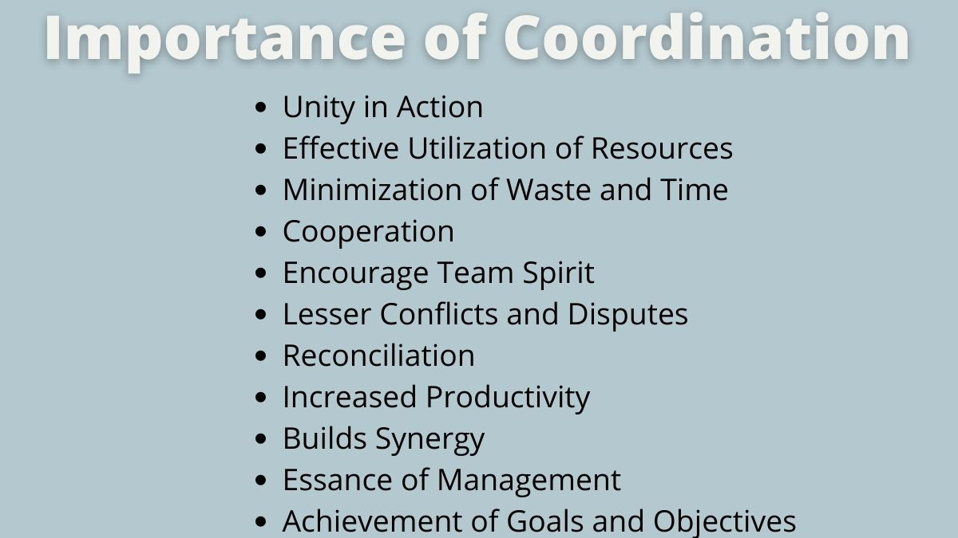
Cooperation As Related to Coordination
While cooperation is helpful and the lack of it could impede progress, its presence alone will not surely get the job done.
  Efforts must be coordinated toward the common goal.

Slide 55

Attaining Coordination
Coordination is not easily attained, and the task of achieving coordination is becoming more complex.
  As an organization grows, coordinating the many activities of various departments becomes an increasingly complicated problem for high-level managers. At the supervisor level, as the number and types of positions in a department increase, the need for coordination to obtain desired results similarly increases. Additionally, as an organization downsizes, supervisors need to focus on coordinating.
    Every supervisor’s primary focus should be on getting the desired results from their people.

Slide 56

Attaining Coordination
The complexities of human nature present added coordination problems.
  For example, every EE comes to the workplace with a baggage cart. Loaded on that baggage cart are all of their issues. We remind EEs to leave their personal problems at the door when they come to work and to leave their work-related issues at the door when they leave. While it sounds good, in reality it doesn’t happen.
  Many EEs understandably are preoccupied with their own work and their personal baggage.
    In the final analysis, they are evaluated primarily on how they do their individual jobs. Therefore EEs tend not to willingly become involved in other areas and often are indifferent to the fact that their activities may affect other departments.

Slide 57
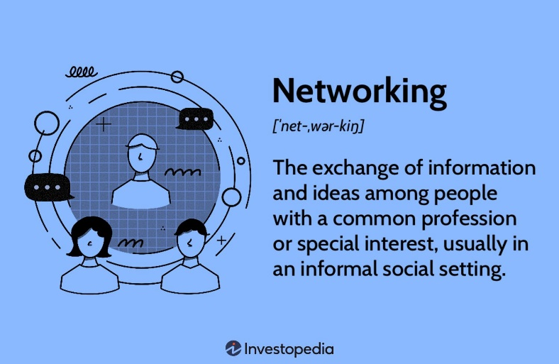
Attaining Coordination
Supervisors can achieve coordination by building networks focused on attaining common objectives.
  According to Merriam Webster’s Collegiate Dictionary, a network is “a fabric or structure of cords or wires that cross at regular intervals and are knotted or secured at the crossings.” Think of it this way –
  A person’s relationships are the knots, and the strengths of the relationships equals the strengths of the network.
    Networking facilitates the flow of ideas across organizational barriers and thereby eases the coordination effort.

Slide 58

Coordination as Part of the Managerial Functions
While performing the managerial functions, the supervisor should recognize that coordination is a desired result of effective management.
  Proper attention to coordination within each of the five managerial functions contributes to overall coordination.

Slide 59

Coordination as Part of the Managerial Functions
Initially, the supervisor must ensure that the various plans are aligned with the right people.
  For example, a supervisor may wish to discuss job assignments with the EEs who are to carry them out. In this way, the EEs can express their opinions or objections, which need to be reconciled in advance. Furthermore, EEs may be encouraged to make suggestions and to discuss the merits of proposed plans and alternatives.
    When EEs are involved in initial departmental planning, the supervisor’s chances of achieving coordination usually improve.

Slide 60

Coordination as Part of the Managerial Functions
The purpose of establishing who is to do what, when, where, and how is to achieve coordination.
  For example, whenever a new job is to be done, a supervisor assigns that job to a unit with the EEs best suited to the work. Whenever a supervisor groups activities and assigns subordinates to those groups, coordination should be uppermost in the supervisor’s mind.
    Achieving coordination should be of concern as a supervisor establishes authority relationships within the department and among EEs.
    Clear statements as to specific duties and reporting relationships in the department foster coordination and prevent duplicate efforts & confusion.

Slide 61

Coordination as Part of the Managerial Functions
When leading, the supervisor is significantly involved in coordination.
  The essence of giving instruction is to coordinate the activities of EEs in such a manner that the overall objectives are reached in the most efficient way possible.
    In addition, a supervisor must assess and reward the performance of EEs to maintain a harmonious work group.

Slide 62
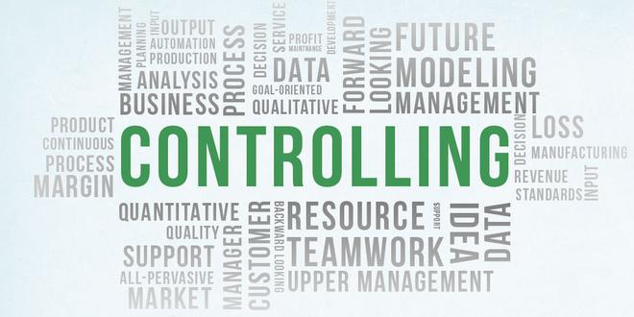
Coordination as Part of the Managerial Functions
The supervisor is also concerned with coordination when performing the controlling function.
  By checking, monitoring, and observing, the supervisor makes certain that activities conform to established plans. If there are any discrepancies, the supervisor should take immediate action to reprioritize or reassign tasks. In so doing, the supervisor may achieve coordination at least from then on.
    The very nature of the controlling process contributes to coordination and keeps the organization moving toward its objectives.

Slide 63

Coordination with Other Departments
Not only must supervisors coordinate activities within their own departments, but they also must coordinate the efforts of their departments with those of others.
  For example, a production department supervisor must meet with supervisors of scheduling, quality control, maintenance, and shipping to coordinate various activities. Similarly, an accounting supervisor typically meets with supervisors from production, sales, and shipping to coordinate cost accounting, inventory, and billing.
    Achieving coordination is an essential component of the supervisory management position.

Slide 64


