Slide 1

Business Communications
Session Five Class Presentation
Business Communication
  Process and Product – 9th Edition
    Mary Ellen Guffey and Dana Loewy; Cengage Learning 2018, 2015
      ISBN: 978-1-305-95796-1

Slide 2

Reporting in the Digital Age Workplace
Digital age organizations compete in a world of constant change facilitated by innovative technology and the ability to generate and share vast amounts of data.
  Whether a company decides to launch a new product, expand into new markets, reduce expenses, improve customer service, or increase its social media presence, the decisions are usually based on information submitted in reports.

Slide 3
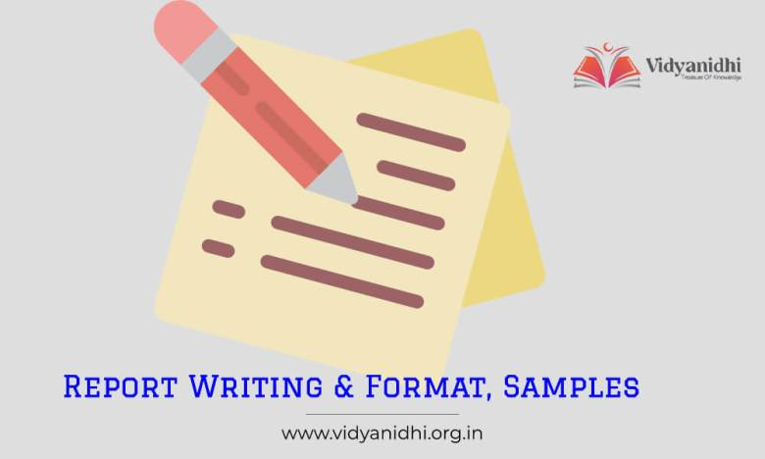
Basic Report Functions
Most reports fit into one of two broad categories:
  Informational Reports
    Present data without analysis or recommendations.
      Writers collect and organize facts, but do not analyze for readers.
  Analytical Reports
    Provide data or findings, analysis, and conclusions.
      If requested, writers also supply recommendations for readers.
      These reports may intend to persuade readers to act or change beliefs.

Slide 4
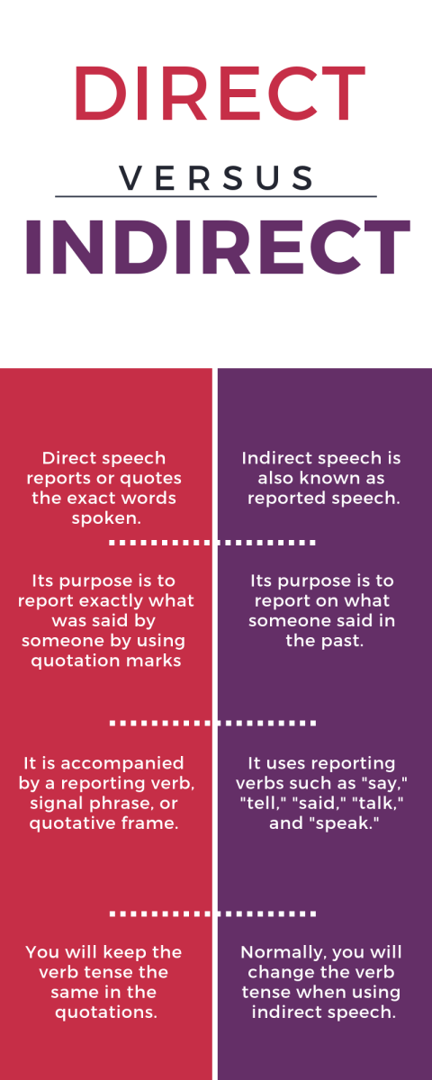
Organizational Strategies
Like other business messages, reports may be organized directly or indirectly. The reader’s anticipated reaction and the content of a report determine its organizational strategy.
  Direct Strategy
    If readers are informed
    If readers are eager to have results first
    If readers are supportive
    Put recommendations first.
  Indirect Strategy
    If readers need to be educated
    If readers need to be persuaded
    If readers may be disappointed or hostile
    Put recommendations last.

Slide 5
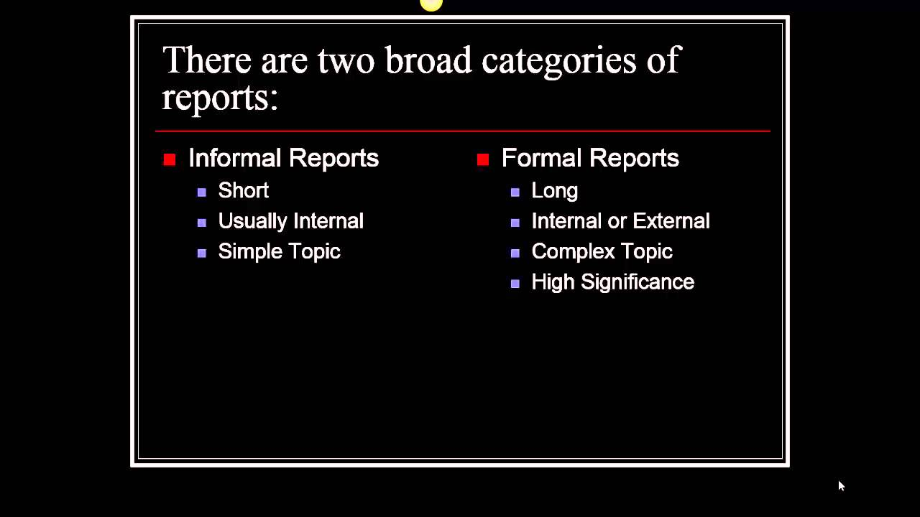
Informal and Formal Writing Styles
Like other business messages, reports can range from informal to formal, depending on their purpose, audience, and setting.

Slide 6

Applying the 3x3 Writing Process to Contemporary Reports
Because business reports are systematic attempts to compile often complex information, answer questions, and solve problems, the best reports are developed methodically.
  In earlier chapters the 3x3 writing process was helpful in guiding the writing of short projects such as emails, memos, and letters.
    That same process is even more necessary when writers are preparing longer projects such as reports and proposals.

Slide 7

Applying the 3x3 Writing Process to Contemporary Reports
Channel the writing process into seven steps:
  Analyze the problem and purpose.
  Anticipate the audience and issues.
  Prepare a work plan.
  Conduct research.
  Organize, analyze, interpret, and illustrate the data.
  Compose the first draft.
  Edit, proofread, and evaluate.

Slide 8

Analyzing the Problem and Purpose
The first step in writing a report is understanding the problem or assignment clearly.
  Prepare a written purpose statement to clarify the task.
    A written purpose statement defines the focus of the report and provides a standard that keeps the project on target.

Slide 9

Anticipating the Audience and Issues
After defining the purpose of a report, a writer must think carefully about who will read it.
  Although one individual may have solicited the report, others within the organization may eventually read it, including people in upper management and in other departments. A report may be read by someone who is familiar with the problem and then distributed to others who are less familiar with it.
    Moreover, candid statements to one audience may be offensive to others.

Slide 10
Anticipating the Audience and Issues
When considering primary and secondary readers, ask yourself these questions:
  What do my readers need to know about this topic?
  What do they already know?
  What is their education level?
  How will they react to this information?
  Which sources will they trust?
  How can I make the info readable, believable, and memorable?

Slide 11

Preparing a Work Plan
After analyzing the problem, anticipating the audience, and factoring the problem, you are ready to prepare a work plan.
  A good work plan includes the following:
    Statement of Problem
      Based on background and contextual information
    Statement of Purpose
      Including scope with limitations and significance
    Research Strategy
      A description of potential sources and methods of collecting data
    An Outline
      Factoring the problem into manageable chunks
    Work Schedule

Slide 12
Preparing a Work Plan
Preparing a plan encourages you to evaluate your resources, set priorities, outline a course of action, and establish a schedule.
  Having a plan keeps you on track, provides management a means of measuring progress, and gives a complete picture of a project.
    Your work plan describes how you expect to generate or collect data.

Slide 13

Conduct Research
Research, or the gathering of information, is one of the most important steps in writing a report.
  As the philosopher Goethe once said, “The greater part of all mischief in the world arises from the fact that men do not sufficiently understand their own aims. They have undertaken to build a tower, and spend no more labor on foundation than would be necessary to erect a hut.”
    Think of your writing a report as building a tower.

Slide 14
Conduct Research
As you analyze a report’s purpose and audience and prepare your research strategy, you will identify and assess the data you need to support your argument or explain your topic.
  As you do, you will answer questions about objectives and audience:
    Will the audience need a lot of background or contextual information?
    Will readers value or trust statistics, case studies, or expert opinions?
    Will they want to see data from interviews or surveys?
    Will summaries of focus groups be useful?
    Should you rely on organizational data?

Slide 15
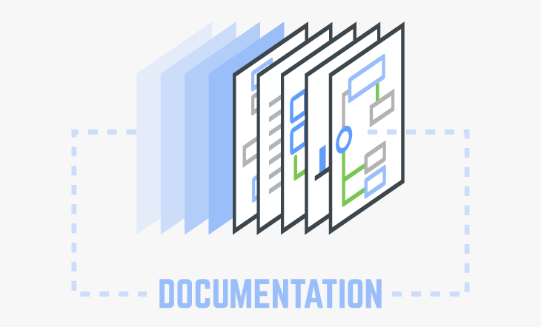
Documenting Information
In writing business reports, you will often build on the ideas and words of others.
  Whenever you borrow the ideas of others, you must give credit to your information sources.
    This is called documentation.

Slide 16

The Purposes of Documentation
As a careful writer, you should take pains to document report data properly for the following reasons:
  To strengthen your argument (reputation and credibility).
  To protect yourself against charges of plagiarism (ethical).
  To instruct the reader, so they can pursue the topic further.
  To save time.

Slide 17
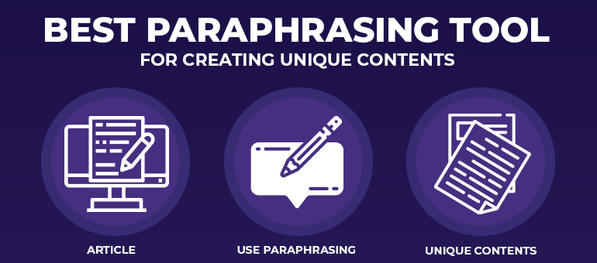
The Fine Art of Paraphrasing
In writing reports and using the ideas of others, you will probably rely heavily on paraphrasing, which means restating an original message in your own words and in your own style.
  Read the original material intently to comprehend full meaning.
  Write your own version without looking at the original.
  Avoid repeating the grammatical structure of the original and merely replacing words with synonyms.
  Reread the original to be sure you covered the main points but did not borrow specific language.

Slide 18

When and How to Quote
On occasion, you will want to use the exact words of a source, but beware of overusing quotations.
  Documents that contain pages of spliced-together quotations suggest that writers have few ideas of their own.
  Wise writers and speakers use direct quotations for 3 purposes only:
    To provide objective background data and establish the severity of a problem as seen by experts.
    To repeat identical phrasing because of its precision, clarity, or aptness.
    To duplicate exact wording before criticizing.

Slide 19

Creating Effective Graphics
After collecting and interpreting information, you need to consider how to best present it.
  If your report contains complex data and numbers, you may want to consider graphics such as tables and charts.
    These graphics clarify data, create visual interest, and make numerical data meaningful.

Slide 20

Analyzing Digital Age Data
Much of the information that allows decision makers to run their organizations efficiently in this digital age comes to them in the form of reports.
  To adapt to changing economic times, businesses need information to stay abreast of what is happening inside and outside of their firms.

Slide 21

Analyzing Digital Age Data
Given easy access to research databases, Web, and other sources of digitized information, collecting information is effortless.
  However, making sense of the massive amounts of data you collect is much harder.
    Unprocessed data become meaningful information through skillful and accurate sorting, analysis, and combination.

Slide 22
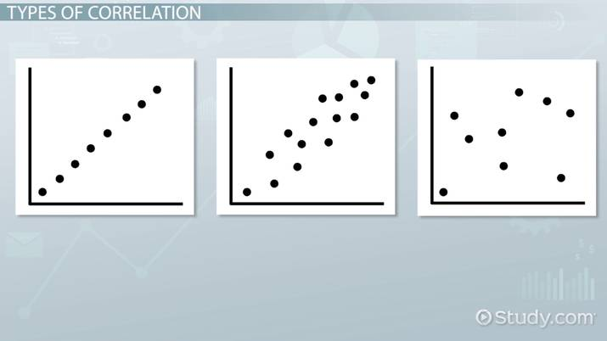
Tabulating and Analyzing Data
In tabulating and analyzing data, you may see relationships between two or more variables that help explain the findings.
  The business researcher who sees a correlation needs to ask why and how the two variables are related.
    Apparent correlations stimulate investigation and present possible solutions to be explored.

Slide 23

Drawing Conclusions and Making Recommendations
The sections devoted to conclusions and recommendations are the most widely read portions of a report.
  Knowledgeable readers go straight to the conclusions to see what the report writer thinks the data mean. Because conclusions summarize and explain the findings, they represent the heart of a report.
    Your value in an organization rises considerably if you can analyze information logically, draw conclusions, and show how the data answer questions and solve problems.

Slide 24
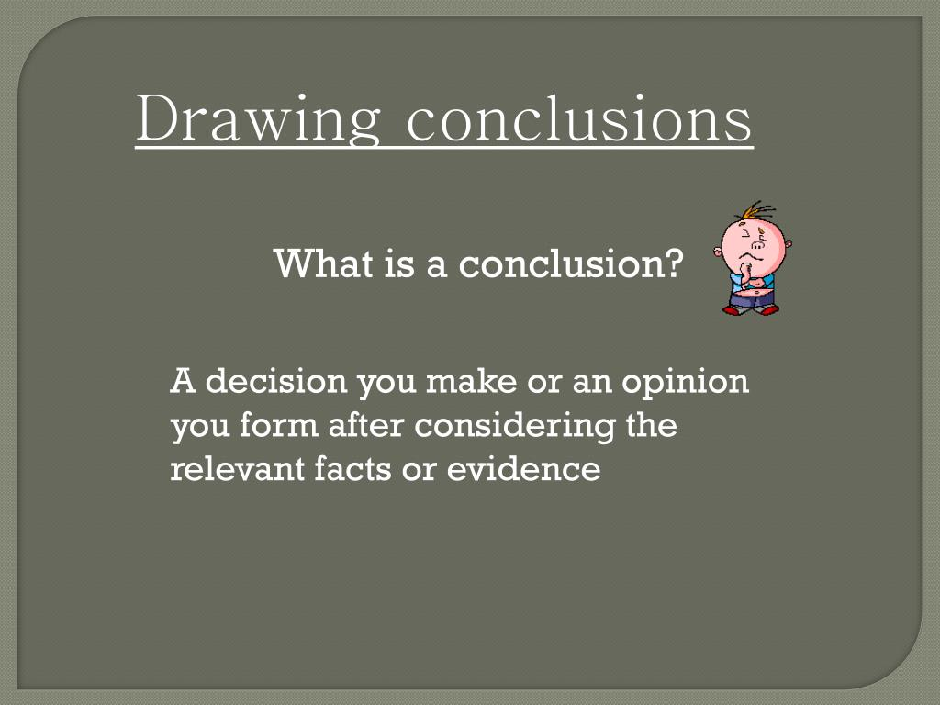
Analyzing Data to Arrive at Conclusions
Any set of data can produce a variety of meaningful conclusions.
  Always bear in mind, though, that the audience for a report wants to know how these data relate to the problem being studied.
    What do findings mean in terms of solving the original report problem?

Slide 25
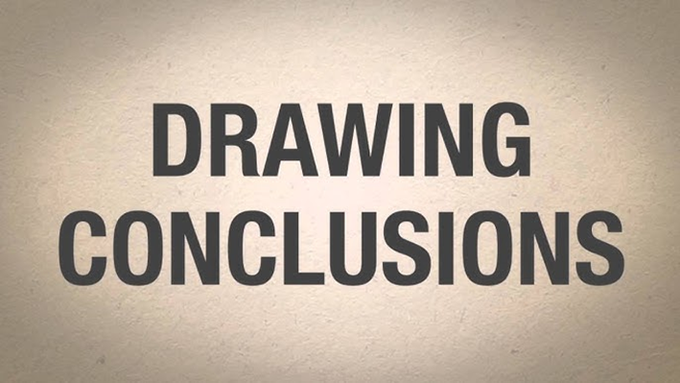
Analyzing Data to Arrive at Conclusions
Although your goal is to remain objective, drawing conclusions naturally involves a degree of subjectivity.
  Your goals, background, and frame of reference all color the inferences you make. All writers interpret findings from their own perspectives, but they should not manipulate them to achieve a preconceived purpose.
    Make report conclusions objective by using consistent evaluation criteria.

Slide 26

Preparing Report Recommendations
Conclusions explain what the problem is, whereas recommendations tell how to solve it.
  Business readers prefer specific, practical recommendations.
  They want to know exactly how to implement the suggestions.
    The specificity of your recommendations depends on your authorization.
    What are you commissioned to do, and what does the reader expect?

Slide 27
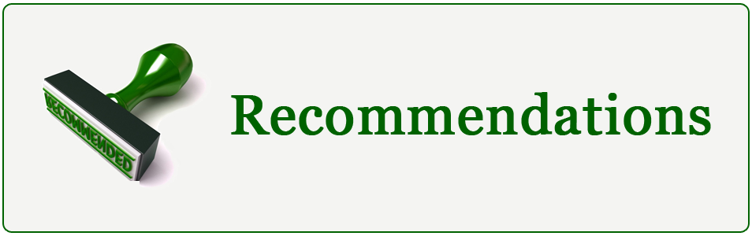
Preparing Report Recommendations
Use intuition and knowledge of the audience to determine how comprehensive your recommendations should be.
  A good report provides practical recommendations that are agreeable to the audience.

Slide 28
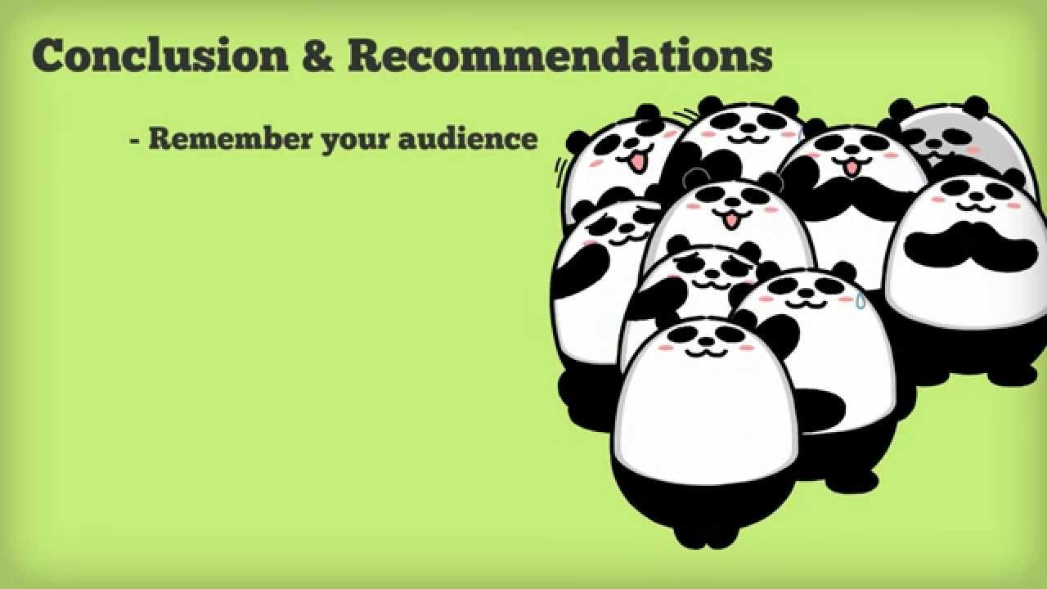
Preparing Report Recommendations
Experienced writers combine recommendations and conclusions.
  In short reports writers may omit conclusions and move straight to recommendations.
    Recommendations include practical suggestions for solving the report problem, and they are the result of logical analysis.

Slide 29
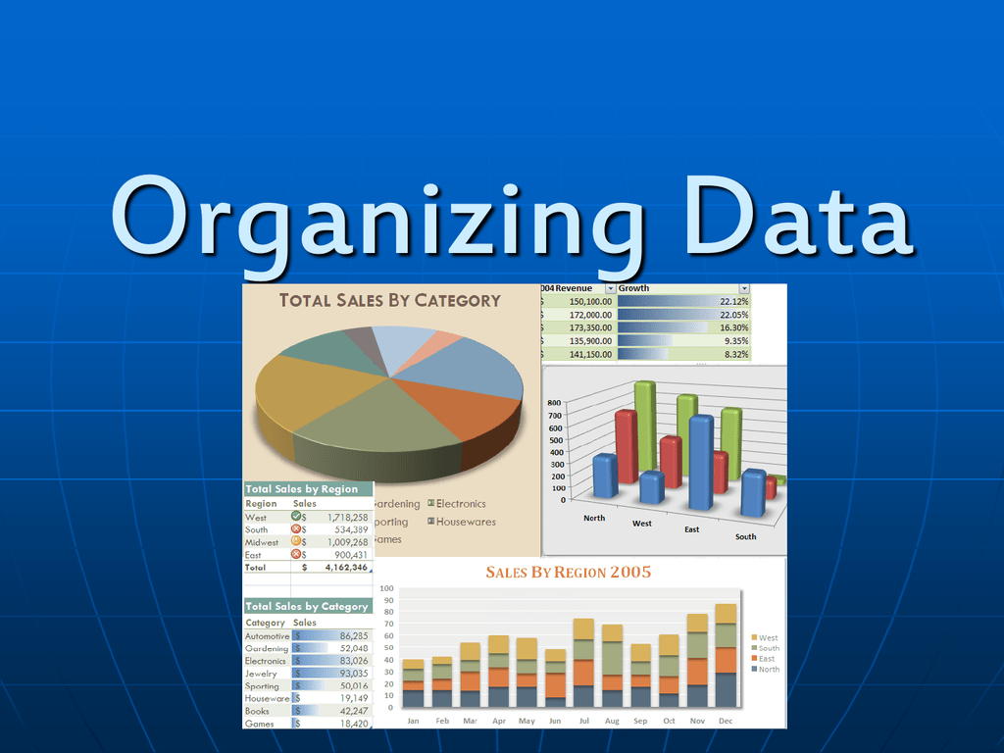
Organizing Data
After collecting data, interpreting it, drawing conclusions, and thinking about the recommendations, you are ready to organize the parts of the report into a logical framework.
  Poorly organized reports lead to frustration. Readers will not understand, remember, or be persuaded.
    Wise writers know that reports rarely “just organize themselves.”
    Instead, the report author must impose organization on the data and provide cues so that the reader can follow the logic of the writer.

Slide 30

Organizing Data
Informational reports often present data without interpretation.
  Analytical reports often analyze data and draw conclusions.
    For readers who know about the project, are supportive, or are eager to learn the results quickly, the direct strategy is appropriate.
      Conclusions and recommendations, if requested, appear up front.
    For readers who must be educated or persuaded, the indirect strategy works better.
      Conclusions and recommendations appear last, after the findings have been presented and analyzed.

Slide 31
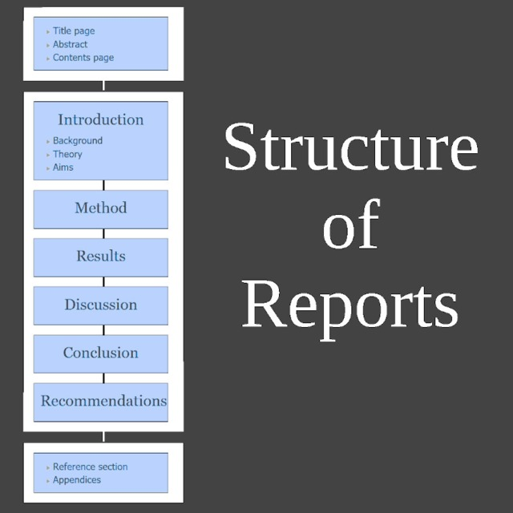
Ordering Information Logically
Whether you are writing informational or analytical reports, you must structure the data you have collected.
  Five common organizational methods are by (1) Time, (2) Component, (3) Importance, (4) Criteria, and (5) Convention.
    Regardless of the method you choose, be sure that it helps the reader understand the data. Reader comprehension, not writer convenience, should govern organization.

Slide 32

Providing Reader Cues
    Devices such as introductions, transitions, and headings prevent readers from getting lost.
  When you finish organizing a report, you probably see a neat outline in your mind: major points supported by subpoints and details.
    Readers, however, do not know the material as well as you do; they cannot see your outline. To guide them through the data, you need to provide the equivalent of a road map and signs.

Slide 33

Providing Reader Cues
One of the best ways to point a reader in the right direction is to provide a report introduction that does three things:
  Tells the purpose of the report.
  Describes the significance of the topic.
  Previews main points and order in which they will be developed.

Slide 34

Providing Reader Cues
Good openers in effect set up a contract with the reader. The writer promises to cover certain topics in a specified order. Readers expect the writer to fulfill the contract. They want topics to be developed as promised – using same wording as presented in order outlined.
  Remember that the introduction provides a map to a report; switching the names on the map will cause readers to get lost.
    To maintain consistency, delay writing the introduction until you have completed the report.

Slide 35

Writing Short Informational Reports
You can expect to write many informational reports as an entry-level or middle-management employee. These reports generally deliver nonsensitive data and are therefore written directly.
  Although the writing style is usually conversational and informal, the report contents must be clear to all readers.
    All headings, lists, and graphics should help the reader grasp major ideas immediately.

Slide 36
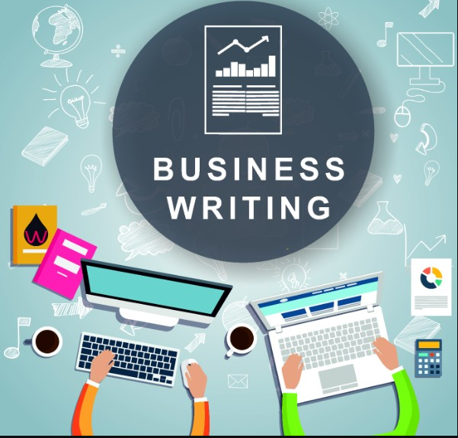
Writing Short Informational Reports
The principles of conciseness, clarity, courtesy, and correctness apply to report writing.
  Your ability to write effective reports can boost your visibility in an organization and result in advancement.

Slide 37

Summaries
A summary compresses the main points from a book, report, article, website, meeting, or convention.
  A summary saves time by reducing a report or article by 85-95%.
    Employees are sometimes asked to write summaries that condense technical reports, periodical articles, or books so that their staff or superiors may grasp the main ideas quickly.
    An executive summary summarizes a long report, proposal, or business plan. It concentrates on what management needs to know.

Slide 38

Summaries
In writing a summary, follow these general guidelines:
  Present the goal or purpose of the document being summarized.
    Why was it written?
  Highlight the research methods, findings, conclusions, and recommendations.
  Omit illustrations, examples, and references.
  Organize for readability by including headings and bulleted or enumerated lists.
  Include your reactions or an overall evaluation of the document, if asked to do so.

Slide 39
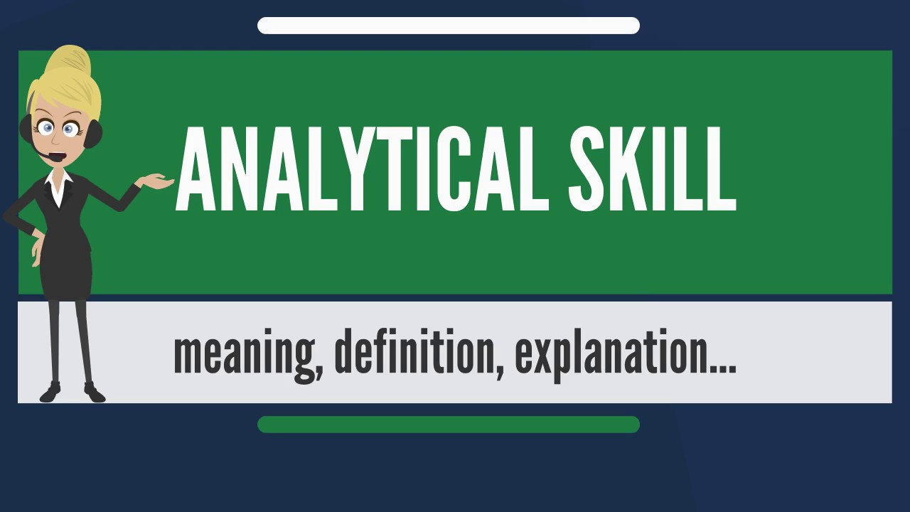
Preparing Short Analytical Reports
There are three common types of Analytical Business Reports.
  Justification/Recommendation Reports
  Feasibility Reports
  Yardstick Reports
    These involve collecting and analyzing data, evaluating the results, drawing conclusions, and making recommendations.

Slide 40
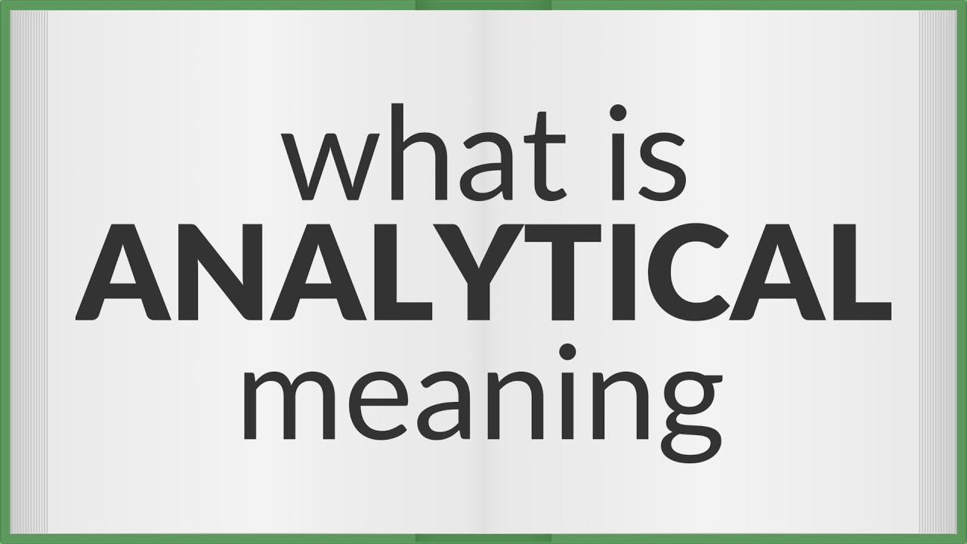
Preparing Short Analytical Reports
Analytical Reports differ significantly from Informational Reports.
  Although both seek to collect and present data clearly, analytical reports also evaluate the data and typically try to persuade the reader to accept the conclusions and act on the recommendations.
    Informational reports emphasize facts; Analytical reports emphasize reasoning and conclusions.

Slide 41
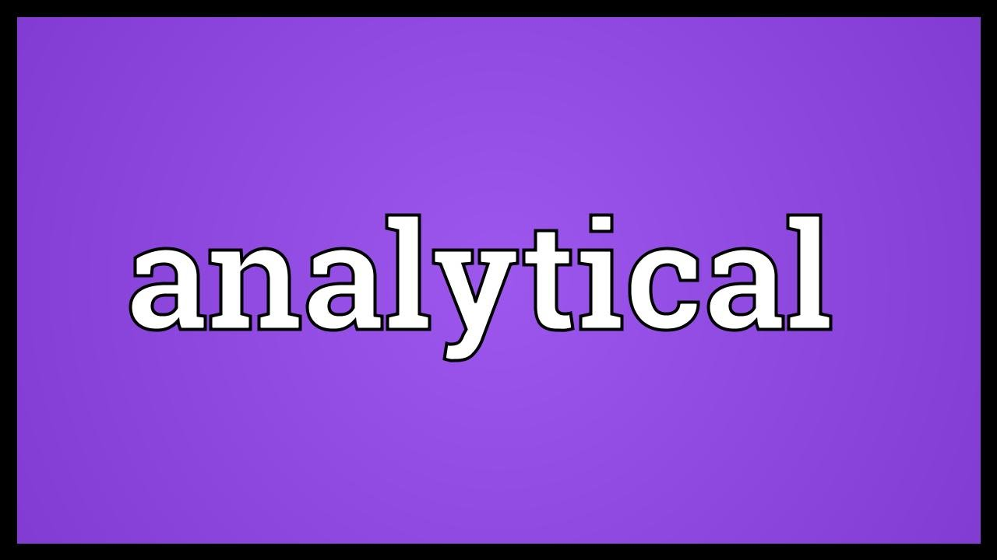
Preparing Short Analytical Reports
For some situations you may organize analytical reports directly with the conclusions and recommendations near the beginning.
  Directness is appropriate when the reader has confidence in the writer, based on either experience or credentials.
    Frontloading the recommendations also works when the topic is routine or familiar and the reader is supportive.

Slide 42

Preparing Short Analytical Reports
If you announce the recommendation too quickly, though, the reader may immediately object to a single idea. Once the reader has an unfavorable mind-set, changing it may be difficult.
  A reader may also believe that you have oversimplified or overlooked something significant if you provide your recommendations first.
    When leading the reader through the process of discovering the solution, use the indirect strategy; present conclusions and recommendations last.

Slide 43
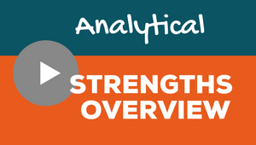
Preparing Short Analytical Reports
Most analytical reports answer questions about specific problems and aid in decision making.

Slide 44


Justification/Recommendation Reports
For nonsensitive topics and recommendations that will be agreeable to readers, you can organize directly.
  When a reader may oppose a recommendation or circumstances suggest caution, do not rush to reveal your recommendation.

Slide 45

Feasibility Reports
Feasibility reports examine the practicality and advisability of following a course of action.
  They answer the question: Will this plan or proposal work?
    They focus on the decision: rejecting or proceeding with proposed option.
    Because your role is not to persuade the reader to accept the decision, you will want to present the decision immediately.

Slide 46

Feasibility Reports
In writing feasibility reports, consider these suggestions:
  Announce your decision immediately.
  Provide description of background and problem requiring proposal.
  Discuss the benefits of the proposal.
  Describe the problems that may result.
  Calculate the costs associated with the proposal, if appropriate.
  Show the timeframe necessary for implementing the proposal.

Slide 47
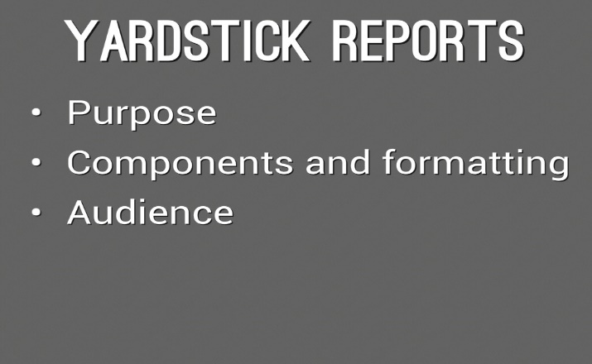
Yardstick Reports
Yardstick reports examine problems with two or more solutions.
  To determine the best solution, the writer establishes criteria by which to compare the alternatives.
    The criteria act as a yardstick against witch all alternatives are measured.

Slide 48

Yardstick Reports
The real advantage to yardstick reports is that alternatives can be measured consistently using the same criteria.
  Writers using a yardstick approach typically do the following:
    Begin by describing the problem or need.
    Explain possible solutions and alternatives.
    Establish criteria for comparing the alternatives; tell how the criteria were selected or developed.

Slide 49


Slide 50

New Planet Activity
Write an analytical report with your analysis, findings, and recommendation for who should go to the new planet.
  Which strategy to use and why? Direct vs. Indirect.
  Prepare a written purpose statement to clarify the task.
  Anticipate the audience.
  Create an outline of a good work plan.
  Conduct research.
  Any correlations with variables considered?
  How did your goals, background, and frame of reference color the inferences you made? What values influenced your decision?
  Did you use consistent evaluation criteria?
  Provide a report introduction (purpose-significance-main points)
  Explain the feasibility of following your recommended course of action (will your plan or proposal work?)

