Slide 1

Human Relations in Organizations
Session 5

Slide 2



Chapter Nine
Ethical Power, Politics, and Etiquette…and Service

Slide 3
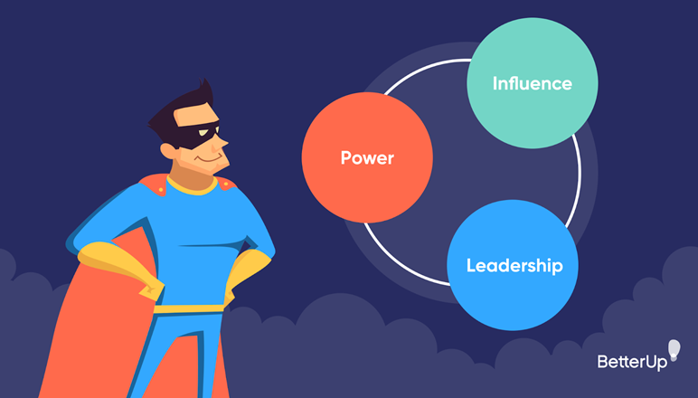
Power-Politics-Etiquette
Power is needed to reach objectives in all organizations, and power affects performance.
  Managers who abuse power using unethical behavior can impair an organization’s morale and performance.

Slide 4
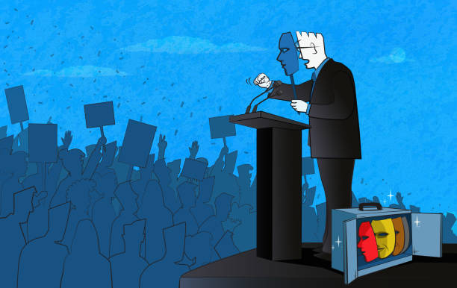
Power-Politics-Etiquette
Like power, politics is important to organizational performance.
  People using unethical politics tend to lie, cheat, and break rules – in time people identify and distrust them.

Slide 5
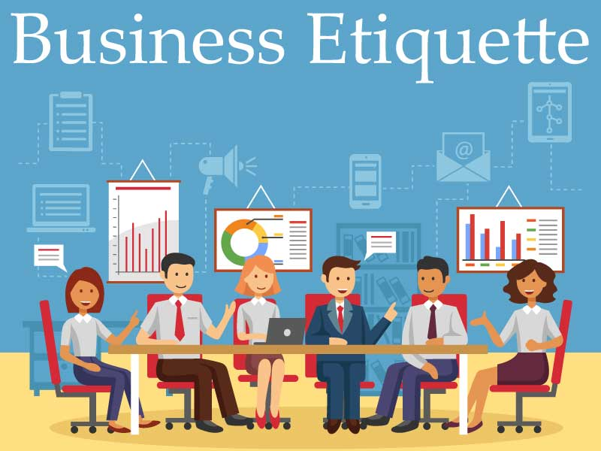
Power-Politics-Etiquette
People using proper etiquette behave differently than those who don’t.
  Unethical etiquette behavior hurts human relations, & performance.

Slide 6

Power and Politics
Power and politics can be helpful or harmful to an organization, depending on the behavior.
  Most large organizations have codes of conduct to help employees know the difference between ethical and unethical behavior

Slide 7

Ethical Power
Ethical power and politics includes behavior that benefits both the individual and the organization.
  It creates a win-win situation, meeting the goal of human relations.

Slide 8


Power
Power is a person’s ability to influence others to do something they would not otherwise do.
  “Martin Luther King, Jr. said, “Power properly understood is nothing but ability to achieve purpose – it is strength to bring about change.”
    Without power, managers could not achieve organizational objectives.

Slide 9


2 Sources of Power
Position Power
  Derived from top-level management and is delegated down the chain of command.
    Coercive, connection, and reward power
Personal Power
  Derived from the person.
    Referent, information, and expert power

Slide 10
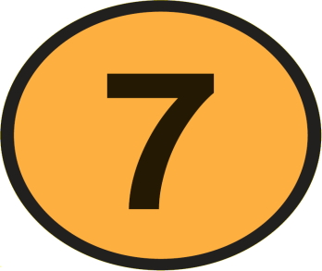
7 Bases of Power
Coercive
  Using threats and/or punishment to influence compliance.
Connection
  Based on the user’s relationship with influential people.
Reward
  Based on the user’s ability to influence others with something of value to them – what’s in it for them?
Legitimate
  Based on the user’s position power, which is given by the organization.
Referent
  Based on the user’s personal power.
Information
  Based on the user’s information being desired by others.
Expert
  Based on the user’s skill and knowledge.

Slide 11

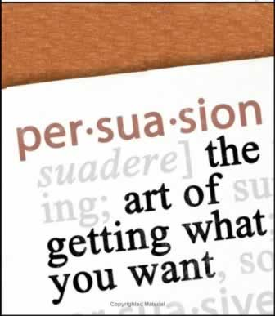
Influencing Tactics
Your power is your ability to influence others to do something they would not otherwise do to help you meet your objectives.
  Along w/ power sources & bases, you need to have persuasion skills.

Slide 12
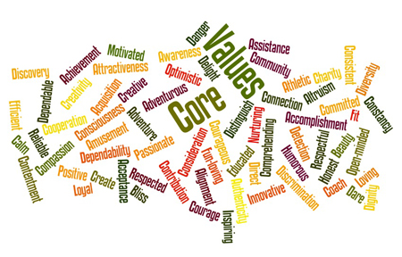

Reading People
If you are going to influence someone, you have to understand the person’s values, attitudes, beliefs, and use incentives that will motivate the individual.

Slide 13

Reading People
Reading people is a key interpersonal skill.
  Put yourself in the place of the person you want to persuade – anticipate how the person sees world
  Get the other person’s expectations right
  Incorporate information about other person’s expectations into your persuasive presentation – use tactic most suitable to person
  Keep focus on other person’s expectations when trying to persuade – create a win-win situation

Slide 14

5 Influencing Tactics
The following five influencing tactics can be used together to help you influence others.
  Ingratiation (Praise)
  Rational Persuasion
  Inspirational Appeal
  Personal Appeal
  Legitimization

Slide 15

1. Ingratiation (Praise)
Be friendly and give praise to get the person in a good mood before making a request.
  When using ingratiation (praise) follow these guidelines:
    Be sensitive to the individual’s moods.
    Compliment the person’s past related achievements.
    State why the person was selected for the task.
      When people believe the task is important and they are well-qualified, they will find it tough to refuse doing you a favor.
    Acknowledge inconvenience posed by your request.

Slide 16

2. Rational Persuasion
Rational Persuasion includes logical arguments with factual evidence to persuade the person that the behavior will result in meeting the objective.
  When you develop rational persuasion, follow these guidelines:
    Explain the reason your objective needs to be met.
    Explain how other person will benefit by meeting your objective.
      Create a win-win situation
    Provide evidence that your objective can be met.
      Offer a detailed step-by-step plan
    Explain how potential problems and concerns will be handled.
      Get the other person’s input on resolution
    Explain why your proposal is better than competing ones.

Slide 17

3. Inspirational Appeal
The inspirational appeal tactic attempts to arouse people’s enthusiasm through internalization to meet the objective.
  You appeal to the other person’s values, ideals, and aspirations or increase their self-confidence by displaying feelings that appeal to the person’s emotions and enthusiasms
  When you develop an inspirational appeal follow these guidelines:
    You need to develop emotions and enthusiasm.
    Link the appeal to the person’s self-concept.
    Link the request to a clear, appealing vision.
    Be positive and optimistic.
    Use nonverbal communication to bring emotions to verbal message.

Slide 18

4. Personal Appeal
When using Personal Appeals request the person to meet your objective based on loyalty and friendship.
  Present your request as a favor to you.
    “Please do it for me,” not “This is an order”
  When using personal appeals, follow these guidelines:
  Begin by stating that you need a favor and why it is important.
    Then ask for the favor – it is tough to say no
  Tell the person that you are counting on him or her.
    Failure to help could hurt your relationship
  Appeal to your friendship.

Slide 19

5. Legitimization
With the legitimization tactic, you rely on organizational authority that a reasonable request is being made and that the person should meet your objective.
  When using legitimization, follow these guidelines:
    Refer to organizational policies, procedures, rules, and other written documentation
    Refer to precedent

Slide 20
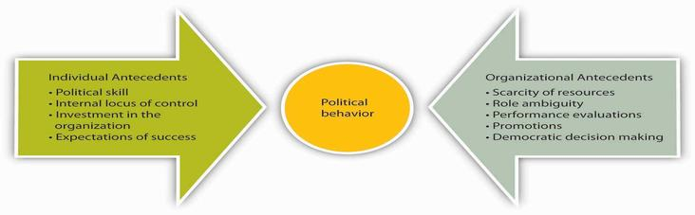
Organizational Politics
Politics is critical to your career success. It is the process of gaining and using power.
  Power and politics go hand in hand.
    Political behavior is used to develop relationships necessary to get the job done.

Slide 21

Political Behavior
Three political behaviors commonly used in organizations:
  1. Networking
    The process of developing relationship alliances with key people for the purpose of politicking – your network of people helps you get your job done.
  2. Reciprocity
    Politics is about reciprocal exchanges – reciprocity involves creating obligations & debts, developing alliances, and using to accomplish objectives.
      When others do something for you, you incur an obligation that they may expect to be repaid.
  3. Coalition Building
    A coalition is a network of alliances that helps you achieve a specific objective.

Slide 22

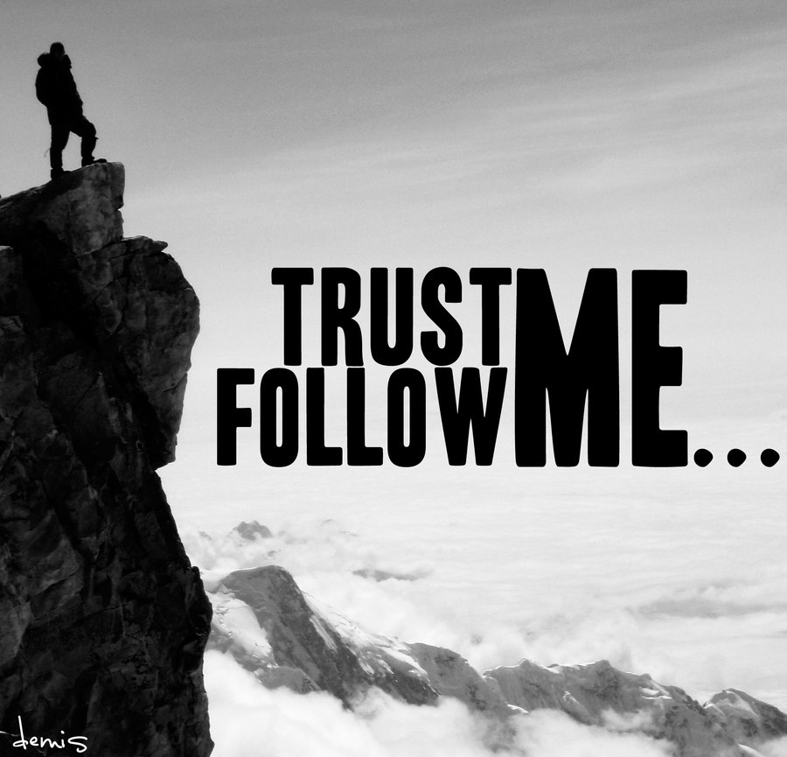
Political Skill
Political success is about developing networks of alliances and coalitions in reciprocal exchanges.
  When exchanges create a win-win situation for all members of the alliance and organization – the goal of human relations is met.
  Developing trust is very important.
    Being honest builds trust.

Slide 23
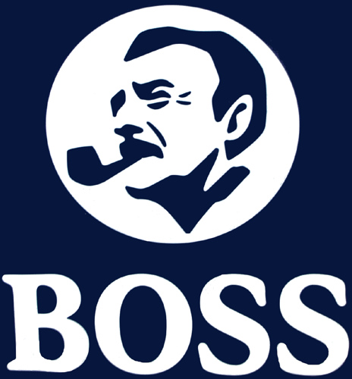

Vertical Politics
Vertical politics are relations with superiors and subordinates.
  Your boss and those you supervise (and who report to you) are the most important persons with whom to develop effective relations.

Slide 24

Relationship with the Boss
Your relationship with your boss will affect job satisfaction and can be the difference between success or failure in job.
  Don’t Try to Change your Boss
    Analyze your boss’ style and preferences, and if necessary – change your style
  Common Expectations of Bosses:
    Loyalty
    Chain of Command
    Cooperation
    Initiative
    Information
    Openness to Criticism
    Regaining Your Boss’s Trust

Slide 25

Developing Manager-Employee Relations
You should strive for harmonious relations with others where differences of opinion are encouraged and settled in a peaceful manner.
  Morale should be kept at high levels, but the manager should not try to please all the people all of the time.
    A manager can have good human relations without being well-liked personally, or popular.

Slide 26


Friendship
The relationship between the manager and employee cannot be one of real friendship.
  Manager must evaluate the employee’s performance.
    True friends don’t evaluate or judge.
  Manager must give employees directions.
    True friends don’t give orders.

Slide 27


The Open-Door Policy
The Open-door policy is the practice of being available to others.
  Your management ability is directly proportional to the amount of time your door is open, both literally and figuratively.
  For effective human relations, you must be available to employees to give them the help they need, when they need it.
    Your success depends on your employees!

Slide 28
Horizontal Politics
Horizontal politics are your relations with your peers and members of other departments and organizations.
  Your peers are the people who are on the same level in the organizational hierarchy as you.
    Your direct peers also report to your boss.

Slide 29


Relations with Peers
To be successful, you must cooperate, compete with, and sometimes even criticize your peers.
  Your success is linked to others in the organization.
  Even though you are cooperative with your peers, you are still in competition with them.
  Do not go looking for faults in your peers, but if your peers fail, help them to try to correct situation or prevent it from recurring.

Slide 30
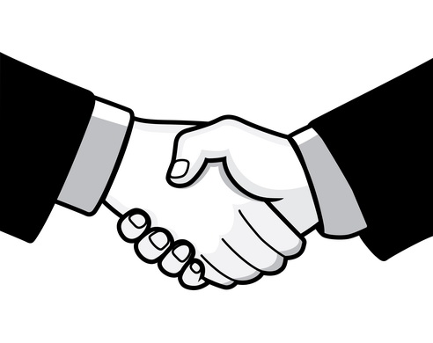
Business Etiquette
When using power and politics, our behavior should be ethical using proper business etiquette:
  Conversation Etiquette
  Dining Etiquette
  Hoteling, Telecommuting, and Cubicle Etiquette
  Cell Phone Etiquette
  E-Mail and Texting – Instant Messaging Etiquette
  Job Interview Etiquette
  Meeting and Presentation Etiquette
  Networking Etiquette

Slide 31
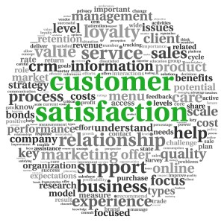
Customer Satisfaction
Customer service is critical to business success because without customers, there’s no business.
  The goal of sales is to provide customer satisfaction so that customers will buy your product now and become repeat customers.

Slide 32


Customer Satisfaction
Customer Needs and Solving Problems
  To provide customer satisfaction, you have to understand what the customers want from your product, or how your product will solve a problem they have –
  Listen carefully
Attitudes Lead to Behavior
  The underlying behavior that makes or breaks the customer experience is attitude
  What we think about customers is how we feel, and what we feel is how we behave toward customers

Slide 33


Customer Service Etiquette
Proper Customer Etiquette
  Develop a welcoming attitude, or service with a smile, not a frown.
  Convey that you care about the customer and want to meet their needs and solve their problems.
  Make the buyer feel good about the sales and service experience as you build effective human relations.
  Invite the customer back for repeat business.

Slide 34
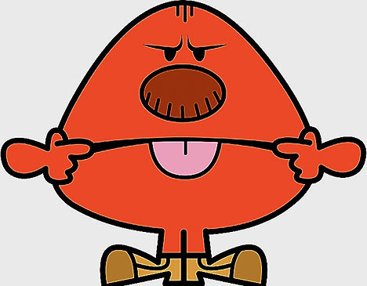
Customer Service Etiquette
Improper Customer Etiquette
  Don’t Ignore Customers
  Don’t Conduct Personal Business While Waiting on Customers
  Don’t Use Rude Behavior and Get Customer Defensive - Apologize

Slide 35

Customer Service Etiquette
Handling Customer Complaints
  Paraphrase the complaint and apologize
  Ask customer to recommend a solution and agree on a solution
  Implement the solution quickly
  Prevent future complaints and follow-up

Slide 36
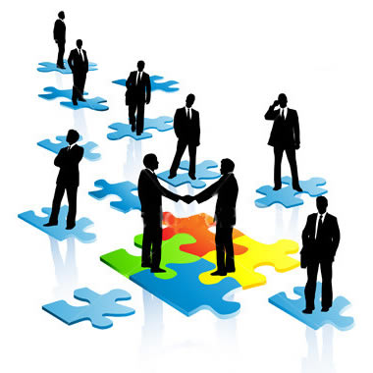
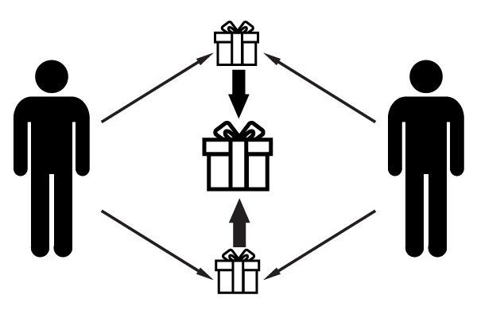
Chapter Ten
Networking and Negotiating

Slide 37

Networking
Networking is the ongoing process of building interconnected relationships for the purpose of politicking and socializing.
  You can’t perform at high levels alone; you need some help and to help others through networking reciprocity.
    It’s not what you know…it’s who you know that’s important.

Slide 38

Networking Objectives
The following are important networking objectives:
  To get a job or a better position
  To perform better at your current job
  To advance within an organization
  To stay current in your field
  To maintain mobility
  To develop relationships

Slide 39
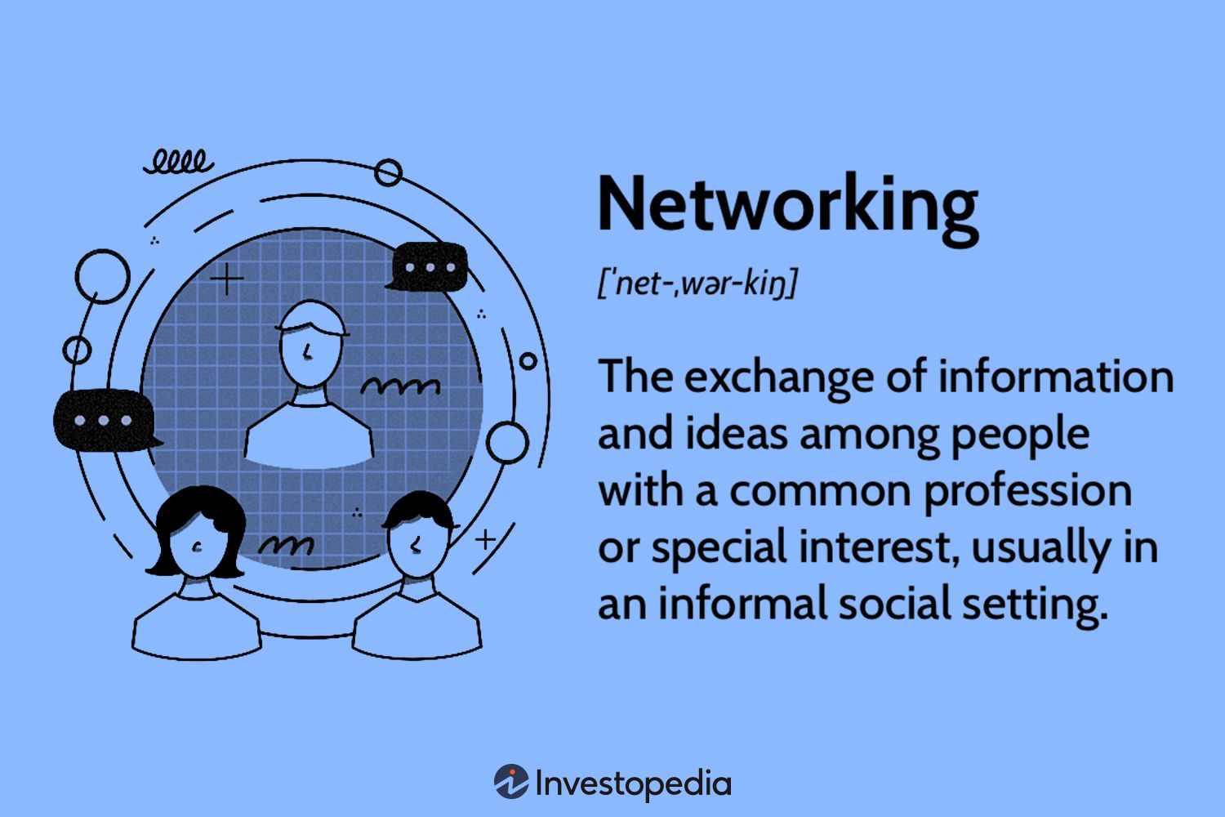
Networking Process
The Networking Process includes:
  Perform a self-assessment and set objectives
  Create a one-minute self-sell
  Develop a network
  Conduct networking interviews
  Maintain the network

Slide 40
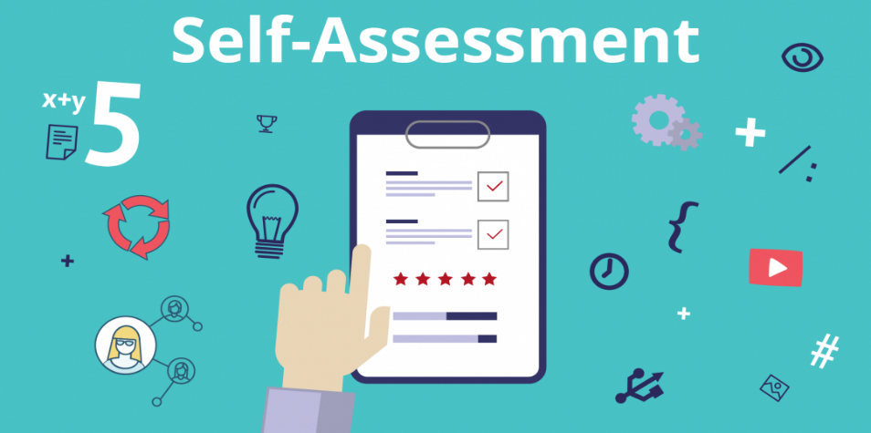
Perform a Self-Assessment and Set Objectives
The task of self-assessment can help clarify your skills, competencies, and knowledge.
  A self-assessment asks you to explore the following:
    Who are you?
    What are your interests, values, needs, skills, and expertise?
    What are your goals and objectives?

Slide 41
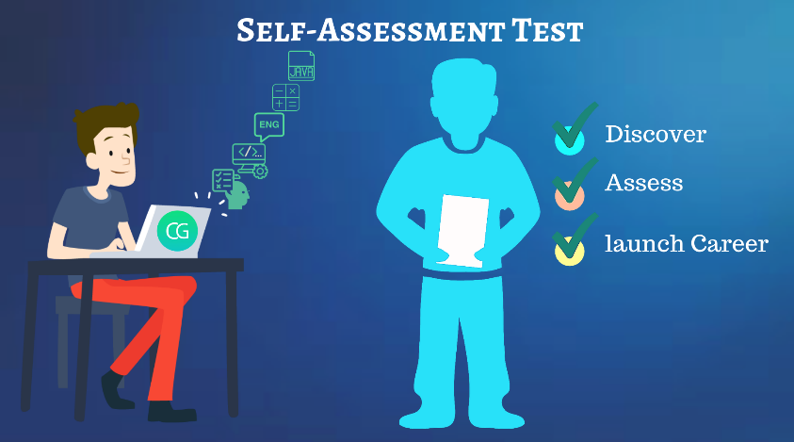
Perform a Self-Assessment and Set Objectives
A Self-assessment can give you insight into transferable skills and criteria that are important for a new job or task.
  After completing a self-assessment, you are ready to translate your talents into accomplishments.
    Results achieved in your job/school are best evidence of skills.
    Tie your accomplishments to the job interview.
    Set networking objectives: state your goal.

Slide 42
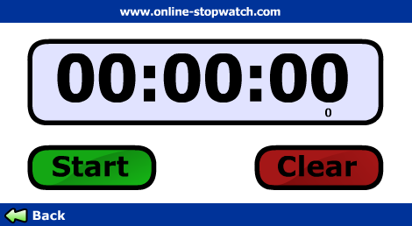

Create a One-Minute Self-Sell
The one-minute self-sell is an opening statement used in networking that quickly summarizes your history and career plan and asks questions.

Slide 43

Develop a Network and Conduct Interviews
When developing your network you should begin with people you know.
    Everyone can create a list of about 200 people!?
  Conduct Networking Interviews.
    Set up a networking interview to meet your objective: ask for a 15-20 minute meeting.
    Your are the interviewer so you need to be prepared with a specific set of questions to ask the contact regarding your targeted career.

Slide 44

Networking Interview Process
Things to do in a networking interview:
  Establish rapport – praise and read the person
  Deliver the one-minute self-sell
  Ask prepared questions
  Get additional contacts for your network
  Ask your contacts how you might help them
  Follow up with a “thank you” note and status report

Slide 45

Maintain Your Network
Keep your network informed of your career progress.
  As you have been helped, so should you help others.

Slide 46
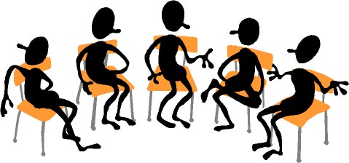

Coalitions
A coalition is a network used to meet an objective.
  Get powerful people on your side, and they can help you get other people in your coalition either directly/indirectly.
    Like networking, building coalitions is an influencing tactic of political behavior.

Slide 47

Negotiating
Negotiation is coming to an agreement to do something.
  Negotiation affects the process of work behavior, human relations, in resolving conflict and increasing performance, and the advancement of careers.
    A big part of day-to-day success is negotiation skills.

Slide 48

Negotiating
Negotiating is a process in which two or more parties have something the other wants and attempt to come to an exchange agreement.
  As with networking, when negotiating, you should be building relationships.
    Power, influence tactics, and politics can all be used during the negotiation process.

Slide 49

Negotiating Strategies
Distributive Bargaining
  Negotiating over shares of a fixed pie.
    Creates a win-lose situation
Integrative Bargaining
  Negotiating to give everyone a good deal.
    Creates a win-win situation

Slide 50

The Negotiating Process
The negotiating process includes the following steps:
  Plan
  Bargain
  Postponement
  Agreement or No Agreement

Slide 51

Negotiating Plan
The Negotiating Plan includes:
  Researching the other parties
    Know the key power players
  Setting objectives
    Based on your research, what can you expect?
  Anticipating questions, objections, and preparing answers
    Understand “What’s in it for me (them)”
    Develop trust
  Developing options and trade-offs
    If you have other options you are in a stronger position
    Let other parties know what they have to lose

Slide 52

Negotiating Planning
Success or failure in negotiating is often based on preparation.

Slide 53
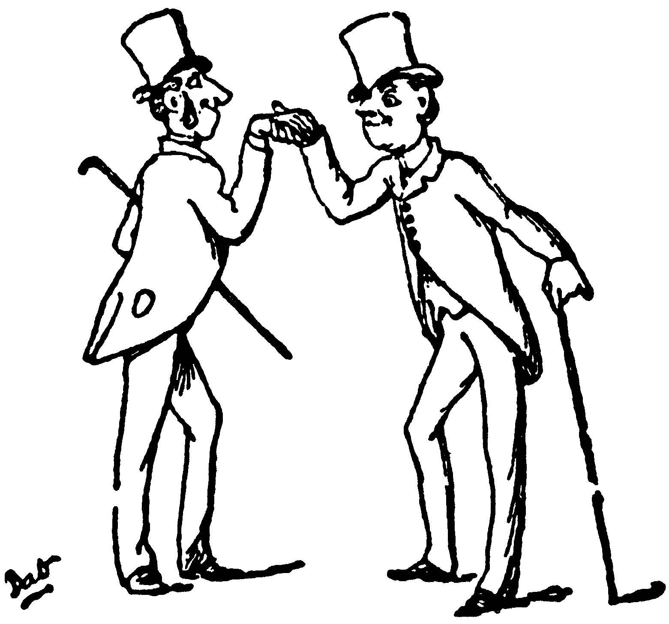
Bargain
After you have planned, you are ready to bargain/negotiate.
  Face to face negotiations are generally preferred because you can see (read) the other person’s nonverbal cues.
  Bargaining includes:
    Developing rapport and focusing on obstacles, not the person.
    Letting the other party make the first offer.
    Listening & asking questions to focus on meeting other’s needs.
    Not being too quick to give in.
    Asking for something in return.

Slide 54


Bargaining
Avoid desperation and being intimidated.
  If others know you are desperate, or weak, and will accept a low agreement, they will likely take advantage of you.
Make the first concession.
  When you are involved with a complex deal, with trade-offs, be willing to be the first to make a concession – they tend to be reciprocated and lead to agreements.

Slide 55


Postponement
When there doesn’t seem to be any progress, it may be wise to postpone the negotiations.
  When the other party is postponing…
    You may create urgency
  When you postpone…
    The other party may create urgency

Slide 56

Agreement or No Agreement
Once the agreement has been made, restate it and/or put it in writing.
  After the deal is made, stop selling it.
  Avoid the so-called “winner’s curse.”
    If you cannot come to an agreement, analyze the situation and try to determine where you went wrong so you can improve.

Slide 57
Networking and Negotiating Globally
There are cultural differences in networking, and you need to appreciate and embrace the host culture.
  There are many implications for negotiating globally:
    Time to reach an agreement and deadlines
    The focus on task vs. relationship
    The use of power/influencing tactics –concessions w/ reciprocity
    Communications: both verbal and nonverbal
    Where the negotiations should take place and use of alcohol
    Name, rank or title, dress, greetings, and rituals

Slide 58


