Slide 1

Fundamentals of Management
Session Seven

Slide 2

Part Five: Controlling
Chapter Fourteen: Foundations of Control
  Explain the nature and importance of control.
  Describe the three steps in the control process.
  Discuss the types of controls organizations and managers use.
  Discuss contemporary issues in control.

Slide 3
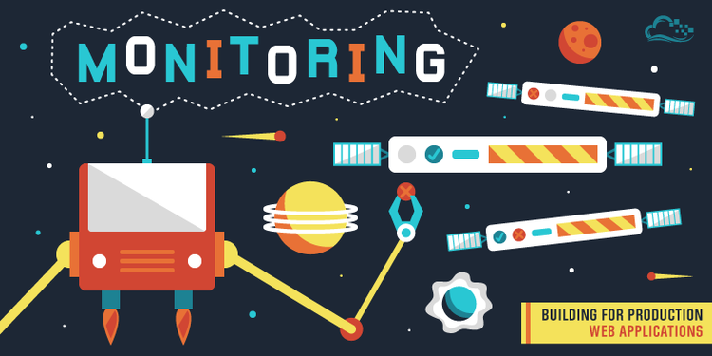
Controlling
Controlling is the final step in the management process.
  Managers must monitor whether goals established as part of the planning process are being accomplished efficiently and effectively.
    Appropriate controls can help managers look for specific performance gaps and areas for improvement.

Slide 4

Control
Control is the management function that involves monitoring activities to ensure that they’re being accomplished as planned and correcting any significant deviations.
  Control is the only way managers know whether organizational goals are being met and, if not, the reasons why.

Slide 5
Control
The value of the control function can be seen in three areas:
  Planning
    Controlling provides the critical link back to planning.
    If managers didn’t control, they’d have no way of knowing whether goals and plans were being achieved and what actions to take.
  Empowering Employees
    Effective control systems can provide information and feedback on EE performance and minimize the chance of potential problems.
  Protecting the Workplace
    Managers must protect the organization and its assets from all threats, including natural disasters, financial pressures, scandals, workplace violence, supply disruptions, market competition, etc.
    Comprehensive controls and backup plans will minimize impact.

Slide 6
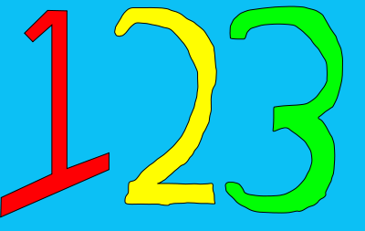
Control Process
The Control Process is a three-step process of:
  Measuring actual performance,
  Comparing actual performance against a standard, and
  Taking managerial action to correct deviations or address inadequate standards.

Slide 7
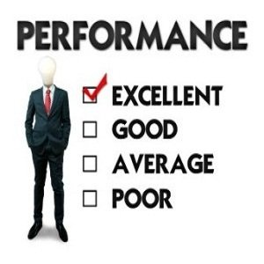
Measuring
To determine actual performance, a manager must first get information about it. Thus, the first step in control is measuring.
  Four common sources of information frequently used to measure actual performance include:
    Personal Observation
    Statistical Reports
    Oral Reports
    Written Reports

Slide 8


Measuring – Personal Observation
Personal Observation provides firsthand, intimate knowledge of the actual activity – information not filtered through others.
  Management by Walking Around (MBWA) is a phrase used to describe when a manager is out in the work area, interacting directly with EE’s and exchanging information about what’s going on.
    MBWA can pick up factual omissions, facial expressions, and tones of voice that may be missed by other sources.
      Unfortunately, MBWA can be biased and time consuming.
      Also, MBWA may be obtrusive and affect trust with EE’s.

Slide 9
Measuring – Statistical Reports
The widespread use of computers has led managers to rely increasingly on Statistical Reports for measuring actual performance.
  This measuring device, however, is limited to computer outputs, and may focus on a few key areas only and ignore other important, often subjective, factors.

Slide 10

Measuring – Oral Reports
Information can also be acquired through Oral Reports – that is, through conferences, meetings, one-on-one conversations, or telephone calls.
  In EE oriented organizations where EE’s work closely together, this approach may be the best way to monitor performance.
    Although the information is filtered, it is fast, allows for feedback, and permits expression and tone of voice, as well as, words themselves to convey meaning.

Slide 11
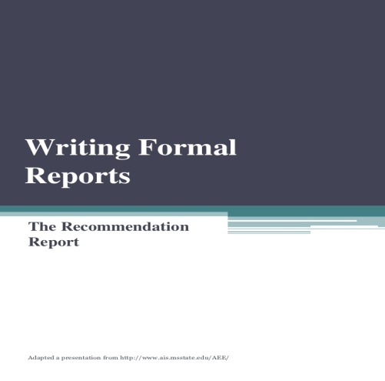
Measuring – Written Reports
Actual performance may also be measured by Written Reports.
  Like Statistical Reports, they are slower yet more formal than firsthand or secondhand oral measures.
    This formality also often gives them greater comprehensiveness and conciseness than found in Oral Reports. In addition, Written Reports are usually easy to catalog and reference.

Slide 12
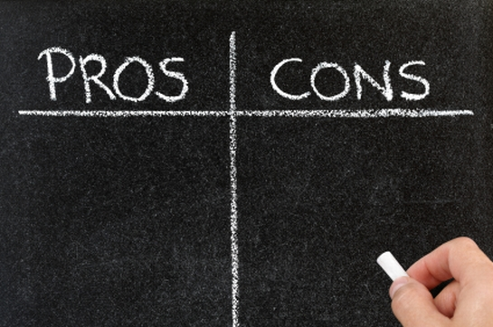
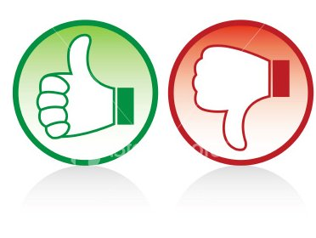
Measuring
Given the varied advantages and disadvantages of each of the four measurement techniques, managers should use all four for comprehensive control efforts.

Slide 13

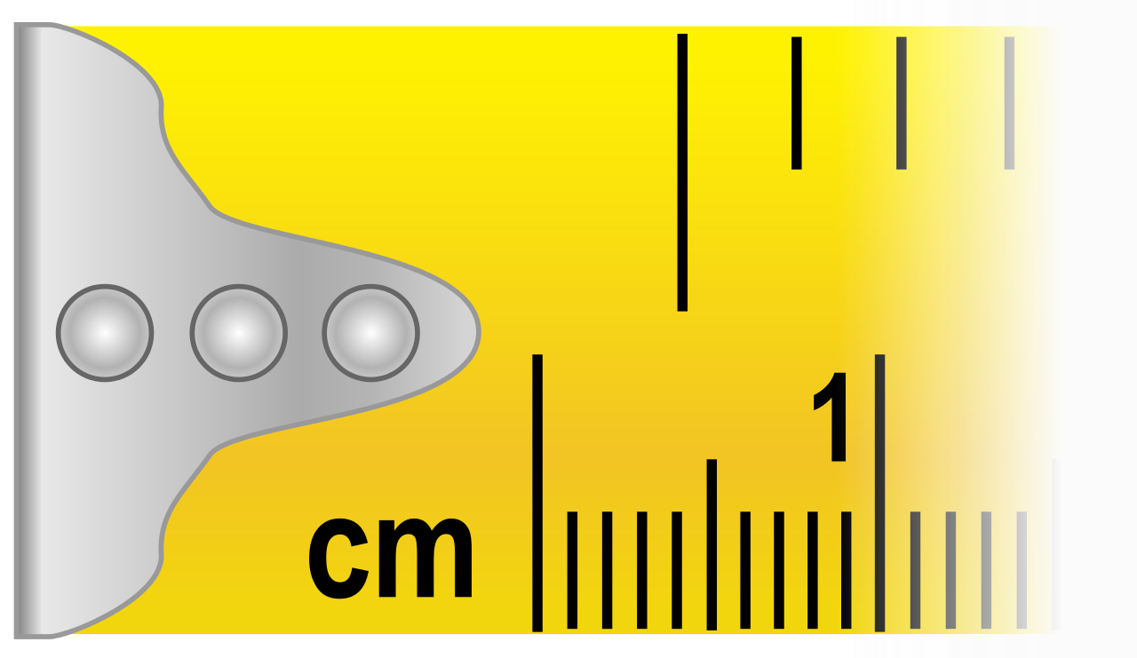
What Do Managers Measure?
What managers measure is probably more critical to the control process than how they measure.
  The selection of the wrong criteria can result in serious dysfunctional consequences.
  Besides, what we measure determines, to a great extent, what people in the organization will attempt to excel at.

Slide 14

Control Criteria
The following Control Criteria are applicable to any management situation:
  EE satisfaction or turnover and absenteeism rates.
  Keeping costs within budget.
    When a performance indicator cannot be stated in quantifiable terms, managers should look for and use subjective measures, despite their limitations.

Slide 15
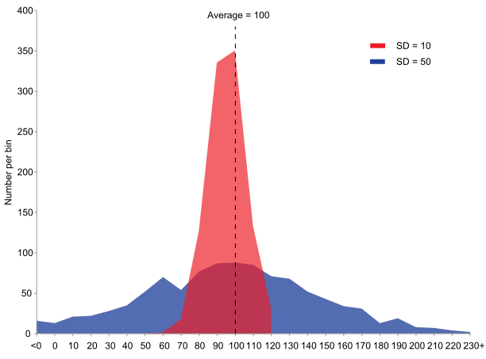
Comparing Actual Performance to Planned Goals
The comparing step determines the variation between actual performance and the standard.
  Although some variation in performance can be expected in all activities, it’s critical to determine an acceptable Range of Variation.
    Deviations outside the range need attention.

Slide 16
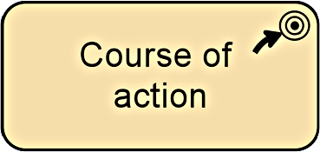
Range of Variation
In regards to acceptable Range of Variation, managers can choose among three possible courses of action:
  Do Nothing (Self-Explanatory)
  Correct Actual Performance
  Revise the Standard

Slide 17
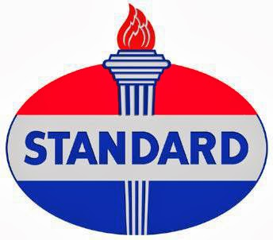
Revise the Standard
It’s possible that a variance is a result of an unrealistic standard – too low or too high a goal. In such cases, it’s the standard that needs corrective action, not the performance.
  However, when performance isn’t up to par, don’t immediately blame the goal or standard.
    If you believe the standard is realistic, fair, and achievable, tell EE’s that you expect future work to improve, and then take the necessary corrective action to help make that happen.

Slide 18

Control
Management can implement controls before an activity commences, during the activity, or after the activity has been completed.
  Feed-Forward Control
    Anticipates Problems
  Concurrent Control
    Corrects Problems As They Occur
  Feedback Control
    Corrects Problems After They Occur

Slide 19

Traditional Financial Controls
Want to earn a profit!? You need financial controls.
  Traditional financial controls include Ratio Analysis.
  Ratios are calculated using selected information from the organization’s balance sheet and income statement.
    Liquidity Ratios measure an organization’s ability to meet its current debt obligations.
    Leverage Ratios examine the org.’s use of debt to finance its assets and whether it’s able to meet the interest payments on debt.
    Activity Ratios assess how efficiently a company is using its assets.
    Profitability Ratios measure how efficiently and effectively the company is using its assets to generate profits.

Slide 20

Budget Analysis
Budgets are tools used for both planning and controlling.
  Planning Tool
    Indicates which work activities are important and what and how much resources should be allocated to those activities.
  Controlling Tool
    Provides managers with quantitative standards against which to measure and compare resource consumption.
    Significant deviations require action and a manager to examine what has happened and why, and then take necessary action.

Slide 21
Information
Information is a critical tool for controlling other organizational activities.
  Managers need the Right Information at the Right Time and in the Right Amount to help them monitor and measure organizational activities:
    About what is happening within their area of responsibility.
    About the standards in order to be able to compare actual performance with the standard.
    To help them determine if deviations are acceptable.
    To help them develop appropriate course of action.

Slide 22
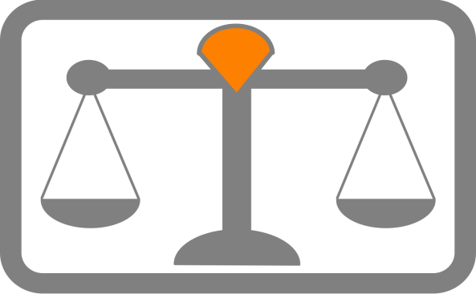
Balanced Scorecard
The Balanced Scorecard approach looks at more than the financial perspective by typically looking at four areas that contribute to a company’s performance.
  Financial
  Customer
  Internal Processes
  People-Innovation-Growth Assets
    Managers should develop goals for each of the four areas and measure whether they are being met.

Slide 23

Workplace Concerns
Today’s workplaces present considerable control challenges for managers, including:
  Employee Performance
  Employee Theft
  Workplace Violence

Slide 24

Disciplining Difficult Employees
Almost all managers will, at one time or another, have to deal with EE’s who are difficult.
  The following are several suggestions that are likely to lessen the angst these people create in your life and may have some influence in reducing their difficult behavior.
    Don’t let your emotions rule.
    Attempt to limit contact with the difficult person.
    Try polite confrontation using a civil tone and approach.
    Practice positive reinforcement to change behavior.
    Recruit fellow victims and witnesses to put pressure for change.

Slide 25

Part Five: Controlling
Chapter Fifteen: Operations Management
  Define operations management and explain its role.
  Define the nature and purpose of value chain management.
  Describe how value chain management is done.
  Discuss contemporary issues in managing operations.

Slide 26
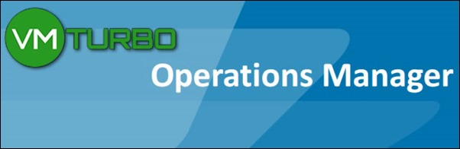
Operations Management
Operations Management is the study and application of the transformation process.
  Organizations need to have well-thought-out and well-designed operating systems, organizational control systems, and quality programs to survive in today’s increasingly competitive global environment.
    And, it’s the manager’s job to manage those things.

Slide 27

Operations Management
Operations Management refers to design, operation, and control of the transformation process that converts such resources as labor and raw materials into goods and services that are sold to customers.
  The system takes inputs – people, technology, capital, equipment, materials, and information – and transforms them through various processes, procedures, and work activities into outputs – finished goods and services.

Slide 28

Operations Management
All organizations produce goods or services through the transformation process.
  For manufacturers, the products are obvious: they produce physical goods; such as, cars, cell phones, food products, etc.
    Raw materials are turned into recognizable products.
  But the transformation process is not as readily evident in service organizations, because they produce non-physical outputs in the form of services.
    For instance, hospitals provide health care services.

Slide 29
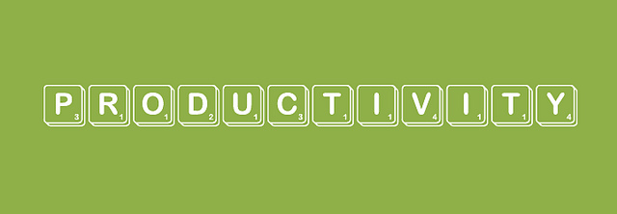
Improving Productivity
Improving productivity has become a major goal in virtually every organization.
  High productivity can lead to economic growth & development.

Slide 30

Productivity
Productivity is a composite of both people and operations variables.
  In the past, it was believed that managers, not workers, were the primary source of increased productivity. Today, an interplay between people and operations has been revealed.
    High productivity can’t come solely from good “people management.” The truly effective organization will maximize productivity by successfully integrating people into the overall operations system.

Slide 31
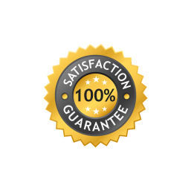
Improving Managers’ Productivity
William Edwards Deming, an American statistician and professor is widely credited with improving production in the United States during World War II.
  His philosophy focused on increasing quality and reducing costs through continually improving how EE work is done by approaching manufacturing in an orderly, systematic, and logical way.

Slide 32

Operations Management
Successful organizations recognize the crucial role that operations management plays as part of the overall organizational strategy to establish and maintain global leadership.
  The strategic role that operations management plays in successful organizational performance can be seen clearly as more organizations move toward managing their operations from a value chain perspective.

Slide 33
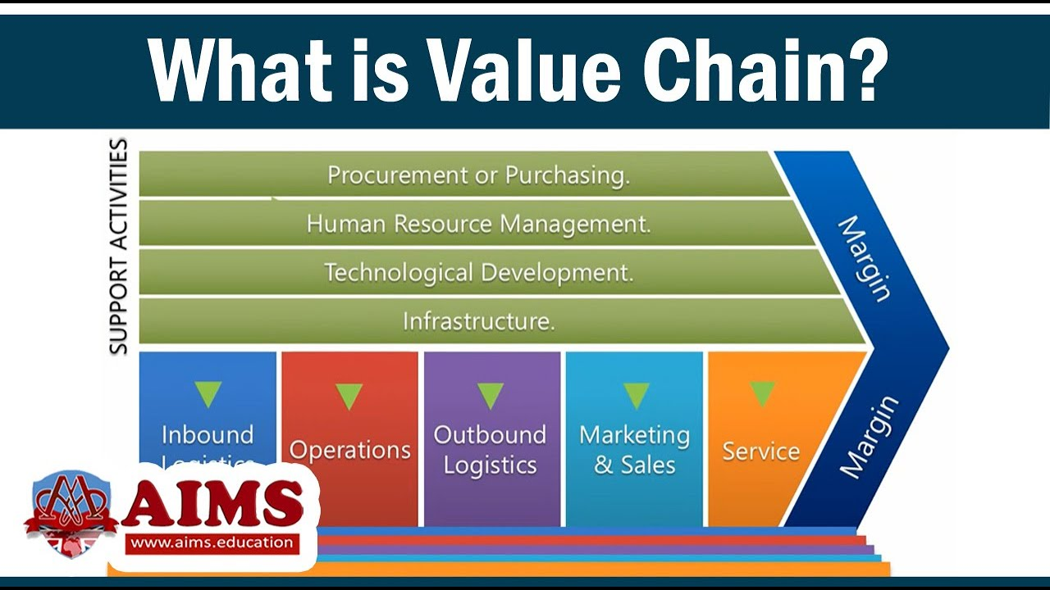
Value Chain
A Value Chain is a concept describing the full chain of a business’s activities in the creation of a product or service – from initial reception of materials all the way through its delivery to market, and everything in between.
  The value chain framework is made up of 5 primary activities – inbound operations, outbound logistics, marketing, sales, & service – and 4 secondary activities – procurement and purchasing, human resource management, technological development, and company infrastructure.

Slide 34
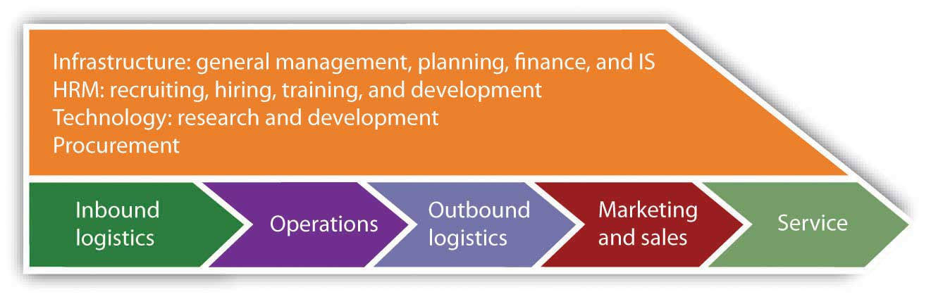
Value Chain (Management)
Value Chain Management is the process of managing the sequence of activities and information along the entire value chain.

Slide 35
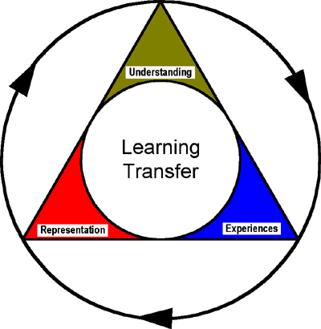
Business Model
The dynamic, competitive environment facing contemporary global organizations demands new solutions.
  Understanding how and why value is determined by the marketplace has led some organizations to experiment with a new Business Model:
    The new model is a strategic design for how a company intends to profit from its broad array of strategies, processes, and activities.

Slide 36

Value Chain Management (VCM)
Requirements for Successful Value Chain Management:
  Coordination and Collaboration
  Technology Investment
  Organizational Processes
  Leadership
  Employees/Human Resources
  Organizational Culture and Attitudes

Slide 37
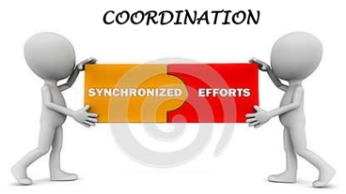
1. Coordination and Collaboration
For the Value Chain to achieve its goal of meeting and exceeding customers’ needs and desires, comprehensive and seamless integration among all members of the chain is necessary.
  All partners in the Value Chain must identify things that they may not value, but that customers do.
    Sharing information and being flexible as far as who does what are important steps in building coordination and collaboration.

Slide 38
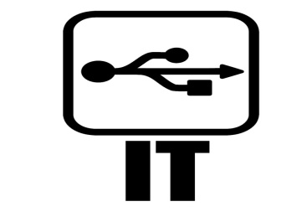

2. Technology Investment
Successful Value Chain Management isn’t possible without a significant investment in information technology.
  The payoff from this investment is that information technology can be used to restructure the Value Chain to better serve end users.

Slide 39

3. Organizational Processes
Value Chain Management radically changes organizational processes – that is, the way organizational work is done.
  Managers must critically evaluate all organizational processes from beginning to end by looking at core competencies – the organization’s unique skills, capabilities, and resources – to determine where value is being added.
    Non-value-adding activities are eliminated.

Slide 40
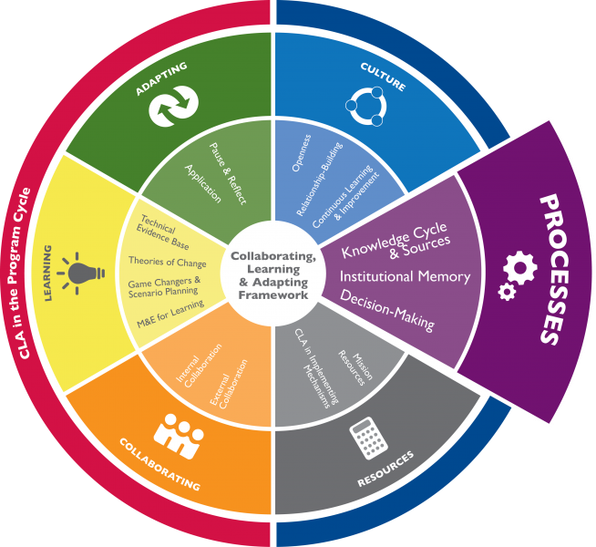
3. Organizational Processes
Three important conclusions can be made about how organizational processes must change:
  Better demand forecasting is necessary and possible because of closer ties with customers and suppliers.
  Selected functions may need to be done collaboratively with other partners in the value chain.
  New measures are needed for evaluating the performance of various activities along the value chain.

Slide 41
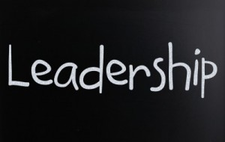
4. Leadership
Successful Value Chain Management isn’t possible without strong and committed leadership.
  Managers must make a serious commitment to identifying what value is, how that value can best be provided, and how successful those efforts have been.
    Leaders must outline expectations for what’s involved in the organization’s pursuit of Value Chain Management.

Slide 42

5. Employees/Human Resources
Employees are the organization’s most important resource, and play an important part in Value Chain Management.
  EE’s must have flexibility in what they do and how they do it.
  EE’s must have proper training and sufficient knowledge.

Slide 43

5. Employees/Human Resources
Three main human resource requirements for Value Chain Management are:
  Flexible approaches to job design
  An effective hiring process
  Ongoing training.
    Jobs need to be designed around work processes that link all functions involved in creating and providing value to customers.

Slide 44
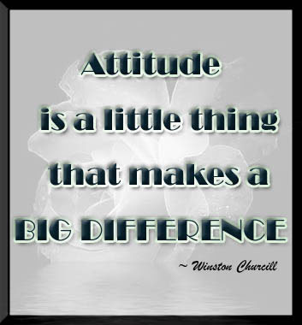
6. Organizational Culture and Attitudes
The last requirement for Value Chain Management is having a supportive organizational culture and attitudes.
  Those cultural attitudes include sharing, collaborating, openness, flexibility, mutual respect, and trust.
    And these attitudes encompass not only the internal partners in the value chain, but external partners as well.

Slide 45
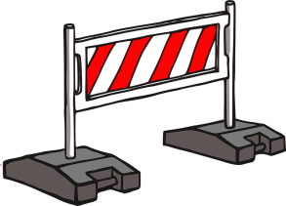
Obstacles to Value Chain Management
Organizational Barriers
  These barriers are among the most difficult obstacles to handle.
  They include refusal or reluctance to share information, reluctance to shake up the status quo, and security issues.
Cultural Attitudes
  Unsupportive cultural attitudes – especially trust and control – can also be obstacles to VCM.
Required Capabilities
  For successful implementation of the VCM, partners need numerous capabilities; including coordination and collaboration, the ability to configure products to satisfy customers and suppliers, and the ability to educate internal and external partners.
People
  The final obstacles to successful VCM can be an organization’s people.
  Without their unwavering commitment, flexibility, time and energy to do whatever it takes, VCM won’t be successful.

Slide 46

3 Contemporary Issues
1. Technology needed for Operations Management
  Managers who understand the power of technology to contribute to more effective and efficient performance know that managing operations is more than the traditional view of simply producing the product.
    Instead the emphasis is on working together with all the organization’s business functions to find solutions to customers’ business problems.

Slide 47

3 Contemporary Issues
2. Project Management
  Project management is the task of getting business activities done on time, within budget, and according to specifications.
    These projects don’t lend themselves well to the standardized operating procedures that guide routine and continuous organizational activities.

Slide 48

3 Contemporary Issues
3. Quality Control
  Organizations unable to produce high-quality products won’t be able to compete successfully in the global marketplace.

Slide 49

Quality
Product Quality Dimensions
  Performance – operating characteristics
  Features – important special characteristics
  Flexibility – meeting operating specifications over a period of time.
  Durability – amount of use before performance deteriorates
  Conformance – match with pre-established standards
  Serviceability – ease and speed of repair or normal service
  Aesthetics – how a product looks and feels
  Perceived Quality – subjective assessment of characteristics (image)

Slide 50
Quality
Service Quality Dimensions
  Timeliness – performed in promised period of time
  Courtesy – performed cheerfully
  Consistency – giving all customers similar experiences each time
  Convenience – accessibility to customers
  Completeness – full service, as required
  Accuracy – performed correctly each time

Slide 51

Quality
To publicly demonstrate their commitment to quality, many organizations worldwide have pursued challenging quality goals. The two best-known are the following:
  1. ISO 9000
    ISO 9000 is a series of international quality management standards established by the International Organization for Standardization, which sets uniform guidelines for processes to ensure that products conform to customer requirements.
      Standards cover everything from product design to product delivery.

Slide 52
Quality
To publicly demonstrate their commitment to quality, many organizations worldwide have pursued challenging quality goals. The two best-known are the following:
  2. Six Sigma
    Six Sigma is the Greek letter that statisticians use to define a deviation from a bell curve. The higher the sigma, the fewer the deviations from the norm. That is, the fewer defects.
      Six Sigma is a quality standard that establishes a goal of no more than 3.4 defects per million units or procedures.

Slide 53
