Slide 1
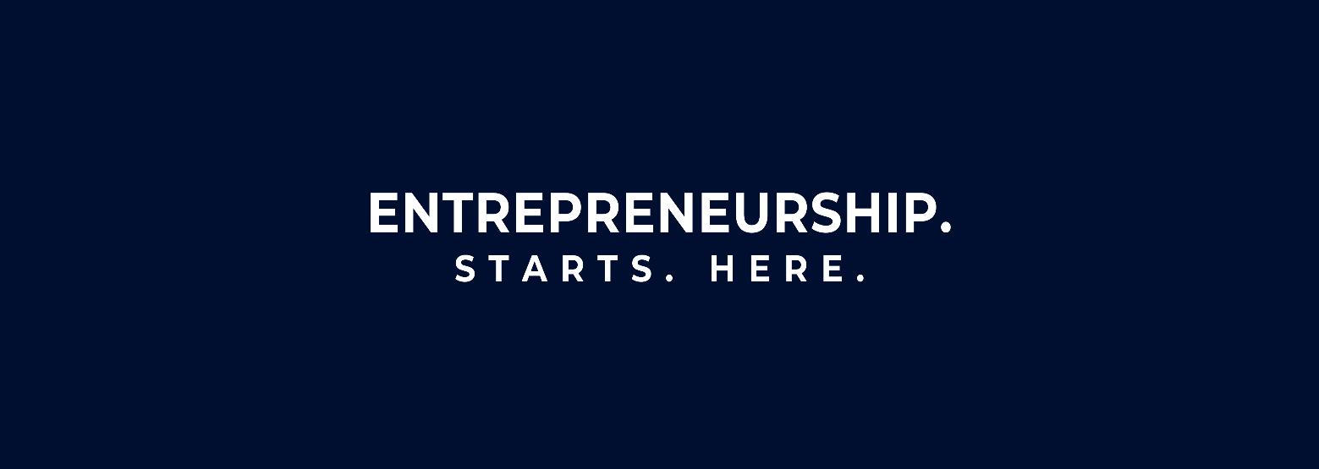
Entrepreneurship
Class Presentation SUMM Consolidate. Session 3
Entrepreneurship
  Theory, Process, Practice -12th Edition
    Donald F. Kuratko, Cengage Learning, Boston, MA 2024
      ISBN: 978-0-357-89950-2

Slide 2

Assessment of Entrepreneurial Opportunities
Chapter 6

Slide 3

The Challenge of New-Venture Startups
Starting a Business is Complex Because it Depends On:
  The Entrepreneur’s Motivation and Skills
  The Environment and Market Conditions
  The Venture Idea Itself

Slide 4

The Challenge of New-Venture Startups
Successful Founders Typically:
  Secure Resources Early
  Form Teams
  Create Legal Structures
  Seek Funding
  Act Decisively and Consistently
    New ventures must move from idea to survival to growth through structured evaluation.

Slide 5

Common Pitfalls in Selecting New Ventures
Entrepreneurs Often Fail Due to Avoidable Mistakes:
  Lack of Objective Evaluation
  Weak Market Understanding
  Underestimating Technical Challenges
  Poor Financial Planning
  Lack of Uniqueness
  Ignoring Legal Requirements
    Passion alone does not make an idea viable.

Slide 6
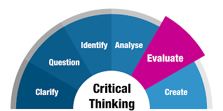
Critical Factors for Venture Development
Entrepreneurs Should Evaluate:
  Venture Feasibility
    Is it possible and legal?
  Value Proposition
    What makes the idea unique?
  Market Potential
    Who will buy it?
  Operations
    How will it run?
  Team Capability
    Who will manage it?
  Financing
    Where will funding come from?
  Competition and Risks
    What threats exist?

Slide 7

Phases of a New Venture
There are Three Phases to a New Venture:
  Pre-Start-Up
    Idea Validation and Planning
  Start-Up
    Sales Begin
  Post-Start-Up
    Growth Stage or Exit Stage

Slide 8
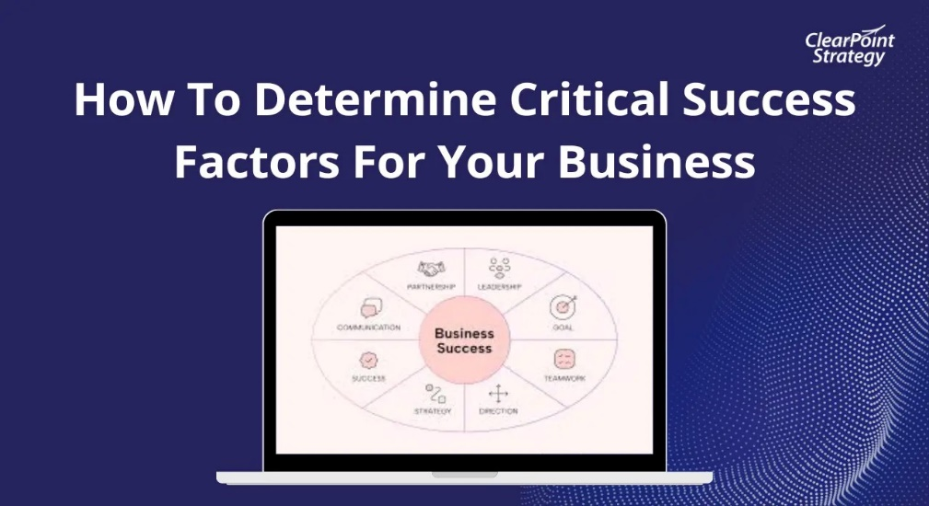
Key Success Variables
Five Critical Determinants:
  Uniqueness of the Idea
  Size of the Required Investment
  Sales Growth Expectations
  Product Readiness
  Customer Availability
    These Influence Survival Probability

Slide 9
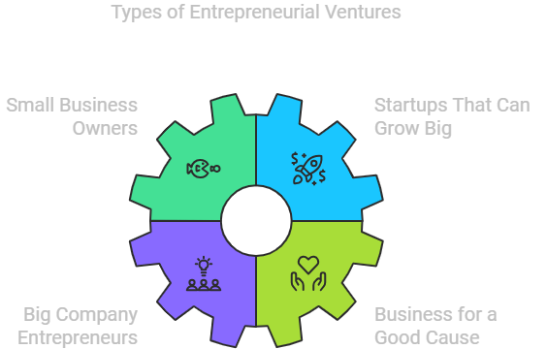
Types of Ventures
There are Three Types of Ventures:
  Lifestyle Ventures
    Focus: Independence and Stability
  Small Profitable Ventures
    Focus: Steady Income and Control
  High-Growth Ventures
    Focus: Scalability and Investment Attraction
      Each Requires a Different Strategy

Slide 10

Importance of Entrepreneurial Teams
Modern Ventures Rarely Succeed Solo.
  Strong Teams Provide:
    Diverse Skills
    Better Decisions
    Investor Confidence
    Stronger Legitimacy
      Research shows most startups rely on 2-3 decision makers, rather than on one founder.

Slide 11
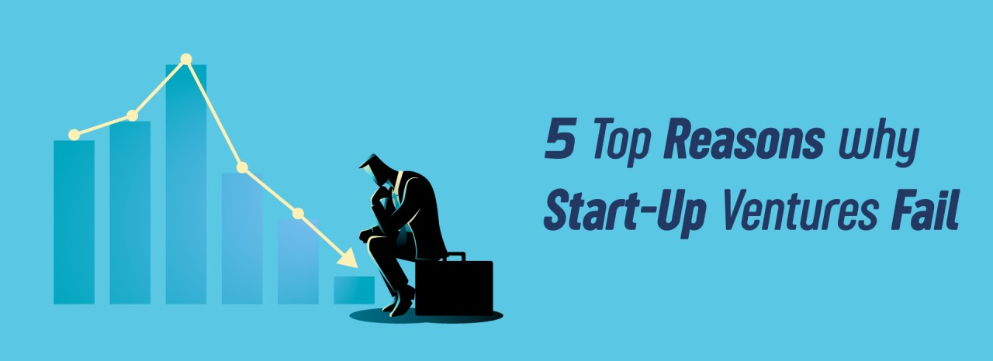
Why Ventures Fail
Failure Usually Comes From Internal Factors:
  Product/Market Problems
    Poor Timing - Weak Design - Unclear Business Model
    Reliance On One Customer
  Financial Problems
    Undercapitalization - Excessive Early Debt
  Managerial Problems
    Weak Leadership - Poor Hiring - Ego Conflicts
      Sales/Marketing issues are the most common early-stage challenges.

Slide 12

Traditional Venture Evaluation Methods
Profile Analysis
  Evaluates Strengths and Weaknesses Across:
    Finance
    Marketing
    Operations
    Human Resources

Slide 13

Traditional Venture Evaluation Methods
Feasibility Criteria Approach
  Tests Viability Through Questions Like:
    Is It Proprietary?
    Are Costs Realistic?
    Is the Market Large?
    Are Margins Strong?
      Meeting this criteria increases funding chances.

Slide 14
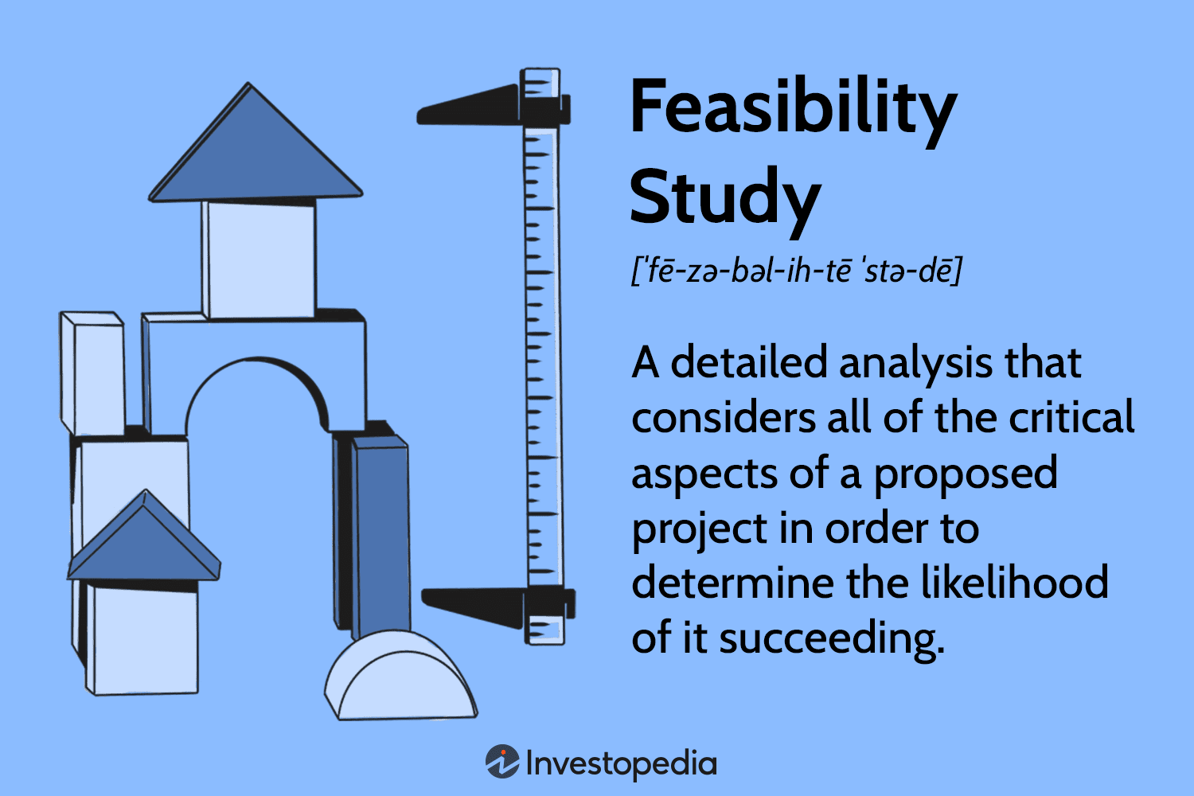
Traditional Venture Evaluation Methods
Comprehensive Feasibility Analysis
  Evaluates Five Areas:
    Technical Feasibility
    Market Feasibility
    Financial Feasibility
    Organizational Readiness
    Competitive Position

Slide 15

Design Methodology
Modern Approach
Design Thinking Improves Ventures Through:
  Observation of Users
  Prototyping Ideas
  Gathering Feedback
  Iterative Refinement
    It Focuses on Latent Customer Needs, Not Just Obvious Ones.

Slide 16
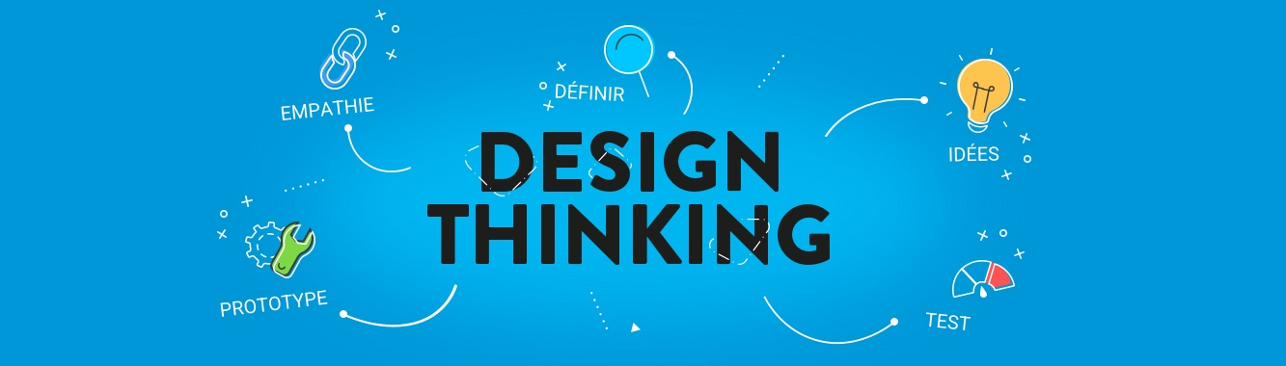
Design Methodology
Modern Approach
Successful Concepts Must Be:
  Feasible
  Desirable
  Financially Viable

Slide 17
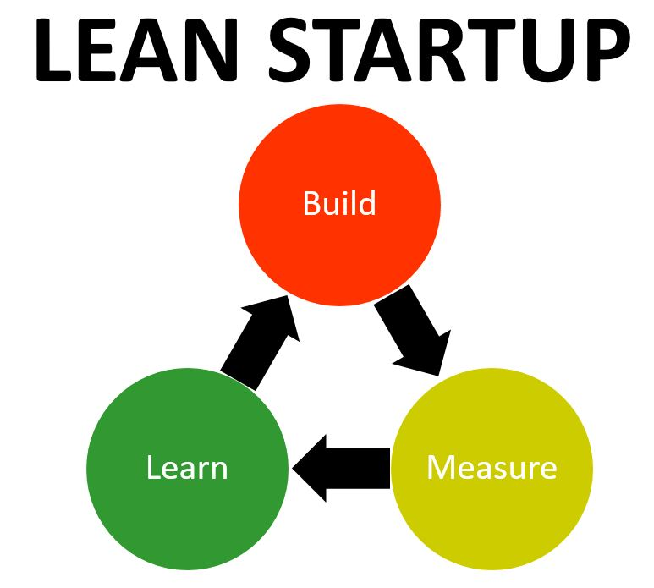
Lean Startup Methodology
Treat Startups as Experiments
  Minimum Viable Product (MVP)
    Build the Simplest Version to Test Assumptions
  Build-Measure-Learn Loop
    Test – Collect Data – Improve
  Pivot
    Change Strategy When Evidence Suggests It’s Necessary
      Goal: Reduce Wasted Time and Resources

Slide 18
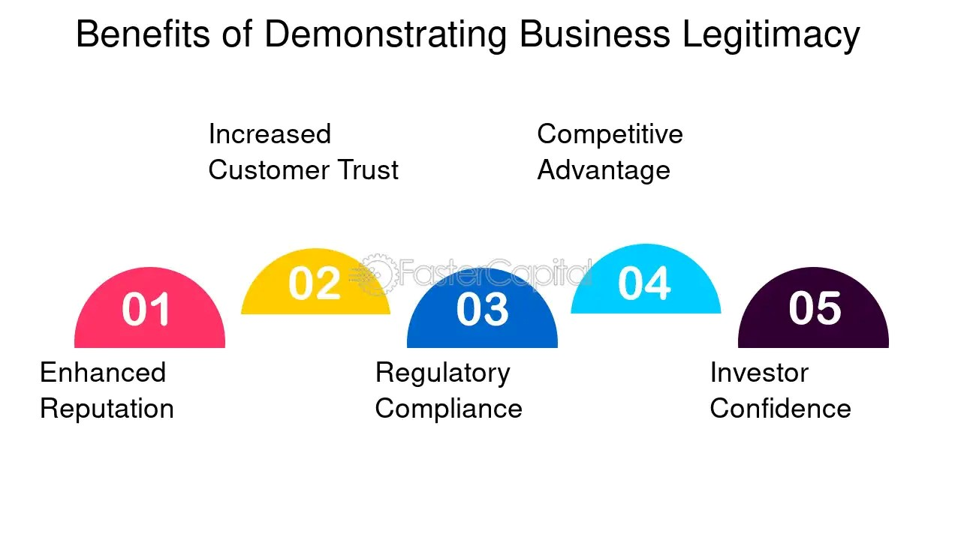
New-Venture Legitimacy
Legitimacy Helps Startups Overcome the “Liability of Newness.”
  It Enables Access To:
    Investors
    Employees
    Partners
    Customers

Slide 19

New-Venture Legitimacy
Strategies Include:
  Conforming to Norms
  Choosing Supportive Environments
  Influencing Stakeholders
  Creating New Market Categories
    Different audiences judge legitimacy differently (government vs. investors vs. customers).

Slide 20

Understanding the Curriculum
Key Insights
This chapter teaches that entrepreneurship is not guessing – it is evaluating.
  Core Principle:
    A strong idea must pass feasibility, market, financial, and legitimacy tests before becoming a viable venture.

Slide 21
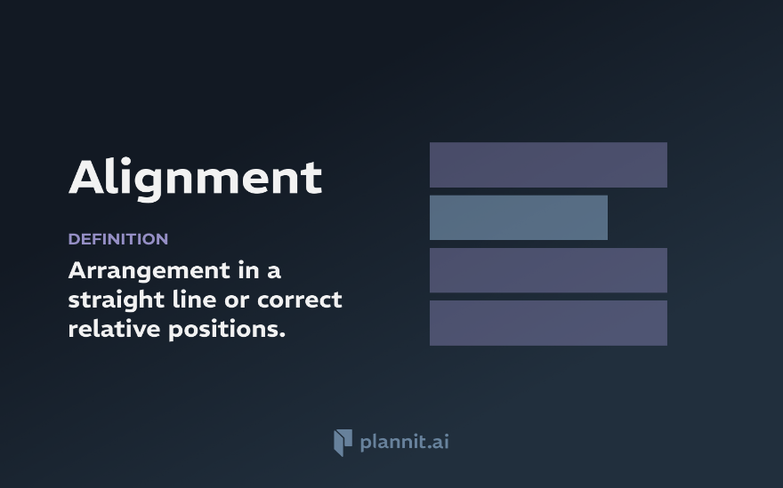
Understanding the Curriculum
Key Insights
Success Depends on Alignment Between:
  Entrepreneur Skills
  Market Demand
  Product Readiness
  Funding Strategy
  Team Strength
    Modern entrepreneurship emphasizes learning quickly rather than planning perfectly.

Slide 22
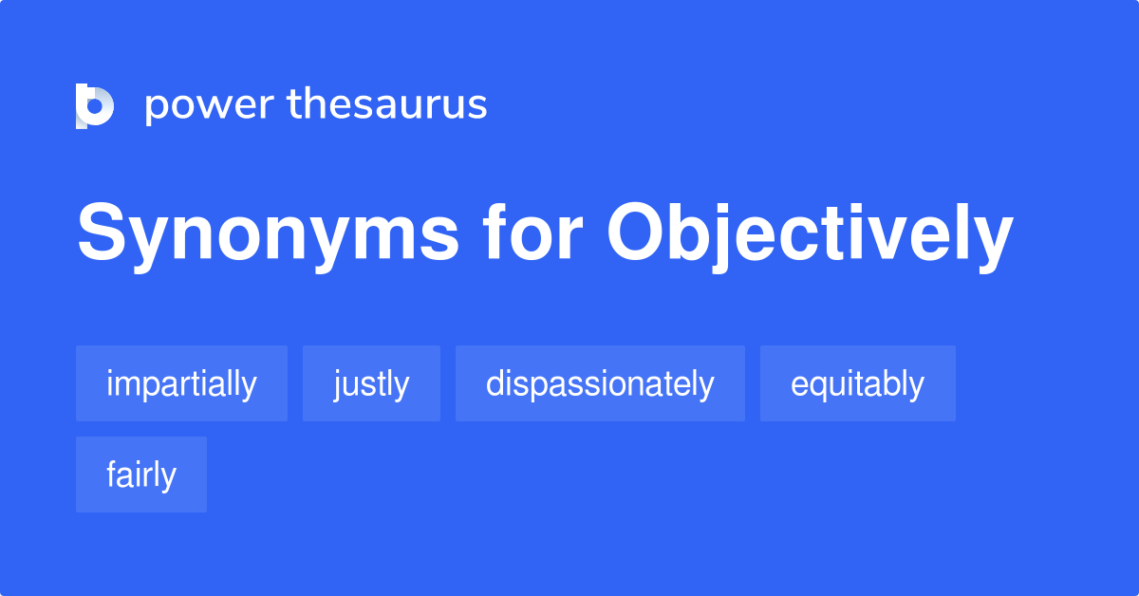
How to Use This in Real Life
Step-By-Step
Step 1: Test Your Idea Objectively
  Ask:
    Who is the Customer?
    What Problem is Solved?
    Why is this Better than Alternatives?
      Avoid Emotional Attachment

Slide 23

How to Use This in Real Life
Step-By-Step
Step 2: Validate Market Demand
  Before Building Anything:
    Interview Potential Users
    Analyze Competitors
    Estimate Pricing Tolerance
      No Demand = No Venture

Slide 24
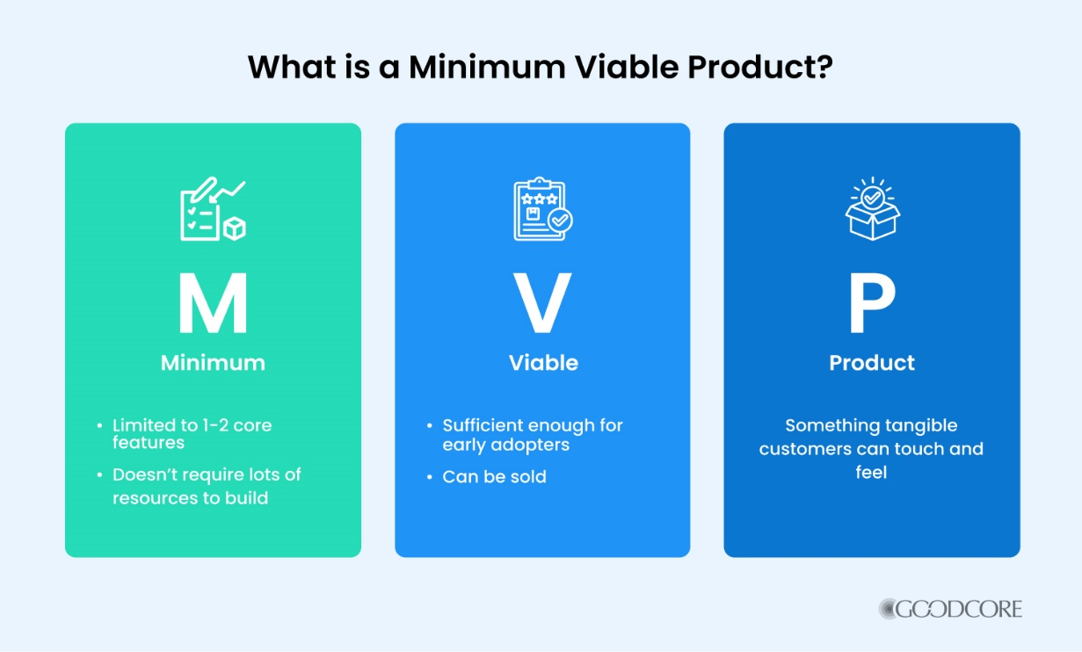
How to Use This in Real Life
Step-By-Step
Step 3: Build and Minimum Viable Product (MVP) Early
  Instead of a Full Product:
    Create a Prototype or Simple Version to Test Assumptions Quickly.

Slide 25

How to Use This in Real Life
Step-By-Step
Step 4: Form a Complementary Team
  Include People Skilled In:
    Operations
    Finance
    Marketing
    Technology
      Investors Prioritize Teams Over Ideas

Slide 26
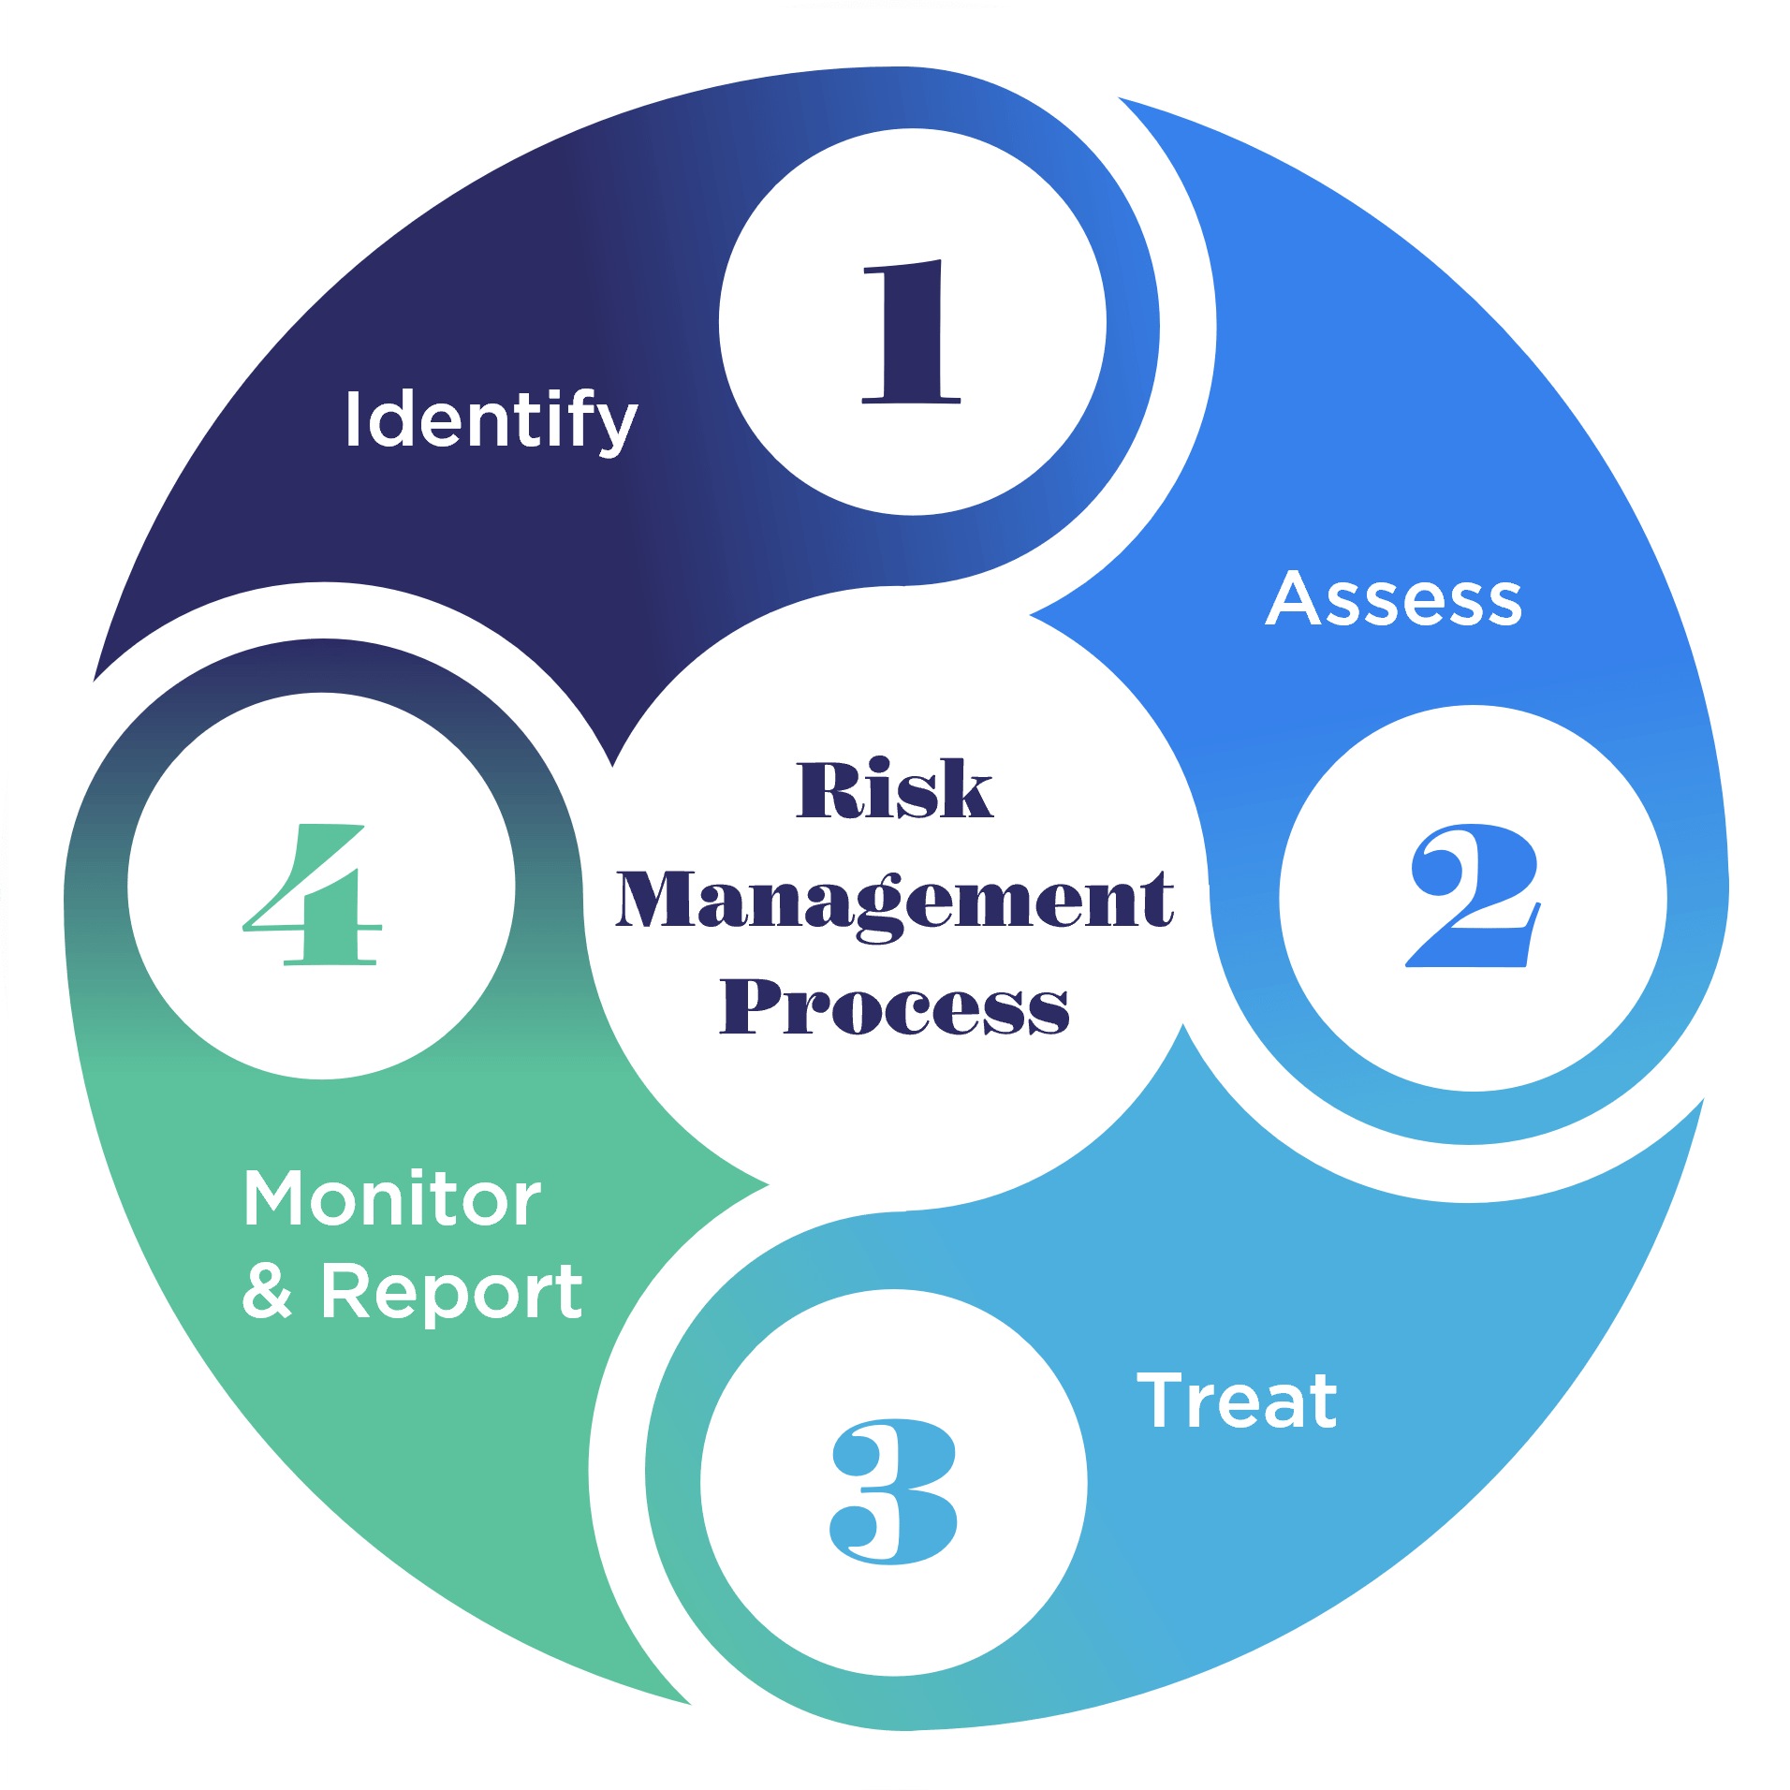
How to Use This in Real Life
Step-By-Step
Step 5: Manage Financial Risk Carefully
  Avoid:
    Excessive Debt
    Unrealistic Projections
    Delayed Revenue Expectations
      Track Early Cash Flow Ratios

Slide 27
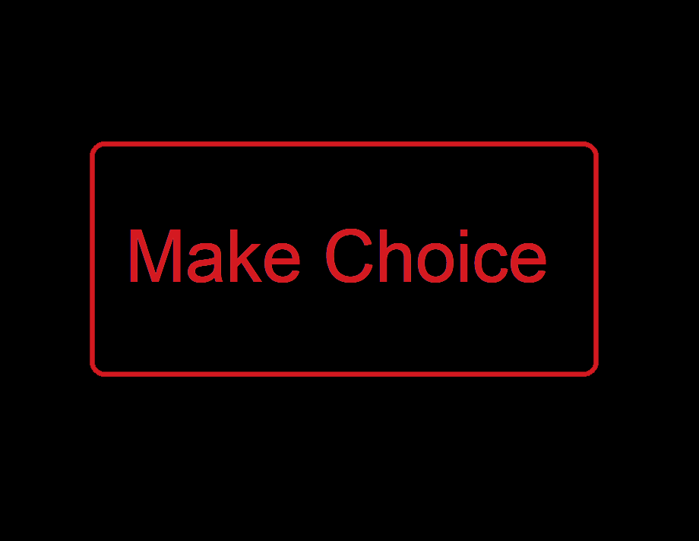
How to Use This in Real Life
Step-By-Step
Step 6: Choose the Right Venture Type
  Ask Yourself:
    Do I Want Independence? – Lifestyle Venture
    Stable Income? – Small Profitable Venture
    Rapid Scaling? – High-Growth Venture
      Your Strategy Depends on this Decision

Slide 28
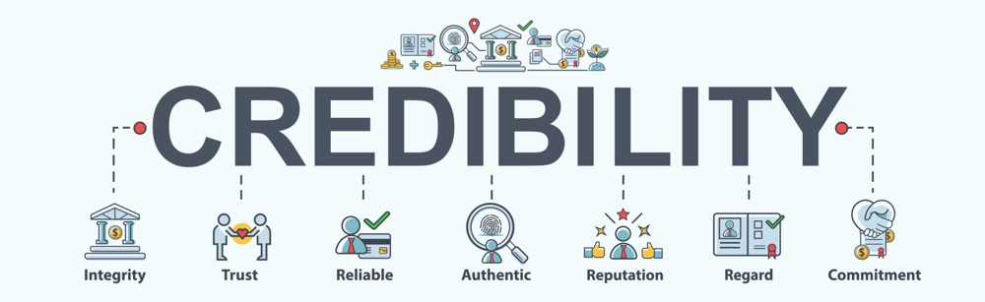
How to Use This in Real Life
Step-By-Step
Step 7: Build Legitimacy Early
  Increase Credibility By:
    Partnerships – Pilot Customers – Advisors – Certifications – Prototypes.
      Trust Accelerates Funding and Adoption

Slide 29

Final Takeaway
Entrepreneurial success comes from structured evaluation + rapid learning + strong teams + market validation.
  The Strongest Ventures:
    Solve Real Problems
    Differentiate Clearly
    Validate Assumptions Early
    Manage Finances Conservatively
    Adapt Based on Feedback

Slide 30

Pathways to Entrepreneurial Ventures
Chapter Seven
This chapter explains 3 ways to become an entrepreneur:
  Creating a New Venture
  Acquiring an Existing Business
  Franchising

Slide 31

Creating a New Venture
Entrepreneurs Can:
  Build Something Entirely New (“New-New”)
  Improve or Adapt an Existing Idea (“New-Old”)

Slide 32

Creating a New Venture
Ideas Often Come From:
  Personal Experiences
  Frustrations with Existing Products
  Hobbies or Prior Jobs

Slide 33

Creating a New Venture
A Newness Framework Helps Classify Venture By:
  Technological Innovation
    Incremental vs. Radical
  Market Disruption
    Existing vs. New Markets

Slide 34

Creating a New Venture
Emerging Opportunity Areas Include:
  Health Care – Automation – Cybersecurity – Niche Markets
  Social and Environmental Responsibility

Slide 35
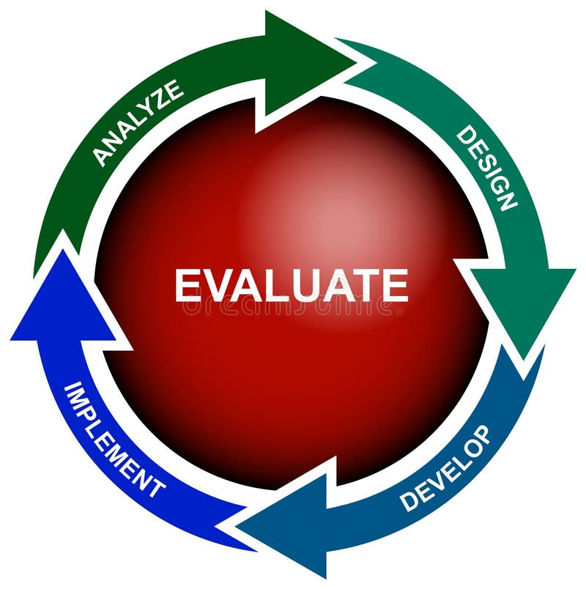
Creating a New Venture
Entrepreneurs Must Also Evaluate:
  Startup Costs
  Revenue Projections
  Risk vs. Rewards
  Contingency Plans

Slide 36
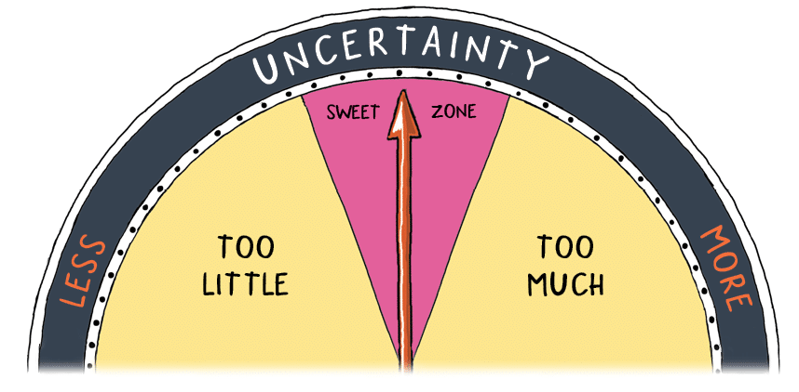
Acquiring an Existing Business
Buying a Business Reduces Uncertainty Because It Already Has:
  Customers
  Systems
  Employees
  Suppliers
  Financial Records

Slide 37

Acquiring an Existing Business
Buyers Must Investigate Key Evaluation Areas:
  Reason for Sale
  Physical Assets
  Inventory Condition
  Employee Retention
  Competition
  Financial Statements
  Goodwill/Reputation

Slide 38
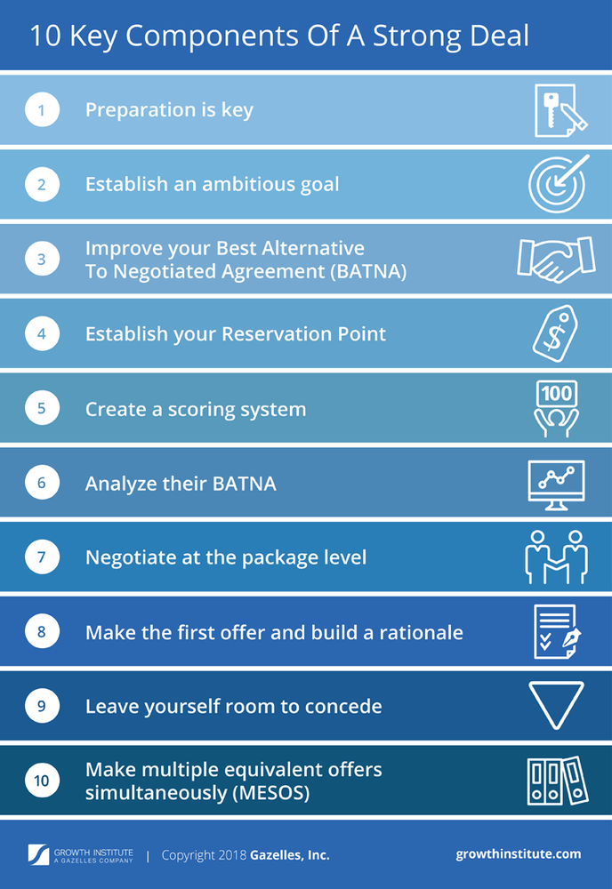
Acquiring an Existing Business
Negotiation Depends On:
  Information
  Time Pressure
  Alternatives
  Bargaining Power

Slide 39

Franchising
Franchising Combines Independence with Corporate Support.
  A Franchisee:
    Pays Startup Fees
    Follows Brand Standards
    Shares Revenue with Franchisor
  In Return Receives:
    Training
    Brand Recognition
    Systems
    Supplier Access
    Marketing Support

Slide 40
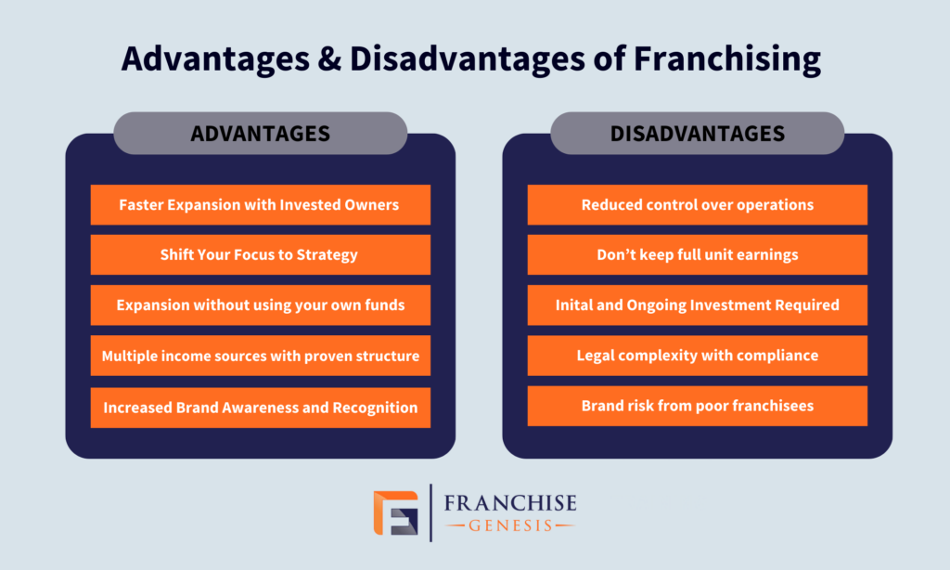
Franchising
There Are Both Advantages and Disadvantages
  Advantages
    Proven Business Model
    Lower Failure Risk
    Easier Financing
    Brand Appeal
  Disadvantages
    High Fees
    Limited Control
    Dependence on Franchisor

Slide 41
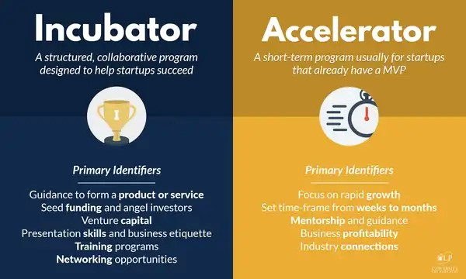
Incubators, Accelerators, and Ecosystems
Incubators
  Provide Mentoring, Workspace, and Resources
Accelerators
  Provide Funding + Mentorship in Exchange for Equity
Entrepreneurial Ecosystems
  Regional Networks of Investors, Universities, Government Agencies, Startups, and Service Providers
    Strong Ecosystems Increase Venture Success Rate

Slide 42
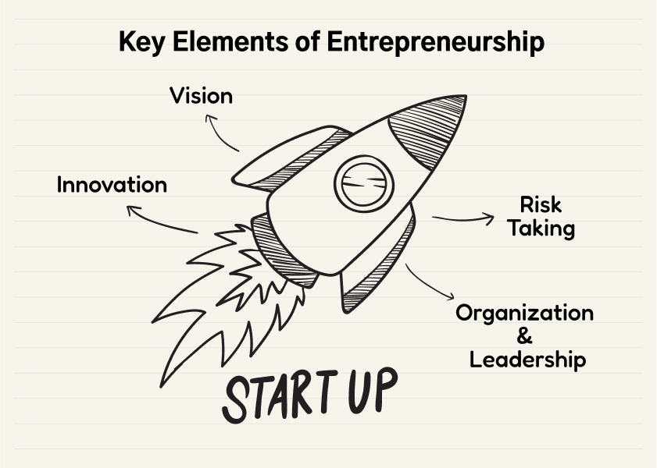
Understanding the Concepts
This chapter teaches that entrepreneurship is not just starting from scratch.
  Instead, there are structured entry pathways depending on risk tolerance and resources.

Slide 43
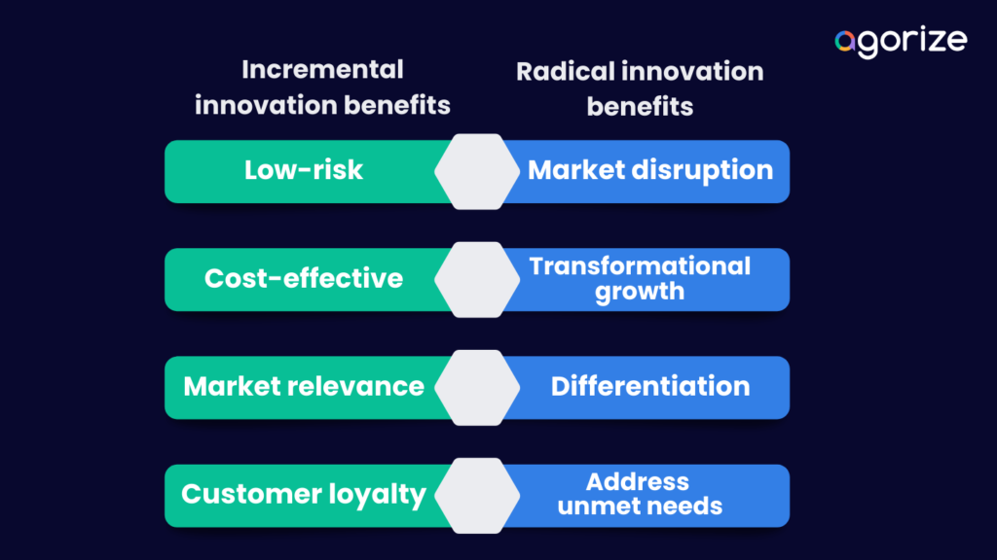
Understanding the Concepts
Innovation Exists on a Spectrum
  Not Every Business Must Be Revolutionary.
    Radical Innovation -> Inventing a New Technology
    Incremental Innovation -> Improving an Existing Service Locally
      Both Can Succeed

Slide 44
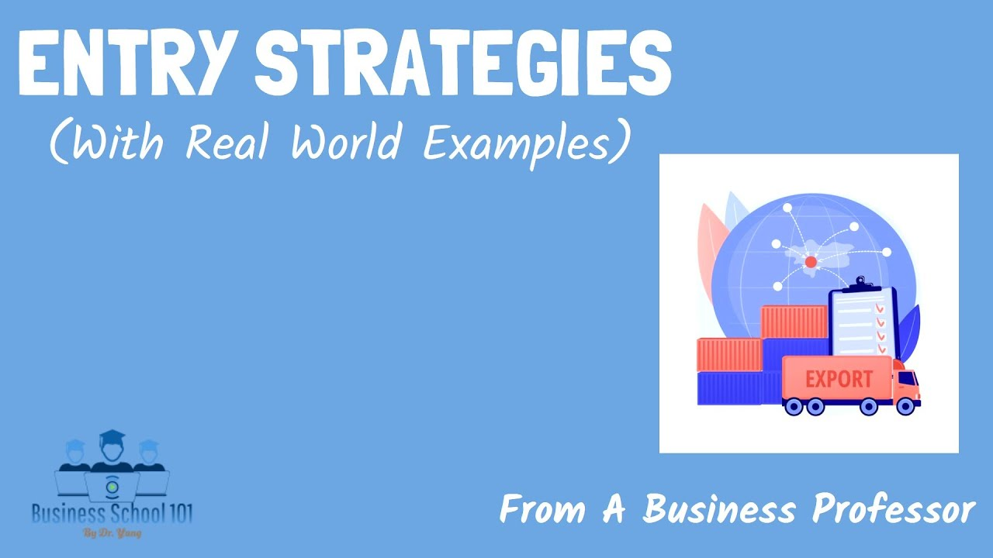
Understanding the Concepts
Risk Changes by Entry Method (Highest to Lowest)
  New Venture Creation
  Buying an Existing Business
  Franchising
    Entrepreneurs Choose Based On: Capital, Experience, Independence Preference, and Tolerance for Uncertainty

Slide 45
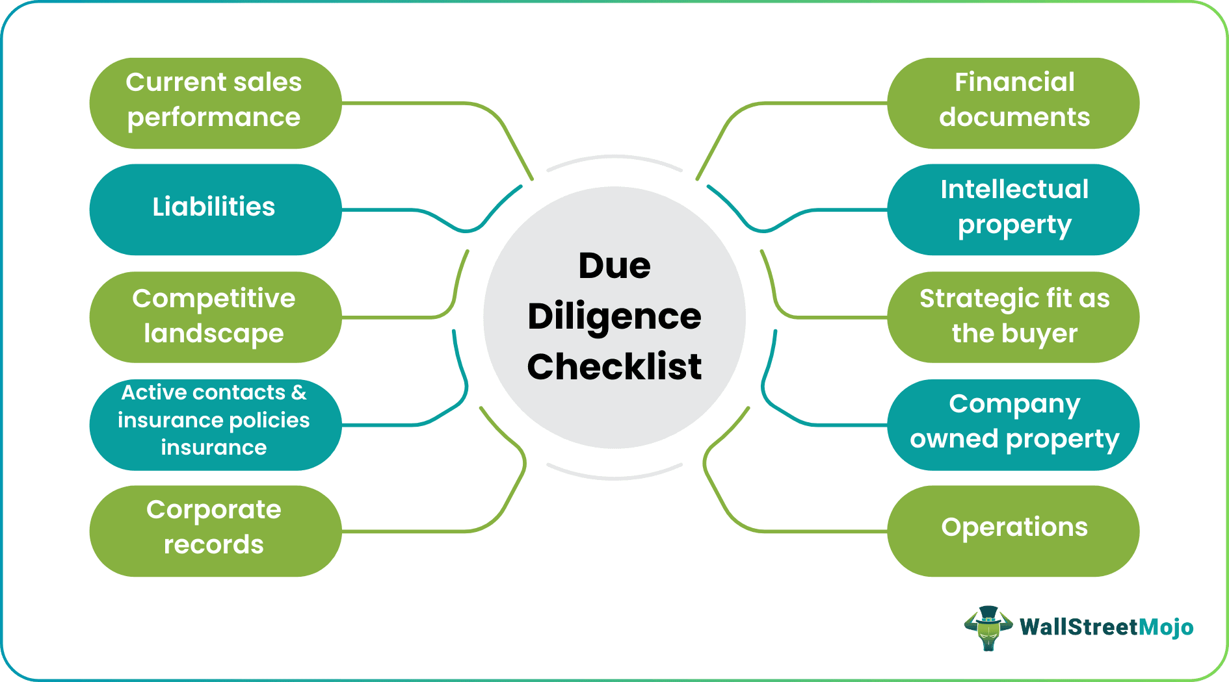
Understanding the Concepts
Due Diligence Determines Success
  Buying or Franchising Without Research is Risky.
  Smart Entrepreneurs Always Evaluate:
    Finances
    Contracts
    Competition
    Assets
    Employees
    Location

Slide 46
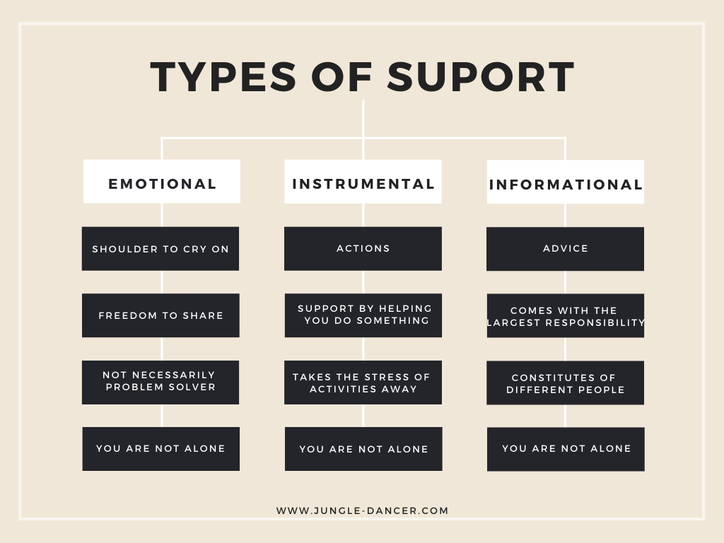
Understanding the Concepts
Support Systems Matter – Success Rarely Happens Alone.
  Accelerators, Incubators, and Ecosystems:
    Reduce Startup Risk
    Increase Funding Access
    Provide Mentorship
    Expand Networks

Slide 47

Application
How to Use This in Real Life
If You Want Maximum Independence
  Create a New Venture – Solve a Local Problem
    Identify an Unmet Need
    Validate Demand
    Estimate Startup Costs
    Test Prototype
    Launch Small – Scale Gradually
      Best for Creative Thinkers, Innovators, Risk-Tolerant Founders

Slide 48

Application
How to Use This in Real Life
If You Want Faster Entry with Lower Uncertainty
  Buy an Existing Business
    Review Financial Statements
    Inspect Assets
    Analyze Customer Base
    Evaluate Competition
    Negotiate Purchase Terms
      Best for experienced operators with capital.

Slide 49

Application
How to Use This in Real Life
If You Want Structure and Brand Support
  Choose Franchising
    Analyze Franchise Disclosure Document (FDD)
    Compare Fees vs. ROI
    Interview Current Franchises
    Consult Attorney and Accountant
    Secure Financing
      Best for First-Time Entrepreneurs Wanting Guidance

Slide 50

Application
How to Use This in Real Life
If You Want Mentorship and Funding Early
  Join an Accelerator or Incubator to Enjoy Their Benefits:
    Coaching
    Investor Access
    Networking
    Structure Growth Plan
      Best For Startup Founders Seeking Rapid Scaling

Slide 51


Practical Decision Framework
Simple Strategy Tool
Potential Entrepreneurs Need to Ask Themselves:
  Do I Want Originality or Stability?
    Originality = New Venture
    Stability = Acquisition
  Do I Want Independence or Support?
    Independence = Startup/Acquisition
    Support = Franchise/Accelerator
  Do I have Capital or Just an Idea?
    Capital = Acquisition/Franchise
    Idea = Incubator/Startup

Slide 52


