Slide 1

Business Survey
Session Three Class Presentation
Business Foundations
  A Changing World 11th Edition
    O.C. Ferrell, Geoffrey Hirt, and Linda Ferrell; McGraw Hill Education; New York, NY 2018
      ISBN: 978-1-259-68523-1

Slide 2

Part Three: Managing for Quality and Competitiveness
Chapter Six: The Nature of Management

Slide 3

Introduction
For any organization to achieve its objectives, it must have resources to support operations, employees to make and sell the products, and financial resources to purchase additional goods and services, pay EEs, and operate the business.
  To accomplish this, it must also have one or more managers to plan, organize, staff, direct, and control the work that goes on.

Slide 4

The Importance of Management
Management is the process designed to achieve an organization’s objectives by using its resources effectively and efficiently in a changing environment.
  Managers make decisions about use of an organization’s resources and are concerned with (1) planning, (2) organizing, (3) directing, and (4) controlling organizational activities to reach its objectives.

Slide 5

The Importance of Management
Universal
Management is universal. It takes place not only in business, but also in government, the military, labor unions, hospitals, schools, and religious groups – any organization requiring the coordination of resources.
  Every organization must acquire resources – people, services, raw materials and equipment, financial, and information – to pursue its objectives and coordinate their use to turn out goods and services.

Slide 6


The Importance of Management
Staffing
Employees are one of the most important resources in helping a business attain its objectives.
  Hiring people to carry out the work of an organization is known as staffing.
    Beyond recruiting people for positions within the firm, managers must determine what skills are needed for the job, how to motivate and train EEs, how much to pay, what benefits to provide, and how to prepare EEs for higher-level jobs in the firm at a later date.

Slide 7

The Importance of Management
Downsizing
Sometimes, managers must make the difficult decision to reduce the workforce.
  This is known as downsizing, the elimination of significant numbers of employees from an organization.
    After downsizing, an effective manager will promote optimism, positive thinking, and minimize criticism and fault-finding.

Slide 8

The Importance of Management
Suppliers
Acquiring suppliers is another important part of managing resources and ensuring that products are made available to customers.
  A good supplier maximizes efficiencies and provides creative solutions to help the company reduce expenses and reach its objectives.

Slide 9

The Importance of Management
Financial Resources
The manager needs adequate financial resources to pay for essential activities.
  Primary funding comes from owners and shareholders, as well as banks and other financial institutions.
    All these resources and activities must be coordinated and controlled if the company is to earn a profit.

Slide 10
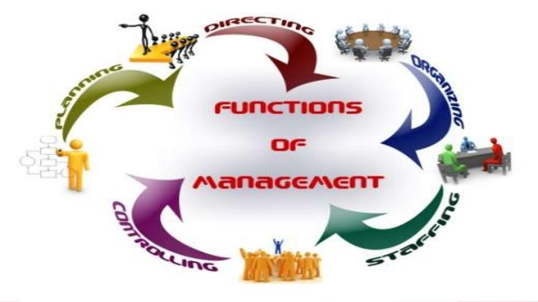
Management Functions
To harmonize the use of resources so that the business can develop, produce, and sell products, managers engage in a series of activities:
  Planning
  Organizing
  Directing
  Controlling

Slide 11
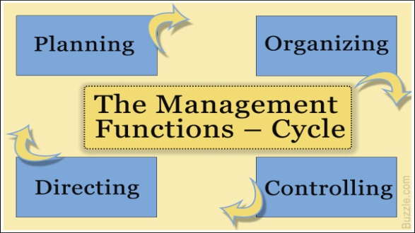
Management Functions
The Functions of Management:
  Planning
    Activities to achieve the organization’s objectives.
  Organizing
    Resources and activities to achieve the organization’s objectives.
  Directing
    Employees’ activities toward achievement of objectives.
  Controlling
    The organization’s activities to keep it on course.

Slide 12

Planning
Planning is the process of determining the organization’s objectives and deciding how to accomplish them. It is the first function of management.
  Planning is a crucial activity because it designs the map that lays the groundwork for other functions.
    It involves forecasting events and determining the best course of action from a set of options or choices.
    The plan itself specifies what should be done, by whom, where, when, and how.

Slide 13

Planning
Mission
A mission, or mission statement, is a declaration of any organization’s fundamental purpose and basic philosophy.
  It seeks to answer the question: “What business are we in?”
    Good mission statements are clear and concise statements that explain the organization’s reason for existence.

Slide 14

Planning
Mission Statement
A well-developed Mission Statement, no matter what the industry or size of the business, will answer five questions:
  Who are we?
  Who are our customers?
  What is our operating philosophy (basic beliefs, values, ethics…)?
  What are our core competencies and competitive advantages?
  What are our responsibilities with respect to being a good steward of environmental, financial, and human resources?

Slide 15


Planning
Goals
A goal is the result that a firm wishes to achieve. A company almost always has multiple goals, which illustrates the complex nature of the business.
  A goal has three key components:
    An attribute sought, such as profits, customer satisfaction, or product quality; A target to be achieved, such as the volume of sales or the extent of management training to be achieved; and a timeframe in which the goal is to be achieved.

Slide 16

Planning
Objectives
Objectives, the ends or results desired by an organization, derive from the organization’s mission.
  A business’s objectives may be elaborate or simple.
    Common objectives relate to profit, competitive advantage, efficiency, and growth.

Slide 17
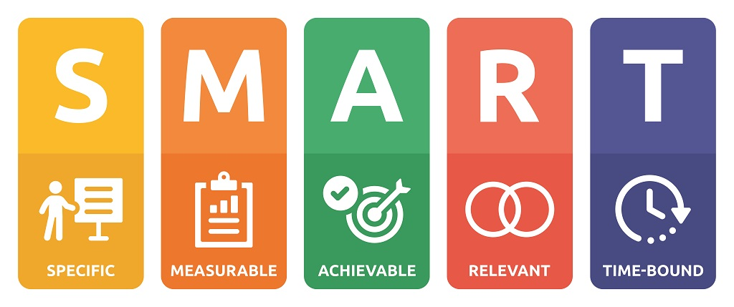
Planning
Goals vs. Objectives
The principal difference between goals and objectives is that objectives are stated in such a way that they are measureable.
  Organizations with profit as an objective want to have money and assets left over after paying off business expenses.
  Objectives regarding competitive advantages are generally stated in terms of percentage of sales increase and market share.
  Efficiency objectives involve making the best use of resources.
  Growth objectives relate to an organization’s ability to adapt and to get new products to the marketplace in a timely fashion.
    One of the most important objectives for business is sales.

Slide 18
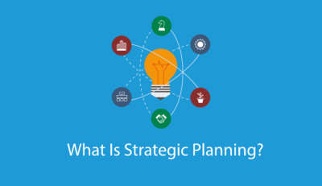
Planning
Strategic Plans
A strategic plan establishes the long-range objectives and overall strategy or course of action by which an organization may fulfill its mission.
    Strategic Plans consider the capabilities and resources, changing business environment, and organizational objectives. These plans should be market-driven, matching customers’ desire for value with operational capabilities, processes, and human resources.

Slide 19
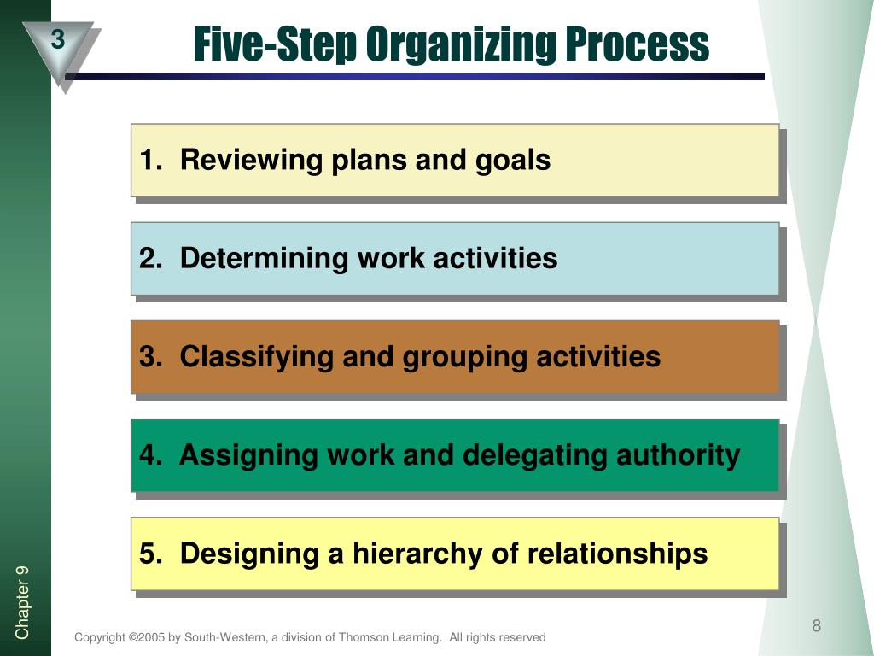

Organizing
Organizing is the structuring of resources and activities to accomplish objectives in an efficient and effective manner.
  Managers organize by reviewing plans and determining what activities are necessary to implement them; then, they divide the work into small units and assign it to specific individuals, groups, or departments.
    Organizing occurs continuously because change is inevitable.

Slide 20
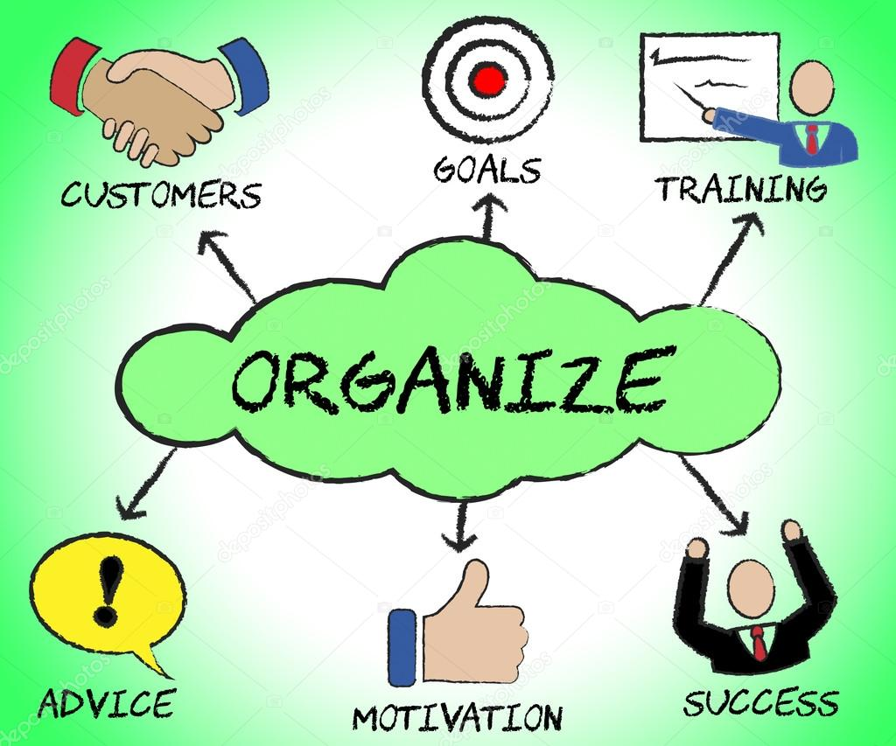
Organizing
Organizing is important for several reasons:
  Organization helps create synergy, whereby the effect of a whole system equals more than the sum of its parts.
  It establishes lines of authority, improves communication, helps avoid duplication of resources, and can improve competitiveness by speeding up decision making.

Slide 21


Directing
During planning and organizing, staffing occurs and management must direct the employees.
  Directing is motivating and leading employees to achieve organizational objectives.
    Directing involves telling EEs what to do and when to do it through the implementation of deadlines and then encouraging them to do their work. It involves determining and administering appropriate rewards and recognition.

Slide 22


Directing
Motivating Employees
Most workers want more than money or reward as an incentive to do their job: they need to know that their employer values their ideas and input.
  Managers should give employees some decision making authority as soon as possible. Smart managers ask workers to contribute ideas for reducing costs, making equipment more efficient, improving customer service, or even developing new products.
    This participation also serves to increase employee morale.

Slide 23


Directing
Motivating Employees
Recognition and appreciation are often the best motivators.
  Employees who understand more about their effect on the financial success of the company may be induced to work harder for that success.
    Managers who understand the needs and desires of workers can encourage their employees to work harder and more productively.

Slide 24

Controlling
Planning, organizing, staffing, and directing are all important to the success of an organization, whether its objective is earning a profit or something else.
  Controlling is the process of evaluating and correcting activities to keep the organization on course.

Slide 25

Controlling
Controlling involves (5) activities:
  Measuring performance
  Comparing present performance with standards or objectives
  Identifying deviations from the standards
  Investigating the causes of deviations
  Taking corrective action when necessary

Slide 26


Controlling
Planning establishes goals and standards and controlling monitors performance and compares it with those standards, so managers can determine whether performance is on target.
  When performance is substandard, management must determine why and take appropriate actions, to get the firm back on course.
    The control function helps managers assess the success of their plans. When outcomes of plans do not meet expectations, the control process facilitates revision of the plans.

Slide 27
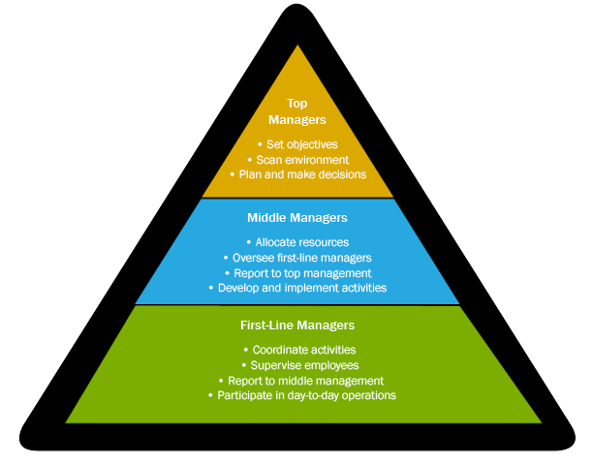
Types of Management
All managers, regardless of type of organization, perform the four functions previously discussed.
  But, in a large company with more than one manager, responsibilities must be divided and delegated.
    The division of responsibility is achieved by establishing levels of management and areas of specialization: finance, marketing, etc.

Slide 28

Levels of Management
Many organizations have multiple levels of management – top management, middle management, and first-line, or supervisory management.
  These levels form a pyramid and as the shape implies there are generally more middle managers than top managers and still more first-line managers.
    Many small organizations may have only one manager, typically the owner, who assumes the responsibilities of all three levels.

Slide 29
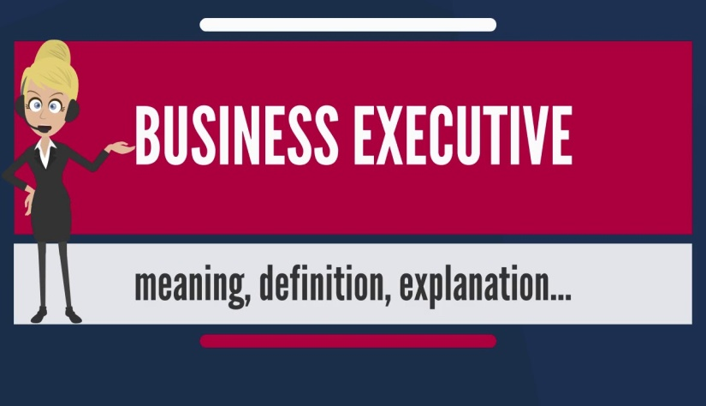
Top Management
Top-level managers spend most of their time planning.
  These managers make the organization’s strategic decisions, decisions that focus on overall scheme or key idea for using resources to take advantage of opportunities. For example, they decide whether to add products, acquire companies, sell unprofitable business segments, and move into other markets.
    They also represent their company to the public and to government regulators.

Slide 30

Middle Management
Rather than making strategic decisions about the whole organization, Middle Mangers are responsible for tactical and operational planning that will implement the general guidelines established by top management.
  Their responsibility is more narrowly focused than that of top managers. They are involved in the specific operations of the firm and spend more time organizing than other mangers.

Slide 31

First-Line Management
Most people get their management experience as First-Line Mangers, those who supervise workers and the daily operations of the organization.
  They are responsible for implementing the plans established by middle management and directing workers’ daily performance on the job.
    They spend much of their time directing and controlling.

Slide 32
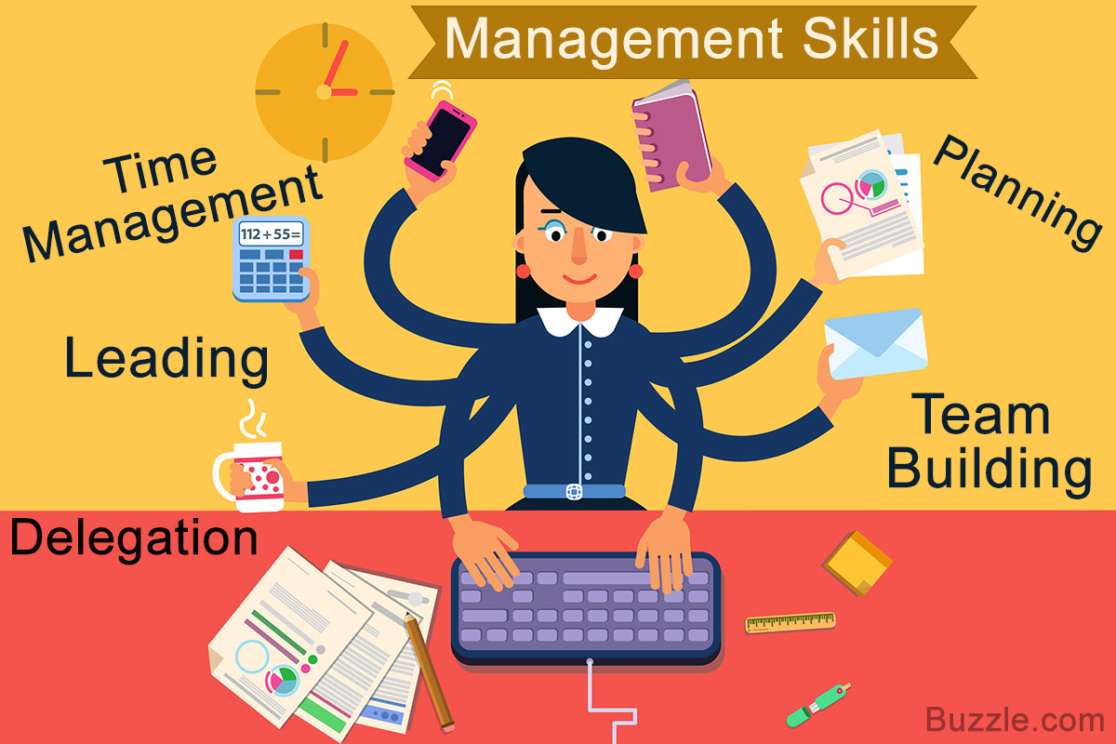
Skills Needed by Managers
Managers are typically evaluated using the metrics of how effective and efficient they are.
  Managing effectively and efficiently requires certain skills:
    Technical Expertise
    Conceptual Skills
    Analytical Skills
    Human Relations Skills
    Leadership

Slide 33

1. Technical Expertise
Managers need Technical Expertise, specialized knowledge and training required to perform jobs related to their area of management.
  Technical skills are most needed by first-line managers and are least critical to top-level managers.

Slide 34
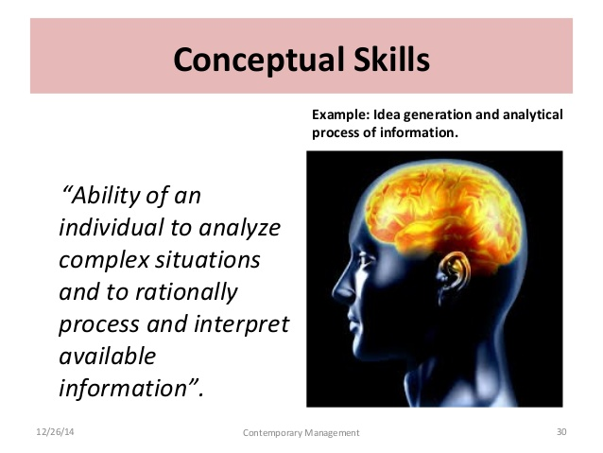
2. Conceptual Skills
Conceptual skills, the ability to think in abstract terms, and to see how parts fit together to form the whole, are needed by all managers, but particularly top-level managers.
  Top management must be able to evaluate continually where the company will be in the future.
    Conceptual skills also involve the ability to think creatively.

Slide 35

3. Analytical Skills
Analytical skills refer to the ability to identify relevant issues and recognize their importance, understand the relationships between them, and perceive the underlying causes of a situation.
  When managers have identified critical factors and causes, they can take appropriate action.
    To be analytical, it is necessary to think about a broad range of issues and to weigh different options before taking action.

Slide 36
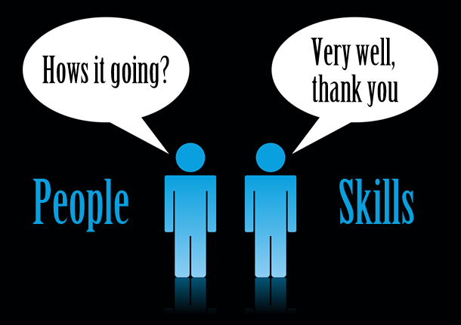
4. Human Relations Skills
People skills, or Human Relations skills, are the ability to deal with people, both inside and outside the organization.
  Those who can relate to others, communicate well with others, understand the needs of others, and show a true appreciation for others are generally more successful than managers who lack such skills.

Slide 37
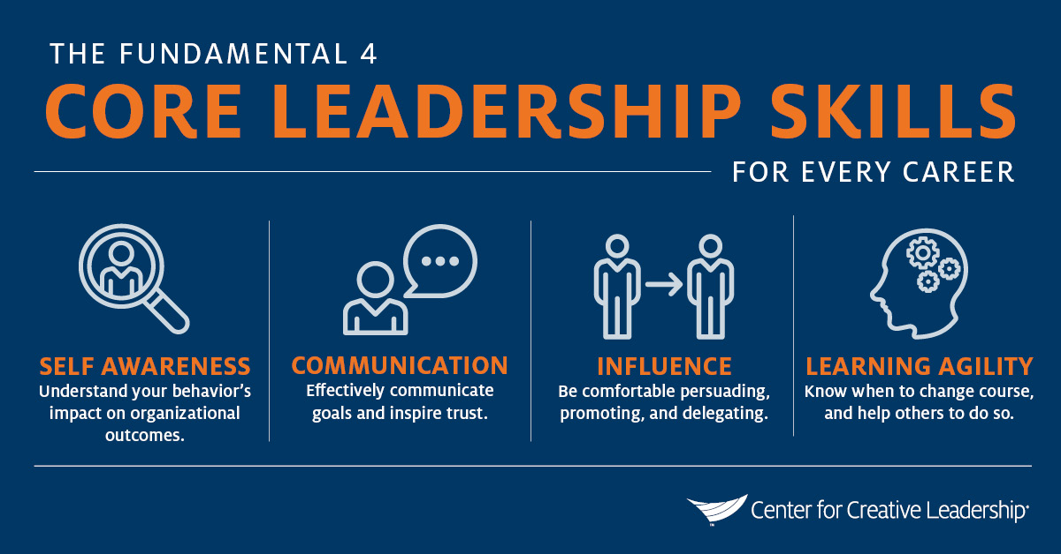
5. Leadership
Leadership is the ability to influence employees to work toward organizational goals.
  Strong leaders manage and pay attention to the culture of their organizations and the needs of their customers.
    Managers are classified into three types based on leadership style:
      Autocratic Leaders
      Democratic Leaders
      Free-Rein Leaders

Slide 38
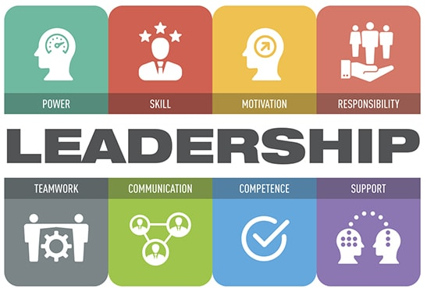
Leadership Styles
The effectiveness of these leadership styles depends on several factors:
  The type of employees.
  The manager’s abilities.
  The situation itself.

Slide 39

Contingency Leadership
Many managers are unable to use more than one style of leadership. Some are even incapable of allowing their subordinates to participate in decision making.
  Thus, what leadership style is “best” depends on specific circumstances, and effective managers will strive to adapt their leadership style as circumstances warrant.

Slide 40

Authentic Leadership
Authentic leadership is a bit different from the other three leadership styles because it is not exclusive.
  Authentic leaders are passionate about the goals and mission of the company, display corporate values in the workplace, and form long-term relationships with stakeholders.
    While leaders might incorporate different leadership styles depending on the business and the situation, all leaders must be able to align employees behind a common vision to be effective.
    Strong leaders also realize the value that employees can provide by participating in the firm’s organizational culture.

Slide 41

Successful Leadership
Requirements for Successful Leadership:
  Communicate objectives and expectations.
  Gain the respect and trust of the stakeholders.
  Develop shared values.
  Acquire and share knowledge.
  Empower employees to make decisions.
  Be a role model for appropriate behavior.
  Provide rewards and take action to achieve goals.

Slide 42

Employee Empowerment
Businesses are realizing the benefits of participative corporate cultures characterized by EE empowerment.
  EE Empowerment occurs when EEs are provided with ability to take on responsibilities and make decisions about their jobs.
    EE empowerment does not mean that managers are not needed. In fact, managers are important for guiding EEs, setting goals, making major decisions, and other responsibilities.

Slide 43

Participative Decision Making
Leaders who wish to empower EEs adopt systems that support an EE’s ability to provide input and feedback on company decisions.
  Participative Decision Making, a type of decision making that involves both manager and employee input, supports employee empowerment within the organization.
    Empowered employees feel like they have an active role in the organization’s success.

Slide 44
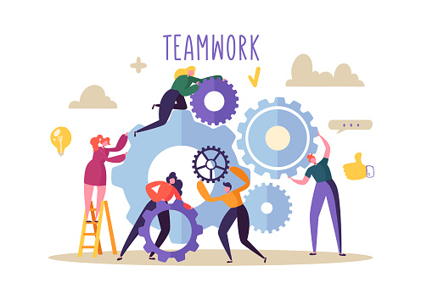
Teamwork
Teamwork has often been an effective way for encouraging employee empowerment.
  Although decision making in teams is collective, the most effective teams are those in which all EEs are encouraged to contribute their ideas and recommendations.
    Because each EE can bring in their own unique insights, teams often result in innovative ideas or decisions that would not have been reached by only one or two people.

Slide 45
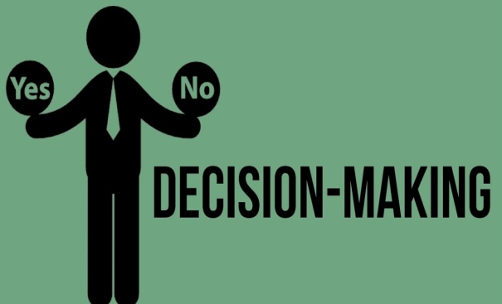
Decision Making
Decision Making is important in all management functions and at all levels, whether the decisions are on a strategic, tactical, or operational level.
  A systematic approach using the following six steps usually leads to more effective decision making:
    Recognize and define the decision situation.
    Develop options to resolve the situation (brainstorm).
    Analyze the options (assess appropriateness).
    Select the best option. Reject the others.
    Implement the decision. Put into action.
    Monitor the consequences of the decision.

Slide 46


Management in Practice
Management functions can be simplified into two basic activities:
  Figuring out what to do despite uncertainty, great diversity, and an enormous amount of potentially relevant information.
  Getting things done through a large and diverse set of people despite having little direct control over most of them.

Slide 47
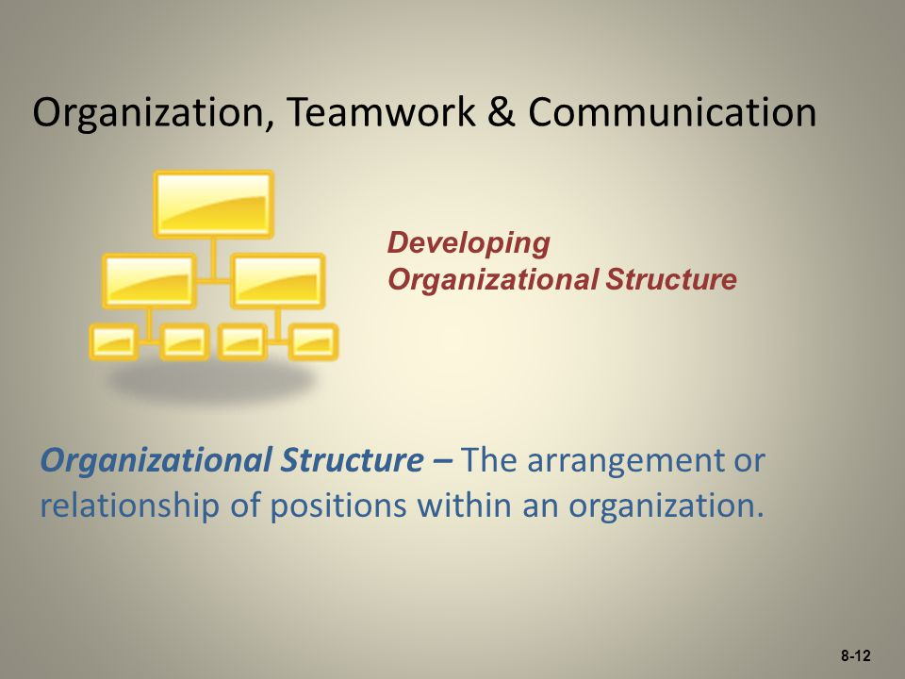
Part Three: Managing for Quality and Competitiveness
Chapter Seven: Organization, Teamwork, and Communication

Slide 48

Organizational Structure
An organization’s structure determines how well it makes decisions and responds to problems, and it influences employee’s attitudes toward their work.
  A suitable structure can minimize a business’s costs and maximized its efficiency.

Slide 49
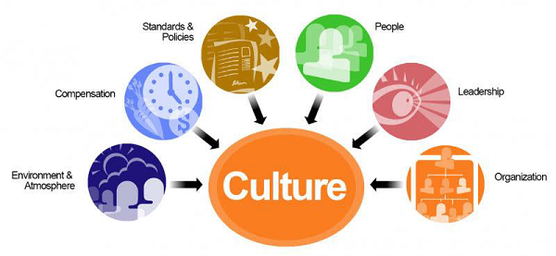
Organizational Culture
One of the most important aspects of organizing a business is determining its organizational culture, a firm’s shared values, beliefs, traditions, philosophies, rules, and role models for behavior.
  An organizational culture exists in every organization, regardless of size, type, product, or profit objective.
    Sometimes behaviors, programs, and policies enhance and support the organizational culture.

Slide 50

Organizational Culture
A firm’s culture may be expressed formally through its mission statement, codes of ethics, memos, manuals, and ceremonies, but it is more commonly expressed informally.
  Examples of informal expressions of culture include dress codes (or the lack thereof), work habits, extracurricular activities and stories.
    Employees often learn the accepted standards through discussion with co-workers.

Slide 51


Organizational Culture
Organizational culture helps ensure that all members of a company share values and suggests rules for how to behave and deal with problems within the organization.
  Corporate culture and engagement is very important for organizational performance and employee satisfaction.
    Establishing a positive organizational culture sets the tone for all decisions, including building an efficient organizational structure.

Slide 52
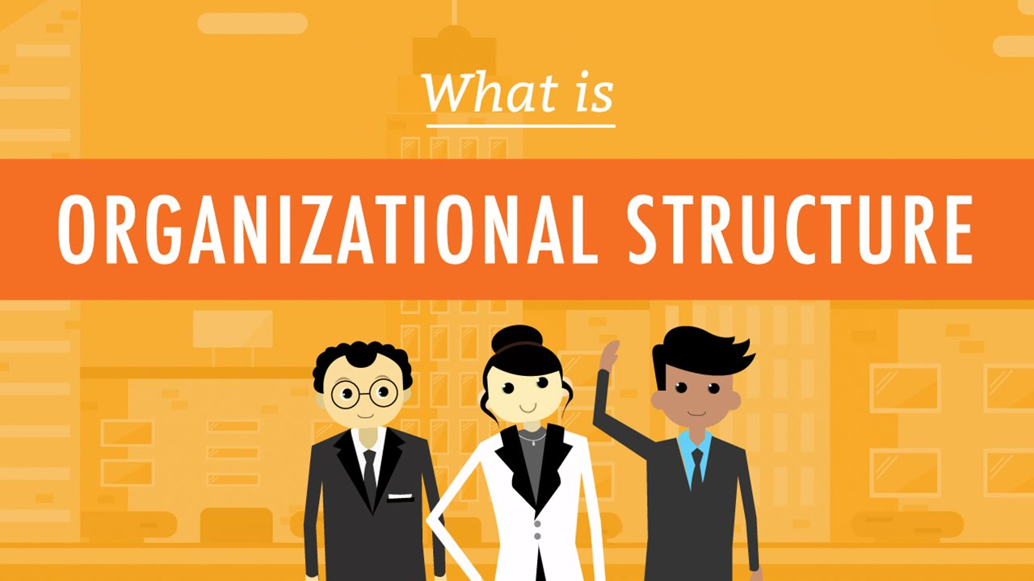
Developing Organizational Structure
Structure is the arrangement or relationship of positions within an organization.
  Rarely is an organization, or any group of individuals, able to achieve common objectives without some form of structure, whether it is explicitly defined or only implied.

Slide 53

Developing Organizational Structure
Getting people to work together efficiently and coordinating the skills of diverse individuals requires careful planning.
  Developing appropriate organizational structures is, therefore, a major challenge for managers in all organizations.
    A organization’s structure develops when managers assign work tasks and activities to specific individual’s or work groups and coordinate the diverse activities to reach a firm’s objectives.

Slide 54
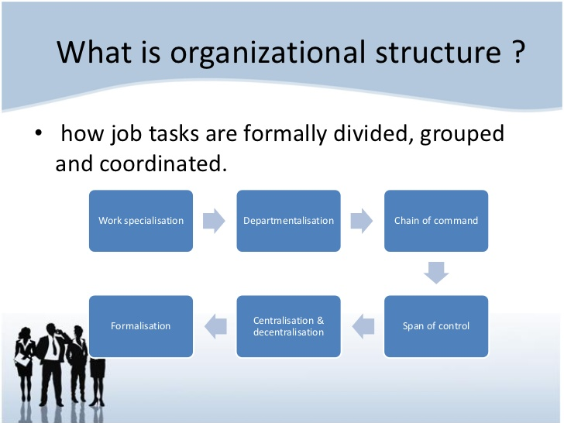
Developing Organizational Structure
Mangers need to organize the structure of human, physical, and financial resources to achieve objectives in an effective and efficient manner.
  Structuring an organization requires that management assign work tasks to specific individuals and departments and assign responsibility for the achievement of organizational objectives.

Slide 55

Assigning Tasks
For a business to earn profits from the sale of its products, its managers must first determine what activities are required to achieve its objectives.
  All these activities must be coordinated, assigned to work groups, and controlled.
    Two important aspects of assigning these work activities are: (1) specialization and (2) departmentalization.

Slide 56
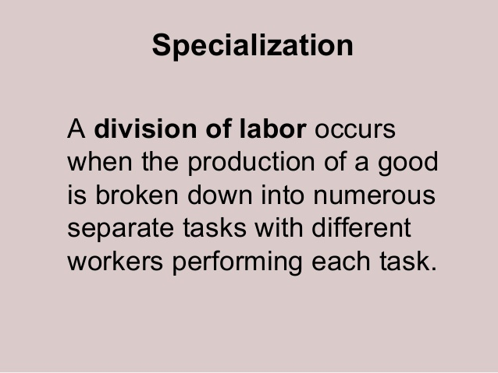

Specialization
After identifying all activities that must be accomplished, managers then break these activities down into specific tasks that can be handled by individual employees.
  Specialization is the division of labor into small, specific tasks and the assignment of employees to do a single task.
    The rationale for specialization is efficiency. People can perform more efficiently if they master just one task rather than all tasks.

Slide 57
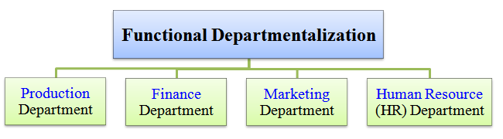
Departmentalization
After assigning specialized tasks to individuals, managers next organize workers doing similar jobs into groups to make them easier to manage.
  Departmentalization is the grouping of jobs into working units usually called departments, units, groups, or divisions.
    Departments are commonly organized by function, product, geographic region, or customer.

Slide 58
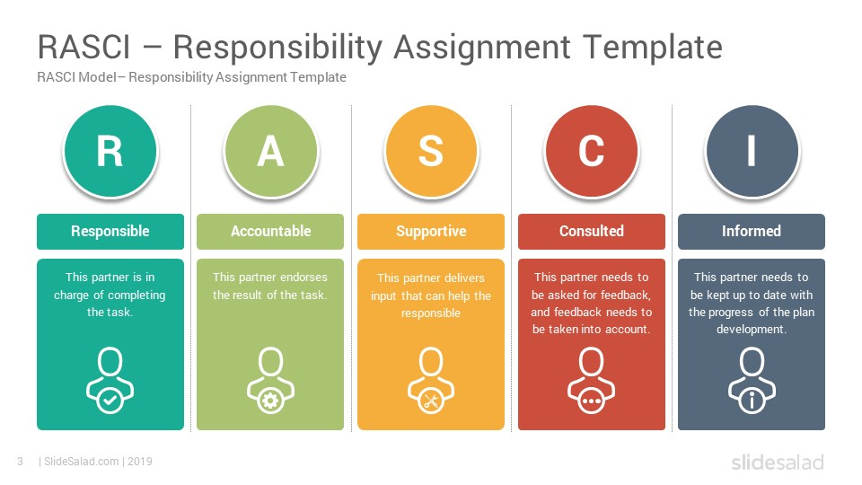
Assigning Responsibility
After all workers and work groups have been assigned tasks, they must be given the responsibility to carry them out.
  Management must determine to what extent it will delegate responsibility throughout the organization and how many employees will report to each manager.

Slide 59

Delegation of Authority
Delegation of Authority means not only giving tasks to EEs, but empowering them to make commitments, use resources, and take the actions necessary to carry out those tasks.
  Without the authority to carry out the assigned task, the EE would have to get the approval of others for every decision and every request for materials.
    As a business grows, so do the number and complexity of decisions that must be made; no one manager can handle them all.

Slide 60

Delegation of Authority
Delegation of authority frees a manager to concentrate on larger issues, such as planning or dealing with problems and opportunities.
  Delegation also gives a responsibility, or obligation, to EEs to carry out assigned tasks satisfactorily and holds them accountable for the proper execution of their assigned work.
    The principle of accountability means that employees who accept an assignment and the authority to carry it out are answerable to a superior for the outcome.

Slide 61

Delegation of Authority
The process of delegating authority establishes a pattern of relationships and accountability between a superior and their subordinates.
  However, the act of delegating authority to a subordinate does not relieve the superior of accountability for the delegated job.

Slide 62

Degree of Centralization
The extent to which authority is delegated throughout an organization determines its degree of centralization.
  In a Centralized Organization, authority is concentrated at the top, and very little decision-making authority is delegated to lower levels.
    Although decision-making authority in centralized organizations rests with top levels of management, most responsibility for carrying out daily and routine procedures is delegated to even the lowest levels of the organization.

Slide 63

Degree of Centralization
A Decentralized Organization is one in which decision-making authority is delegated as far down the chain of command as possible.
  Decentralization is characteristic of organizations that operate in complex, unpredictable environments.
  Businesses that face intense competition often decentralize to improve responsiveness and enhance creativity.
    Delegating authority to lower levels of managers may increase the organization’s productivity.

Slide 64

Span of Management
Span of Management refers to the number of subordinates who report to a particular manager.
  A wide span of management exists when a manager directly supervises a large number of employees. A narrow span of management exists when a manager supervises only a few.
    Research shows that top managers should not supervise more than four to eight people, while lower-level managers who supervise routine tasks are capable of managing a much larger number.

Slide 65
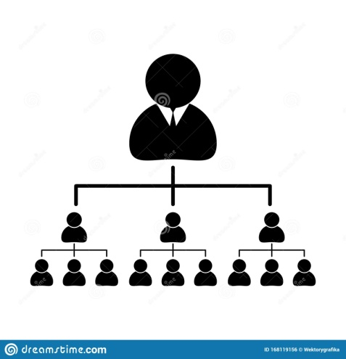
Organizational Layers
Complementing the concept of span of management is organizational layers, the levels of management in an organization.
  A firm with many layers of management is considered tall; in a tall organization, the span of management is narrow.
    Because each manager supervises only a few subordinates, many layers of management are necessary to carry out operations. This can be more costly and communication may be slower as a result of additional layers than in flat organizations.

Slide 66
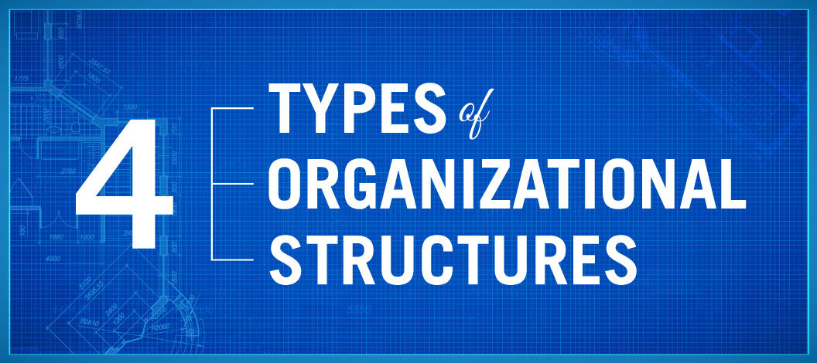
Forms of Organizational Structure
Along with assigning tasks and the responsibility for carrying them out, managers must consider how to structure their authority relationships – that is, how to structure the organization itself (organizational chart).
  Common forms of organizational structure include:
    Line Structure
    Line-and-Staff Structure
    Multidivisional Structure
    Matrix

Slide 67
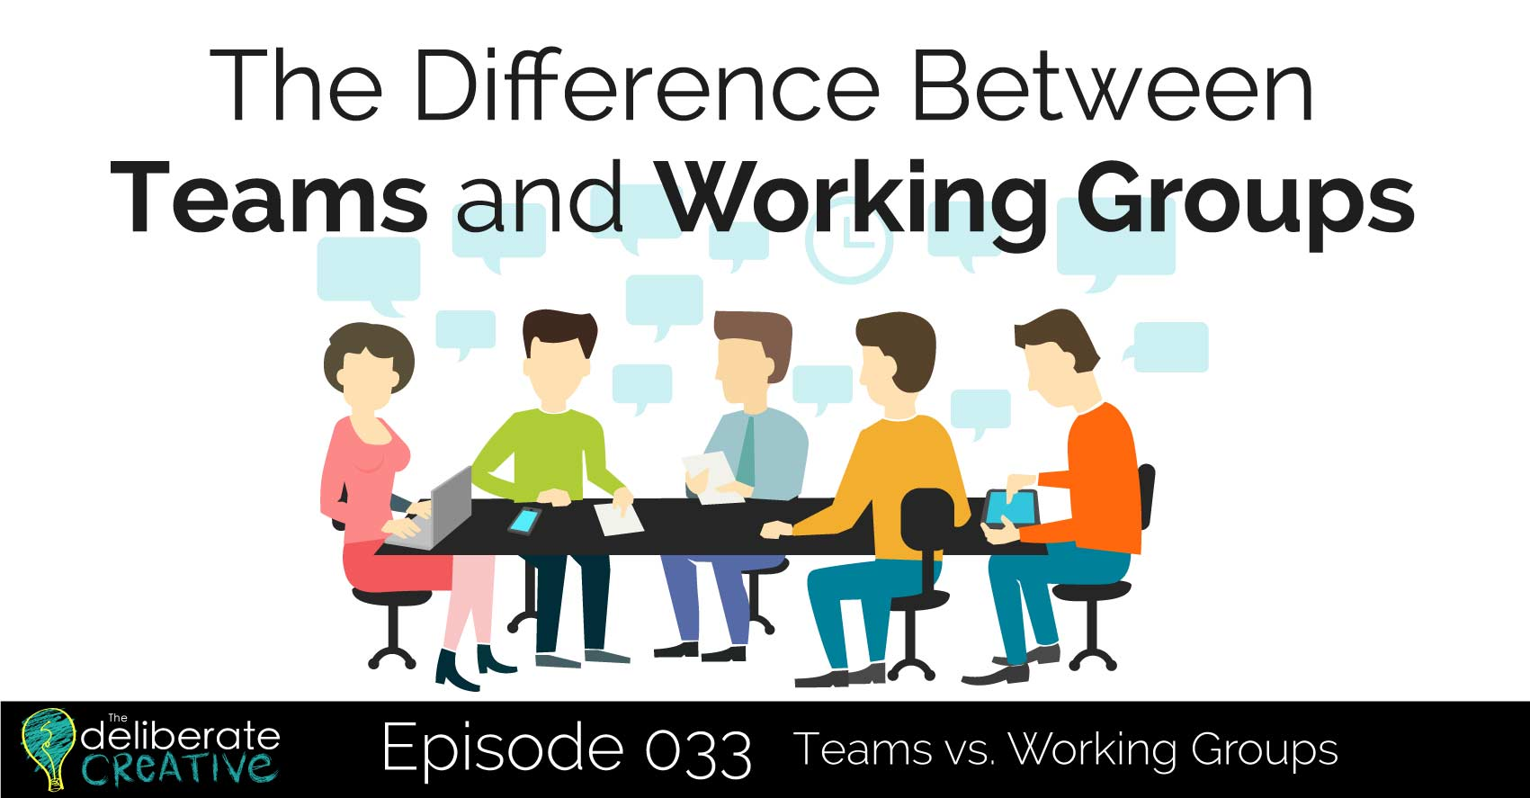
The Role of Groups and Teams in Organizations
There has been a gradual shift toward an emphasis on teams and managing them to enhance individual and organizational success.
  Some experts believe that highest productivity results only when groups become teams.
    A Group is defined as two or more individuals who communicate with one another, share common identity, and have common goal.
    A Team is a small group with complementary skills; a common purpose, goals, and approach; and hold each other accountable.

Slide 68

Communicating in Organizations
Communication within an organization can flow in a variety of directions and from a number of sources, each using both oral and written forms of communication.
  The success of communication systems within the organization has a tremendous effect on the overall success of the firm.
    Communication mistakes can lower productivity and morale.

Slide 69
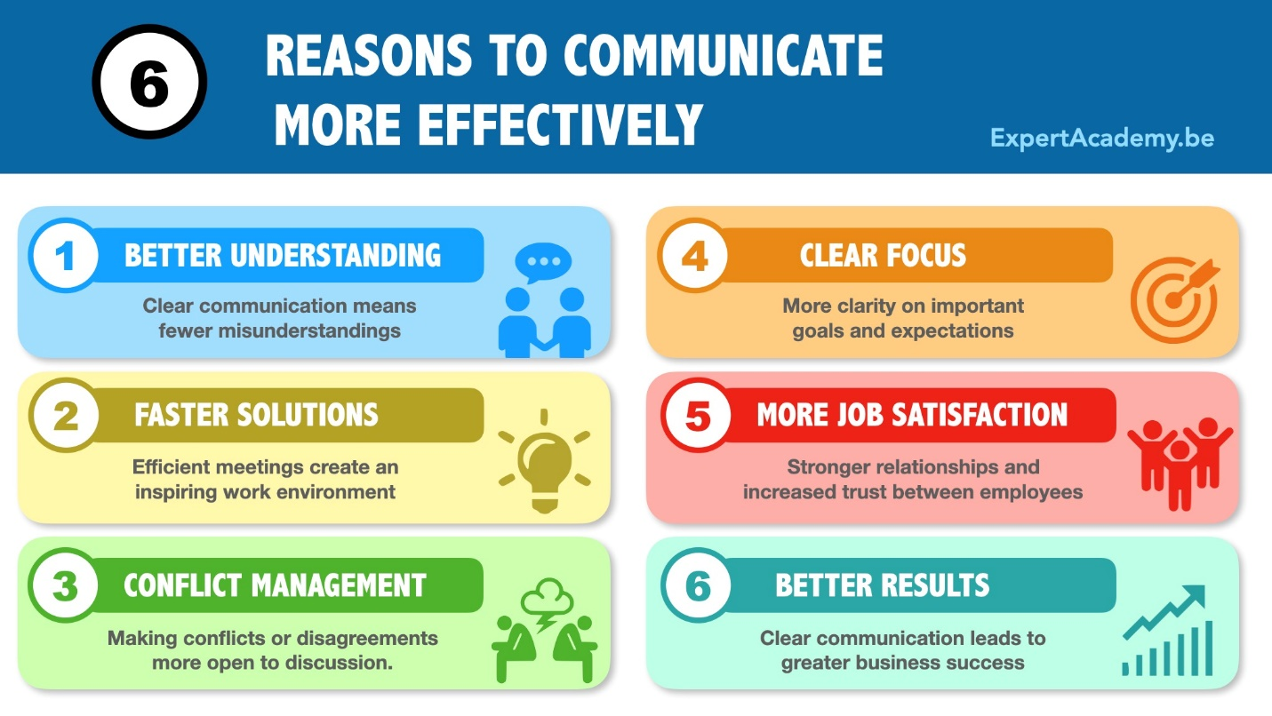
Improving Communication Effectiveness
Without effective communication, the activities and overall productivity of projects, groups, teams, and individuals will be diminished. Communication is an important area for a firm to address at all levels of management.

Slide 70


Improving Communication Effectiveness
Feedback-Listening
One of the critical areas of effective communication is obtaining feedback. Managers should always encourage feedback, including concerns and challenges about issues.
  Managers should listen, which is a skill that involves “hearing.”
    Employees list a failure to listen to their concerns as a top complaint in the workplace.

Slide 71

Improving Communication Effectiveness
Effective communication channels are a requirement for companies to distribute information to all levels.
  Communication is necessary in helping every organizational member understand what is expected of them.
    Businesses have several channels for communication including face-to-face, e-mail, phone, and written communication.
    Each channel has its advantages and disadvantages, and some are more appropriate to use than others.

Slide 72


