Slide 1
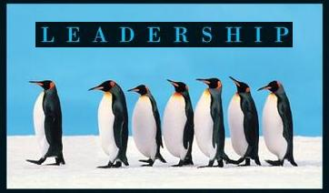
Leadership
Session Seven Class Presentation
Leadership
  Enhancing the Lessons of Experience 8th Edition
    Richard L. Hughes, Robert C. Ginnett, and Gordy J. Curphy, McGraw Hill Education, New York, NY 2015
      ISBN: 978-0-07-786240-4

Slide 2

Part Four: Focus on the Situation
Skills for Optimizing Leadership as Situations Change
  The following are skills appropriate to the last element of the interactional framework. These skills include advanced leadership skills useful in specific situational challenges:
    Diagnosing Performance Problems in Individuals, Groups, and Organizations
    Creating a Compelling Vision
    Managing Conflict
    Negotiation
    Team Building at the Top
    Punishment

Slide 3

Creating a Compelling Vision
Many leaders struggle to provide a compelling description of how they add value; as a result they have difficulty getting anyone excited to become part of their groups. They cannot effectively articulate a clear and dynamic leadership vision.
  Yet many followers want to know where their team or group is going, how it intends to get there, and what they need to do to win.
    A leader’s vision can answer these questions, explain why change is necessary, and keep team members motivated and focused.

Slide 4

Creating a Compelling Vision
People tend to get more involved when leaders extend communication beyond presentations or formal speeches and use stories, analogies, and personal experiences to paint compelling pictures of the future.
  As such a leader’s vision should be a personal statement that should help listeners answer the following questions:
    Where is the team going, and how will it get there?
    How does the team win, and how does it contribute to the broader organization’s success?
    How does the speaker define leadership?
    What gets the speaker excited about being a leader?
    What are the speaker’s key values and expectations for the team?

Slide 5
Ideas: The Future Picture
The idea component of a leader’s vision begins with an honest assessment of the current situation facing the team.
  Leaders need to clearly identify what the team is doing well, what it is not doing well, how it is performing compared to the competition, and what challenges it faces.
    The future picture needs to describe the team’s upcoming goals; the reputation it needs to have within the organization, among competitors, and with customers; and what strategies the team will pursue to achieve these outcomes.

Slide 6
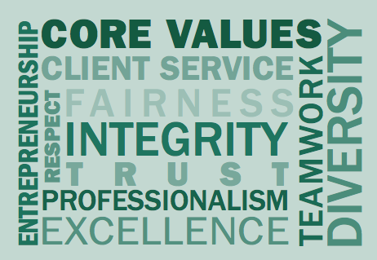
Expectations: Values and Performance Standards
A leader’s vision also needs to clearly describe expectations for team member behavior.
  More specifically, what behaviors do leaders want team members to exhibit, and just as importantly, what behaviors will they not tolerate from team members?
    Expectations for team members are related to its leader’s values. Core values can be further developed with team members.
    Leaders need to be role models for these core values, and hold members accountable for behaving in accordance with these operating principles.

Slide 7

Emotional Energy: The Power and Passion
Emotional energy is the level of enthusiasm leaders use to convey the future vision and the team’s operating principles.
  If leader’s are not excited about where the team is going and how it will get there, it will be difficult to get others to join the effort. However, leaders who are excited still need to make sure this enthusiasm is clear in the delivery of their vision.
    Emotional appeals make for compelling messages, and leaders should use a range of emotions when describing the future.

Slide 8

Edge: Stories, Analogies, and Metaphors
Edge pertains to lessons of leadership learned through personal experience that are related to the team’s future picture and core values.
  Edge includes personal stories and examples that can help color a team’s future picture.
  Edge also includes stories that illustrate why some of the team’s core values are so important.
  Edge can also include slogans, analogies, and metaphors to help clarify and simplify where the team is going or what it stands for.
    The more personal the examples and the simpler the stories, the more likely leaders will leave an impression on members.

Slide 9

Components of a Leader’s Vision
Although ideas, expectations, emotional energy, and edge make up the key components of a leader’s vision, some other leadership vision issues are worth noting.
  The delivery of a leader’s vision improves with practice.
  The most compelling leadership visions are relatively short.
  Leaders need to tie team events back to their vision and values.
  Having a clear and compelling leadership vision should help answer the question, “Why should I work for you?”

Slide 10
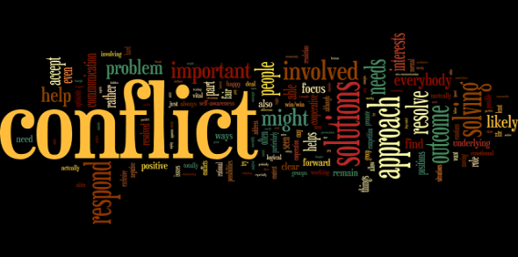
Managing Conflict
Conflict is an inevitable fact of life and leadership.
  Researchers have found that supervisors/managers can spend more than 25 percent of their time dealing with conflict, and resolving conflict is an important factor in leader effectiveness.
    Successfully resolving conflicts will become an increasingly important skill as leadership and management practice moves away from authoritarian directives and toward cooperative approaches emphasizing rational persuasion, collaboration, compromise, and solutions of mutual gain.

Slide 11


What is Conflict?
Conflict occurs when opposing parties have interests or goals that appear to be incompatible, for example:
  Strong differences in values, beliefs, or goals.
  High levels of task or lateral interdependence.
  Competing for scarce resources or rewards.
  Under high levels of stress.
  Face uncertain or incompatible demands.
    Conflict can also occur when leaders act in a manner inconsistent with their vision and goals they have articulated.

Slide 12
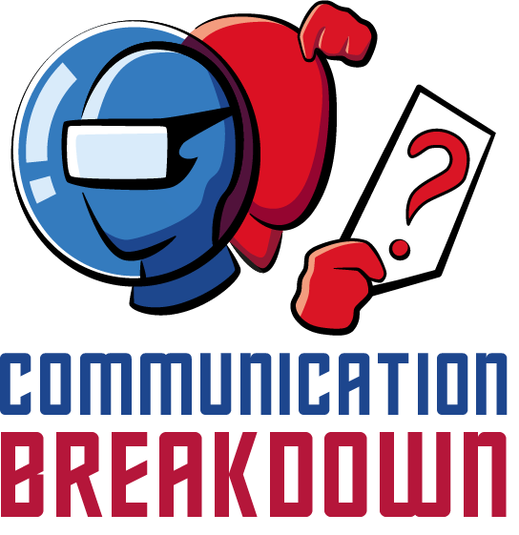
What is Conflict?
Because many conflicts are the result of misunderstandings and communication breakdowns, leaders can minimize the level of conflict within and between groups by improving their communication and listening skills, as well as, spending time with others.

Slide 13

What is Conflict?
It is necessary to describe several aspects of conflict that can have an impact on the resolution process.
  The size of an issue, the extent to which parties define the problem egocentrically (how much personally invested), and the existence of hidden agendas can all affect the process.
  Seeing a conflict situation in win-lose or either-or terms restricts the perceived possible outcomes to total satisfaction or total frustration.
  Seeing a conflict as a zero-sum situation, one in which intermediate degrees of satisfaction are possible, but increases in one party’s satisfaction inherently decreases the other party’s satisfaction, and vice-versa can have an adverse effect.
  Finally, parties may perceive a conflict as un-resolvable, in which neither party gains at the expense of the other, but continues to perceive the other as an obstacle to satisfaction.

Slide 14


Is Conflict Always Bad?
Some conflict may bolster innovation and performance.
Various positive and negative effects of conflict, include:
  Positive Effects of Conflict
    Increased Effort – Feelings Get Aired – Better Understanding of Others – Impetus for Change – Better Decision Making – Key Issues Surface – Critical Thinking Stimulated
  Negative Effects of Conflict
    Reduced Productivity – Decreased Communication – Negative Feelings – Stress – Poorer Decision Making – Decreased Cooperation – Political Backstabbing

Slide 15

Is Conflict Always Bad?
Conflict can cause a radical change in political power, as well as, dramatic changes in organizational structure and design, group cohesiveness, and group or organizational effectiveness.
  Nevertheless, it is important to realize that this current conceptualization of conflict is still somewhat limited in scope.
    For example, increasing the level of conflict within a group or team may enhance immediate overall performance but may also have a disastrous effect on organizational climate and turnover.

Slide 16

Conflict Resolution Strategies
In addition to spending time understanding and clarifying positions, separating people from the problem, and focusing on interests, leaders can use five strategies or approaches to resolve conflicts.
  Perhaps the best way to differentiate between these strategies is to think of conflict resolution in terms of two independent dimensions:
    Cooperativeness vs. Uncooperativeness
    Assertiveness vs. Unassertiveness.

Slide 17
Five Conflict Resolution Strategies
Competition
  Reflects a desire to achieve one’s own ends at the expense of someone else. This is domination, also known as win-lose.
Accommodation
  Reflects a mirror image of competition – entirely giving in to someone’s concerns w/out making any effort to achieve one’s goal. This is a tactic of appeasement.
Sharing
  An approach that represents a compromise between domination & appeasement. Both parties give up something, yet both parties get something. Both parties are moderately, but incompletely, satisfied.
Collaboration
  Reflects an effort to fully satisfy both parties. This is a problem-solving approach that requires the integration of each party’s concerns.
Avoidance
  Involves indifference to the concerns of both parties. It reflects a withdrawal from or neglect of any party’s interests.

Slide 18

Situations in Which to Use the 5 Approaches to Conflict Management
1. Competing
  When quick, decisive action is vital – such as, emergencies.
  On important issues where unpopular actions need implementing – cost cutting, enforcing unpopular rules, discipline.
  On issues vital to company welfare when you know you’re right.
  Against people who take advantage of noncompetitive behavior.
2. Accommodating
  When you find you are wrong – to allow a better position to be heard, to learn, and to show your reasonableness.
  When issues are more important to others than yourself – to satisfy others and maintain cooperation.
  To build social credits for later issues.
  To minimize loss when you are outmatched and losing.
  When harmony and stability are especially important.
  To allow subordinates to develop by learning from mistakes.

Slide 19
Situations in Which to Use the 5 Approaches to Conflict Management
3. Compromising
  When goals are important, but not worth the effort or potential disruption of more assertive modes.
  When opponents with equal power are committed to mutually exclusive goals.
  To achieve temporary settlements of complex issues.
  To arrive at expedient solutions under time pressure.
  As a backup when collaboration or competition is unsuccessful.
4. Collaboration
  To find an integrative solution when both sets of concerns are too important to be compromised.
  When your objective is to learn.
  To merge insights from people with different perspectives.
  To gain commitment by incorporating concerns into a consensus.
  To work through feelings that have interfered with a relationship.

Slide 20
Situations in Which to Use the 5 Approaches to Conflict Management
5. Avoiding
  When an issue is trivial or more important issues are pressing.
  When you perceive no chance of satisfying your concerns.
  When potential disruption outweighs the benefits of resolution.
  To let people cool down and regain perspective.
  When gathering information supersedes immediate decisions.
  When others can resolve the conflict more effectively.
  When issues seem tangential to or symptomatic of other issues.

Slide 21

Shark Analogy
The following rules for interacting with the sharks of the sea serve as useful analogies for interacting with the sharks of everyday life.
  Assume any unidentified fish is a shark.
  Don’t bleed.
  Confront aggression quickly.
  Get out of the water if anyone starts bleeding.
  Create dissention among the attackers.
  Never divert a shark toward another swimmer.

Slide 22
Shark Analogy
Assume Any Unidentified Fish is a Shark
  Just because a fish may be acting in a docile manner does not mean it is not a shark.
  The real test is how it will act when blood is in the water.
Don’t Bleed
  Bleeding will prompt even more aggressive behavior and the involvement of even more sharks.
  Of course, it is not easy to keep from bleeding when injured. Those who cannot do so are advised not to swim with sharks at all.
Confront Aggression Quickly
  Sharks usually give warning before attacking a swimmer. Swimmers should watch for indications an attack is imminent and take prompt counteraction. A blow to the nose is often appropriate because it shows you understand the shark’s intentions and will respond in kind.
Get Out of the Water if Anyone Starts Bleeding
  Docile sharks may begin attacking if blood is in the water. Their behavior can become so irrational, even including attacking themselves. It is safest to remove yourself entirely from the situation.
Create Dissention Among the Attackers
  Sharks are self-centered and rarely act in an organized fashion with other sharks. This significantly reduces the risk of swimming with sharks. Sharks may launch a coordinated attack, though. The best strategy then is to create internal dissension among them because they are already prone to it.
Never Divert a Shark Toward Another Swimmer
  Please observe this final item of swimming etiquette!

Slide 23

Negotiation
Negotiation is an approach that may help resolve some conflicts.
  The following negotiation tips, from Fisher and Ury, include:
    Taking the time to prepare for a negotiating session;
    Keeping the people and problems separate; and
    Focusing on interests rather than positions.

Slide 24

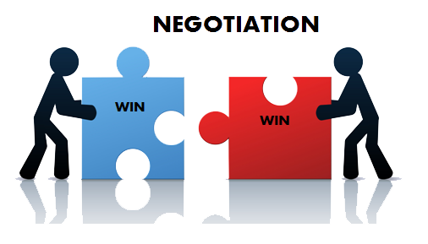
1. Prepare for the Negotiation
To successfully resolve conflicts, leaders may need to spend considerable time preparing for a negotiating session.
  Leaders should anticipate each side’s key concerns and issues, attitudes, possible negotiating strategies, and goals.

Slide 25

2. Separate the People from the Problem
Because all negotiations involve substantive issues and relationships between negotiators, it is easy for these parts to become entangled.
  When that happens, parties may inadvertently treat the people and the problem as though they were the same.
    Leaders should not let their fears color the perceptions of each side’s intention. It does no good to blame the other side for our own problems.
    Personally attacking the other party may make the conflict even more difficult to resolve, particularly since the genesis of the issue and/or the decision may be out of their hands.

Slide 26
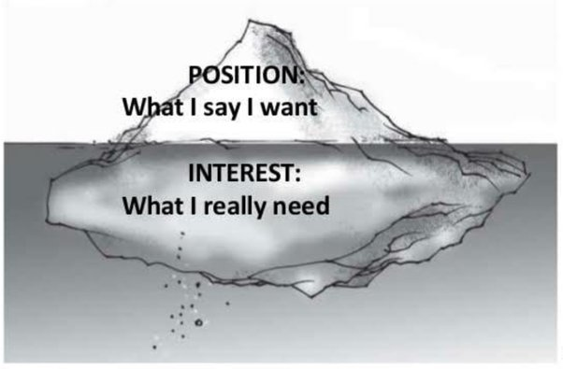
3. Focus on Interests, Not Positions
Focusing on interests depends on understanding the difference between interests and positions.
  In negotiating, it is much more constructive to satisfy interests than to fight over positions.
    For example, if Frankie has the same reserved seat at the Red Sox during each home game, but was notified that he would no longer get his usual reserved seat. He could become upset and demand the same seat as always (position) or accept an alternative seat that is just as satisfactory (interest).

Slide 27
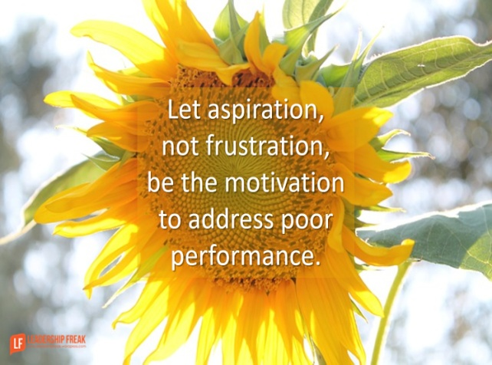
Diagnosing Performance Problems
Individuals, Groups, and Organizations
In many ways leaders will only be as effective as the followers and teams they lead.
  One of the most difficult issues leaders will face is managing individuals or teams that are not performing to expectations.
    What makes this even more difficult is that although the lack of performance may be obvious, the reasons for it may not.

Slide 28

Diagnosing Performance Problems
Individuals, Groups, and Organizations
Unfortunately, many leaders do not have a model or a framework for diagnosing performance problems at work, and as a result do a poor job of dealing with problem performers.
  The following Model of Performance gives leaders a pragmatic framework for understanding why a follower or team may not be performing up to expectations and what the leader can do to improve the situation.
  Performance = (Expectations X Capabilities X Opportunities X Motivation)

Slide 29

Expectations
Performance problems often occur because individuals or groups do not understand what they are supposed to do.
  It is the leader’s responsibility to ensure that followers understand their roles, goals, performance standards, and the key metrics for determining success.

Slide 30

Capabilities
Just because followers understand what they are supposed to do does not necessarily mean they can do it. Sometimes followers and teams lack the capabilities needed to achieve a goal or to perform above expectations.
  Ability and skills are the two components that make up capabilities.
    Ability is similar to raw talent, and includes individual variables like athleticism, intelligence, creativity, and personality traits.
    Skills consist of a body of knowledge and related behaviors.

Slide 31

Opportunities
Performance can also be limited when followers lack the resources needed to get the job done. Other times followers may lack the opportunity to demonstrate acquired skills.
  Leaders must ensure followers/teams have needed equipment, financial resources, and opportunities to exhibit their skills if they want to eliminate this constraint on performance.

Slide 32

Motivation
Many performance problems can be attributed to a lack of motivation. The critical issue here is whether followers or groups choose to perform or exhibit the level of effort necessary to accomplish a task.
  The leader should try to learn why people are not motivated.
    The tasks may involve risks the leader is unaware of.
    Followers may run out of steam to perform the task.
    There may be few rewards for superior or consequences for unsatisfactory performance.

Slide 33
Motivation (Cont.)
Leaders have several options to resolve motivation problems in followers and teams.
  They can select followers who have higher levels of achievement or intrinsic motivation for the task.
  They can set clear goals or provide better performance feedback.
  They can reallocate work across the team or redesign the tasks to improve skill variety, task significance, and task identity.
  They can restructure rewards and punishments so they are more closely linked to performance levels.

Slide 34

Performance Model
The Performance Model addresses only follower, group, and organizational performance.
  Leaders need to remember that there are other desirable outcomes, too, such as organizational climate and job satisfaction, and that actions to increase performance (especially in the short term) may adversely impact these other desirable outcomes.

Slide 35

Punishment
In an ideal world, perhaps everyone would be dependable, achievement oriented, and committed to their organization’s goals.
  However, leaders sometimes must deal with followers who are openly hostile or insubordinate, create conflicts among co-workers, do not work up to standards, or openly violate important rules or policies.
    In such cases, leaders may need to administer punishment to change the followers’ behavior.

Slide 36
Punishment
Punishment is the administration of an aversive event or withdrawal of a positive event or stimulus, which decreases the likelihood that a particular behavior will be repeated.
  When properly administered, punishment:
    Does not cause undesirable emotional side effects, is not unethical, and may effectively suppress undesirable behavior.
    Does not adversely affect follower satisfaction and performance.
    Can clarify roles and expectations and reduce ambiguity.
    Can reduce absenteeism and tardiness rates.
    Can enhance performance.

Slide 37
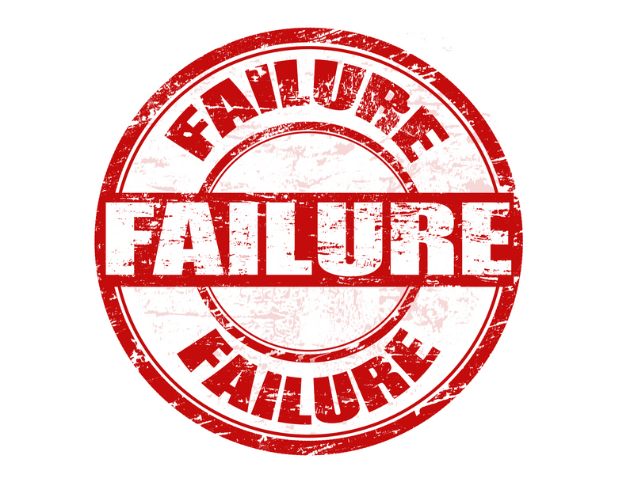
Failure to Punish
Failing to use punishment when it seems called for in most follower’s eyes may lead to perceptions of inequity, which may in turn reduce group cohesiveness and satisfaction.

Slide 38

Administering Punishment
Usually leaders administer punishment to rectify some type of behavioral or performance problem at work. However, not every behavior or performance problem is punished, and leaders probably weigh several different factors before deciding whether to administer punishment.
  Attribution theory maintains that leaders weigh three factors when making internal or external attributions about follower’s substandard performance.

Slide 39

Attribution Theory in Punishment
Leaders would be more likely to make an internal attribution about a follower’s substandard performance, and administer punishment, if:
  The follower had previously completed the task before.
  Other followers had successfully completed the task.
  The follower had successfully completed other tasks in past.

Slide 40
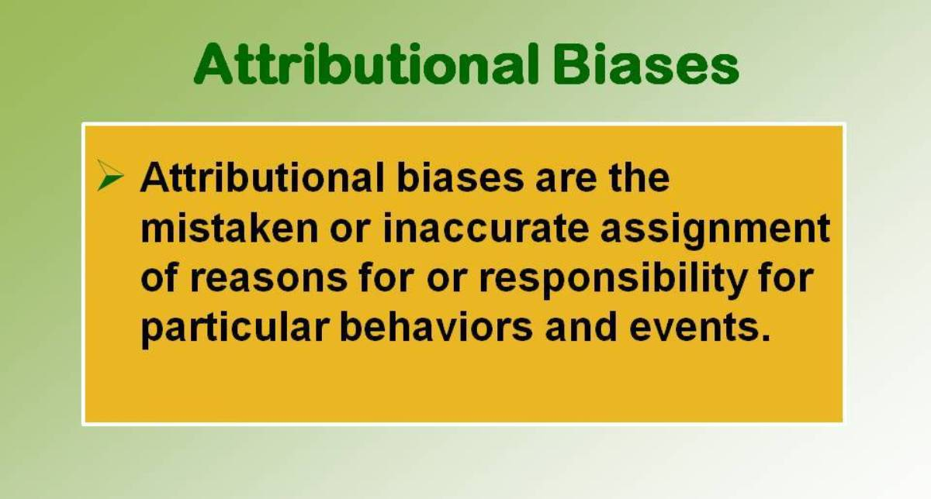
Attribution Theory in Punishment
It was found that leaders were biased toward making internal attributions about followers’ poor performance (fundamental attribution error) and thus more likely to use punishment to modify a follower’s behavior.

Slide 41

Attribution Theory in Punishment
Because leaders are biased toward making internal attributions about their followers’ substandard performance, leaders can administer punishment more effectively by being aware of this bias and getting as many facts as possible before acting.
  Leaders can also improve the manner or skill with which they administer punishment by using certain tips, such as, that punishment is administered most effectively when it focuses on acts, not the person. By focusing on specific behaviors, leaders minimize the threat to their followers’ self-concepts.
    Punishment needs to be consistent across both behaviors and leaders; the same actions need to have the same consequences across work groups.

Slide 42
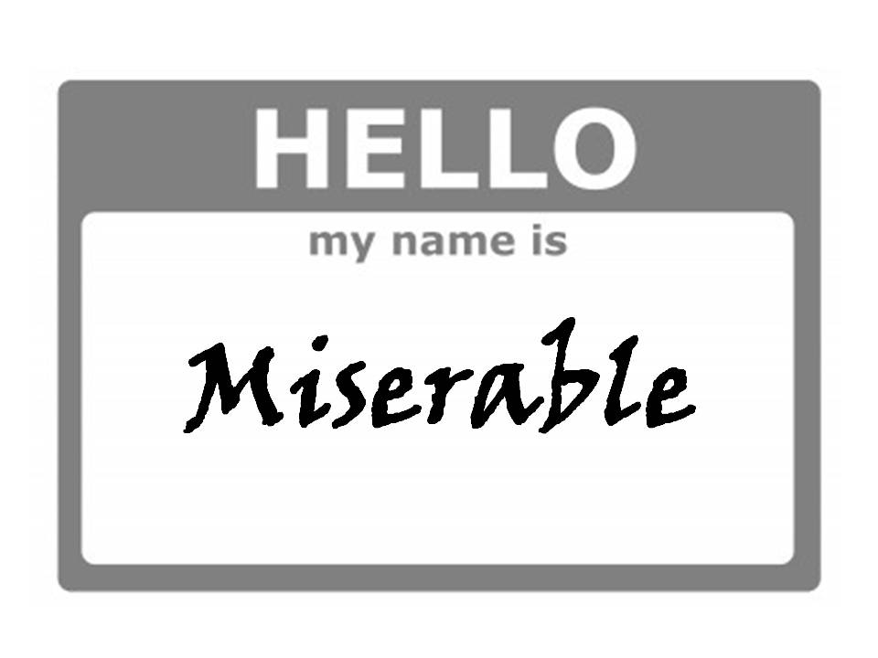
Part Four: Focus on the Situation
The Dark Side of Leadership
  Leadership plays such a pervasive part in our lives that it is easy to overlook its impact on our day-to-day behaviors.
    Because of the profound ways in which leadership affects us all, it would be nice if the people in positions of authority were actually good at it. But, research shows that most people are woefully inadequate when it comes to influencing an organized group toward accomplishing its goals.

Slide 43
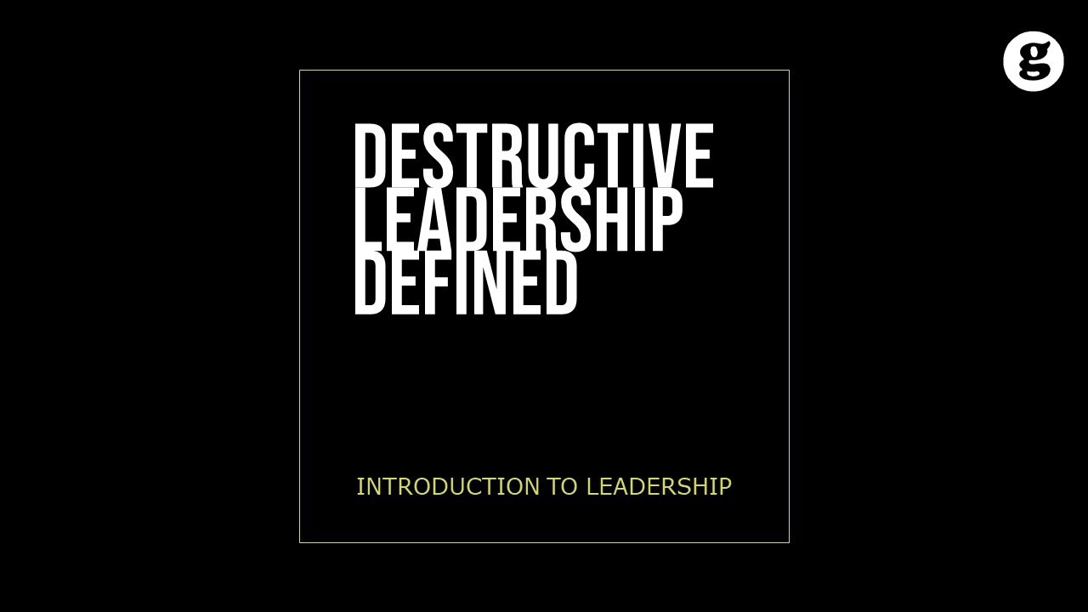
Destructive Leadership
Destructive Leadership is associated with individuals who are effective at building teams and getting results through others, but who obtain results that are morally or ethically challenged or undermine organizational success.
  An example is Adolph Hitler, as he was clearly able to rally an entire country around a common cause and conquered a number of countries, but the end result was a continent in ruins and the death of over 20,000,000 people.

Slide 44
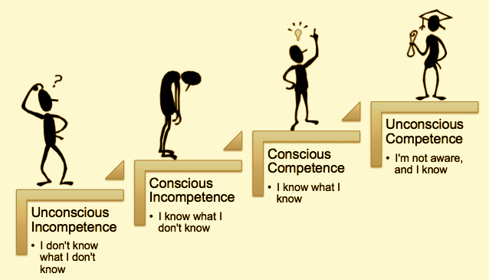
Managerial Incompetence
Managerial Incompetence concerns a person’s inability to build teams or get results through others.
  A majority of people in positions of authority can:
    Build teams but not get results
    Get results but destroy team morale and cohesiveness, or
    Neither build teams nor get results.

Slide 45
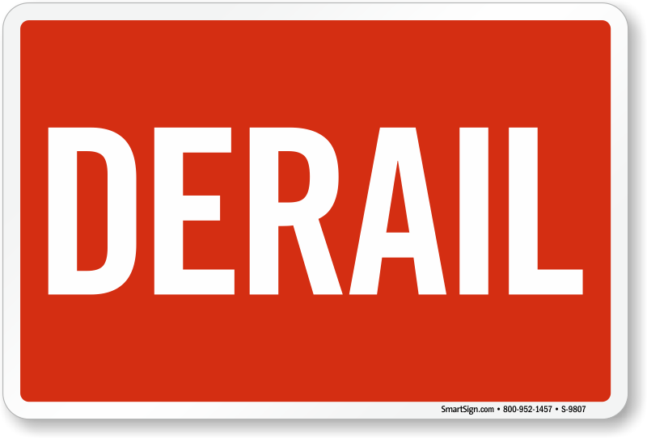
Managerial Derailment
Managerial Derailment describes the common reasons why people in positions of authority have difficulties building teams or getting results through others.
  Knowing the root causes of managerial derailment and what to do to avoid pitfalls can help you be more effective as a leader.

Slide 46

Effective Leadership
One way to evaluate leadership effectiveness is to look at one’s ability to build teams and get results through others.
  Effective leaders are those who can meet both criteria.
    James MacGregor Burns maintains that truly effective leaders need to meet an additional criterion, which is to raise the standard of human conduct and improve the lives of everyone they touch.
    Effective leaders must make the organizations or societies they belong to better places to work or live.

Slide 47


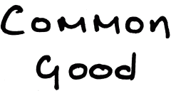
Truth in Leadership
There is a subset of leaders who are good at painting a compelling picture of the future and getting followers to drive the organizational or societal changes needed to make their vision become a reality.
  Yet, the end result may be morally or ethically reprehensible or work against the common good.

Slide 48

Optimism in Leadership
Many leadership practitioners have an optimistic outlook on leadership, maintain that leadership is easy to learn, and believe that leaders are inherently good and effective.
  However, Jared Diamond in his book “Guns, Germs, and Steel: The Fates of Human Societies,” shows that most societies from the earliest times to today have been “Kleptocracies.”
    Some are legitimate kleptocracies, where kings, queens, and elected officials write laws/rules to increase their power or wealth.

Slide 49

Destructive Leadership
Destructive leadership occurs when people in positions of authority use their team-building skills to achieve greedy, selfish, or immoral results.
  As history mournfully suggests, evil, corrupt, greedy, and selfish leaders will likely be around for a long time.
    Sometimes leaders may advocate for what many believe are the wrong things, but could turn out to be the right things over time. Thus, destructive leadership might not be quite so clear-cut.

Slide 50

Managerial Incompetence
Whereas destructive leadership is associated w/ those who build teams to achieve corrupt or evil ends, incompetent management is associated with individuals who either cannot build teams or cannot get results through others.
  Incompetent managers have difficulties building loyal followings or getting anything done.

Slide 51

Managerial Incompetence
Research shows that there may be more incompetent than competent managers.
  The base rate of managerial incompetence may be 50 to 75%.
    Confidence in business leaders is the lowest it has ever been for the past 10 years; healthy and respectful work climates are limited.
    EE satisfaction surveys show that 75% of all respondents indicate that the most stressful part of their job is their immediate boss.

Slide 52


Dimensions of Managerial Incompetence
It is believed that those occupying positions of authority are paid to get results, and they get results by building teams.
  Four types of leaders on this scale have been identified:
    Competent Managers
    Taskmasters
    Cheerleaders
    Figureheads

Slide 53
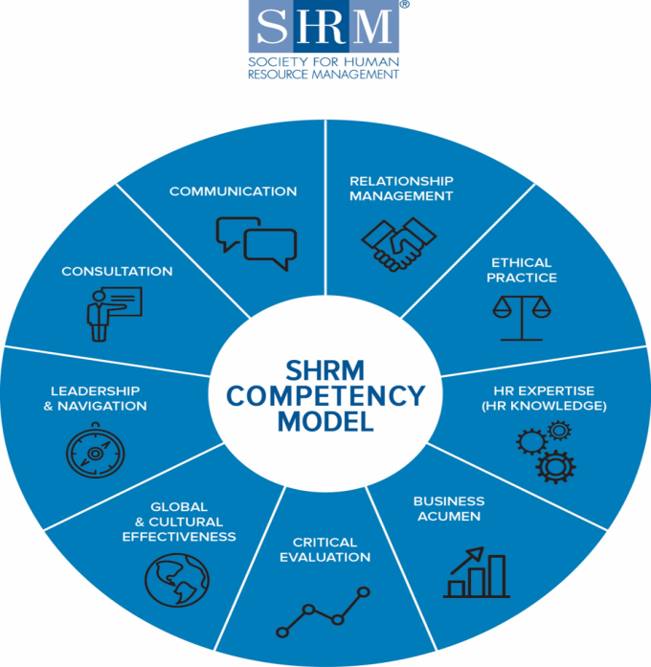
1. Competent Managers
Competent Managers are good at building teams and getting results through others.
  Although these are the types of leaders most people aspire to be, they are few and far between. Most people in positions of authority fall into one of the other three categories.

Slide 54
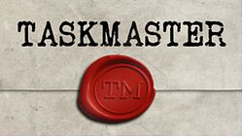
2. Taskmasters
Taskmasters are good at achieving results, such as financial targets or win-loss records, but tend to treat followers so poorly that these results are generally short-lived.
  Because these managers do not care for people, they can make the tough decisions needed to right a “sinking ship.”
  Some Taskmasters are good at projecting an image of success by launching programs and initiatives that garner a lot of attention, but have no real chance of success.
    Superiors often promote task masters before the consequences of their poorly conceived ideas and lack of team-building skills become evident.

Slide 55

3. Cheerleaders
Cheerleaders are people in positions of authority who are people-centered and try to get along with everyone.
  Thanks to their focus on making the workplace fun, most people like working for cheerleaders. However…,
    Cheerleaders spend so much time making the workplace enjoyable that they forget why they are paid to be in leadership positions, which is to get results. They confuse activity with productivity.
    Also, Cheerleaders have a difficult time doing anything that could erode relationships with followers, which includes dealing with conflict or confronting performance problems.

Slide 56

4. Figureheads
Figureheads do not play to win; they play to not lose.
  They may not be complete failures at building teams and getting results, but they could be a lot better at both of these endeavors. Many times Figureheads do just enough to stay out of trouble and avoid the spotlight.
    Figureheads may hold back or even sabotage team performance to avoid having to meet higher expectations in the future.

Slide 57
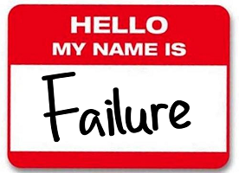
Managerial Derailment
Research suggests both successful and derailed high-potential managers are smart, ambitious, willing to do whatever it takes to get the job done, and have considerable technical expertise. However, the derailed candidates exhibit one or more behavioral patterns that are not evident in successful candidates.
  The following five reasons for failure are universal.
    Failure to Meet Business Objectives.
    Inability to Build and Lead Teams.
    Inability to Build Relationships.
    Inability to Adapt.
    Inadequate Preparation for Promotion.

Slide 58

Root Causes of Managerial Incompetence and Derailment
The Following are the Six Root Causes of Managerial Incompetence and Derailment:
  Situational and Follower Factors in Managerial Derailment
  The Lack of Organizational Fit
  Lack of Situational and Self-Awareness
  Lack of Intelligence, Subject Matter and Team-Building Expertise
  Poor Followership
  Dark-Side Personality Traits

Slide 59

Root Causes of Managerial Incompetence and Derailment
The following situational and follower factors typically affect a person’s ability to build a team and get results.
  New competitive threats, globalization, technology, changing customer preferences, unreliable suppliers, new governments or government regulations, unfavorable media coverage, natural disasters, and wars.
  Mergers, acquisitions, divestitures, bankruptcies, new strategies, reorganizations, major change initiatives, incidents of workplace violence, or environmental disasters.
  New bosses, peers, direct reports; disengaged or disgruntled EE’s; disruptive worker cliques, and strikes or dysfunctional turnover.
  New jobs, responsibilities, or projects.
  Fit for organizational culture (norms, values, beliefs)

Slide 60
Root Causes of Managerial Incompetence and Derailment
Figuring out how to build teams and get things done despite potentially disruptive situational and follower factors is part of any leadership role, but at times these external factors can be so overwhelming that there may be little a person can do to build teams or get results.
  Competent managers take time to reflect on the situation, determine what they need to do differently, and then ensure that their decisions are executed.
    Competent managers often succeed where others fail because they investigate all the alternatives and then make the changes needed to maintain team cohesiveness and performance.

Slide 61

Root Causes of Managerial Incompetence and Derailment
Competent managers must accurately read the situational and follower factors affecting their teams and remain vigilant for changes.
  Competent managers not only have high levels of Situational Awareness, but also have high levels of Self Awareness.
    Individuals who are keenly aware of their own strengths and shortcomings often find ways to either manage or staff around their personal knowledge and skill gaps.

Slide 62
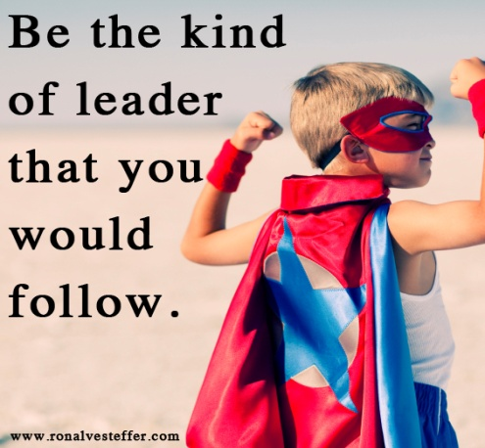
Root Causes of Managerial Incompetence and Derailment
Although situational and follower factors can sometimes play key roles, leader factors are much more likely to cause managerial incompetence and derailment.
  Some leaders cannot see how they impact others, some consistently exercise poor judgment, others do not value building teams or getting results, and others are such poor followers that they are removed from their role.

Slide 63

Root Causes of Managerial Incompetence and Derailment
It is imperative that people wanting to be competent managers get regular feedback on their performance, ideally in the form of a 360-degree feedback.
  It is also imperative that people in positions of authority regularly ask team members for ideas on improving team performance and find ways to stay abreast of important situational & follower events.
    By building teams of self-starters, competent managers encourage team members to share ideas and solutions for improving team morale and performance, even it this means telling leaders what they personally need to do differently in order to be more effective.

Slide 64


Root Causes of Managerial Incompetence and Derailment
All positions of authority require some level of intelligence and technical expertise.
  Being smart improves the odds of being a competent manager, but intelligence alone does not equal good judgment.
  A shortfall in critical knowledge (technical expertise) decreases a person’s ability to solve problems and make decisions and increases the odds of managerial incompetence.
    Technology and staffing can make up for shortfalls in intelligence and subject matter expertise. Another way to improve is through hard work.

Slide 65

Root Causes of Managerial Incompetence and Derailment
Everything done at work or even outside of work counts.
Day-to-day actions, work activities, social media presence, and e-mail all affect a leader’s perceived followership types.
  It’s not enough to build cohesive teams and get results – competent managers need to build good relationships with peers and superiors if they want to get resources and decision-making latitude.
    Leaders need to honestly assess their follower type and help them ALL become self-starters.

Slide 66

Root Causes of Managerial Incompetence and Derailment
Dark-side personality traits are irritating, annoying, and counterproductive behavioral tendencies that interfere with a leader’s ability to build cohesive teams and cause one’s followers to exert less effort toward goal accomplishment.
  The following is a listing of the most common dark-side traits:
    Excitable – Skeptical – Cautious – Reserved – Leisurely – Bold – Mischievous – Colorful – Imaginative – Diligent – Dutiful

Slide 67

Dark-Side Traits
Competent managers are those who have gained insight into their dark-side personality traits, and have found ways to negate their debilitating effects on followers.
  Competent managers will ask trusted others about how they act under pressure or what behaviors interfere w/ability to build teams. Once these tendencies are identified, leaders will need to understand the situations or conditions in which tendencies are likely to appear.
    Just having an awareness of these dark-side tendencies and situations/conditions in which they appear will help to control the manifestation of counterproductive leadership behaviors.

Slide 68


