Slide 1

Human Relations in Organizations
Session Six

Slide 2



Problem-Solving and Decision-Making
Problem-solving and decision-making are an important part of group structure, affecting behavior, human relations, and performance.
  Decision-making separates the successful from the failed teams.

Slide 3
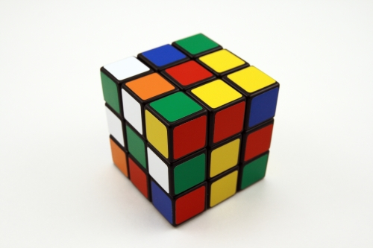
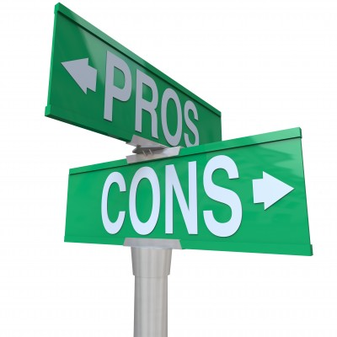
Problem-Solving and Decision-Making
Problem-Solving
  The process of taking corrective action in order to meet objectives.
Decision-Making
  The process of selecting an alternative course of action to solve a problem.

Slide 4
Three Decision-Making Styles
Reflexive Style
  A reflexive decision maker likes to make quick decisions, without taking the time to get all the information that may be needed and without considering all alternatives.
Reflective Style
  A reflective decision maker likes to take plenty of time to make decisions, taking into account considerable information and an analysis of several alternatives.
Consistent Style
  A consistent decision maker makes decisions without rushing or wasting time – knows when they have enough information and alternatives to make a sound decision – and have the most consistent record of good decisions.

Slide 5
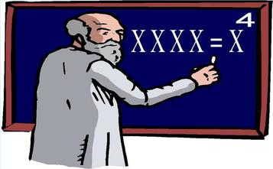

Decision-Making Model
We all like to think that we are rational and have great intuitive judgment when making decisions.
  However, research reveals the opposite effect.
    People are far from rational and often act against their best interests.
    Intuitive judgment is flawed and doesn’t help make good decisions.

Slide 6

Five Steps in the Decision-Making Model
The five steps in the Decision-Making Model do not simply go from start to end – at any step, you may have to return to a previous step to make changes.
  Define the Problem
  Set Objectives and Criteria
  Generate Alternatives
  Analyze Alternatives and Select One
  Plan, Implement the Decision, and Control

Slide 7

Using Groups to Generate Creative Alternatives
In step three of the decision-making process, organizations are using group input to generate creative alternatives.
  Brainstorming
  Synectics
  Nominal Grouping
  Consensus Mapping
  Delphi Technique

Slide 8
1. Brainstorming
Brainstorming is the process of suggesting many alternatives, without evaluation, to solve a problem
  Quantity
    Team members should generate as many ideas as possible.
  No Criticism
    Team members should not criticize or evaluate ideas in any way during the solution-generation phase.
  Freewheel
    You can’t think outside the box when you are in it – you have to see things from new angles or perspectives.
  Extend
    Team members should try to build on ideas of others and even take them in new directions.
  Brainwriting
    To eliminate the influence of team peer pressure and other members’ suggestions, participants write their own ideas down.

Slide 9

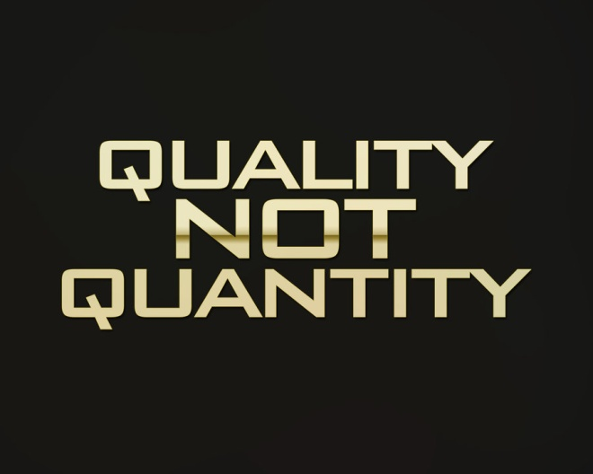
2. Synectics
Synectics focuses on coming up with novel ideas rather than a quantity of ideas.
  It is the process of generating novel alternatives through role-playing and fantasizing.

Slide 10

3. Nominal Grouping
Nominal Grouping is the process of generating and evaluating alternatives through a structured voting method.
  It is appropriate to use Nominal Grouping to ensure that status difference among members doesn’t influence the process and decision; some members tend to agree with the boss or informal leader and ignore low status ideas.

Slide 11


4. Consensus Mapping
A consensus is a cooperative attempt to develop a solution acceptable to all employees, rather than a competitive battle in which a solution is forced on some members

Slide 12

5. Delphi Technique
The Delphi Technique is considered a variation of nominal grouping, without face-to-face interaction at any point, and it also includes consensus.
  Uses anonymous questionnaires.

Slide 13


Advantage/Disadvantage
There are advantages and disadvantages of using groups to make decisions.
  Synergy occurs when the group’s solution to a problem or opportunity is superior to all individual’s.
    Unfortunately, research indicates that people often choose inferior alternatives when choosing in groups.

Slide 14

Advantages of Using Groups
Better Decisions
  With synergy, including avoiding errors with the help of the devil’s advocate technique.
More Alternatives
  More people provide diverse ideas.
Acceptance and Commitment
  People tend to accept and be more committed to implement decisions they help make.
Morale
  Participants have more job satisfactions.

Slide 15

Disadvantages of Using Groups
Time
  It takes a long time to make group decisions.
Domination
  Powerful individuals or a coalition may actually make the decision.
Conformity of Groupthink
  Members may go along with the suggested decision without questioning when they disagree with it to avoid conflict and keep social solidarity.
Responsibility and Social Loafing
  No one individual is accountable for the decision, so people don’t take it as seriously and some don’t do their fair share of the work.

Slide 16

Putting it all Together
Organizations use groups to meet performance objectives.
  The more effective the group structure and dynamics, the higher the stage of development, and the higher the stage of development, the greater the level of performance.
    The group’s performance affects its behavior and human relations.

Slide 17


Decision Making
To be a successful manager – and to be a valued employee – you need to know about decision making.

Slide 18

Decision Making
A good decision should be judged by the process used, not the results achieved.

Slide 19

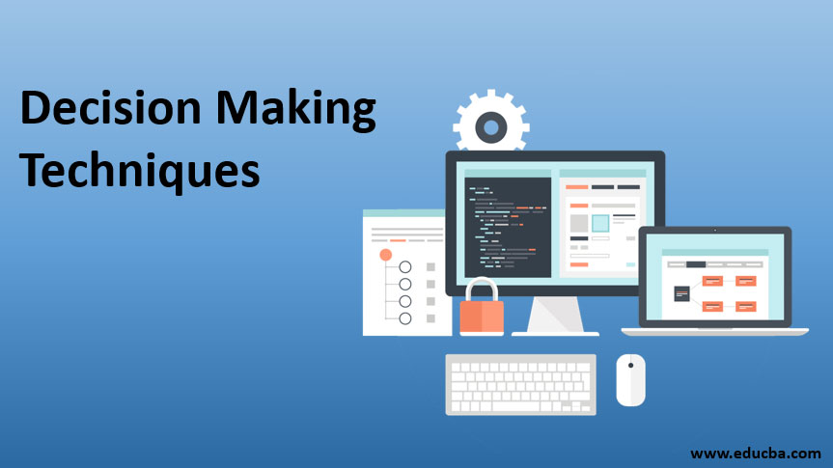
Decision Making
Decision making is a process, not a simple act of choosing among alternatives.

Slide 20

Decision Making
The 8 Steps of the Decision-Making Process:
  Identification of a Problem
  Identification of Decision Criteria
  Allocation of Weights to Criteria
  Development of Alternatives
  Analysis of Alternatives
  Selection of an Alternative
  Implementation of the Alternative
  Evaluation of Decision Effectiveness

Slide 21

1. Identification of a Problem
The decision-making process begins with the identification of a problem, or more specifically, a discrepancy between an existing and desired state of affairs.

Slide 22

2. Identification of Decision Criteria
Once a manager has identified a problem that needs attention, the decision criteria that will be important in solving the problem must be identified.

Slide 23

3. Allocation of Weights to Criteria
In many decision-making situations, the criteria are not all equally important, so the decision maker has to allocate weights to the decision criteria.

Slide 24

4. Development of Alternatives
After assigning weight to the decision criteria, the decision maker lists the alternatives that could successfully resolve the problem.

Slide 25
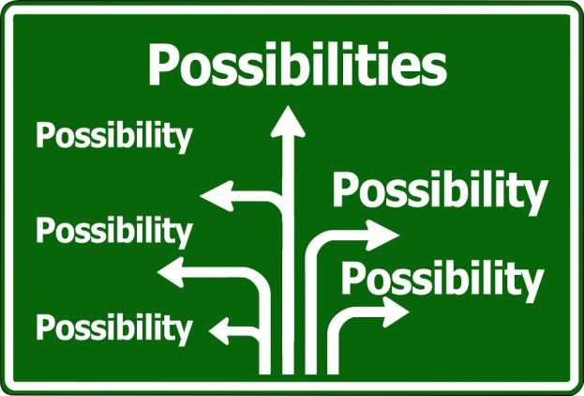
5. Analysis of Alternatives
Once the alternatives have been identified, the decision maker critically needs to analyze each one, by evaluating it against the criteria.

Slide 26

Personal Judgments
Personal judgments are reflected in (1) the decision criteria, (2) weight allocation, and (3) evaluation of alternatives.

Slide 27
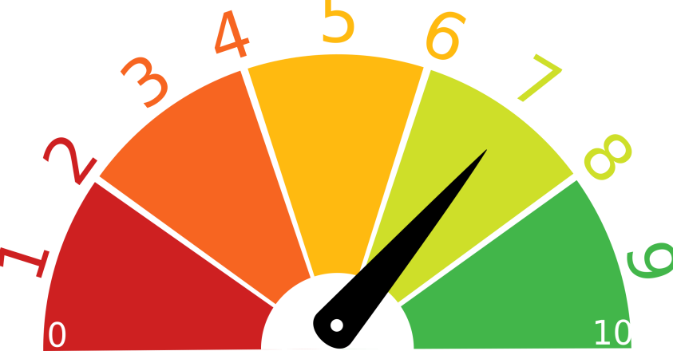
6. Selection of an Alternative
After the decision maker (1) determines all the pertinent factors in the decision, (2) weights them appropriately, and (3) identifies and assesses all the viable alternatives, it should be quite simple to select the best alternative.
  Choose the alternative that generates the highest score.

Slide 28


7. Implementation of the Alternative
Implementation involves putting the decision into action.
  Implementation includes conveying the decision to all those affected, and getting their commitment to it.
    If you want people to be committed to a decision…let them participate in the decision-making process.

Slide 29


8. Evaluation of Decision Effectiveness
In the last step of the decision-making process, you should appraise the outcome of the decision to see whether the problem was resolved.
  Did the alternative accomplish the desired result?

Slide 30

Common Errors
Managers may use their own heuristics (rules of thumb) to simplify their decision making.
    These rules of thumb may lead to errors and biases in processing and evaluating information.

Slide 31

Common Errors and Biases
Common Decision-Making Errors and Biases:
  1. Overconfidence
    A tendency to think you know more than you do, or hold unrealistic positive views of yourself and your performance.
  2. Immediate Gratification
    A tendency to want immediate rewards and to avoid immediate costs.
  3. Anchoring Effect
    When you fixate on initial information as a starting point and then, once set, fail to adequately adjust for subsequent information.
  4. Selective Perception
    When you selectively organize and interpret events based on your biased perceptions.
  5. Confirmation
    When you seek out information that reaffirms past choices and discount information that contradicts past judgments.
  6. Framing
    When you select and highlight certain aspects of a situation while excluding others.

Slide 32
Common Errors and Biases
Common Decision-Making Errors and Biases:
  7. Availability
    When you tend to remember events that are most recent and vivid in your memory.
  8. Representation
    When you assess the likelihood of an event based on how closely it resembles other events or sets of events.
  9. Randomness
    When you try to create meaning out of random events.
  10. Sunk Costs
    When you forget that current choices can’t correct the past.
  11. Self-Serving
    When you are quick to take credit for successes and blame failure on outside factors.
  12. Hindsight
    When you falsely believe that you would have accurately predicted the outcome of an event once the outcome is actually known.

Slide 33
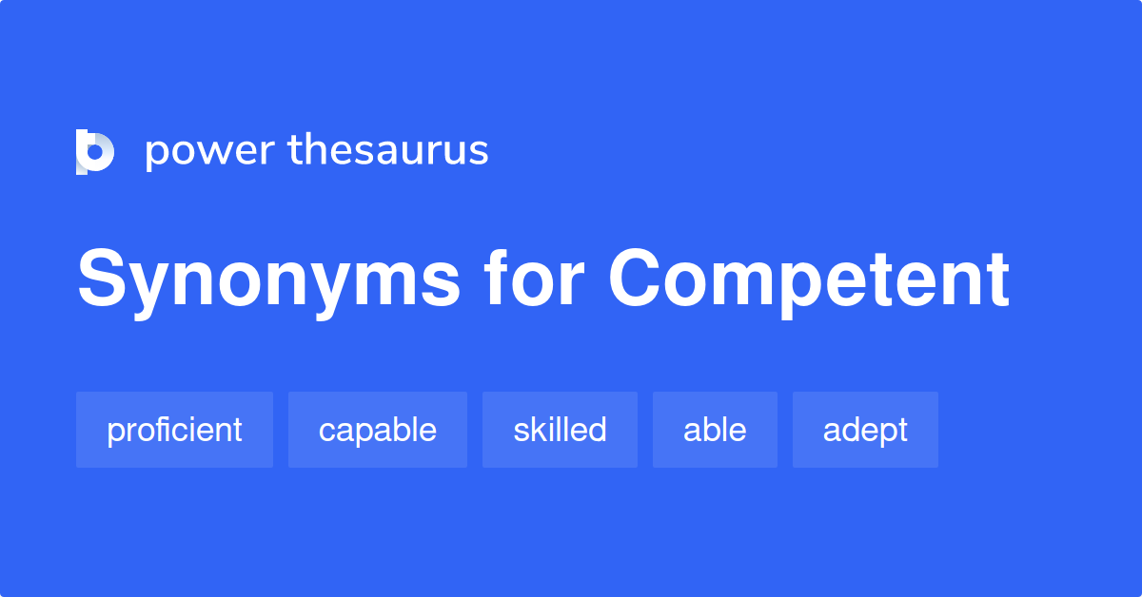
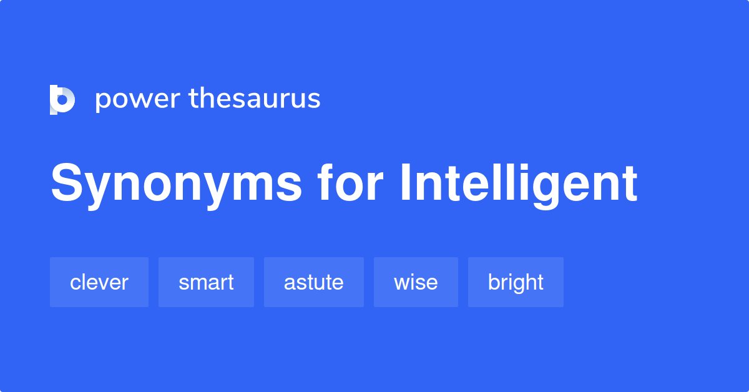
Decision-Making
Decision-Making is the Essence of Management
  Everyone in an organization makes decisions, but it’s particularly important to managers. Managers make decisions as they: Plan, Organize, Lead, and Control
    Managers want to be good decision makers and exhibit good decision-making behaviors, so they appear competent and intelligent to their bosses, employees, and co-workers.

Slide 34

3 Approaches to Make Decisions
1. Rational Model
  This approach assumes: Decision Makers MUST ACT RATIONALLY. That is, make logical and consistent choices to maximize value.
  A “Rational” Decision Maker…should be, but may never fully be:
    Objective and Logical
    Clear and Focused on Problem
    Clear and Specific on Goals Regarding Decision
    Aware of All Possible Alternatives and Consequences
    Effective in Choosing Alternative that Maximizes Achievement of Goal
    Considerate of Organization’s Best Interests
      Therefore, Rationality is not a very realistic approach.

Slide 35

3 Approaches to Make Decisions
2. Bounded Rationality
  Making decisions that are rational within the limits of a manager’s ability to process information.
    People are limited in their ability to grasp present and anticipate future, which makes it difficult to achieve the best possible decisions.
      No one can possibly analyze all information on all alternatives so they SATISFICE – that is, accept solutions that are “good enough,” rather than spend time and other resources trying to maximize.

Slide 36

3 Approaches to Make Decisions
3. Intuition and Managerial Decision Making
  Making decisions on the basis of experience, feelings, and accumulated judgment.
    Described as “Unconscious Reasoning”
      Almost half of managers rely on intuition more often than formal analysis to make decisions about their companies.

Slide 37

Intuition
What is Intuition?
  Experienced-Based Decisions
    Managers make decisions based on their past experiences.
  Affect-Initiated Decisions
    Managers make decisions based on feelings or emotions.
  Cognitive-Based Decisions
    Managers make decisions based on skills, knowledge, and training.
  Subconscious Mental Processing
    Managers use data from subconscious mind to help them make decisions.
  Values or Ethics-Based Decisions
    Managers make decisions based on ethical values or culture.

Slide 38
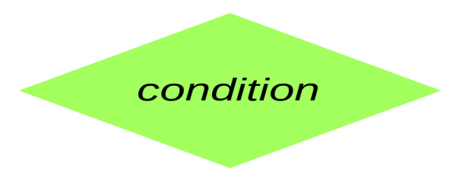

Decisions and Decision Making Conditions
When making decisions, managers face three different conditions:
  Certainty
    Conditions in which a manager can make accurate decisions because the outcome of every alternative is known.
  Risk
    Conditions in which the decision maker is able to estimate the likelihood of certain outcomes.
  Uncertainty
    Conditions in which the choice of alternative is influenced by the limited amount of available information and by the psychological orientation of the decision maker.

Slide 39

Group Decision Making
Many decisions in organizations, especially important decisions that have far-reaching effects on organizational activities and people, are typically made in groups.

Slide 40
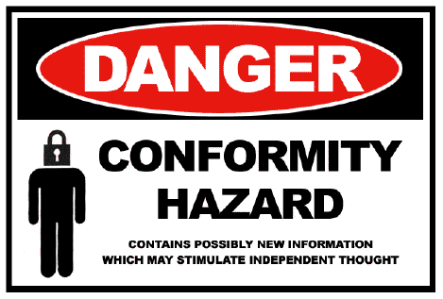
Groupthink
Groupthink is a psychological phenomenon that occurs within a group of people in which the desire for harmony or conformity results in irrational or dysfunctional decision-making outcomes.
  Groupthink hinders decision making, and jeopardizes the quality of a decision by:
    Undermining critical thinking in the group.
    Affecting a group’s ability to objectively appraise alternatives.
    Deterring individuals from appraising unusual, minority, or unpopular views.

Slide 41

Group Effectiveness
Group decisions take longer to formulate, but they tend to be more Accurate, Creative, and Accepted.

Slide 42

Brainstorming
Brainstorming is a relatively simple idea-generating process that specifically encourages any and all alternatives while withholding criticism of those alternatives.

Slide 43

Nominal Group Technique
The Nominal Group Technique helps groups arrive at a preferred solution by restricting discussion during the decision-making process.
  Members secretly write a list of general problem areas or potential solutions to a problem.

Slide 44

Decision Making Issues
Important issues managers face, include:
  1. National Culture
    As managers deal with employees from diverse cultures, they need to recognize common and accepted behavior when asking them to make decisions. Some may not be comfortable being included in the process, or may have difficulty with type of change.

Slide 45

Decision Making Issues
Important issues managers face, include:
  2. Creativity and Design Thinking
    A decision maker needs creativity, the ability to produce novel and useful ideas. Creativity offers value in identifying viable alternatives.
    Design thinking in essence, is approaching management problems as designers approach design problems.

Slide 46

Creativity
Most people have creative potential, but need to unleash it. Individual creativity essentially requires:
  Expertise
    The potential for creativity is enhanced when individuals have abilities, knowledge, proficiencies, and similar expertise in their fields of endeavor.
  Creative-Thinking Skills
    Ability to use analogies to apply an idea from one context to another.
  Intrinsic Task Motivation
    A desire to work on something because it’s interesting, involving, exciting, satisfying, or personally challenging. Turns concept into construct.

Slide 47

Creativity
Suggestions to help develop your creativity:
  Think of yourself as creative.
  Pay attention to your intuition.
  Move away from your comfort zone.
  Determine what you want to do.
  Think outside the box.
  Look for ways to do things better.
  Find several right answers.
  Believe in finding a workable solution.
  Brainstorm with others.
  Turn creative ideas into action.

Slide 48

…

