Slide 1
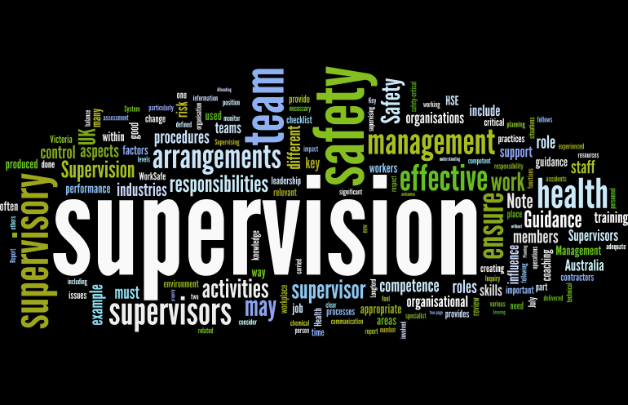
Supervision
Supervision
  Concepts and Practices of Management, 13th Edition
    Edwin C. Leonard, Jr., Ph.D. and Kelly A. Trusty, Ph.D. Cengage Learning, Boston, MA 2013
      ISBN: 978-1-285-86637-6

Slide 2

Part One: Supervisory Management Overview and Challenges
Chapter Four: Supervising a Diverse Workforce
  After studying this chapter, you will be able to:
    Define the concept of workforce diversity and identify the major categories of legally protected EEs and general guidelines for supervising diverse workforce.
    Explain the issues involved in supervising racial or ethnic minority EEs.
    Discuss factors that are particularly important when supervising female EEs.
    Identify and discuss the legal and other considerations of supervising EEs with physical and mental disabilities.
    Discuss the considerations of supervising older workers and managing an intergenerational workforce.
    Provide examples of religious accommodation.
    Describe the unique challenges of supervising globally dispersed EEs.
    Recognize pressures faced by supervisors who are members of protected groups.
    Explain the issue of reverse discrimination.
    Understand how to best supervise a diverse workforce.

Slide 3

Managing Diversity is the Bottom-Line Concern
Diversity management encompasses many considerations, including legal, demographic, economic, and political.
  Managing a diverse workforce encompasses virtually all aspects of a firm’s operations, especially on the supervisor level.
    Initiatives and efforts to better manage a diverse workforce are growing, not just because of legal requirements or social considerations but also because there is a recognition that this has become an area of vital importance to a firm’s long-term success and bottom-line results.

Slide 4

Classifications of Protected-Group Employees
The supervision of protected-group employees is, by definition, part of a firm’s efforts to manage diversity so as to benefit both the firm and the EEs.
  Regardless of personal views, supervisors must be sensitive to possible illegal discriminatory actions and adjust their supervisory practices accordingly. More important, however, is that supervisors recognize the strengths and potential contributions of all EEs and supervise in ways that do not limit EE development.
    Effective supervision of a diversified workforce is an opportunity to draw on and use the differences of people in a positive, productive manner.

Slide 5

The Ouch Test in Supervising Employees
A Supervisor’s actions should be objective, uniform in application, consistent in effect, and have job relatedness.
  For example, assume that organization policy specifies a disciplinary warning for being tardy 3x in one month. The supervisor should give the same warning to every EE who is late the 3rd time in one month, regardless of whether the EE is in a protected-group category.
    This supervisory approach would meet the “Ouch Test” because tardiness is an observable behavior that is measured objectively for all EEs.
    The penalty is the same for all, is consistent, and is clearly job-related.

Slide 6
The Ouch Test in Supervising Employees
A myth occasionally voiced by some supervisors is that certain categories of EEs cannot be disciplined or discharged because of government regulations.
  This view is unfounded. Laws and regulations do not prevent a supervisor from taking disciplinary action against protected-group employees. However, they do require that such EEs be treated the same as other EEs whenever disciplinary actions are taken.
    It is extremely important that supervisors be careful in meeting the Ouch Test and in justifying their actions through adequate documentation.

Slide 7

Supervising Racial and Ethnic Minorities
With the passage of major civil rights legislation, most employers have developed nondiscrimination or affirmative-action policies or programs for employing people from racial and ethnic minority groups.
  A major thrust of these policies and programs is to ensure that minorities, as well as certain other protected-group individuals, receive special consideration in hiring and promotion decisions.

Slide 8

Supervising Racial and Ethnic Minorities
The philosophy underlying affirmative-action plans is to overcome the impact of past discriminatory practices and to provide greater opportunities for underrepresented groups to participate more fully throughout the workforce.
  The long-term goal is to have a fully diversified workforce in which all EEs are hired and supervised solely on the basis of capability and performance.

Slide 9

Supervising Racial and Ethnic Minorities
While most organization’s recognize the importance of integrating the workplace, minority populations still face substantial barriers.
  Research by the Joseph Rowntree Foundation indicated the following barriers for minorities.
    Lack of role models in leadership positions
    Language difficulties
    Lower educational levels
    Low self-confidence
    Exclusion from informal networks
    Lack of organizational understanding of ethnic minority communities
    Unequal access to opportunities for training and development
    Prejudice and stereotyping
    Under-recognition of existing skills and experience

Slide 10

Understanding Discrimination’s Effects
Minority EEs who have experienced prejudicial treatment may resent supervisors of different racial or ethnic backgrounds.
  Even though nondiscrimination laws have been in place for several decades, annual data compiled by the EEOC show that minority members file tens of thousands of complaints about unfair treatment because of their race.
    Typically alleged discriminatory discipline and discharge have been the most frequent basis for these complaints, although some are based on incidents of direct harassment.

Slide 11

Understanding Discrimination’s Effects
Because the responsibility for initiating discipline and discharge actions usually rests with supervisors, such decisions play a significant role in discrimination charges.
  Supervisors must be sensitive to the feelings of minority EEs who may have experienced discriminatory treatment in the past or who believe they are currently experiencing it.
    Supervisors should not enter into racial debates with minority EEs who display lingering resentment and suspicion.

Slide 12

Understanding Discrimination’s Effects
Supervisors should strive to be fair and considerate when making decisions that affect these EEs.
  By demonstrating that minority EEs will be supervised in the same manner as other EEs, a supervisor can reduce the negative effects of past discrimination.
    In the event that a minority EE’s feelings of resentment interfere with job performance or department relations, the supervisor should refer the EE to the HR department.

Slide 13

Appreciating Cultural Differences
Differences in ethnic or cultural backgrounds can contribute to prejudicial attitudes and treatment of minority EEs.
  For example, a minority EE’s values regarding the importance of work and punctuality may differ from those of a supervisor.
    If a minority EE has not grown up in an environment that stresses the importance of punctuality, especially in a work situation, the supervisor must be prepared to spend extra time explaining to the EE the reasons for punctual attendance and the consequences of tardiness and absenteeism.

Slide 14

Appreciating Cultural Differences
Regardless of what cultural differences exist, it is the supervisor’s job to exert special efforts to reduce the effects of these differences.
  By so doing, the supervisor can help the minority person learn to accept the requirements of the work environment and to meet the standards expected of all EEs in the department.

Slide 15

Overcoming Language Difficulties
Another consideration in supervising minority EEs relates to the different languages that may be spoken in a work environment.
  In many parts of the United States, the English language is the minority language, and a bilingual person is a valuable asset.
    We encourage you to add more language skills to your toolbox.

Slide 16

Supervising Women
Throughout the past several decades, both the number and the percentage of women in the labor force have increased dramatically.
  While there is consensus that opportunities for women will increase, barriers remain. These barriers include the lack of females at the executive board level, male-dominated corporate cultures, stereotypes or preconceptions about women, exclusion from informal networks, and lack of mentoring opportunities.
    Both male and female supervisors should be aware of a number of important concerns regarding the supervision of women.

Slide 17

Entry of Women Into Many Career Fields
While women have surmounted many of the barriers that previously limited their entry into male-dominated positions, problems sill arise, especially at the departmental level.
  One common supervisory consideration when a woman takes a job traditionally held by a man is the reaction of male co-workers.
  Some men may resent and even openly criticize her.
    The supervisor should be prepared to deal with such attitudes to enable the woman to perform her job satisfactorily.

Slide 18

Entry of Women Into Many Career Fields
The supervisor should first inform the men about the starting employment date of the woman so that her presence does not come as a surprise.
  Then, the supervisor should make it clear to the men that disciplinary action will be taken if this woman, or any female EE in the future, is ignored or subjected to abuse or harassment.
    The supervisor also should make it clear that any woman taking a previously all-male job will be afforded a realistic opportunity to succeed based on her ability to perform the job.

Slide 19

Balancing Work-Life Issues
Supervisors must be diligent and observant and aware of the life challenges that EEs bring to the workplace.
  Often times, EEs may need special accommodations, such as flex time and time off from work, so they can be productive EEs.
    To that end, many organizations have developed a family-friendly culture that incorporates these benefits in order to facilitate work-life balance.

Slide 20
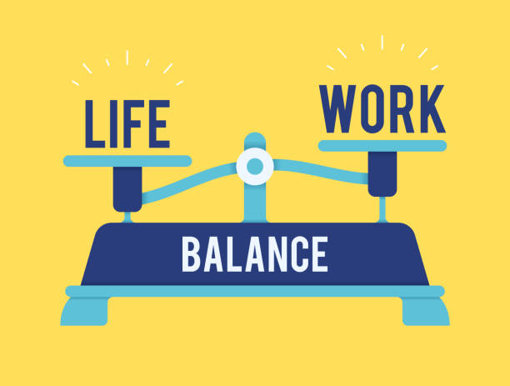
Balancing Work-Life Issues
Women with children often must cope with demanding responsibilities at home, which are not often shared with their husbands.
  Moreover, many women head single-parent households in which they are the primary provider.
    Because of concerns like these, many employers have adopted flexible policies concerning work schedules, leaves, and other arrangements to help EEs, especially women, meet their obligations.

Slide 21

Balancing Work-Life Issues
The conflict and tension between family and job responsibilities is one that employers and supervisors will have to address for many years to come.
  Supervisors should become familiar with their firm’s policies regarding family and childcare assistance, and, whenever possible, they should try to solve those conflicts that interfere with the EE’s capacity to carry out their responsibilities.

Slide 22

Sexual-Harassment and Sexual-Stereotyping Issues
Sexual harassment usually means a female EE is subjected to sexual language, touching, or sexual advances by a male EE, a male supervisor, or a male customer.
  If a female EE resists or protests such behavior by a male supervisor, for example, she may fear retribution when the supervisor is considering pay raises or promotions.
    It is important to note that a female supervisor or a female EE can be charged with the sexual harassment of a male EE and the harassment can also occur when both parties are of the same sex.

Slide 23
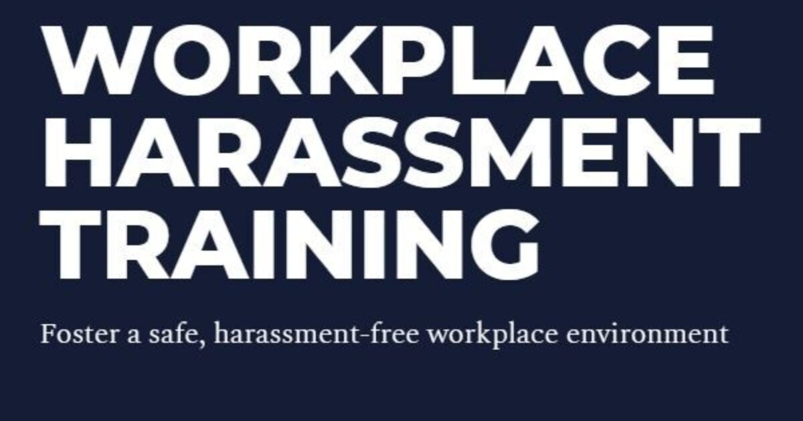
Sexual-Harassment and Sexual-Stereotyping Issues
Guidelines issued by EEOC, which enforces the Civil Rights Act, define sexual harassment as sexual advances, requests for sexual favors, and verbal or physical conduct of a sexual nature when:
  Submission to such conduct is explicitly or implicitly made a condition of an individual’s employment.
  Submission to or rejection of such conduct by an individual is used as the basis for employment decisions affecting the person.
  Such conduct has the purpose or effect of unreasonably interfering with an individual’s work performance or creating an intimidating, hostile, or offensive working environment.

Slide 24
Sexual-Harassment and Sexual-Stereotyping Issues
Court decisions have generally held that an employer is liable if the sexual harassment of EEs is condoned or overlooked or fails to lead to corrective actions by management.
  Reprimand and discipline of offending EEs and supervisors are recommended courses of action.
    Supervisors should avoid and strongly discourage sexual language, innuendos, and behavior that is inappropriate in the work environment.

Slide 25

Sexual-Harassment and Sexual-Stereotyping Issues
Consensual workplace dating does not in and of itself constitute sexual harassment, but there may be harassment if the EE feels coerced to engage in or continue a relationship.
  Other EEs who lose out on a promotion or pay raise that goes to the more favored person may also have discrimination claims against the organization.
    Worse yet, the organization may lose the faith and trust of its various stakeholders when the indiscretion becomes public knowledge.

Slide 26

Sexual-Harassment and Sexual-Stereotyping Issues
Gender stereotyping involves the use of demeaning language, judgments, or behavior based on a person’s gender.
  For example, a marketing department supervisor may suggest that men are more bull-headed and less open to creative suggestions than women, or a factory floor supervisor may imply that woman are more emotional, less rational, and less reliable than men.
    Many gender-specific assertions are inaccurate.

Slide 27

Sexual-Harassment and Sexual-Stereotyping Issues
Along with perpetuating inaccuracies, gender stereotyping can reduce EE motivation, perpetuate discrimination, and lead to perceived harassment.
  Therefore, the supervisor should not make supervisory decisions based on sexual stereotypes, and the supervisor should discourage EEs from stereotyping in their workplace interactions.
    To avoid gender implications, many job titles have been changed. For example, the job title fireman is now firefighter, a mailman is now a letter carrier, and a stewardess is now a flight attendant.

Slide 28

Training and Development Opportunities
Women EEs should be offered equal access to training and development activities, and those EEs with potential should be encouraged to develop their skills.
  This is especially important with regard to upgrading women to supervisory and other managerial positions.

Slide 29
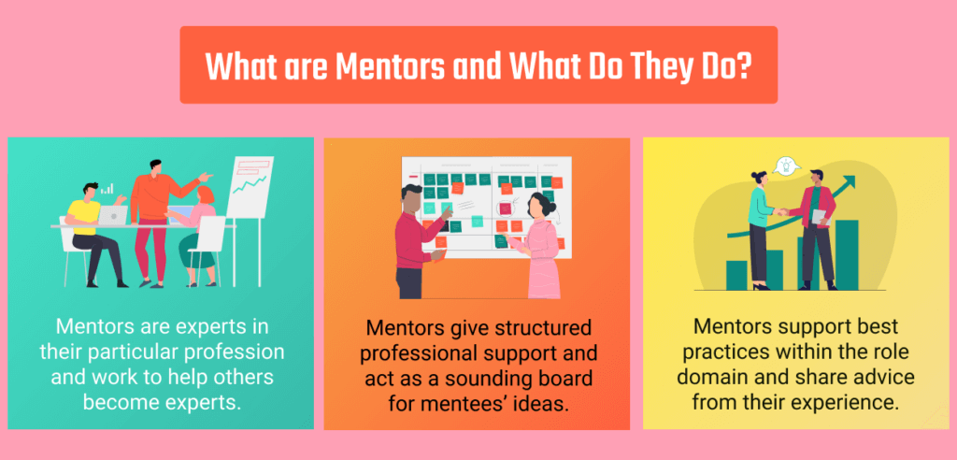
Training and Development Opportunities
In order to empower women, firms find that well-conceived and well implemented mentoring programs are essential.
  Mentors provide assistance in various ways, including feedback on job performance; career counseling; and networking with mentors, advisors, and others to make them better known to people who can influence promotion and career decisions.

Slide 30

Equitable Compensation
Statistically, the pay received by women in the U.S. workforce generally has been below that of men.
  This disparity exists even though the Equal Pay Act of 1963 requires that men and women performing equal work must receive equal pay.
    It is important for supervisors to understand the issue of comparable worth, the concept that jobs should be paid at the same level when they require similar skills and abilities, because it may become a major issue.
    It is even more important for supervisors to identify and support qualified women to train and develop for higher-paying jobs that have been held predominantly by men.

Slide 31

Supervising Employees with Disabilities
The Rehabilitation Act of 1973 requires organizations to develop affirmative-action programs and to reasonably accommodate the employment of persons with disabilities.
  The Americans with Disabilities Act of 1990 applies to employers with 15 or more EEs and identifies coverage for people w/ disabilities.
    The ADA requires employers to provide access to public spaces for people w/ disabilities and make necessary alterations to public accommodations and commercial facilities for accessibility by people with disabilities.

Slide 32
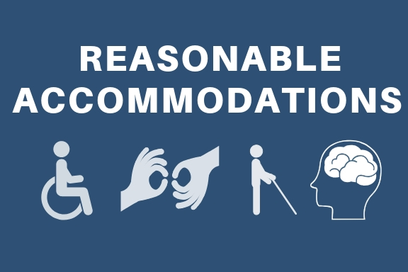
Supervising Employees with Disabilities
Reasonable Accommodation means altering the usual ways to doing things so that an otherwise qualified disabled person can perform the essential duties of a job but without creating an undue hardship for the employer.
  Undue hardship means an alteration that would require a significant expense or an unreasonable change in activities on the part of the employer to accommodate the disabled person.
    It is not the responsibility of the employer to speculate about accommodation needs of employees.

Slide 33

Supervising Employees with Disabilities
Supervisors should be familiar with major ADA provisions and, more important, ADA implications for those supervising employees with disabilities.

Slide 34

Supervisor and Employee Attitudes
The ADA is aimed at changing perceptions as well as actions in the workplace.
  The law encourages supervisors and EEs to recognize the abilities, rather than the disabilities, of co-workers and others.
    As much as anything else, attitudes play an important role in organizational efforts to accommodate people with disabilities.

Slide 35
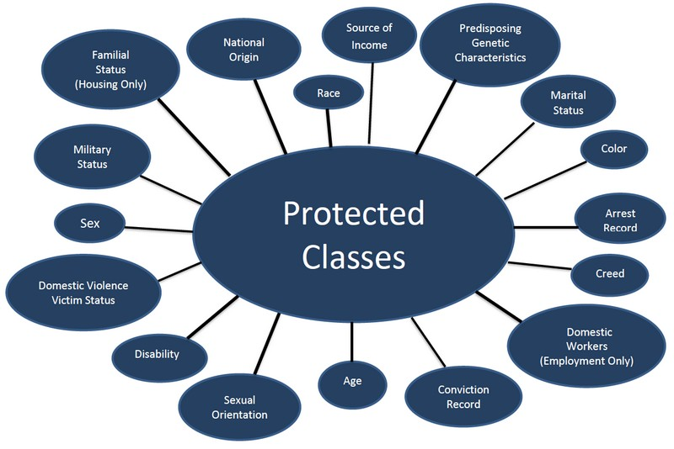
Supervising Older Workers and
Accommodating Different Religious Beliefs
There are a number of protected-group categories in addition to racial and ethnic minorities, women, and people with disabilities, including older EEs and EEs with different religious beliefs:
  When deciding to hire, promote, or discharge, supervisors should be aware of the legal protections afforded to these groups.
    Decisions “to do or not to do” should be documented with sound, objective performance appraisals.

Slide 36

Supervising Older Workers
It is common for newly elevated supervisors to supervise EEs old enough to be their parents or perhaps older, which defines the proverbial “generation gap.”
  Some older EEs will reject the new supervisor and will resist changing their habits and learning new ways.
    In these situations, the supervisor must open channels of communication, ask probing questions, avoid putting the older EE on the defensive, listen actively to them – most have a wealth of experience and information – and involve them in the decision-making process.

Slide 37

Supervising Older Workers
Also, when differences exist in skill sets of younger and older workers, particularly technology skills, the supervisor should provide training and support necessary to help older workers build skills necessary to remain productive.
  Supervisors must use common sense and sound supervisory practices with older EEs.

Slide 38

Accommodating Different Religious Beliefs
Under the Civil Rights Act, most employers are required to afford nondiscriminatory treatment to EEs who hold different religious views.
  Although EEOC and court decisions have not always clearly defined religious discrimination, two principles have evolved:
    Employers must make reasonable accommodations for EEs with different religious beliefs.
    An EE may not create a hostile work environment for others by harassing them about what they do or do not believe.

Slide 39

Accommodating Different Religious Beliefs
If an employer has any doubt that a request for an accommodation is religious in nature (i.e. holidays), the employer is allowed to make further inquiries of the requestor.
  An employer can not deliberately “stay in the dark.”

Slide 40

Managing Employees Around the World
Increasing corporate globalization presents unique challenges for supervisors that can incorporate any of the protected classes of workers employed in multinational corporations.
  A multinational corporation establishes locations, manages production, and delivers services in more than one country.
    The multiplicity of people who interact in these organizations, and the diversity among them, increase the physical and interpersonal boundaries that a supervisor must manage.

Slide 41

Managing Employees Around the World
Supervisors must recognize and consider the cultural and legal demands of managing geographically dispersed EEs.

Slide 42

Building Shared Understanding and Identity
Researchers indicate that in the growing global workplace, differences such as language, work methods and philosophies, cultural identities and practices, and biases about home country power can pose challenges to supervisors charged with productively integrating their workforce.
  For example, corporate policies that originated in one country may not fit the cultural practices of acquired counterparts.

Slide 43

Building Shared Understanding and Identity
Researchers assert that companies should appreciate cultural differences rather than try to erase them and recognize that firms, their employees, and their customers all have deep cultural roots.
  Leaders and managers should be deliberate in helping EEs develop a cosmopolitan attitude by establishing and promoting conceptual frameworks that reflect the appreciation of home-country cultures.

Slide 44


Protected-Group Supervisors
Supervision of legally protected EEs requires both awareness and sensitivity to various factors.
  Additional concerns can arise for supervisors who are themselves members of legally protected categories and who may experience resistance and resentment in their supervisory positions.
    These issues are not unusual and should even be anticipated.

Slide 45
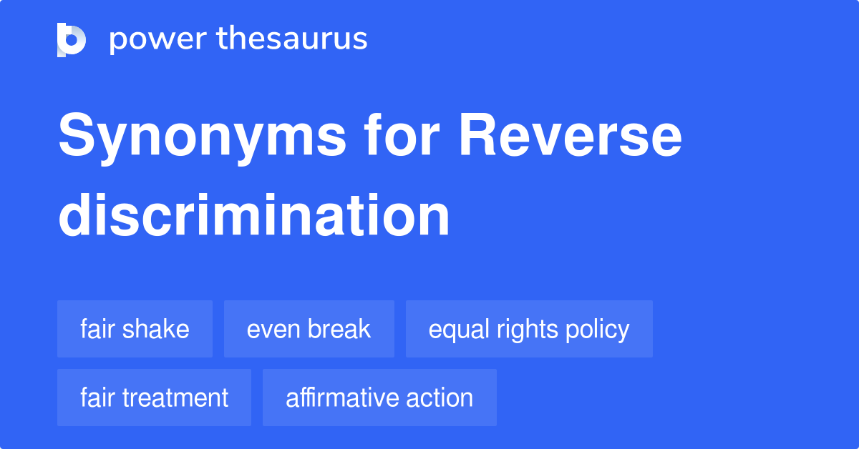
Understanding Reverse Discrimination
The reactions of EEs who are not members of a legally protected group to hiring and promotion decisions are another challenge for supervisors. These EEs may view the promotion of a protected-group EE as reverse discrimination.
  Reverse discrimination may be charged when a more senior or qualified person is denied a job opportunity or promotion because preference has been given to a protected-group individual who may be less qualified or who has less seniority.

Slide 46

Understanding Reverse Discrimination
EEO and affirmative-action programs most often impact white male EEs.
  Some white males feel they lack an equal or a fair opportunity to compete for promotions or higher-paying jobs.
    They interpret the numerical goals of affirmative-action programs as quotas that must be met by hiring and promoting unqualified or less qualified women and minorities.

Slide 47
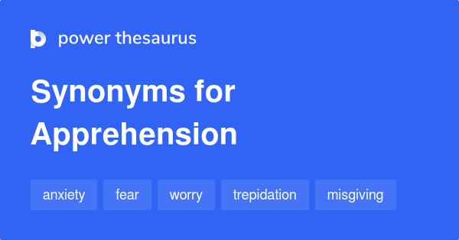
Understanding Reverse Discrimination
Supervisors of integrated racial groups and male and female EEs may be apprehensive of their situations.
  For example, supervisors may be reluctant to discipline anyone so as to avoid charges of favoritism or discrimination.
    Another difficulty is that conflicts and distrust among these various groups may arise and stress interpersonal relationships, thereby impeding the department’s performance.

Slide 48

Understanding Reverse Discrimination
Communication between the supervisor and all groups of EEs is essential, and the supervisor should try to correct misperceptions about any EE’s abilities and qualifications as they occur.
  Whether reverse discrimination exists is not really important.
    Rather, what is important is the supervisor’s response to the feelings of all groups and individuals in an understanding, fair and objective manner.

Slide 49
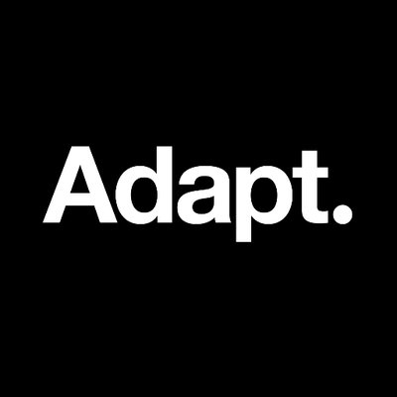
Supervising Well
The Overriding Consideration
Although the diversity and complexity of the workforce varies, a supervisor can take several steps to reduce the likelihood of litigation and to deal with complaints and charges.
  Supervisors must adapt their ways of managing their departments to meet the considerations afforded legally protected EEs.
    In this effort, supervisors should always recognize that the best way to manage all EEs in their departments – protected or not – is to constantly apply principles of good supervision as presented.

Slide 50
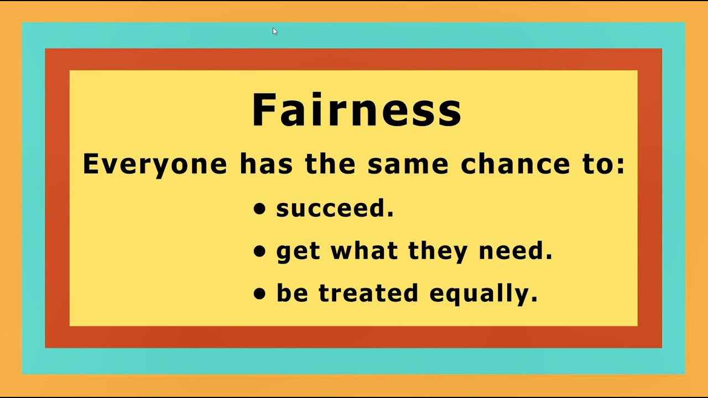
Being Fair in All Supervisory Actions and Decisions
The supervisor must be diligent in their fairness.
  If a protected class EE complains of harassment or discriminatory treatment by a fellow EE, supervisor, or some other person, the supervisor must treat the complaint as a priority.
    In most cases, the supervisor should listen carefully to the nature of the complaint and report it to a higher-level manager or the human resources department for further consideration and direction.

Slide 51
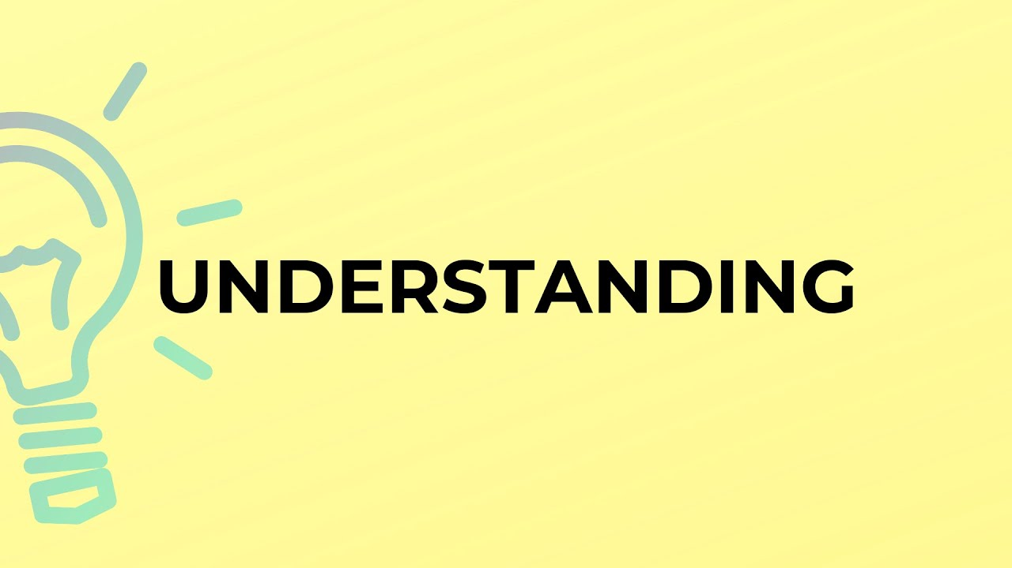
Being Fair in All Supervisory Actions and Decisions
In no way should a supervisor retaliate against the EE who has registered the complaint, even if the supervisor believes the discrimination or harassment allegation is without merit.
  The law protects an EE’s right to challenge management decisions and actions that the EE believes are discriminatory. The supervisor is responsible for making sure that this right is protected.
    Supervising protected classes of EEs requires understanding, sensitivity, and extra fairness when the supervisor is not a member of that group.

Slide 52
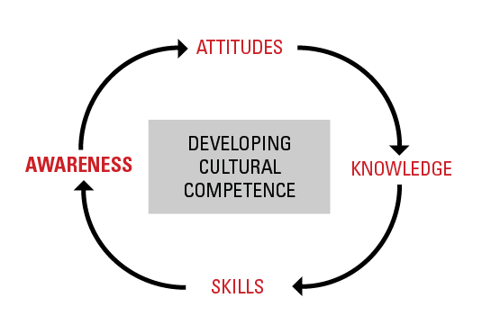
Being Fair in All Supervisory Actions and Decisions
For all EEs, but especially when protected class EEs are part of the departmental work group, supervisors should develop cultural competency.
  Cultural competency means that the supervisor is scrupulously fair, yet can understand and adapt to a variety of cultural communities.
    When assigning work, affording training opportunities, conducting performance appraisals, or taking disciplinary actions – in all supervisory actions and decisions – supervisors must make choices on objective and job-related grounds.

Slide 53
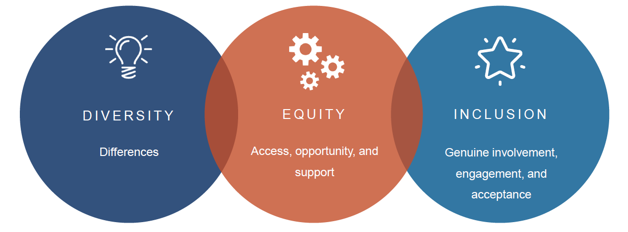
Being Fair in All Supervisory Actions and Decisions
Organizations are encouraged to focus on inclusion, defined as creating and maintaining “a work environment where everyone has an opportunity to fully participate in creative success and where each person is valued for their distinctive skills, experience, and perspectives.”
  It is the responsibility of supervisors to recognize that promoting diversity and inclusion and managing a diverse workforce are integral and significant components of their ongoing responsibilities and challenges.

Slide 54


