Slide 1
activity:
Interview questions
What’s the problem?
How does this affect us?
How can we fix this problem?

Slide 2
1. In a small group setting, meet with someone and have them share personal stories about significant events in their lives that affected them in some way. Take notes about how the person participates and reacts. Report to your counselor the differences between each person you’ve communicated with.
2. Think of a creative way to describe yourself and create a presentation for your counselor
3. Write a five-minute speech. Give it at a meeting of a group
4. Interview a person you know, admire, or respect. Listen to what he has to say, learn as much as you can from this person. Then prepare and deliver to your counselor an introduction of the person, mention why the audience would want to hear this person speak.
5. Attend a public meeting approved by your counselor, take notes, and prepare a report that includes all the points expressed in the meeting with your counselor.
6. Develop a plan to teach a skill or inform someone about something, prepare what you need and carry out a plan. With your counselor, determine how well the person learned the skill.
7. Use desktop publishing to produce a newsletter for your troop or crew. Must include at least three articles and one illustration.
8. Plan a troop or crew court of-honor, campfire program, or an interfaith worship service. Have a council approve it, then write the script and prepare the program. Serve as master of ceremonies.
9. Find out about career opportunities in communication. Pick one and find out the education training, explain why this profession might interest you to the counselor.

Slide 3
Get to know each other
ACTIVITY #1
Pick a number from the basket. (2 min.)
Pair up by numbers. (1 min.)
In two minutes share a story about yourself (5 min.)
You will explain each others story (5 min.)

Slide 4
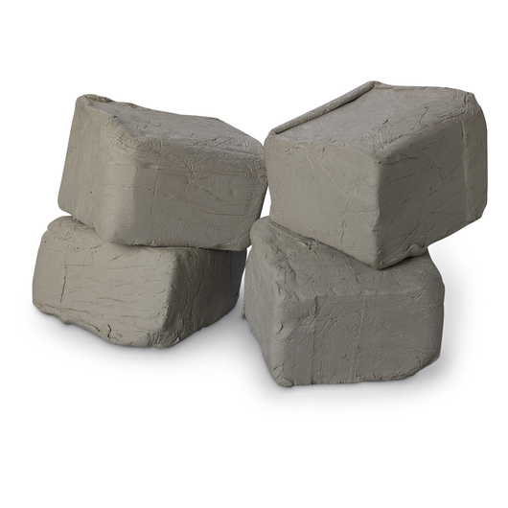
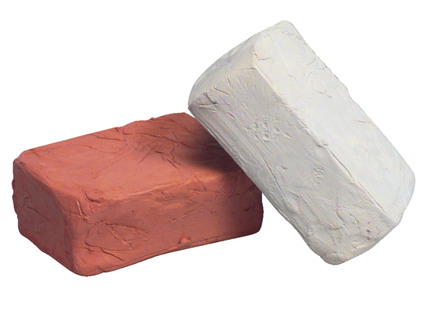
Playing with Clay
ACTIVITY #2
Pick a maximum of five clay colors (1 min.)
Create a mold that describes yourself (10 min.)
Present your mold to the class (2 min.)

Slide 5
GIVE A SPEECH TO THE CLASS
ACTIVITY #3
Think about something you would like to share with the class, you can write it down. (5 min.)
Prepare a short speech for the class. (5 min.)
Give the speech, be sure to speak loud and clear. (5 min)

Slide 6
Communications

Slide 7
WHAT ARE YOU DOING?
Communications R1, R2, and R3 (pg. 2-3)
R2:
- Describe yourself in a creative way
R1:
- Share a personal story
- Take notes and reflect
- Turn in your notes
R3:
- Write a five-minute speech

Slide 8
MERGING WITH ANOTHER MERIT
Public Speaking R1, R2 (pg. 2-3)
R1:
- Give a 3-5 minute introduction of yourself.
R2:
- Give a 3-5 minute speech on a topic of your choice with visual aid.

Slide 9
Sharing stories and taking notes
Communications R1 (pg. 15-19)
When you focus on the speaker and what is being said, you learn, remember, and retain the information more.
Listening is one of the most important skills you can learn.

Slide 10
describe yourself in a creative way
Communications R2 (pg. 7-11)
Not all communication uses words. There are many ways to communicate nonverbally, or “without words”. Nonverbal communication can still use symbols.
Body language is communication through body movements or gestures, It can be as simple as a smile.

Slide 11
ACTIVITY #1
1. Grab an index card and sit with your partner.
2. Introduce yourself to your partner using the following template:
Hi, my name is __________ and two interesting facts about me are ___________ and ___________. (Red number starts first)
3. Ask your partner at least one question as aid for your notes.
4. Write down notes (Ex. He likes music) and observations (Ex. He talks fast) from your partner. (6 min.)
5. With your partner, share what you learned from each other to the class
(2 minutes each.)

Slide 12
MILESTONES SO FAR
Communication
R1 -
R2 -
R3 -
Public Speaking
R1 -
R2 -
TRY GUESSING HOW MANY HAVE WE ACCOMPLISHED

Slide 13
MILESTONES SO FAR
Communication
R1 - DONE
R2 - NOT DONE
R3 - NOT DONE
Public Speaking
R1 - DONE
R2 - NOT DONE
IF YOU GUESSED TWO OUT OF FIVE, YOU ARE RIGHT

Slide 14
MILESTONES SO FAR
Communication
R1 - DONE - We shared a facts about ourselves
R2 - NOT DONE - Haven’t described ourselves in a creative way
R3 - NOT DONE - Missing a 3-5 minute speech
Public Speaking
R1 - DONE - We gave a 3-5 minute introduction of ourselves
R2 - NOT DONE - Missing a 3-5 minute speech with visual aid
AND THIS IS WHY

Slide 15
write a 5 min speech
Communications R3 (pg. 27-35)
A short speech consists of an introduction, the main body, and a closing. The trick is to know what you are going to say and to organize it well.
Your speech will be better if you choose a topic that you are personally familiar with and know about.

Slide 16
ACTIVITY #2
1. Think of a creative way to describe yourself using clay
(3 minutes)
2. Create your piece of work with clay, it will serve as a visual aid.
(5 minutes)
3. Present it to the class in no more than two minutes.
(2 minutes)

Slide 17
MILESTONES SO FAR
Communication
R1 - DONE - We shared a facts about ourselves
R2 - NOT DONE - Haven’t described ourselves in a creative way
R3 - NOT DONE - Missing a 3-5 minute speech
Public Speaking
R1 - DONE - We gave a 3-5 minute introduction of ourselves
R2 - NOT DONE - Missing a 3-5 minute speech with visual aid
DID WE COMPLETED THE MISSING ASSIGNMENTS?

Slide 18
MILESTONES SO FAR
Communication
R1 - DONE - We shared a facts about ourselves
R2 - DONE - We described ourselves in a creative way
R3 - DONE - We gave a 3-5 minute speech
Public Speaking
R1 - DONE - We gave a 3-5 minute introduction of ourselves
R2 - DONE -We gave a 3-5 minute speech with visual aid
YES, AND HERE IS WHY

Slide 19
Communications R4:
interview a person Interview a person you know, admire, or respect.
How to conduct an interview:
https://www.youtube.com/watch?v=WEdbKoY4wVs
Interview Jason
Interview him (using your 3 questions)

Slide 20
Communications R5:
Citizenship
attend a public mtg
Write a report of what was discussed in the meeting

Slide 21
Communications R6
with public speaking (R5)
Teach about the parliamentary rule

Slide 22
Communications R7 (C):
create a Brochure about
boy scouts
The brochure must have
Name and Logo
Brochure Cover
Slogan
Main Text
Contact Information

Slide 24
Name and Logo
Your business's name and logo are the building blocks your brochure should be designed around.
Your logo be memorable, bright and eye catching
Your logo and name should be displayed on the brochure in a prominent position and on the front and back covers if possible.

Slide 25
Brochure Cover The cover image should make people want to own a piece of the dream you are advertising. If the brochure is showcasing a vacation destination, choose an image that makes the destination look both exotic and inviting.
Make sure your product is easily visible in the image -- it should be a bright color and at the center of the image’s focus.

Slide 26
Slogan Your slogan is a way to impart the basic of the organization.
Whatever the case, select a quote that is representative of your product or service and that is short and catch.
. The slogan should be a hook that is memorable or witty.
Like if you sell a ball

Slide 27
Main Text
Your main text is found in the center of the brochure, and it contains all of the relevant product or service information. Your should include pricing information and a product guide. List the destinations and outings. If you are marketing a product line, list the types of product you are selling, and give a synopsis of each.

Slide 28
Communications R8:
court of honor (graduation)
1
2
https://youtu.be/DCWv56hsj6c
3
The court of honor members enter
Standard Flag Ceremony
The Pledge of Allegiance
Open ceremony
Awards presentations
Close or Closing ceremony
4
5
https://youtu.be/XBRoEV51gJk
6
https://youtu.be/ev1duZ5vjII

Slide 29
Communications R9:
CREATE PRES. ABOUT CAREERS
In the earth, there are many funny and amazing
.
Find your best interesting jobs .

Slide 30
Communications R9:
CREATE PRES. ABOUT CAREERS
Advertising
Communication Education
Electronic Media
Journalism
Public Relations
Theater/Performing Arts/Dramatic Arts

Slide 31
-If you are creative and like to write, you may want to be a copywriter. This professional writes
the text or copy for advertisement
and commercials.
-There are many more positions in newscasting or talk shows than just the person on air.
-Technical, creative, sales and administrative careers
-Video/Audio Librarian, Community Relations Director, Unit Manager,
Video/Audio Editor
https://youtu.be/khxkjXipbd0
-Sales Manager, Advertising or Marketing Specialist, Media Planner, Creative Director
-Bachelor’s degree related to
the subject you will be teaching
-School Speech Teacher, Drama Director, College or University Professor.
https://youtu.be/4brYk0HAPnE
https://youtu.be/Jk4ynntSOSI

Slide 32
-It involves researching and gathering information and communicating it to the public.
-Reporter, Editor, Photographer,
News Service Researcher
-Many actors do not become stars. They just work in educational, community, and professional theaters. There are many other supporting jobs though like scriptwriter, producer, and costume designer.
-Movie Actor,
Musical Actor
https://youtu.be/5uN9sf-z0z0
-This field entails
controlling how the public
sees an individual or organization.
-Advertising Manager, Sales Manager, Media Analyst, Media Planner, Creative Director
https://youtu.be/HZ0yZGl0zzA
https://youtu.be/uDRaU_JV-4U

