Slide 1

Entrepreneurship
Class Presentation SUMM Consolidate. Session 6
Entrepreneurship
  Theory, Process, Practice -12th Edition
    Donald F. Kuratko, Cengage Learning, Boston, MA 2024
      ISBN: 978-0-357-89950-2

Slide 2

Purpose of a Business Plan
A Business Plan is a Written Map that Explains:
  What The Business Is
  How It Will Operate
  Who The Customers Are
  How It Will Make Money
  How It Will Grow
    It is Essential for: Attracting Investors, Guiding Operations, Evaluating Risks, and Setting Measurable Goals.

Slide 3

Business Plan Pitfalls
Five Common Planning Pitfalls (and how to Avoid Them)
  No Realistic Goals
    Create Timelines and Action Steps
  Failure to Anticipate Problems
    Identify Risks and Backup Plans
  Lack of Commitment
    Show Dedication and Invest Effort/Resources
  Lack of Experience
    Build a Qualified Team or Seek Expertise
  No Target Market
    Identify a Clear Customer Segment

Slide 4
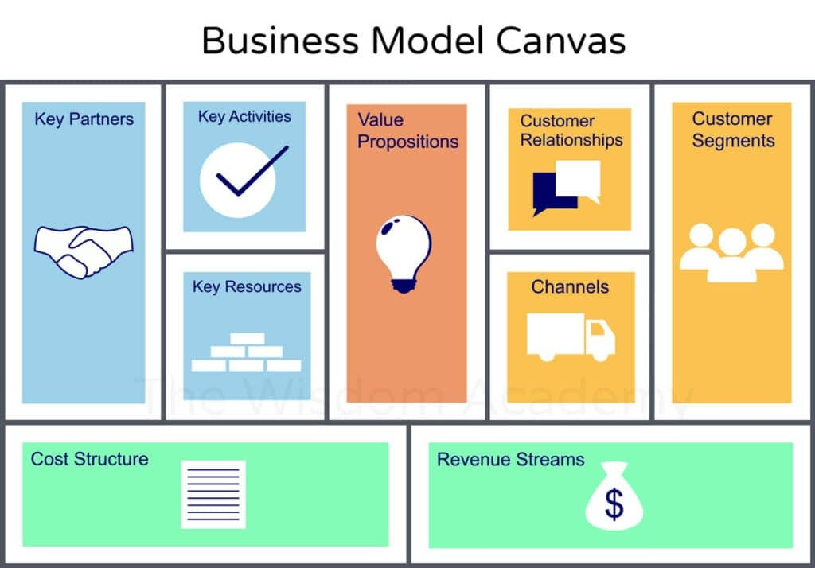
Business Model Canvas
A Business Model Canvas (BMC) is a strategic management tool used to describe, design, analyze, and improve a business model on a single page.
  It helps entrepreneurs, startups, and established companies understand how their business creates, delivers, and captures value.

Slide 5
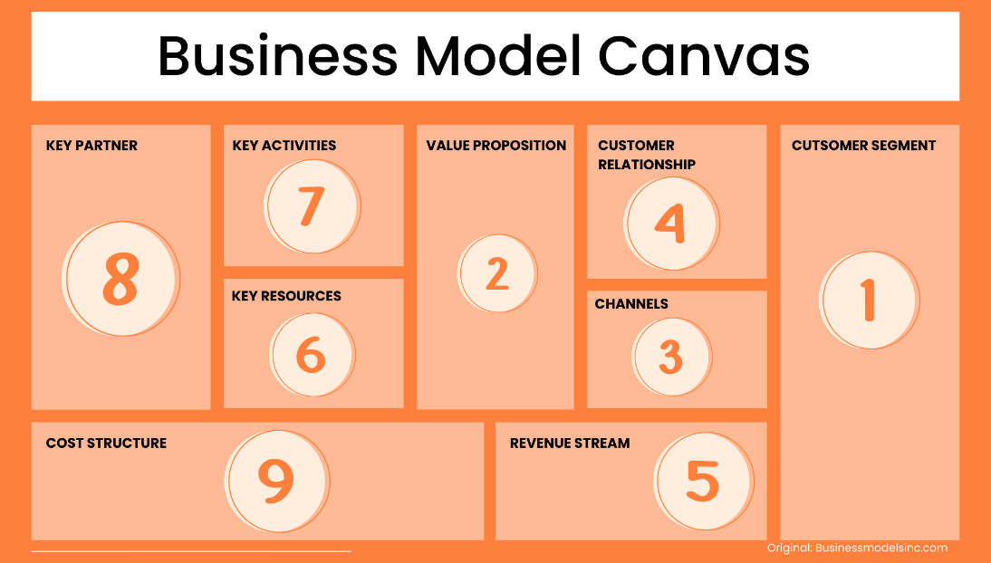
Business Model Canvas
9 Core Elements
This Tool Helps Structure a Venture Before Writing a Full Plan. It is divided into Nine Building Blocks.
  Value Proposition
  Customer Segments
  Channels
  Customer Relationships
  Revenue Streams
  Key Activities
  Key Resources
  Key Partners
  Cost Structure

Slide 6
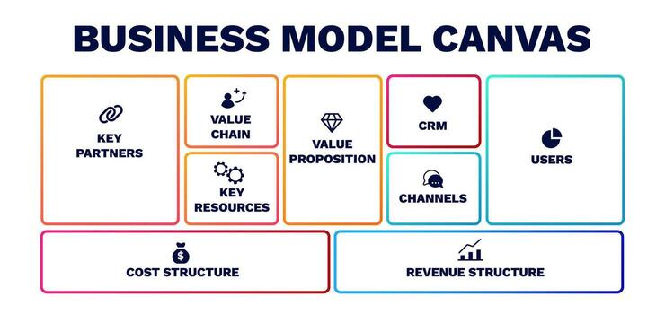
Business Model Canvas
Why Use a Business Model Canvas?
  Provides a clear overview of the entire business on one page.
  Helps identify strengths, weaknesses, and opportunities.
  Facilitates communication among team members and stakeholders.
  Supports innovation and business model redesign.
  Useful for startups seeking investment & businesses planning growth.

Slide 7
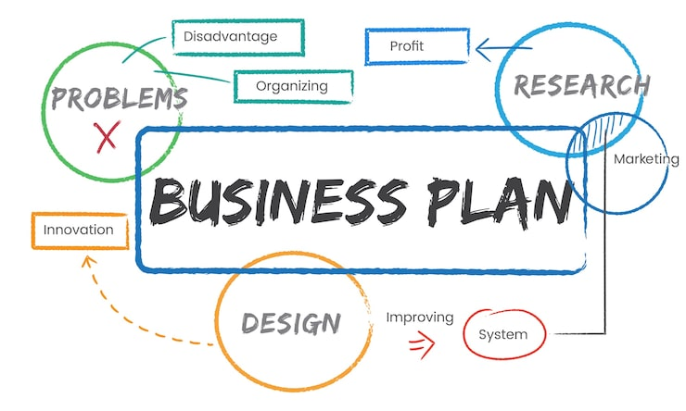
Benefits of Writing a Business Plan
For Entrepreneurs:
  Clarifies Strategy
  Tests Assumptions
  Sets Benchmarks
  Improves Decision-Making
For Investors:
  Evaluates Risk
  Estimates Return
  Assesses Management Capability
  Confirms Market Opportunity

Slide 8
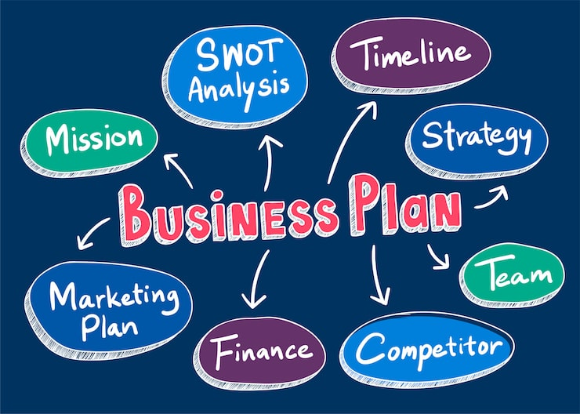
Three Key Perspectives in a Business Plan
A Strong Plan Addresses:
  Entrepreneur Perspective
    Vision and Execution
  Customer Perspective
    Market Need and Demand
  Investor Perspective
    Profitability and Return Potential

Slide 9
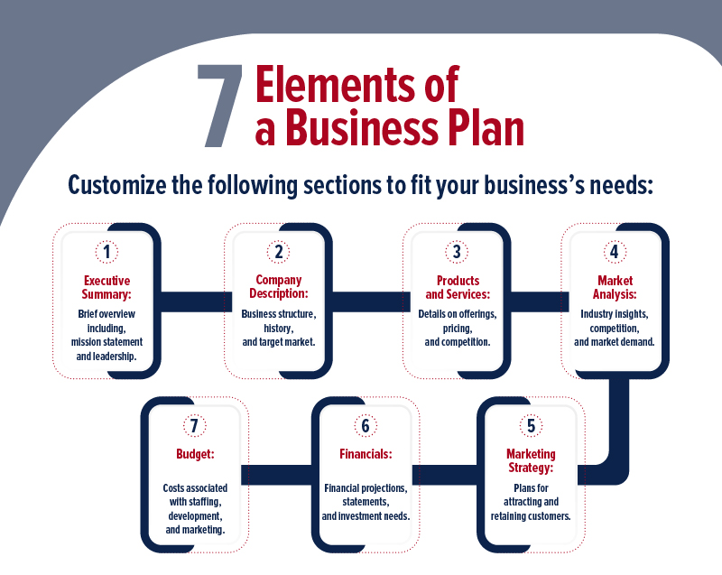
Major Sections of a Business Plan
Typical Structure Includes:
  Executive Summary
  Venture Concept and Valuation Proposition
  Marketing Analysis
  Operations Plan
  Management Team
  Financial Projections
  Risk Analysis
  Exit Strategy
  Milestone Schedule
  Appendix

Slide 10

The 10 Major Sections of a Business Plan
1. Executive Summary
This is the Overview of the Entire Business Plan and is Often the Most Important Section. It Briefly Explains:
  Business Concept
  Value Proposition
  Target Market
  Financial Needs
  Expected Growth
  Benefits to Investors
    Its Goal is to Capture Attention and Motivate Readers to Continue Reviewing the Plan.

Slide 11
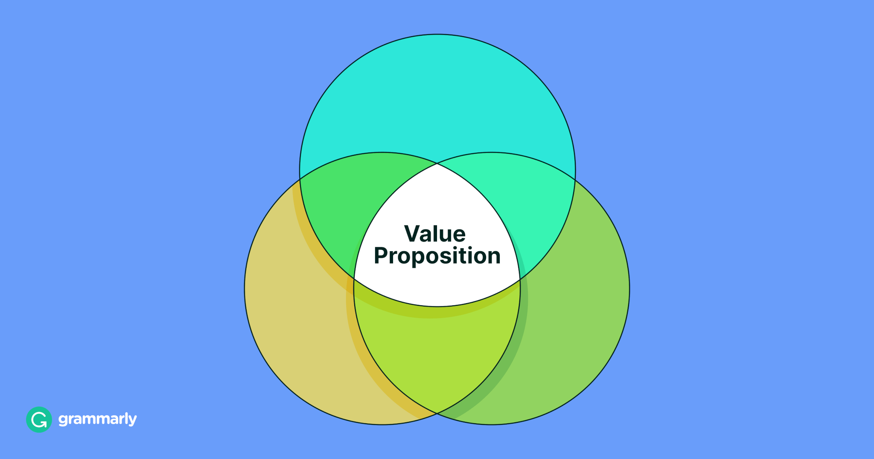
The 10 Major Sections of a Business Plan
2. Venture Concept and Value Proposition
This Section Explains What the Business is and Why it Matters. It Includes:
  Business Description
  Mission and Goals
  Product or Service Details
  Industry Background
  Competitive Advantages
  Uniqueness of the Offering.
    It Answers: What Problem Does this Business Solve?

Slide 12
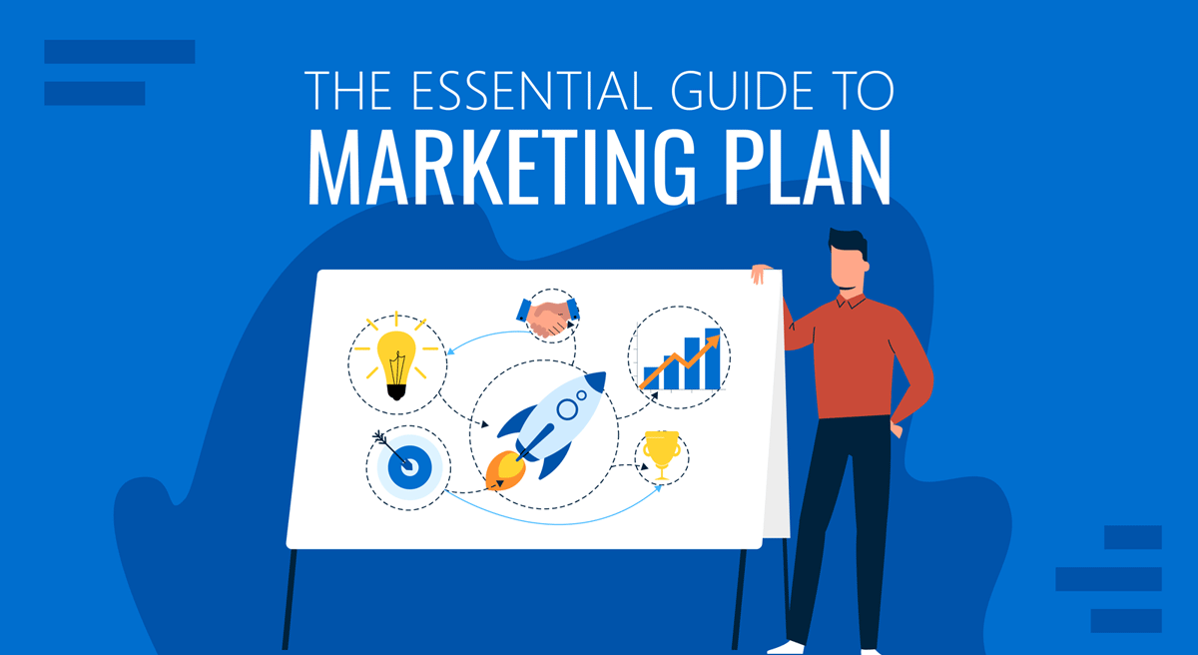
The 10 Major Sections of a Business Plan
3. Marketing Plan
This Section Proves that Customers Exist and Will Buy the Product/Service. It Covers:
  Target Customers
  Market Size and Trends
  Competition Analysis
  Pricing Strategy
  Promotions and Advertising
  Sales Projections
  Go-To-Market Strategy
    It is One of the Most Critical Sections Because Revenue Depends on it.

Slide 13

The 10 Major Sections of a Business Plan
4. Operations Plan
This Explains How the Business Will Function Day-to-Day. It Includes:
  Location and Facilities
  Production Process
  Equipment Needs
  Distribution Channels
  Suppliers
  Staffing Requirements
  Logistics
    It Shows how the Business Delivers Value Efficiently.

Slide 14

The 10 Major Sections of a Business Plan
5. Management Team
This Section Introduces the People Running the Business. It Describes:
  Leadership Roles
  Experience and Qualifications
  Organizational Structure
  Advisors and Consultants
  Ownership Structure
    Investors Often Evaluate this Section Closely Because Strong Leadership Increases Success Chances.

Slide 15

The 10 Major Sections of a Business Plan
6. Financial Plan
This Demonstrates Whether the Business is Profitable and Sustainable. It Includes Projections such as:
  Income Statements
  Balance Sheets
  Cash-Flow Forecasts
  Break-Even Analysis
  Funding Requirements
    This Section Proves Financial Feasibility.

Slide 16
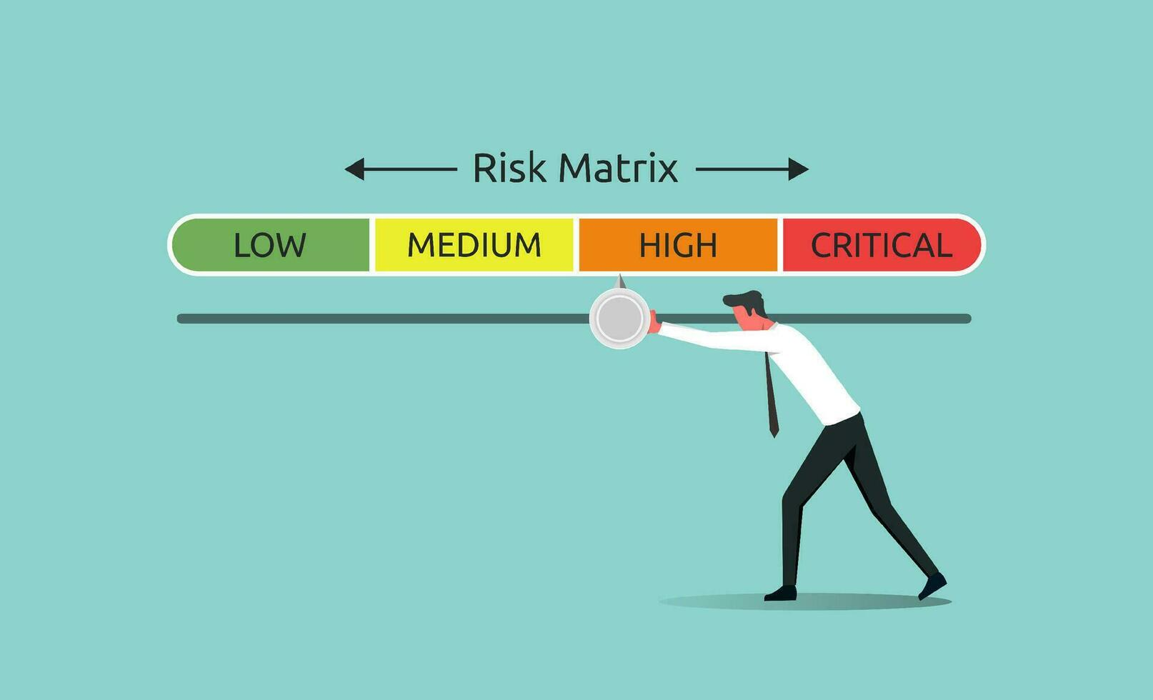
The 10 Major Sections of a Business Plan
7. Critical Risks
This Section Identifies Possible Problems and Backup Strategies. It Discusses:
  Market Uncertainties
  Competition Threats
  Cost Overruns
  Operational Delays
  Management Risks
  Contingency Plans
    Showing Awareness of Risks Builds Credibility with Investors.

Slide 17

The 10 Major Sections of a Business Plan
8. Harvest (Exit) Strategy
This Explains How Investors Will Eventually Earn Returns:
  Common Exit Strategies Include:
    Selling the Company
    Merging with Another Firm
    Public Stock Offering (IPO)
    Leadership Transition Planning
      It Reassures Investors There is a Path to Liquidity.

Slide 18

The 10 Major Sections of a Business Plan
9. Milestone Schedule
This Provides a Timeline of Important Business Goals. Examples Include:
  Product Development Completion
  Hiring Key Staff
  First Sales
  Partnerships Secured
  Expansion Phases
    It Shows Realistic Planning and Progress Tracking

Slide 19

The 10 Major Sections of a Business Plan
10. Appendix (or Supporting Documents)
This Section Contains Extra Evidence that Strengthens the Plan. It May Include:
  Resumes of Team Members
  Technical Diagrams
  Legal Documents
  Market Research Data
  Financial Spreadsheets
  References or Citations
    It supports Claims Made in Earlier Sections Without Cluttering the Main Plan.

Slide 20

The 10 Major Sections of a Business Plan
Key Takeaway
Together, these 10 sections explain what the business is, who it serves, how it operates, why it will succeed, what risks exist, and how investors benefit.
  A strong business plan integrates all sections into one clear strategy.

Slide 21

The Pitch
Presenting the Plan
An Effective Pitch Should:
  Explain the Problem Solved
  Identify the Target Market
  Show the Revenue Model
  Highlight Team Strengths
  Present Financial Metrics
  Motivate Investors to Continue Discussion

Slide 22

Understanding the Curriculum
A Business Plan is Not Just Paperwork. It is a Strategic Thinking Tool.
  Planning Reduces Risk
    Writing a Plan Forces Entrepreneurs to Analyze Weaknesses Before Investing Time and Money.
  Market Validation Matters Most
    Investors Care More About Demand Than Creativity Alone.
  Numbers Must Support the Idea
    Financial Projections Determine Whether a Venture is Realistic.
  Execution Depends on People
    A Strong Management Team Increases Credibility
  Flexibility is Essential
    Plans Should Adapt as Markets Change

Slide 23
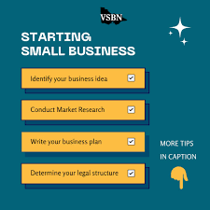
Application of the Curriculum
Example 1: Starting a Small Business
  If Opening a Café Use the Canvas to Define:
    Target Customers (Students – Commuters)
    Value Proposition (Fast Service – Specialty Drinks)
    Revenue Streams (Coffee – Pastries – Subscriptions)
    Cost Structure (Rent – Supplies – Labor)
      Then Expand into a Full Plan

Slide 24

Application of the Curriculum
Example 2: Applying for Funding
  Investors Will Expect:
    Market Research
    Financial Forecasts
    Competitive Advantage
    Growth Strategy
      Without These, Funding is Unlikely.

Slide 25

Application of the Curriculum
Example 3: Launching a Startup App
  You Would:
    Identify a Real User Problem
    Define a Customer Segment
    Estimate Development Costs
    Project Revenue Sources
    Create Milestones for Release
    Prepare a Pitch Deck

Slide 26
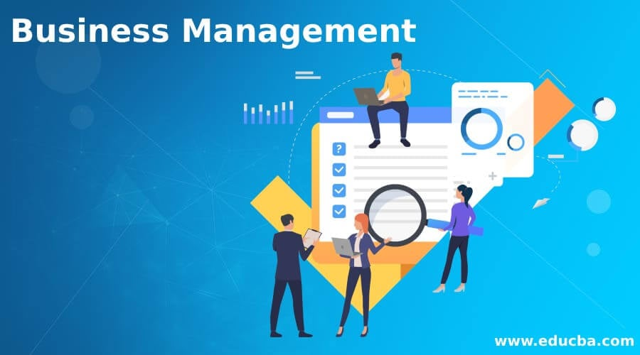
Application of the Curriculum
Example 4: Managing an Existing Business
  Business Plans Should be Updated When:
    Entering New Markets
    Hiring Leadership
    Launching New Products
    Seeking Additional Funding
    Responding the Competition

Slide 27
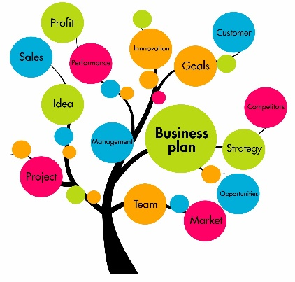
Key Takeaway
An Effective Business Plan:
  Clarifies Strategy
  Proves Market Demand
  Demonstrates Financial Viability
  Communicates Vision to Investors
  Guides Long-Term Growth
    It is Both a Planning Tool and a Persuasion Tool – Helping Entrepreneurs think Clearly and Convince Others to Support Their Venture.

Slide 28
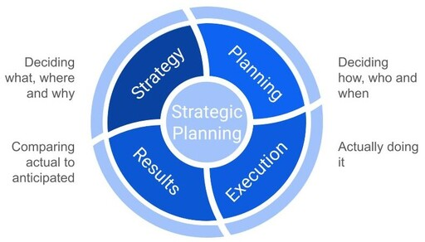
Strategic Planning in Growing Ventures
Strategic Planning Helps Entrepreneurs Guide Expansion by Aligning Internal Strengths with External Opportunities.
  Core Steps of Strategic Planning
    Analyze Internal and External Environments (SWOT)
    Define Mission, Objectives, and Strategies
    Implement Strategy
    Evaluate Performance
    Adjust Using Feedback
      Planning Improves Survival Rates and Performance.
      Firms with Structured Plans Outperform Those without Them.

Slide 29
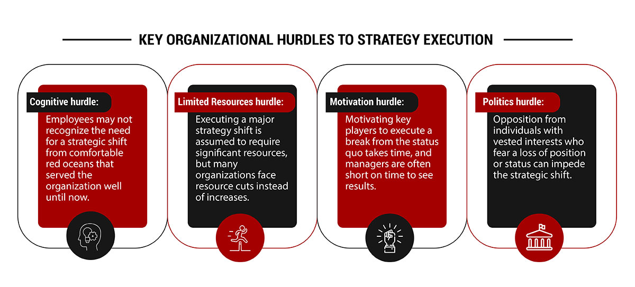
Why Entrepreneurs Often Avoid Planning
Common Barriers Include:
  Lack of Time
  Limited Planning Knowledge
  Lack of Expertise
  Fear of Sharing Information
  Perceived Cost
    Despite These Barriers, Planning is Strongly Linked to Business Success.

Slide 30

Five Strategic Mistakes Entrepreneurs Must Avoid
According to Michael Porter:
  Confusing Fast Growth Industries with Attractive Industries
  Copying Competitors without Differentiation
  Pursuing Unsustainable Competitive Positions
  Sacrificing Strategy for Rapid Growth
  Failing to Communicate Strategy to Employees

Slide 31

Entrepreneurial + Strategic Actions Create Wealth
Growth Comes from Combining:
  Innovation
  Networks
  Internationalization
  Organizational Learning
  Leadership and Governance
  Expansion Strategy

Slide 32
The Entrepreneurial Strategy Matrix
Risk vs. Innovation
Businesses Fall Into Four Categories:
  Best Position: High Innovation + Low Risk
Innovation | Risk | Strategy
High | Low | Move Fast and Protect Advantage
High | High | Reduce Costs and Share Risk
Low | Low | Maintain Stability
Low | High | Improve Innovation or Exit

Slide 33
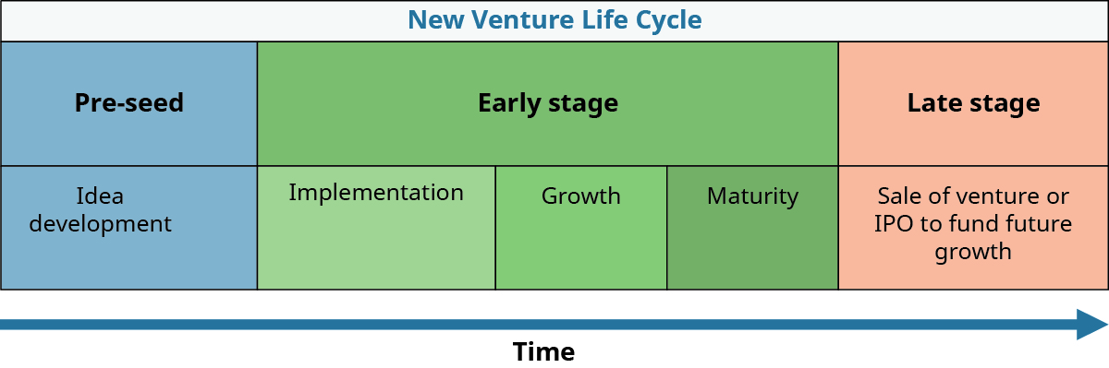
Venture Life Cycle Stages
Every Business Progresses Through:
  New Venture Development
  Start-Up
  Growth
  Stabilization
  Innovation or Decline
    Growth Stage is the Most Difficult Because Leadership Style Must Evolve.

Slide 34

Transition from Entrepreneur to Manager
As a Firm Grows:
  Entrepreneurs Shift From:
    Creativity – Flexibility – Independence
  To:
    Systems – Delegation – Structure – Teamwork
      Balancing Both Mindsets is Essential for Long-Term Success.

Slide 35
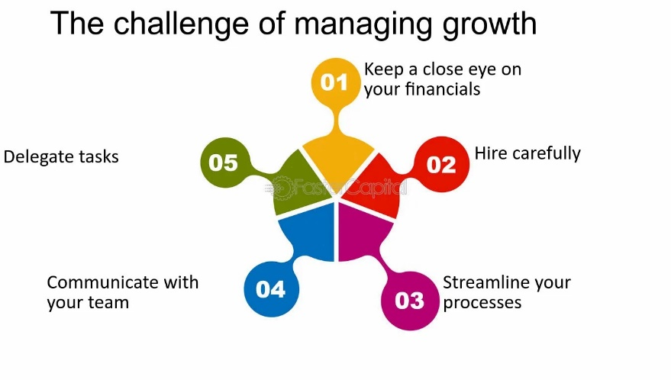
Managing Growth Challenges
During Expansion, Firms Must Manage:
  Control
    Build Trust-Based Systems
  Responsibility
    Encourage Ownership Across Employees
  Failure Tolerance
    Support Learning from Mistakes
  Change Adaptation
    Maintain Flexibility While Scaling

Slide 36

Managing Organizational Paradoxes
Growing Firms Must Balance:
  Bureaucracy vs. Flexibility
  Cost vs. Quality vs. Innovation
  Control vs. Decentralization
    Successful Companies Manage Contradictions Instead of Eliminating Them.

Slide 37

Breaking Through the “Growth Wall”
Successful Scaling Firms:
  Anticipate Future Size Early
  Hire Ahead of Need
  Reinforce Company Vision
  Introduce Structure Gradually
  Minimize Hierarchy
  Give Employees Ownership Stakes

Slide 38

Growth Hacking
Growth Hacking Combines:
  Marketing Experimentation
  Customer Data Analytics
  Coding and AI Automation
    It Enables Rapid, Cost-Efficient Scaling Through Continuous Testing.

Slide 39
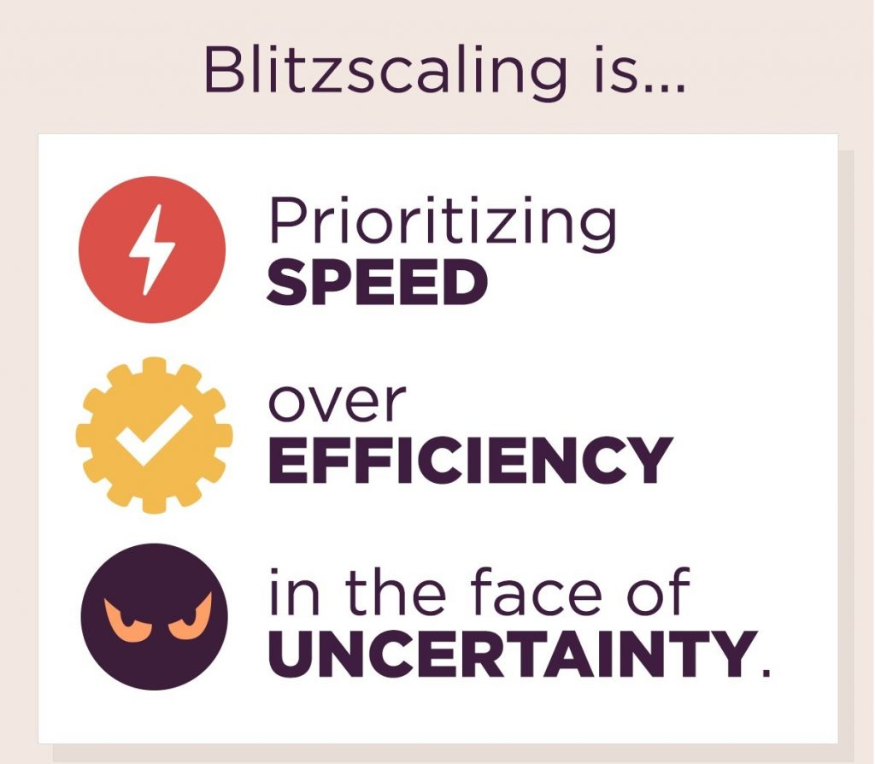
Blitzscaling
Blitzscaling is Prioritizing Speed Over Efficiency to Dominate Markets Quickly.
  Best Suited For:
    Software – Digital Platforms – Tech Startups
  Risks Include:
    Inefficiency – Ethical Shortcuts – Cultural Instability – Capital Burn Rate

Slide 40
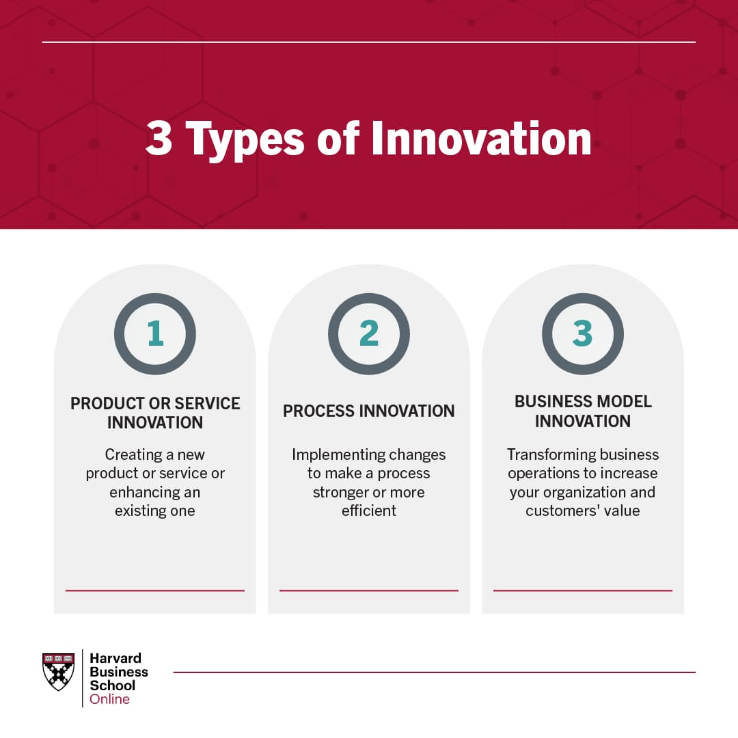
Building an Entrepreneurial Company
To Stay Innovative During Growth Leaders Must:
  Share Vision
  Empower Employees
  Reward Innovation
  Tolerate Failure
  Maintain Flexible Operations
  Create Venture Teams

Slide 41

Unique Challenges of Growing Small Firms
Common Issues Include:
  One-Person-Brand Syndrome
    Failure to Delegate Slows Growth.
  Time Management
    Entrepreneurs Must Prioritize Tasks Strategically.
  Community Expectations
    Owners Face Pressure for Leadership and Donations.
  Continuous Learning
    Adaptation is Essential in Changing Markets

Slide 42
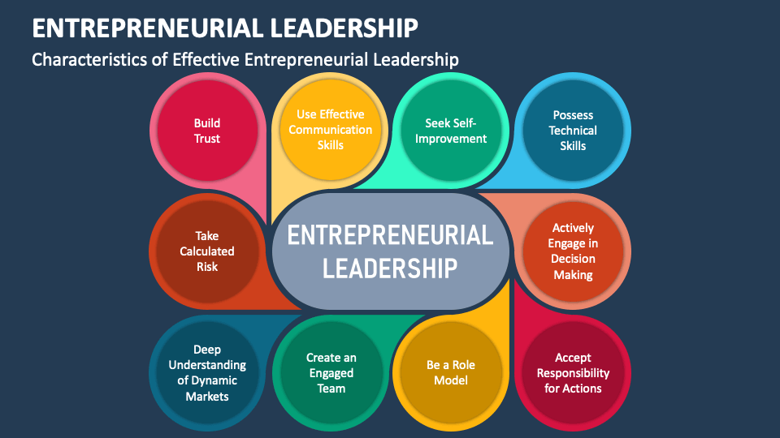
Entrepreneurial Leadership
Strong Growth Leaders:
  Anticipate Change
  Remain Flexible
  Think Strategically
  Inspire Innovation
  Align Teams Around Vision
    Strategic Leadership Combines Visionary Thinking and Managerial Execution.

Slide 43

Key Takeaways
This Chapter Teaches that Growth is Not Automatic – It Must be Managed Strategically.
  Growth Requires Structure
    Informal Planning Works Early, but Scaling Requires Systems.
  Innovation Must Continue During Expansion
    Companies that Stop Innovating Decline.
  Leadership Style Must Evolve
    Founders Must Transition from Doers to Coordinators.
  Culture Determines Scalability
    Trust, Teamwork, and Flexibility Enable Sustainable Growth.
  Strategy Must Guide Expansion
    Growing Fast without Direction can Destroy a Company.

Slide 44
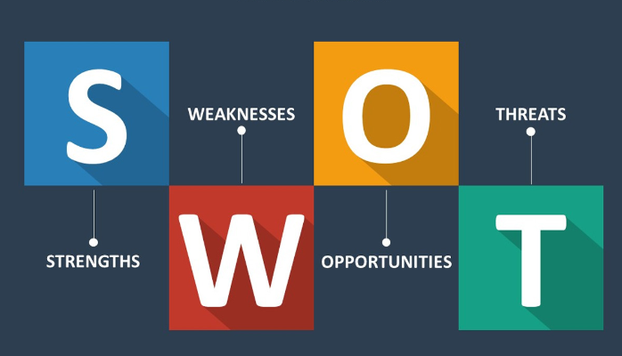
Application
How to Use this in Real Life
1. Use SWOT Before Expanding
  Before Opening a Second Location, Analyze:
    Strengths (Brand Reputation)
    Weaknesses (Staff Shortage)
    Opportunities (New Market Demand)
    Threats (Local Competition)

Slide 45

Application
How to Use this in Real Life
2. Avoid the “Copy Competitor” Trap
  Instead of Copying Pricing Models Create Differentiation Through:
    Service Speed
    Personalization
    Niche Specialization
    Technology Integration

Slide 46
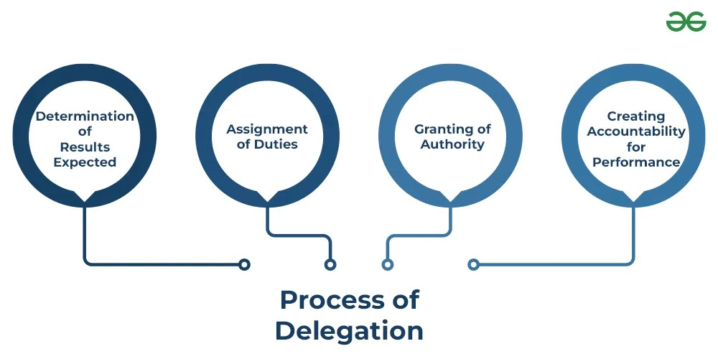
Application
How to Use this in Real Life
3. Transition from Doing Everything Yourself
  Early-Stage:
    Founder Handles Operations.
  Growth-Stage:
    Founder Builds Systems and Teams.
      Example: Delegate Scheduling, Bookkeeping, and Hiring Processes

Slide 47
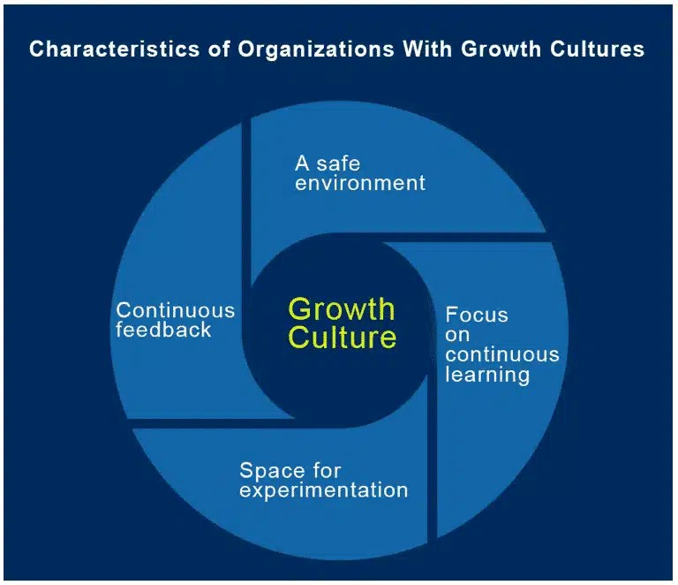
Application
How to Use this in Real Life
4. Build a Growth Culture
  Encourage Employees to:
    Suggest Improvements
    Test Ideas
    Solve Problems
    Collaborate Across Departments
      This Increases Innovation Capacity.

Slide 48

Application
How to Use this in Real Life
5. Decide Whether Blitzscaling Fits Your Business
  Good Candidates:
    Apps – SaaS Platforms – Marketplaces
  Poor Candidates:
    Manufacturing – Healthcare Services – Hardware Products
      Choose Strategy Based on Industry Structure.

Slide 49
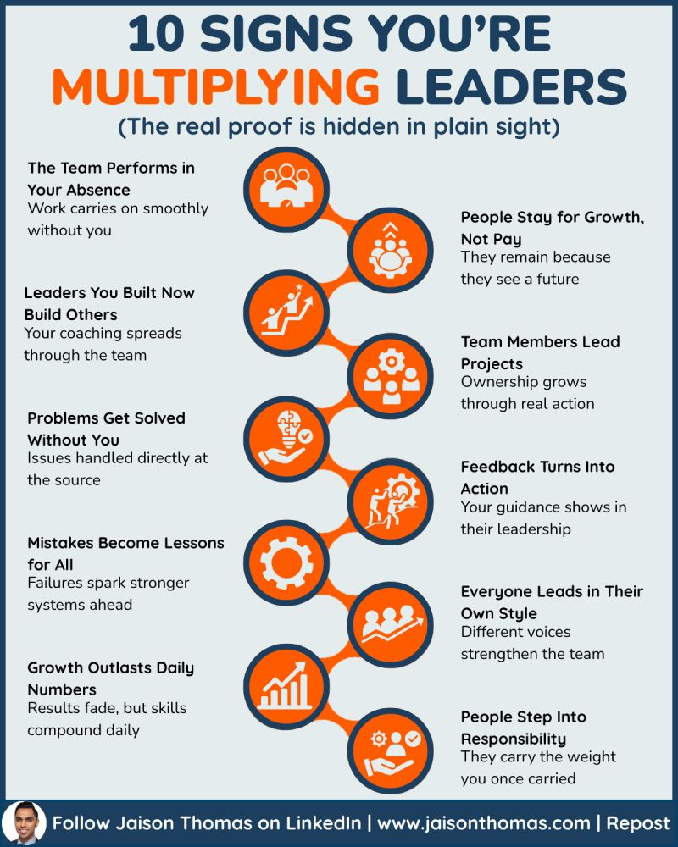
Application
How to Use this in Real Life
6. Break the One-Person-Band Pattern
  Create:
    Documented Procedures
    Department Leads
    Accountability Systems
    Decision Frameworks
      This Multiplies Leadership Capacity

Slide 50
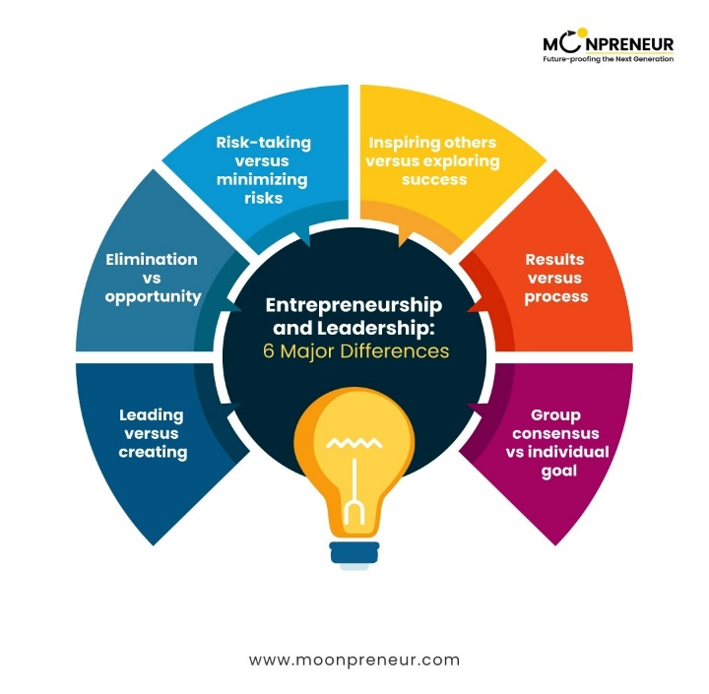
Application
How to Use this in Real Life
7. Apply Entrepreneurial Leadership Daily
  Practice:
    Thinking Long-Term
    Staying Adaptable
    Communicating Vision Clearly
    Balancing Risk with Planning
      These Habits Support Sustainable Scaling.

Slide 51

Final Insight
The Central Message of the Curriculum is:
  Successful Ventures Don’t Just Grow –
    They Scale Intentionally Through Planning, Leadership, Evolution, Innovation Culture, and Strategic Positioning.

Slide 52


