Slide 1
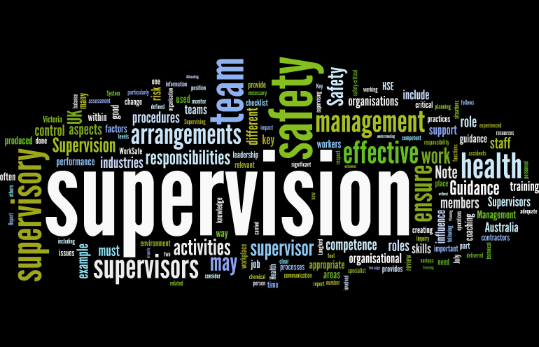
Supervision
Supervision
  Concepts and Practices of Management, 13th Edition
    Edwin C. Leonard, Jr., Ph.D. and Kelly A. Trusty, Ph.D. Cengage Learning, Boston, MA 2013
      ISBN: 978-1-285-86637-6

Slide 2

Part One: Supervisory Management Overview and Challenges
Chapter One: The Supervisory Challenge
  After studying this chapter, you will be able to:
    Understand that we are in difficult times.
    Explain the demands and rewards of being a supervisor.
    Describe the contributions of four schools of management thought.
    Identify the trends that will affect supervisors.
    Explain why supervisors must continually grow and develop.

Slide 3

Difficult Times
What does it mean to be a supervisor in uncertain times?
  These recent years have been chaotic, uncertain, and unpredictable.
  Virtually every aspect of contemporary life has undergone change.
  These have certainly been times that try men’s souls.
    Major changes will continue to take place, and continuing change will challenge every person in every organization.

Slide 4


Prepare and Plan
In order to be successful in these difficult times, supervisors must prepare for and plan to cope with these trends, factors, and problems requiring attention and more effective management.
  Supervisors will need to obtain better performance from their human resources and to do so in a constantly changing environment.

Slide 5

Managers and Supervisors
Most people obtain their first management experience in supervisory management positions.
  Supervision has become more complex, sophisticated, demanding, and it requires professional and interpersonal skills.

Slide 6

Schools of Management Thought
Management practices can be traced throughout history.
  Many early schools of thought still influence the way people approach the supervisory task.

Slide 7


Schools of Management Thought
Four Approaches to Management
  The Scientific Management Approach
  The Functional Approach
  The Human Relations-Behavioral Approach
  The Quantitative-Systems Approach

Slide 8
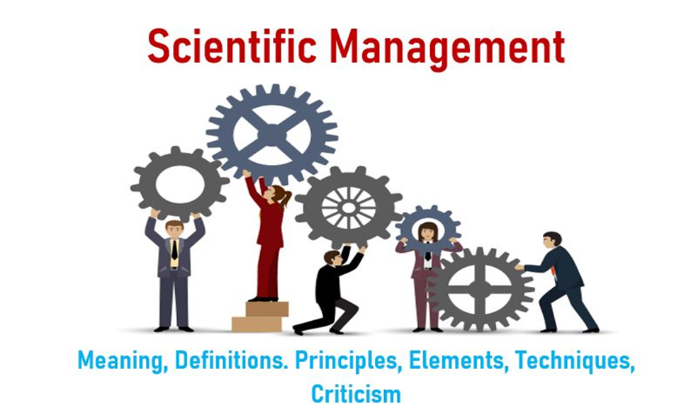
The Scientific Management Approach
Frederick Taylor is the Father of Scientific Management.
  He believed that a manager’s job was to perform mental tasks, such as determining the “one best way” to do a job.
    He focused on determining the most efficient ways to increase output and productivity.

Slide 9

The Scientific Management Approach
The principles of Scientific Management, include:
  Analyze the tasks associated with each job.
    Use the principles of science to find the best way to perform the work.
  Recruit the EE best suited to perform the job.
    Choose the person who has skills, aptitude, and other attributes to do the job.
  Instruct the EE in the one best way to perform the job.
  Reward the accomplishment of the EE.
    Taylor believed workers were economically motivated and would, therefore, do the job the way they were instructed if rewarded with money.
  Cooperate with EEs to ensure the job matches plans and principles.
  Ensure equal division of work and responsibility.

Slide 10

The Functional Approach
The Functional Approach asserts that all managers perform various functions in doing their jobs.
  He identified five functions critical to managerial effectiveness:
  Planning
    Setting down a course of action.
  Organizing
    Designing a structure, with tasks and authority clearly defined.
  Commanding
    Directing subordinate’s actions.
  Coordinating
    Pulling organizational elements toward common objectives.
  Controlling
    Ensuring that plans are carried out.

Slide 11
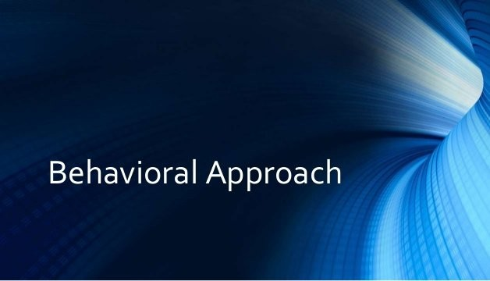
The Human Relations-Behavioral Approach
Elton Mayo conducted a study and hypothesized that if lighting at Western Electric Company in Hawthorne Illinois improved, then productivity would increase.
  Numerous variations in working conditions were introduced, and no matter what change occurred, productivity continued to rise until it stabilized at a relatively high level.
    He concluded that the workers performed differently than normal, because the researchers were observing them.
    This became known as the Hawthorne Effect.

Slide 12
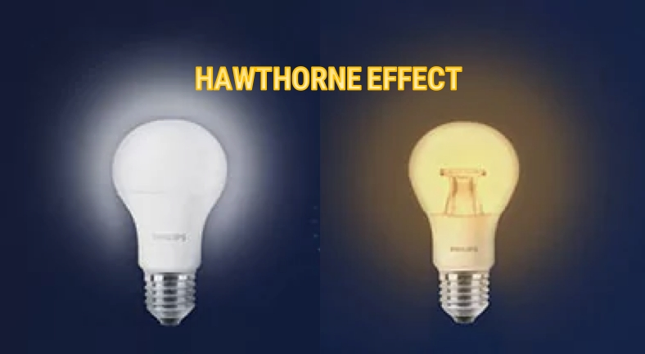
The Human Relations-Behavioral Approach
These studies gave rise to what was known as the human relations movement and later as the behavioral science approach.
  This approach focuses on the behavior of people in organizations.
    Contributions from psychologists, sociologists, and other behavioral disciplines have provided numerous insights into individual and group behavior in work settings and the impact of supervisory practices and procedures on EE motivation and work performance.

Slide 13

The Quantitative-Systems Approaches
The Quantitative-Systems Approaches refers to the field of management that uses mathematical modeling as a foundation.
  These models quantitatively describe the interrelationship of variables through data. The models can be manipulated and outcomes predicted. They are used in decision making.
    Mathematical modeling typically is used to build “what-if” scenarios (i.e. what would be the effect on sales if we reduce EEs by 10%?).

Slide 14
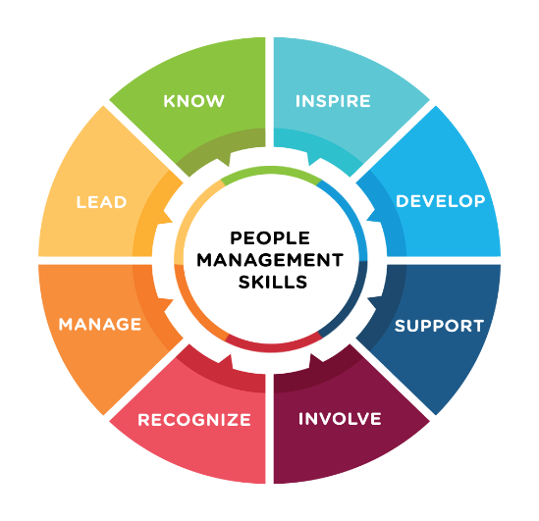
Factors and Trends Affecting the Role of the Supervisor
In the near future, supervisors will have to understand and address many complex environmental factors and trends.
  Although every supervisor is responsible for managing numerous resources, unquestionably the most important, overriding aspect of supervision is the management of people.
    Therefore the nature of the workforce should be of vital concern to the supervisor who plans for the future.

Slide 15

Factors and Trends Affecting the Role of the Supervisor
Finding qualified EEs and assimilating them into the organization is a critical supervisory responsibility.
  The traditional challenges of attracting and retaining the most qualified EEs is overshadowed by the challenge of leading and motivating an increasingly changing workforce.
    The most significant characteristic of this changing workforce is diversity.
    Organizations are composed of EEs with different cultural, ethnic, gender, age, educational level, racial, and lifestyle characteristics. The supervisor will need to get people from many different cultures to work together.

Slide 16

Population and Workforce Growth
Both the population and workforce will continue to grow.
  Immigration has accounted for, and will continue to account for, a considerable share of the nation’s population and workforce growth.
    The growth in the number of new immigrants (refugees, legal or illegal) may expand certain interracial and intercultural problems that supervisors face in managing diverse workforces.

Slide 17

Population and Workforce Growth
Although managing a diverse workforce presents some difficulties, it also presents numerous opportunities for supervisors to build on the strengths of individuals and groups.
  Supervisors must understand the rights of EEs and their employers, regardless of workforce differences.
    And, they must recognize the value of a diverse workforce and their own need to become more adaptable to change.

Slide 18

Other Population and Workforce Growth Considerations
Changing Age Patterns
Women in the Workforce and Related Issues
  Flextime – Job Sharing – Telecommuting
Minorities in the Workforce
Barriers for Women and Minorities
  Glass Ceiling – Barrier that Limits Advancement
  Glass Walls – Barriers that Compartmentalize Occupational Classes
Educational Preparation
  Underemployment: Skills-Knowledge-Abilities (SKAs)
  Competitive Advantage
Occupational and Industry Trends
Changing Technology and Business Conditions
Global Challenges – Government and Societal Issues
Work Scheduling and Employment Conditions
  Contingent Workforce – Part Time or Temporary to Meet Employer Needs

Slide 19

Corporate Culture and Ethical Conduct
Corporate Social Responsibility (CSR) is a concept whereby organizations consider the interests of society by taking responsibility for the impact of their actions on all stakeholders, and the environment and communities in which they operate.

Slide 20

Corporate Social Responsibility
Author Archie Carrol developed a four-part definition of CSR that provides a medium for analyzing a company’s responsibility.
  Legal Responsibility
    To comply with statutory obligations – play by the rules.
  Economic Responsibility
    To be profitable – to make money for the shareholders.
  Ethical Responsibility
    To do what is right, just, and fair.
  Philanthropic Responsibility
    To contribute resources to improve the community and society.

Slide 21
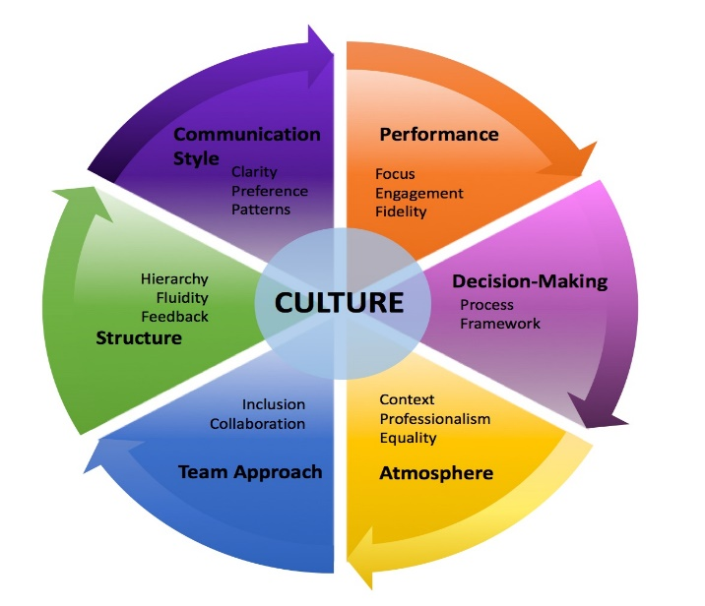
Corporate Culture
Corporate Culture is the set of shared purposes, values, and beliefs that EEs have about their organization.
  To provide a foundation for the desired type of corporate culture, many companies develop mission statements and codes of conduct.

Slide 22

Corporate Culture
Supervisors have a major influence in determining the direction of the corporate culture in their departments.
  They play significant roles in informing, educating, and setting examples for ethical behavior.
    It is critical that ethical behavior and fair dealings are at the forefront of good management practices, beginning at the supervisory level.

Slide 23

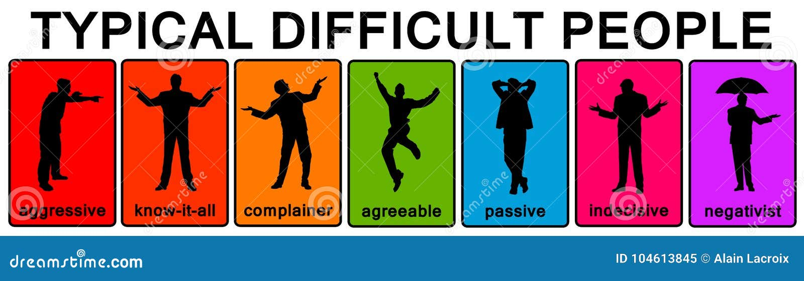
Workplace Incivility
People Who Make Life Difficult
Research suggests that “rude behavior is on the rise in the workplace and can undermine organizational effectiveness.”
  Crude or impolite behavior directly affects the recipients and lowers group morale.

Slide 24
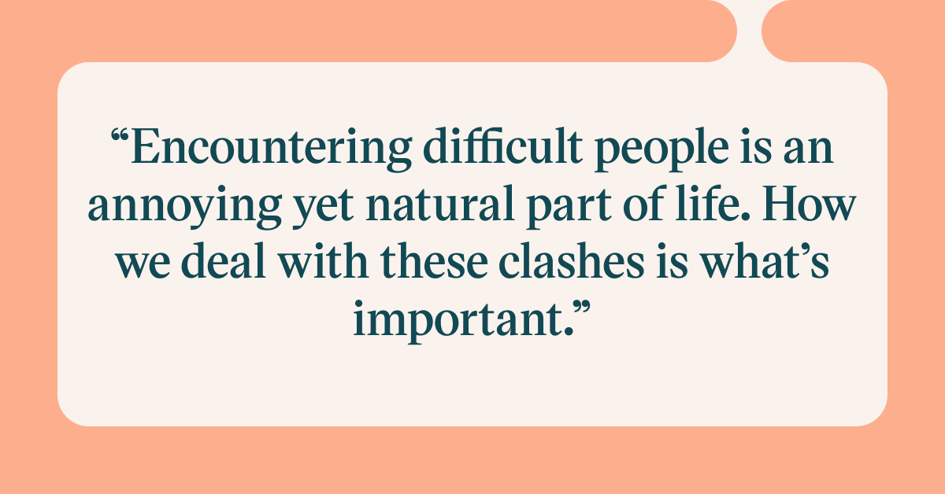

Slide 25


Dealing with Difficult People
How do you get people off the bench and into the game?
How do you get diverse groups of people to work together?
  These questions have been with us since the beginning of time.
    The Three E’s – Engagement, Empowerment, and Employee Participation in Decision Making help with this effort.

Slide 26

Dealing with Difficult People
Certain factors that need to be present for EEs to further both their own self-interests and the interests of their organization:
  Do I believe that my job is important?
  Do managers communicate expectations-provide feedback-lead by example?
  Is the job mentally stimulating?
  Is there a connection between what I do and organizational performance?
  Are there opportunities for personal and professional growth?
  Do I connect to what the organization stands for? Am I passionate about it?
  Is there a climate of open and honest communication?
  Am I empowered to make decisions that impact what I do and how I do it?

Slide 27

Engage Employees
Engaged employees are those who are enthused about what they do, where they do it, and who they do it with.
  They are fully involved because they have been engaged.

Slide 28
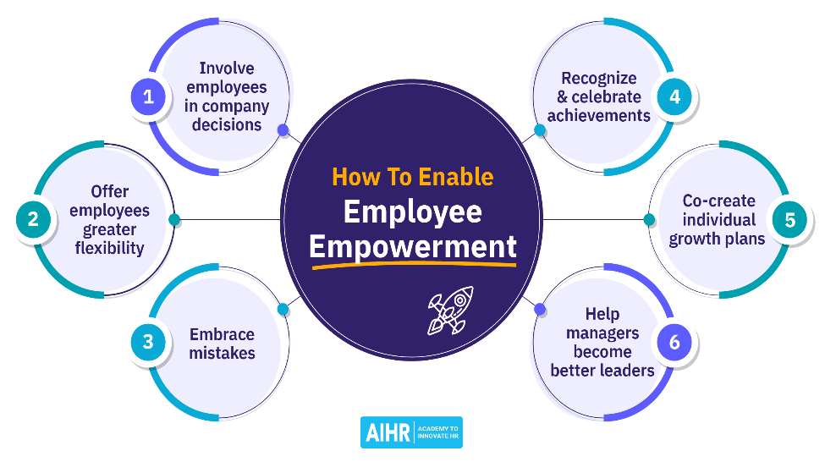
Empower Employees
Empowerment means giving employees the authority and responsibility to achieve objectives.
  Opportunities to make suggestions and participate in decisions affecting their jobs can and should be supported.

Slide 29

Participative Management
Participative Management essentially means a willingness to permit EEs to influence or share in managerial decisions.
  If supervisors learn to react to this practice in a positive way, it should improve their own and their company’s performance.

Slide 30

Supervision: A Professional Perspective
The primary responsibility of most supervisors is to manage their firms’ most important resources – human resources (people).
  Managing people starts with selecting and training individuals, and it continues with ongoing development, motivation, leadership, and preparation of EEs for promotion.

Slide 31

Supervision: A Professional Perspective
It is imperative that supervisors recognize the need for constant self-improvement and self-renewal.
  Supervisors must recognize that they, too, can become obsolete unless they constantly take measures to update their own skills and knowledge through a program of continuous self-development.
    Become a learning organization.
    Always try to improve yourself.
    Make yourself more valuable.
    Seek opportunities to grow.
    “Sharpen your saw.”

Slide 32


