Slide 1
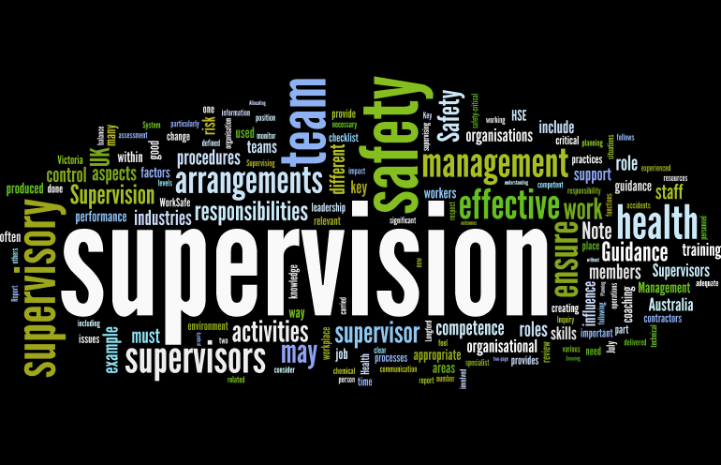
Supervision
Supervision
  Concepts and Practices of Management, 13th Edition
    Edwin C. Leonard, Jr., Ph.D. and Kelly A. Trusty, Ph.D. Cengage Learning, Boston, MA 2013
      ISBN: 978-1-285-86637-6

Slide 2

Part Three: Organizing, Staffing, Managing and Measuring for Success
Chapter Twelve: Performance Management
  After studying this chapter, you will be able to:
    Describe the roles and responsibilities of a supervisor in a system of performance management.
    Summarize the management tasks required in the performance appraisal process and describe the purposes of a formal appraisal system.
    Explain the factors, techniques, and challenges involved in measuring and documenting performance.
    Discuss the process of conducting a sound appraisal meeting.
    Give examples of coaching strategies that can be used as follow-up to personal performance appraisal.
    Identify the benefits and challenges of a promotion-from-within policy.
    Discuss the supervisor’s role in EE compensation and outline the goals of an effective compensation program.

Slide 3
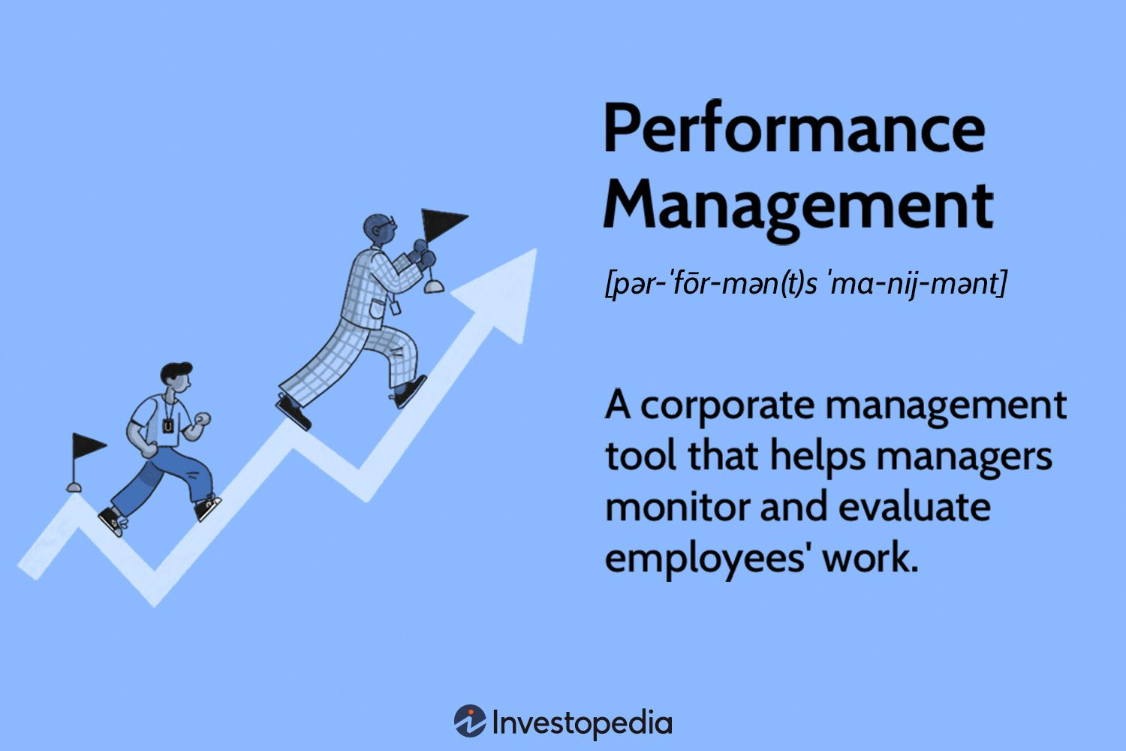
The Performance Management Process
Management is the process of getting things accomplished with and through people by guiding and motivating their efforts toward common objectives.
  People are an organization’s most important assets and as such must be managed effectively to achieve organizational objectives.

Slide 4
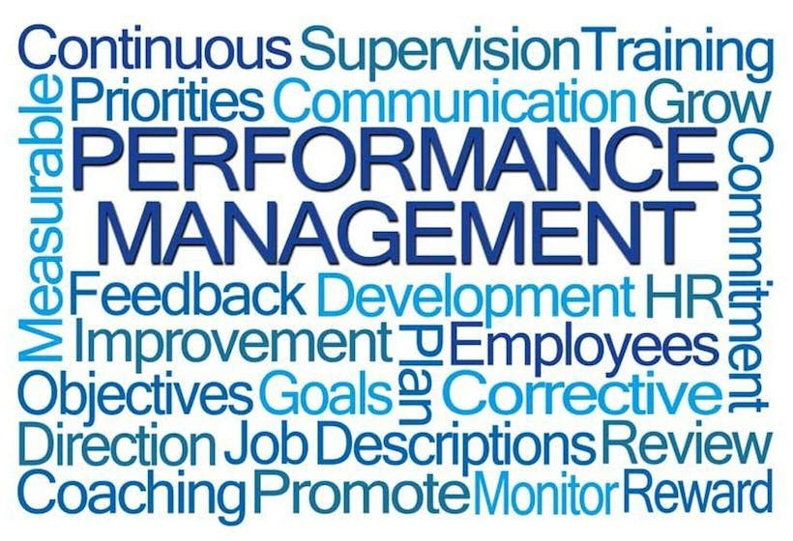
The Performance Management Process
Once an EE joins the work group, the task for supervisors becomes one of creating and maintaining conditions that will enhance EE skills, knowledge, and abilities (SKAs).
  Ongoing communication with EEs, along with various coaching and mentoring activities, are opportunities to provide information as well as feedback to EEs about their job performance.

Slide 5
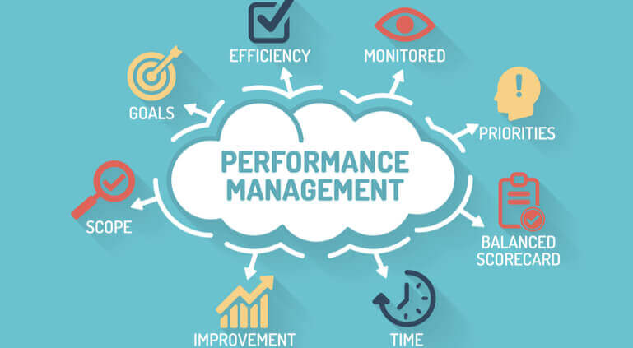
The Performance Management Process
Our system of performance management identifies all those things a supervisor must do to enable an EE to achieve the organization’s objectives.
  The system of performance management begins with the supervisor setting the stage for EE success.
    The supervisor must monitor performance regularly and provide support, guidance, and direction as needed.

Slide 6
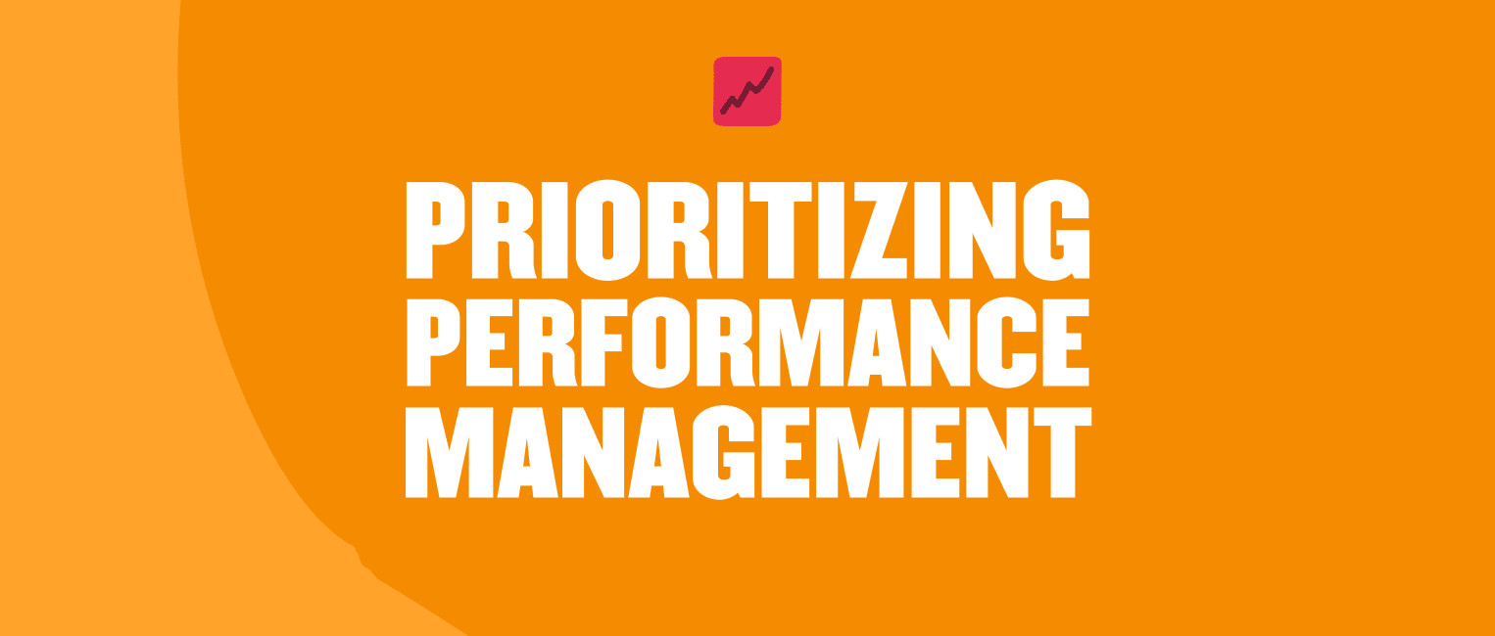
The Performance Management Process
Performance Management
Planning
  Determining what should be done.
Organizing
  Determining how the work will be divided and accomplished.
Staffing
  Recruiting, selecting, orienting, training, appraising, and compensating EEs.
Leading
  Guiding the activities of EEs toward achievement of realistic goals.
Controlling
  Ensuring that actual performance is in line with intended performance or taking corrective action.

Slide 7

The Performance Management Process
Performance Management
Recruiting
  Determine the requirements of the job.
    Job Description – Job Specification – Core Competencies
Selecting
  Conduct the selection interview.
    RJP - ROP
Orienting
  Connect your potential “winner” to a “star.”
    Clarify Expectations – Establish Performance Standards – Develop Objectives
Evaluating
  Observe and monitor performance.
    Document Performance and Critical Incidents – Obtain Feedback
Developing
  Jointly plan development.
    Coach – Train – Add New SKAs and Experiences – Prepare for Advancement

Slide 8
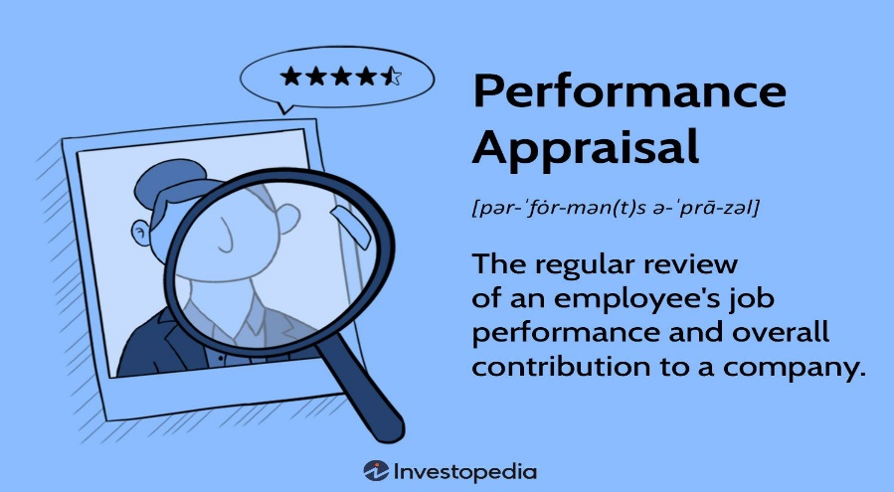
The Employee Performance Appraisal
From the time EEs begin their employment with a company, the supervisor is responsible for evaluating EE’s job performance.
  Performance Appraisal is the systematic assessment of how well EEs are performing their jobs and communication of assessment to them.
  Supervisors establish performance standards or targets that subordinates are expected to achieve.
    Performance appraisal includes comparing EE’s performance with the standards. Often these standards may be referred to as metrics.

Slide 9
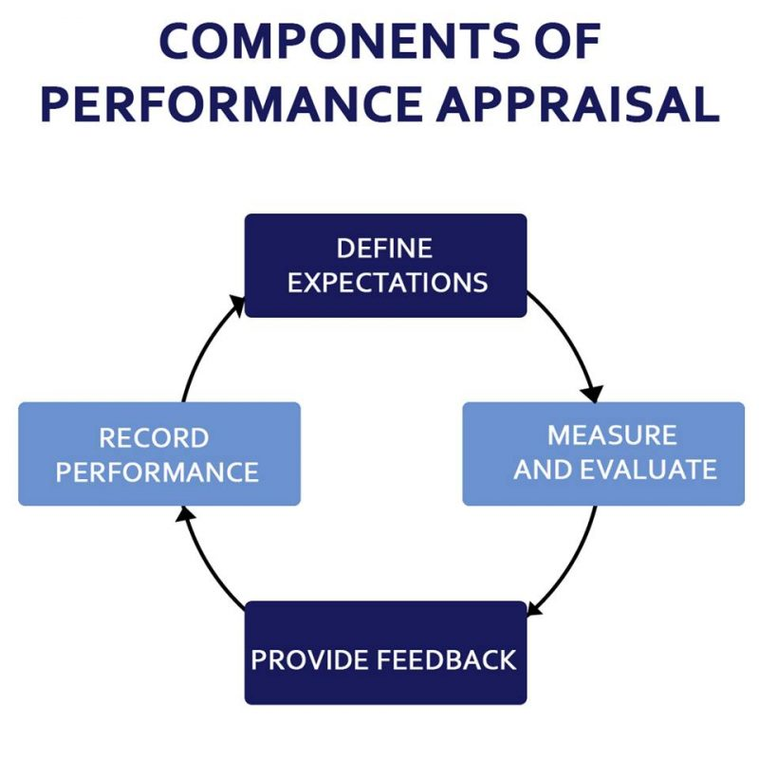
The Employee Performance Appraisal
The metrics used should enable management to compare the EE’s performance to others and how they contribute to the overall team success.
  Effective supervisors provide their subordinates with day-to-day feedback on performance.
    Regular feedback on performance is essential to improve EE performance and to provide the recognition that will motivate EEs to sustain satisfactory performance.

Slide 10
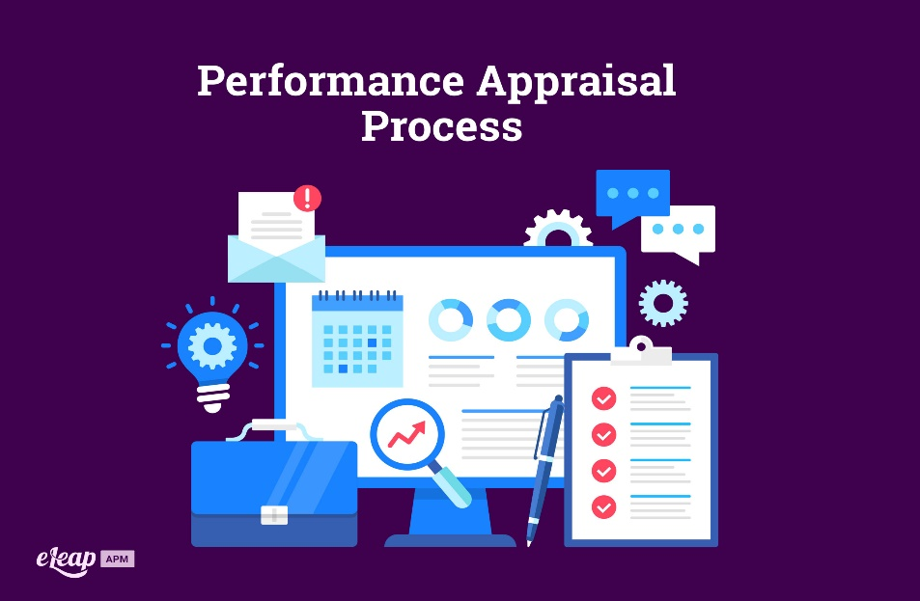
The Employee Performance Appraisal
Most organizations require supervisors to evaluate their EE’s performance formally.
  These evaluations become part of an EE’s permanent record and play an important role in management’s training, promotion, retention, and compensations decisions.

Slide 11
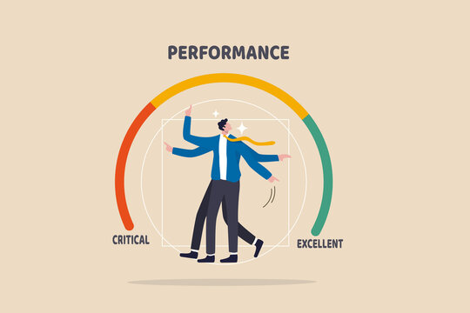
The Employee Performance Appraisal
When EEs understand what is expected of them and the criteria on which they will be evaluated, they will also believe the process is administered fairly, and then that performance appraisal serves as a powerful motivational tool.
  Performance appraisals are frequently used to determine compensation, and supervisors also use performance appraisals to provide feedback to EEs so that they know where they stand and what they can do to improve their performance as well as to develop to their full potential.

Slide 12
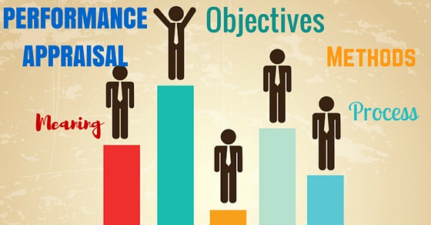
The Employee Performance Appraisal
The purpose of the appraisal is to evaluate, document, and communicate job achievements in understandable and objective terms, as well as secondary results of EE effort compared with job expectations. This is done by considering such factors as the job description, performance standards, specific objectives, and critical incidents for the evaluation period.
  The evaluation is based on direct observation of EE’s work over a set period.

Slide 13
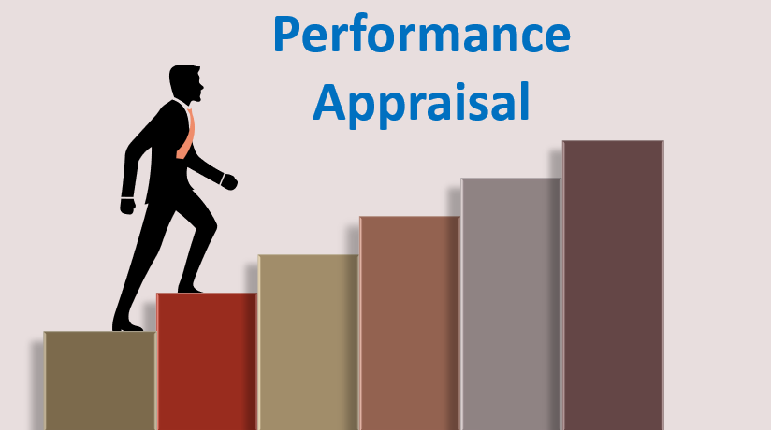
The Employee Performance Appraisal
The long-term success of an organization depends on the performance of its workforce.
  We have learned that to get EEs to work smarter, they must first know what is expected in the way of performance, and then they must receive regular feedback on their performance.
    We contend most EEs want to know how well they have performed relative to the organization’s expectations or performance standards.

Slide 14

The Employee Performance Appraisal
The supervisor should recognize and comment on a particular aspect of performance when that aspect occurs.
  The supervisor may glean this information from direct observation of the EE’s work or from other sources.
    Because it is impossible for supervisors to observe everything EEs do, they must rely on performance feedback from other sources like customers, peers, attendance records, production and sales data, or customer feedback surveys.

Slide 15

The Supervisor’s Responsibility to do Performance Appraisals
A performance appraisal should be done by an EE’s immediate supervisor because the immediate supervisor is usually in the best position to observe and judge how well the EE has performed on the job.
  In some situations, a “consensus” or “pooled” appraisal may be done by a group of supervisors.

Slide 16
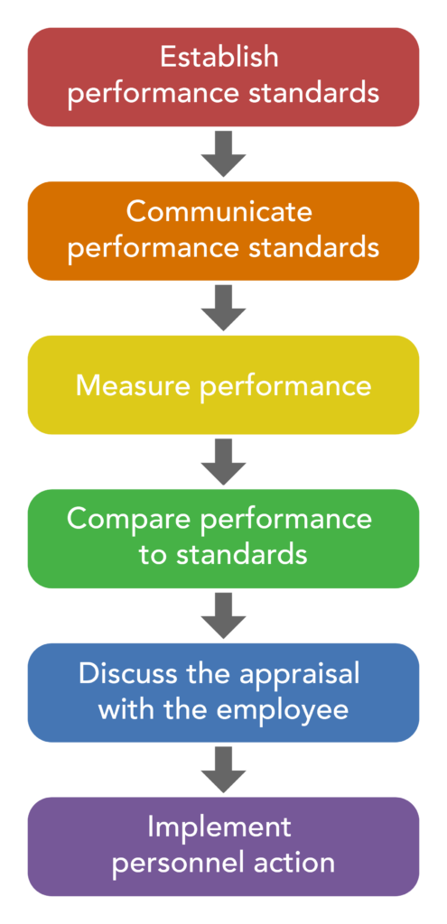
The Supervisor’s Responsibility to do Performance Appraisals
To ensure EEs feel that the appraisal process is fair, each evaluator must understand what is needed for successful job performance and apply standards uniformly.

Slide 17

Self-Evaluations
Many effective supervisors find it appropriate to supplement their judgments with self-ratings from subordinates.
  About a week before the performance review, the EE is asked to conduct a self-evaluation. The supervisor compares the two evaluations to make sure to discuss all important performance metrics in the appraisal meeting.
    If the supervisor has provided ongoing feedback to the EE, the EE’s self-ratings should be very close to the supervisor’s ratings.

Slide 18

Self-Evaluations
However, research done at Cornell University revealed that self-appraisal is often inaccurate; top performers tend to rank their performance lower than it actually is, while less competent individuals tend to overestimate their skills and abilities.
  Widely divergent ratings could mean that performance expectations are not clearly defined or supervisors are giving too little feedback throughout the year for the EEs to have clear pictures of how well they are doing.

Slide 19

Managing the Appraisal Process
Performance evaluation should be a normal part of day-to-day relationships between a supervisor and their employees.
  If an EE is given ongoing feedback, then the appraisal process should contain no surprises. The supervisor who communicates frequently with EEs concerning how they are doing will find that engaging EEs in formal appraisal is primarily a matter of reviewing much of what has already been discussed during the year.
    Regular feedback removes uncertainty and can reduce the natural apprehension surrounding performance appraisals.

Slide 20

Timing Performance Appraisals
Most organizations require supervisors to formally appraise all EEs at least once a year.
  Traditionally, this has been considered long enough to develop a reasonably accurate record of the EE’s performance and short enough to provide current, useful information.
    However, if an EE has just started or if the EE has been transferred to a new and perhaps more responsible position, it is advisable to conduct an appraisal within the first 90-days.

Slide 21

Advantages of a Formal Appraisal System
Ongoing feedback throughout year, both positive and negative, rewards good performance and fosters improvement.
  Over time, ongoing feedback, as well as formal appraisals, can become an important influence on EE motivation and morale.
  Appraisals reaffirm the supervisor’s genuine interest in EE’s growth and development.
    Most EEs would rather be told how they are doing – even if it involves some criticism – than receive no feedback from their supervisors.

Slide 22
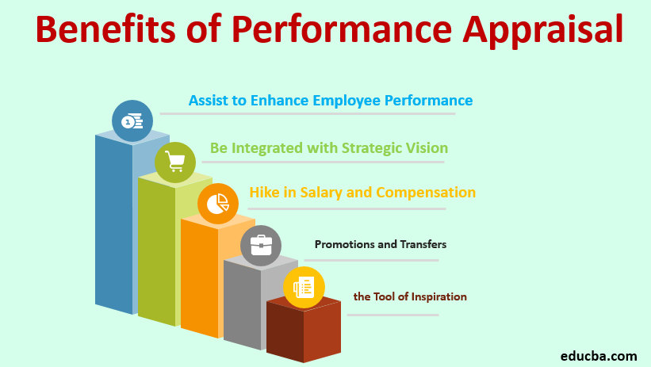
Advantages of a Formal Appraisal System
A formal appraisal system provides a framework to help the supervisor evaluate performance systematically.
  It forces the supervisor to scrutinize the work of EEs from the standpoint of how well those EEs are meeting established standards and to identify areas that need improvement.

Slide 23
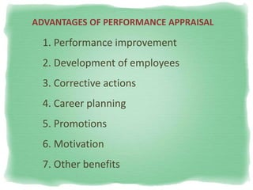
Advantages of a Formal Appraisal System
EEs have the right to know how well they are doing and what they can do to improve.
  Most EEs want to know what their supervisors think of their work. This desire can stem from different motives.
    Some EEs realize they are doing relatively poor jobs, but hope that their supervisors are not too critical and will help improve performance.
    Other EEs feel that they are doing outstanding jobs and want to ensure that their supervisors recognize and appreciate their services.

Slide 24

Advantages of a Formal Appraisal System
Appraisals should become part of the EE’s permanent employment records.
  These appraisals serve as documents that are likely to be reviewed and even relied on in talks concerning promotion, compensation, training, disciplinary action, and even termination.

Slide 25

Advantages of a Formal Appraisal System
Performance appraisals can answer such questions as:
  Who should be promoted to department supervisor when the incumbent retires?
  Who should get merit raises this year?
  What should be the raise differential between EEs?
  Who, if anyone, needs training?
  What training do EEs need?
  This behavior has happened before. Does the EE need additional coaching, or is the behavior serious enough for disciplinary action?
  If an EE is appealing our termination decision, do we have adequate documentation to support the decision?

Slide 26

Advantages of a Formal Appraisal System
A formal appraisal system serves another important purpose: An EE’s poor performance and failure to improve may be due in part to the supervisor’s inadequate supervision.
  A formal appraisal system provides clues to the supervisor’s own performance and may suggest where the supervisor must improve.

Slide 27

Advantages of a Formal Appraisal System
Even when designed and implemented with the best intentions, performance appraisal systems are often sources of anxiety for the EE and supervisor alike.
  Formal performance appraisal systems can be misused as disciplinary devices rather than as constructive feedback tools aimed at rewarding good performance and helping EEs improve.
    The purpose of the annual performance review is to direct EE attention to new targets.

Slide 28
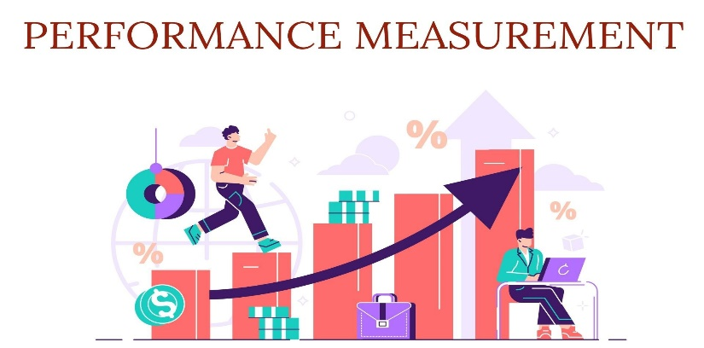
Factors in Measuring Performance
Most appraisal forms include factors that serve as criteria for measuring job performance, skills, knowledge, and abilities.
  Following are some of the factors that are most frequently included on EE appraisal rating forms:
    Job knowledge – Timeliness of Output – Positive/Negative Effects of Effort Suggestions and Ideas Generated – Dependability (Absenteeism-Tardiness) Work Done on Time – Safety – Amount of Supervision Required – Initiative Aptitude – Cooperation (Effectiveness in Dealing w/ Others) – Adaptability Ability to Work w/ Others – Ability to Learn – Quantity and Quality of Work Effective Use of Resource – Customer Service Skill – Judgment – Appearance.

Slide 29
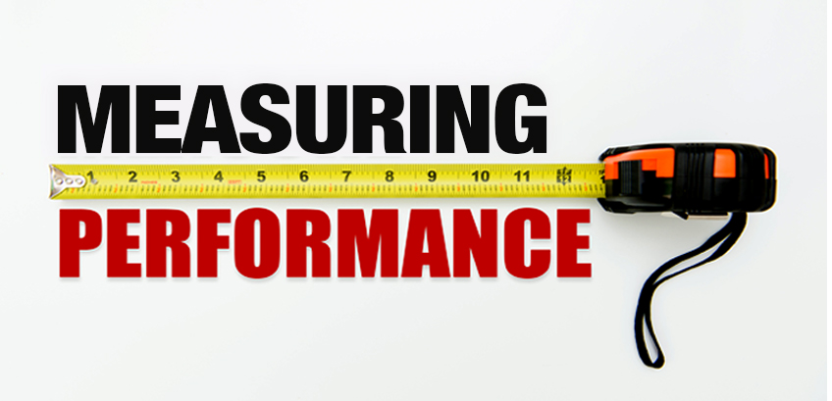

Factors in Measuring Performance
Factors that enable the supervisor to make objective performance evaluations rather than personality judgments should be used whenever possible.
  For each of these factors, the supervisor may be given a “check-the-box” choice or a place to fill in the EE’s achievements.
    Some appraisal forms offer a series of descriptive sentences, phrases, or adjectives to help the supervisor understand how to judge rating factors.

Slide 30

Factors in Measuring Performance
Typically, the supervisor reads each item and checks the appropriate box.
  The supervisor identifies the outstanding aspects of the EE’s work as well as specific performance characteristics that need improvement and suggests several things that can be done to improve performance.
    Most forms provide space for additional comments about the various aspects of an EE’s performance.

Slide 31

Factors in Measuring Performance
For a performance review to be effective, it must be built on factual information that is the culmination of the observed and reported incidents of the EE’s performance.
  It can frustrate EEs to leave appraisals feeling that their supervisors ignored outstanding performance incidents or only covered recent performance.
    Supervisors must get in the habit of recording positive and negative performance information as incidents occur, so that there will be no surprises at annual review time.

Slide 32

Problems in the Appraisal Process
Not all raters agree on the meaning of such terms as exceptional, very good, satisfactory, fair, and unsatisfactory.
  Descriptive phrases or sentences added to each of these adjectives help describe the levels that best describe the EE, but the choice of an appraisal term or level depends mostly on the rater’s perceptions, which may inaccurately measure performance.

Slide 33

Problems in the Appraisal Process
Another problem is that one supervisor may be more severe than another in the appraisal of EEs.
  A supervisor who gives lower ratings than other supervisors for the same performance is likely to damage morale of EEs, who may feel they have been judged unfairly. One such supervisor stated because no one is perfect, no one should ever be evaluated as above average.
    Another supervisor felt that if they rated their EEs too high, those EEs would be considered for promotions elsewhere in the organization and would be lost to their department. As a result the supervisor rated their EEs much lower than was fair. In the long run, the supervisor lost the EE’s trust and respect or lost them to other firms.

Slide 34

Problems in the Appraisal Process
In contrast to this supervisor, some supervisors tend to be overly generous or lenient in their ratings.
  The leniency error occurs when supervisors give EEs higher ratings than they deserve.
    Some supervisors give high ratings because they believe that poor evaluations may reflect negatively on their own performance, suggesting that they have been unable to elicit good performance from their EEs.
    Other supervisors do not give low ratings because they are afraid that they will antagonize their EEs and make them less cooperative.
    Some supervisors are so eager to be liked by their EEs that they give out only high ratings, even when the ratings are undeserved.

Slide 35
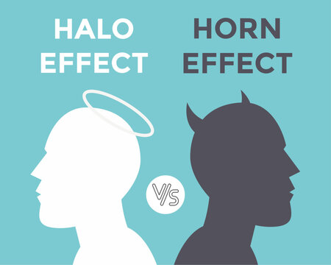
Problems in the Appraisal Process
In addition to leniency errors, supervisors should be aware of the problems of the halo effect and the horns effect, each of which causes a rating in one factor to inspire similar ratings in others.
  One way to avoid the halo or horns effect is for the supervisor to rate all EEs on only one factor and proceed to the next factor for all EEs.
    For each factor, the supervisor must rate each EE relative to a standard or to another EE.

Slide 36

Problems in the Appraisal Process
The previous examples of errors that can be made in assessing performance are examples of rater bias, the influence our unconscious thinking processes can have on decisions and judgments we make.
  Rater bias can substantially affect the ways in which supervisors evaluate EE’s work.
    The supervisor’s values, stereotypes, experiences, culture, background, personality differences with individual workers, understanding of the assessment process, or even simply being distracted can affect how they assess individual EE performance. Therefore, an evaluator should know their biases and identify them before the review begins.

Slide 37

Problems in the Appraisal Process
The supervisor should ask what conditions exist when the job is done well.
  These conditions, called performance standards, are the job-related requirements by which the EE’s performance should be evaluated.
  They should be described in terms of how much, how well, when, and in what manner. Effectiveness and efficiency measures are part of these standards.
    The positive and negative effects of performance should be considered.

Slide 38
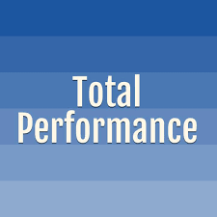
Problems in the Appraisal Process
To reiterate, every appraisal should be made in the context of each EE’s job, and every rating should be based on the EE’s total performance.
  It would be unfair to appraise an EE based on one assignment that had been done recently, done particularly well, or done very poorly.
    The appraisal should be based on an EE’s total record for the appraisal period.

Slide 39

The Appraisal Meeting
The second major part of the appraisal process is the evaluation or appraisal meeting.
  After supervisors complete the rating form, they arrange to meet with EEs to review the EE’s ratings. Because these meetings are the most vital part of the appraisal process, the supervisor should develop a general plan for carrying out appraisal discussions.
    If handled poorly, appraisal meetings can lead to resentment and misunderstanding. The conflict that develops may be irreparable.

Slide 40

The Right Purposes
The primary purposes of appraisal meetings are to let EEs know how they are doing and to help them set goals for future performance.
  In the interest of maintaining EE’s productive behaviors, supervisors formally praise EEs for their past and current good performance.
    Supervisors also use these meetings to help EEs develop future performance.
    Emphasizing strengths on which EEs can build supports EE’s career plans.
    Supervisors can explain the opportunities for growth in the organization and can encourage EEs to develop the needed skills.

Slide 41

The Right Purposes
Finally, supervisors use appraisal meetings to explain behavior that needs to be corrected and the need for improvement.
  Even when improvement is needed, supervisors should take the approach that they believe the EE can improve and that they will do everything possible to help.
    It is important supervisors conduct appraisal meetings for right purpose.

Slide 42

The Right Time and Place
Appraisal meetings should be held shortly after the performance rating process has been completed, preferably in a private space.
  To enable EEs to prepare for their appraisal meetings and to consider what they would like to discuss, supervisors should make appointments with EEs several days in advance.
    Privacy and confidentiality of the appraisal meeting should be ensured because discussion may include criticisms, personal feelings and opinions.

Slide 43
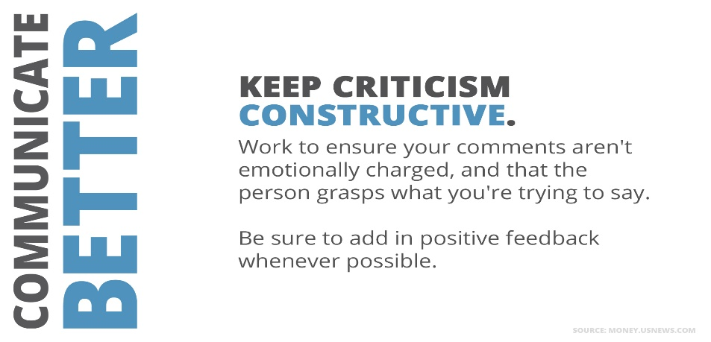
Conducting the Appraisal Meeting
While appraisal meetings tend to be directive, they can take on non-directive characteristics because EEs may bring up issues that supervisors did not expect or of which they were unaware.
  It is easy for most supervisors to communicate the positive aspects of job performance, but it is difficult to communicate major criticisms without generating resentment and defensiveness.
    There is a limit to how much criticism an individual can absorb in one session. If there is a lot of criticism to impart, dividing the appraisal meeting into several sessions may ease the stress.

Slide 44

Conducting the Appraisal Meeting
The manner in which the supervisor conducts the appraisal meeting influences how the EE reacts.
  After a brief, informal opening, the supervisor should state purpose of the meeting is to assess EE’s performance in objective terms.
  The supervisor should state that the purpose of the performance appraisal is to recognize the EE for their achievements, to help the EE improve, if necessary, and to set goals for future performance.
    The supervisor should review the EE’s achievements during the review period, compliment the EE on those accomplishments, identify the EE’s strengths, and then proceed to the areas that need improvement.

Slide 45

Conducting the Appraisal Meeting
A secret of success is to get the EE to agree on their strengths first because it is easier to build on strengths than weaknesses.
  Unfortunately, not every EE performs at the expected level.
  Limiting criticism to just one or two major points, rather than to all minor transgressions, draws attention to the major areas that need improvement without being overwhelming.
    The supervisor must get the EE to agree on the areas that need correction or improvement. When there is agreement, the supervisor and EE can use a problem-solving approach to jointly determine how the EE can improve performance.

Slide 46

Conducting the Appraisal Meeting
When dealing with an EE who is performing at substandard levels, the supervisor must clearly communicate to the EE that deficiencies are serious and substantial improvement must be made.
  Supervisors should mix in some positive observations so that the EE knows they are doing some things right.
    The supervisor should work with the EE to create an action plan for improvement with expectations and progress checkpoints along the way.
    It is important that EE leaves meeting feeling able to meet expectations.
    The supervisor must be available to help, assist, coach, and advise the EE. Often, a co-worker will be asked to serve as a coach or trainer.

Slide 47

Conducting the Appraisal Meeting
Most mature EEs are able to handle deserved, fair criticism.
  It is important for the supervisor to provide authentic and specific feedback, which is sometimes easier said than done.
    Conversations should be clear and concise with the goal of making sure the EE understands the full meaning of the information being provided.

Slide 48

Conducting the Appraisal Meeting
It is essential that organizations ensure that their performance appraisal systems are legally defensible.
  EEs often disagree with negative aspects of the performance appraisal because the ratings later affect their jobs, specifically their compensation and potential for promotion.

Slide 49
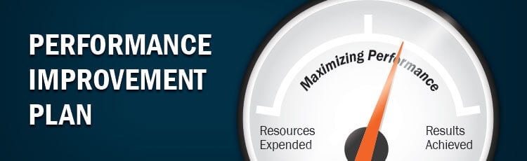
Conducting the Appraisal Meeting
Regardless of how supervisors approach the appraisal meeting, they must include a discussion about plans for improvement and possible opportunities for the EE’s future.
  The supervisor should mention any educational or training plans that may be available. The supervisor should be familiar with advancement opportunities open to EE, requirements of future jobs, and each EE’s personal ambitions and qualifications.
    When discussing the future, the supervisor should be careful to make no promises for training or promotion that are uncertain to materialize in the foreseeable future. False promises are a quick way to lose credibility.

Slide 50

Conducting the Appraisal Meeting
The evaluation meeting also should give the EE an opportunity to ask questions, and the supervisor should answer those questions as fully as possible.
  When the supervisor is uncertain about an answer, it is better to say, “I don’t know, but I’ll find out and get back to you ASAP.”
    EEs lose trust in supervisors who evade subjects, are dishonest, and fail to return with answers in a timely fashion.

Slide 51

Conducting the Appraisal Meeting
In the final analysis, the value of an evaluation meeting depends on the EE’s ability to recognize the need for self-improvement and the supervisor’s ability to stimulate in the EE a desire to improve and facilitate opportunities for improvement, actions that together help build EE engagement.
  It takes sensitivity and skill for a supervisor to accomplish these outcomes, and it is frequently necessary for the supervisor to adapt to each EE’s reactions as they surface during the meeting.

Slide 52

Closing the Appraisal Meeting
When closing the appraisal meeting, the supervisor should be certain that EEs clearly understand their performance ratings.
  In situations in which an EE’s performance needs improvement, the supervisor and EE should agree on some mutual skill-building goals.

Slide 53

Closing the Appraisal Meeting
When EEs who are performing at a high level express the desire for more challenge or additional responsibilities during appraisal meeting, supervisor can use opportunity to gather information on the EE’s interests and aspirations and, where appropriate, work with the EE to set stretch goals to accommodate those requests and advance the work of the department.
  If there are presently no such opportunities, the supervisor should communicate that clearly and let the EE know that information will be provided when and if opportunities become available.

Slide 54

The Appraisal Meeting
With or without a formal appraisal system, supervisors must provide regular feedback on performance.
  Most EEs want to know how they are doing.

Slide 55
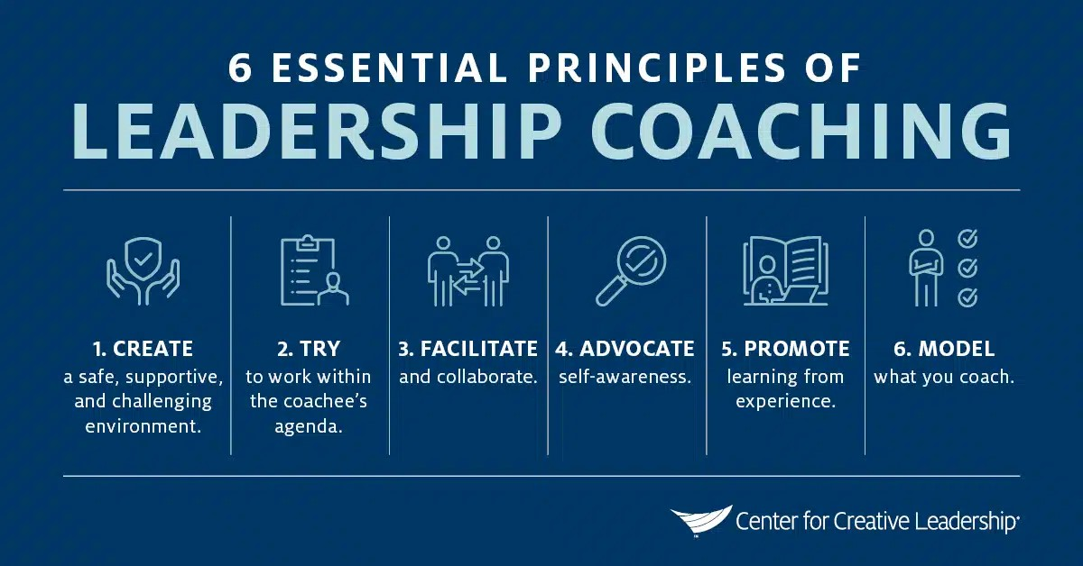
Managing Performance Appraisal Results
Coaching Employees
Effective supervisors use periodic performance evaluations as a way to develop their EE’s competence.
  Coaching, a supervisor activity, gives EEs information, instructions, and suggestions relating to their job assignments and performance.
    In addition to being a coach, the supervisor should be a cheerleader and a facilitator who guides EE behaviors toward desired results.

Slide 56
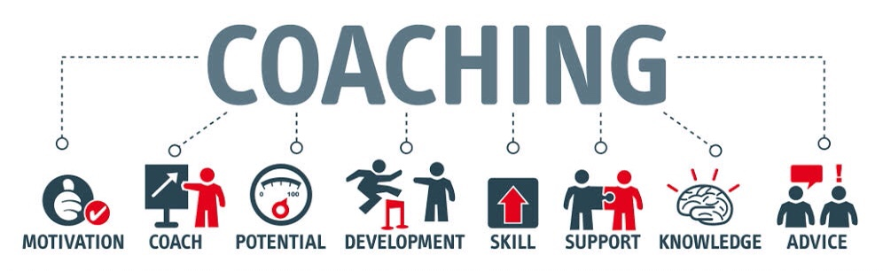
Managing Performance Appraisal Results
Coaching Employees
If you want your people to be high performers (winners), then you need to help them get there (coach).
  The supervisor must identify activities that prepare EEs for greater depth and breadth in their current or future jobs, reinforce EE’s positive behaviors, and correct negative behaviors positively.
    In addition, by coaching, the supervisor can inspire EEs toward a shared vision and remove barriers along the way.

Slide 57

Managing Performance Appraisal Results
Coaching Employees
The supervisor’s follow-up role in performance appraisal varies with the assessment.
  As a rule, supervisors use coaching to help superior EEs prepare for greater responsibility as well as to improve performance of all EEs. In both cases, the purpose of coaching is to help EEs become more productive by developing action plans.
    Even though a plan may be jointly determined with the EE, the supervisor is ultimately responsible for providing the plan and the instructions for carrying it out.

Slide 58

Managing Performance Appraisal Results
Coaching Employees
Effective supervisors recognize that ongoing EE skill development is critical to the organization’s success.
  Instruction, practice, and feedback are essential elements of development.

Slide 59

Managing Performance Appraisal Results
Coaching Employees
In business, as in sports, EEs benefit from coaching.
  The coach observes the EE’s performance and communicates what went well and what specifically needs improvement.
    A plan for improvement includes defining the expected level of performance, recommending specific steps for improvement, and observing performance.
    After developing the plan, the coach instructs the EE and allows the EE time to practice the skills. The coach then observes the EE’s performance, providing feedback about its effectiveness, and offers instruction and encouragement.

Slide 60
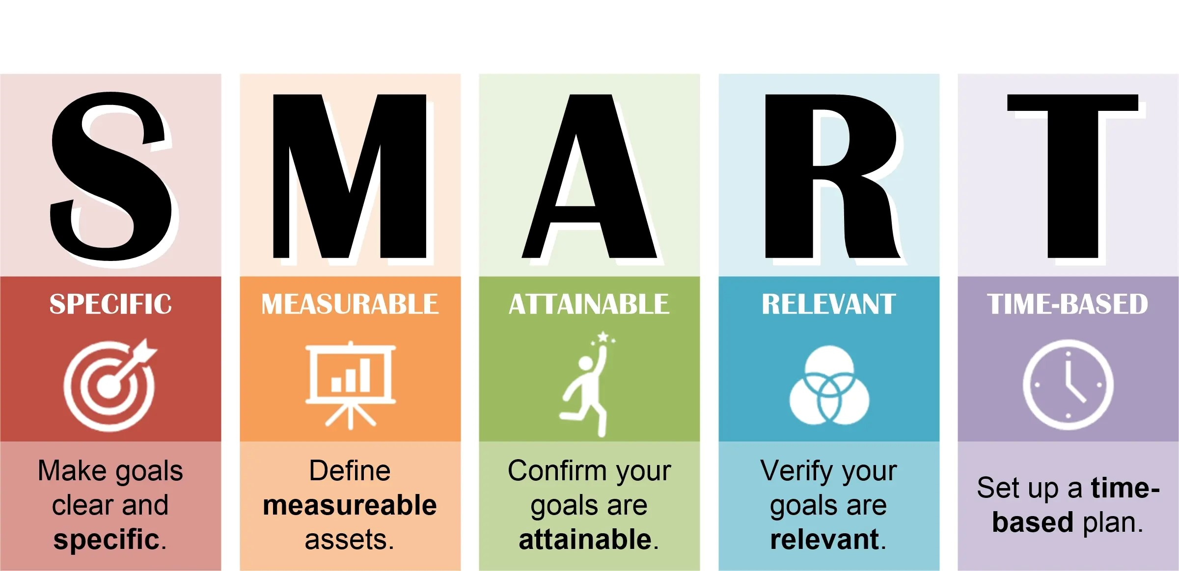
Managing Performance Appraisal Results
Coaching Employees
EE performance usually improves when specific improvement goals are established during the performance appraisal.
  It is important that supervisors realize that they are responsible for improving the performance of deficient EEs.
    The supervisor must remember that EEs cannot improve unless they know exactly what is expected.

Slide 61
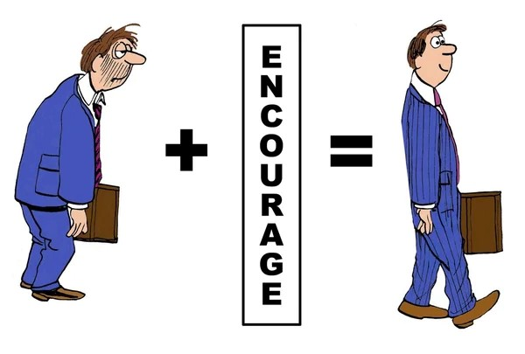

Managing Performance Appraisal Results
Promoting Employees
Given proper encouragement, many EEs strive to improve their performance and eventually be promoted.
  A promotion means advancement to a job with more responsibility, more privileges, higher status, greater potential, and higher pay.

Slide 62

Promoting From Within
Most organizations have policies for promoting EEs.
  The policy of promoting from within is widely practiced, and it is important to both an organization and its EEs. For the organization, it means a steady source of trained personnel for higher positions; for EEs, it is a major incentive to perform better.
    When EEs work for organizations for a long time, more is usually known about them than even the best selection processes and interviews could reveal about outside applicants for the same job. Know your EEs.

Slide 63

Promoting From Within
Occasionally, a supervisor might want to bypass an EE from promotion because the productivity of the department will suffer until a replacement is found and trained.
  However, this thinking is shortsighted.
    It is better for the organization in the long run to have the best qualified people in positions where they can make the greatest contributions to the organization’s success.

Slide 64
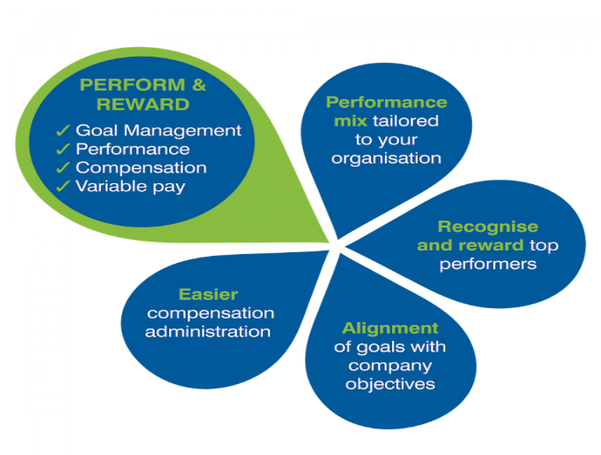
Promoting From Within
There would be little reason for EEs to improve if they believed that the better and higher-paying jobs were reserved for outsiders.
  Job satisfaction results when EEs know that stronger efforts on their part may lead to more interesting and challenging work, higher pay and status, and better working conditions.
    Most EEs are more motivated when they see a link between excellent performance and a reward they covet.

Slide 65

Promoting From Within
When considering promotion for an EE, the supervisor should recognize what management considers a promotion may not always be perceived as such by the EE.
  (X) An engineer may believe that a promotion to administrative work is a hardship, not an advancement. The engineer may feel admin activities are less interesting or more difficult than technical duties, and may be concerned about losing or diluting professional skills.
    This is understandable, and the supervisor should suggest promotional opportunities that do not require unacceptable compromises.

Slide 66

Promoting From Within
Also, the supervisor should be sensitive to EEs who appear to be satisfied in their present positions.
  Such EEs may prefer to stay with their fellow EEs and to retain responsibilities with which they are familiar and comfortable.
    The supervisor should not pressure them to accept higher-level positions. However, if supervisor believes such an EE has excellent qualifications for promotion, they should offer all the encouragement and counsel that may make a promotion attractive to EE for current or future consideration.

Slide 67

Promoting From Within
When the EE agrees to accept the promotion, it is essential for both the supervisor and EE to recognize that the dynamics between the EE and their peers will change dramatically.
  The EE will be required to make staffing and workload decisions that may not be well-received by others who were previously “buddies.”
    The supervisor can play a significant role in facilitating a successful transition by providing time, resources, and coaching to help the new leader acquire and apply new SKAs.

Slide 68

Modifying a Promotion From Within Policy
Generally, it is preferable to apply a promotion-from-within policy whenever possible.
  However, in some cases strict adherence to this policy might not be sensible and might even harm an organization.
    If there are no qualified internal candidates for a position, then someone from the outside must be recruited.

Slide 69

Modifying a Promotion From Within Policy
At times, bringing a new EE into a department may be desirable because this person brings different ideas and fresh perspectives to the job.
  Another reason for recruiting EEs from the outside is that an organization may not be in a position to train its own EEs in the necessary skills.

Slide 70

Criteria for Promoting From Within
Typically, more EEs are interested in being promoted than there are openings.
  Because promotions should be incentives for EEs to perform better, some supervisors believe EEs who have best records of production, quality, and cooperation are the ones who should be promoted.
    In some situations, however, it is difficult to measure such aspects of EE performance accurately or objectively, even when supervisors have made a conscientious effort in form of merit ratings or performance appraisals.

Slide 71

Seniority
One easily measured and objective criterion that has been applied extensively is seniority.
  Seniority is an EE’s length of service in the department or organization.
    Labor unions have emphasized seniority as a major promotion criterion.
    Its use is also widespread among organizations that are not unionized.

Slide 72

Seniority
Many supervisors are comfortable with the concept of seniority as a basis for promotion.
  Some supervisors feel that an EE’s loyalty, as expressed by length of service, deserves to be rewarded.

Slide 73

Seniority
Basing promotion on seniority also assumes that an EE’s abilities tend to increase with service.
  Although this assumption is not always accurate, it is likely that, with continued service, an EE’s skills and knowledge will improve.
    If promotion is to be based largely on seniority, then the initial selection procedure for new EEs must be followed carefully, and each new EE should receive considerable training in various positions.

Slide 74

Seniority
Probably the most serious drawback to using seniority as the major criterion for promotion is that it discourages young EEs – those with less seniority.
  Younger EEs may believe that they cannot advance until they too have accumulated years of service on the job. Consequently, they may lose enthusiasm and perform at only average levels.
    Another serious drawback is that the best performer is not always the most senior. If seniority is the only criterion, then there may be no incentive to perform well.

Slide 75

Merit and Ability
Seniority alone does not guarantee an individual either deserves promotion or is capable of advancing to a higher-level job.
  In fact, some EEs with high seniority may lack the educational or skill levels needed for advancement.
    Consequently, most unions understand that length of service cannot be the only criterion for promotion. They agree that promotion should be based on seniority combined with merit and ability.

Slide 76

Merit and Ability
Merit usually refers to the quality of an EE’s job performance.
Ability means an EE’s ability or potential to perform or to be trained to perform a higher-level job.
  Supervisors are in the best position to determine the degree to which merit and ability are necessary to compensate for less seniority.
    However, seniority is frequently the decisive criterion when merit and ability are relatively equal among several candidates seeking a promotion.

Slide 77
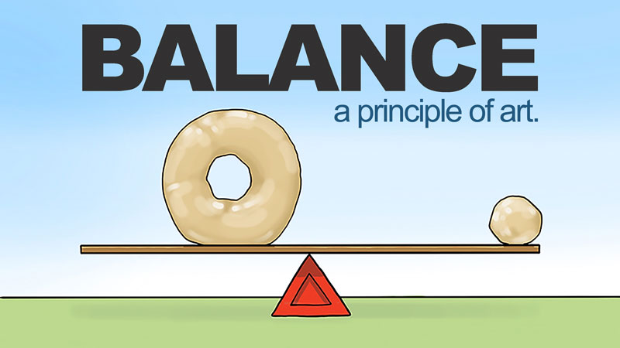
Balancing Criteria
Good supervisory practice attempts to attain a workable balance among merit, ability, and seniority.
  When selecting from among the most qualified candidates available, the supervisor may decide that, in order to be promoted, the EE who is most capable but who has less seniority will have to be far better than those with more seniority. This is sometimes referred to as the head-and-shoulders concept.
    Otherwise, the supervisor will promote the qualified EE with the greatest seniority, at least on a trial basis.

Slide 78

Balancing Criteria
Because promotion decisions can have great significance, the preferred solution would be to apply all criteria equally.
  However, promotion decisions often involve gray areas or subjective considerations that can lead rejected EEs to be dissatisfied and possibly file a grievance.
    Realistically, unless there are unusual circumstances, it is unlikely that a supervisor will choose to promote an EE based solely on merit and ability without some thought to seniority.

Slide 79
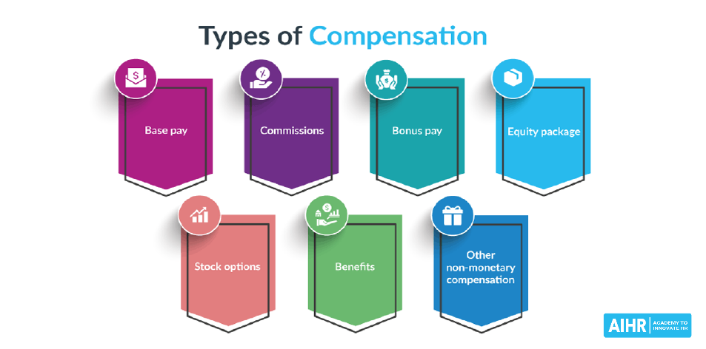
Managing Performance Appraisal Results
Compensating Employees
Although it is not always recognized, a supervisor’s staffing function includes helping to determine the relative worth of jobs.
  Typically, wage rates and salary schedules are formulated by higher-level management, by the HR department, by union contract, or by government legislation or regulation. In this respect, the supervisor’s authority is limited.
    Nevertheless, the supervisor is responsible for determining appropriate compensation for departmental EEs.

Slide 80
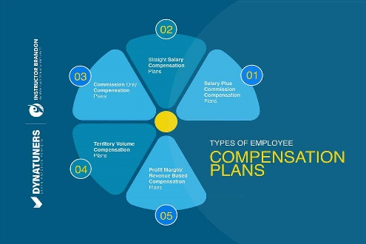
Managing Performance Appraisal Results
Compensating Employees
The question of how much to pay EEs poses a problem for many organizations. It is possible, however, to establish a compensation program that is objective, fair, and relatively easy to administer.
  The objectives of a compensation program should be to:
    Eliminate pay inequities to minimize dissatisfaction and complaints.
    Establish and/or maintain sufficiently attractive pay rates so that qualified EEs are attracted to and retained by the company.
    Conduct periodic EE merit ratings to provide the basis for comparative performance rewards.
    Control labor costs with respect to productivity gains.
    Reward EEs for outstanding performance or for the acquisition of additional skills or knowledge.

Slide 81

The Supervisor’s Role in Compensation Decisions
Although a sound and equitable compensation structure should be of great concern to everyone in management, it is an area in which supervisors typically have limited direct authority.
  However, supervisors should try to make higher-level managers aware of serious compensation inequities at the departmental level.
    This often can be done when supervisors make their recommendations for wage and salary adjustments for individual EEs.

Slide 82

The Supervisor’s Role in Compensation Decisions
It is imperative supervisors and EEs know the “lay of the land” as it relates to the relationship between performance evaluation and salary increases.
  Generally, an individual EE or team of EEs will be given a merit raise when they achieve some performance objective.
    EEs are willing to put forth effort when they perceive these linkages: making greater effort will lead to achievement, which will lead to a desirable outcome: a merit raise.

Slide 83

The Supervisor’s Role in Compensation Decisions
It is imperative that supervisors be able to justify and document performance evaluations regardless of whether the EE exceeded expectations, met expectations, or did not meet expectations, and be able to explain how performance evaluation relates to the raise an EE might receive.

Slide 84

Recommending Wage Adjustments
Unfortunately, too often supervisors automatically recommend full wage increases without seriously considering whether each EE deserves such a raise.
  Here is where EE performance evaluation is crucial.
    If an EE’s work has been satisfactory, then EE deserves the increase.
    If the EE has performed unsatisfactorily, the supervisor should suspend the recommendation for an increase and discuss this decision with EE.

Slide 85

Recommending Wage Adjustments
The supervisor should outline specific targets for improvement that the EE must meet before recommending a wage increase.
  If an EE has performed at an outstanding level, the supervisor should not hesitate to recommend a generous, above-average wage increase if this can be done within the wage structure.
    Such a tangible reward will encourage the outstanding EE to continue striving for excellence.

Slide 86

Compensation Concerns
EEs commonly compare their compensation to that of others.
  This becomes a serious motivational problem for the supervisor when the organization has wages or benefits that are considerably lower than those for similar jobs at other firms in the community.
    What does the company owe a great EE, and what does the EE expect in return for doing a great job?

Slide 87
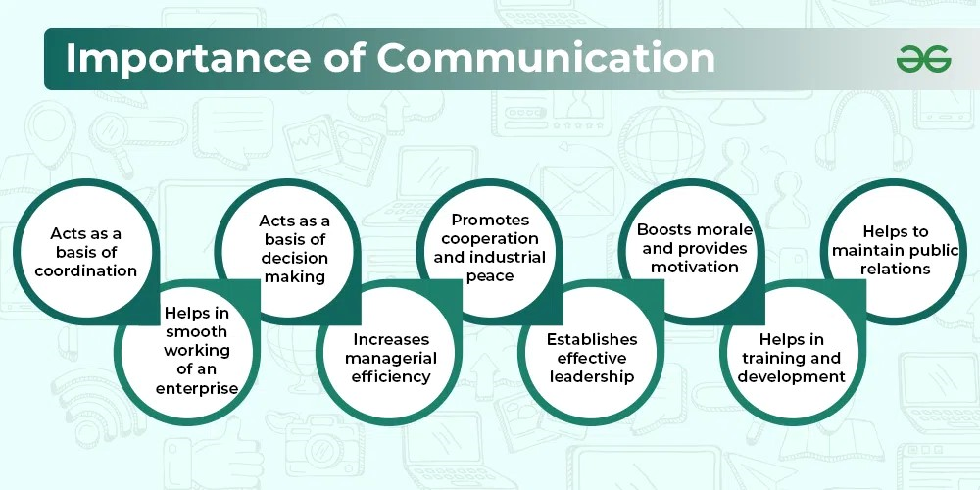
Conclusion
We cannot emphasize enough the importance of communication.
  If the supervisor does not have the answer to the EE’s question, the supervisor should say so and then should strive to find the answer.
    Moreover, supervisors should permit and even encourage EEs to visit the HR department or the appropriate manager for advice and assistance concerning benefits and compensation problems.

Slide 88


