Slide 1

Business Communications
Session Seven
Business Communication
  Process and Product – 9th Edition
    Mary Ellen Guffey and Dana Loewy; Cengage Learning 2018, 2015
      ISBN: 978-1-305-95796-1

Slide 2


Unit Five: Employment Communication
The Job Search, Resumes, and Cover Letters in the Digital Age

Slide 3

4 Steps in a Successful Job Search
Following is the best plan for completing your job search:
  Analyze Yourself
    Identify your interests and goals - Assess your qualifications - Explore career opportunities.
  Develop a Job-Search Strategy
    Search the open job market - Pursue the hidden job market - Cultivate your online presence - Build your personal brand – Network
  Create a Customized Resume
    Choose a resume style - Organize your info concisely - Tailor your resume to each position - Optimize for digital technology
  Know the Hiring Process
    Submit a resume, application, or e-portfolio – Undergo screening and hiring interviews – Accept an offer or reevaluate your progress

Slide 4

Launching Your Job Search with Self-Analysis
For guidance in choosing a career that proves to be satisfying, ask yourself the following questions:
  What are you passionate about? Can you turn this passion into a career?
  Do you enjoy working with people, data, or things?
  How important are salary, benefits, technology support, & job stimulation?
  Must you work in a specific city, geographic area, or climate?
  Are you looking for security, travel opportunities, money, power, prestige?
  How would you describe the perfect job, boss, and coworkers?

Slide 5

Evaluating Your Qualifications
In addition to analyzing your interests and goals, take a good look at your qualifications.
  Remember that today’s job market is not so much about what you want, but what the employer wants.
    What assets can you offer?

Slide 6
Developing a Job-Search Strategy Focused on the Open Job Market
Once you analyze what you want in a job and what you have to offer, you are ready to focus on the job-search strategy.
  How are job seekers today finding their jobs?
Personal Networking | 40%
Online Social Networking | 21%
Online Job Board | 20%
Classified Advertisement | 19%
Recruiter | 10%
Career Fair | 7%
College or University Connection | 7%

Slide 7

Unlocking the Hidden Job Market with Networking
The most successful job candidates seek to transform themselves from unknown into known quantities through networking.
  Most jobs are found through referrals and person-to-person contacts than through any other method. People trust what they know.
    Your goal is to become known to a large network of people.

Slide 8
Building a Personal Network
Three steps that will help you establish your own network:
  Develop a Contact List
    Make a list of anyone willing to talk with you about finding a job.
  Make Contacts in Person and Online
    Call the people on your list or connect online.
    Be friendly, polite, and interested in what the person has to say.
    Provide a copy of your resume and stay centered on job search.
    Get at least two referrals.
  Follow Up on Your Referrals
    Don’t ask for a job.
    Ask how individual got started in career.
    Ask what they like best (or least) about their work.
    Ask what career paths exist in your field, and how you can get started.
    Stay in contact during and after your search

Slide 9

Targeting Social Media in a Job Search
Job candidates have powerful new tools at their disposal: social media networks. These networks are critical to your job search.
  It is important to list yourself in LinkedIn. This social media site dominates the world of job searching, recruiting, and networking.
    In addition to LinkedIn, job seekers can join Facebook, Twitter, and Google+ to find job opportunities, market themselves to companies, showcase skills, highlight experience, and land their dream job.

Slide 10

Creating Your Personal Brand
An important part of your job-search involves building a brand for yourself.
  Before you get into the thick of the job hunt, focus on developing your brand so that you know what you want to emphasize.

Slide 11
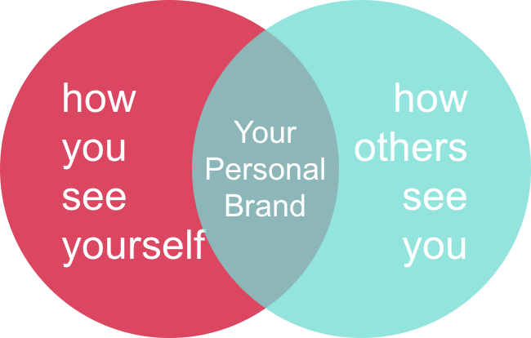
Creating Your Personal Brand
Personal branding involves deciding what makes you special and desirable in the job market.
  What is your unique selling point? What special skill set makes you stand out among job applicants? What would your instructors or employers say is your greatest strength?
    Think about your intended audience.
    What are you promoting about yourself?

Slide 12

Creating Your Personal Brand
Experts suggest you create a tagline that describes what you do, who you are, and what’s special about you.
  Keep the tagline short, simple, and truthful so it’s easy to remember. A nurse wrote this tagline: “Tireless, caring Registered Nurse who helps pediatric cancer patients and their families feel at ease throughout treatment and recovery.”
    Once you have a tagline, prepare a professional-looking business card with your name and tagline. Include and easy-to-remember email address such as firstname.lastname@domain.com.

Slide 13

Creating Your Personal Brand
Now that you have your tagline and business card, work on an elevator speech.
  This is a pitch that you can give in 60 seconds or less, describing who you are and what you can offer.
    Adjust speech for your audience, and practice until you can say it naturally and effortlessly.

Slide 14

Elevator Speech
Here are suggestions to help you prepare your own authentic elevator speech depending on your situation:
  Hi, my name is ____, and I am about to graduate from ____ with a major in ____. I’m looking to ____ because I enjoy ____. Recently I ____ where I was able to develop skills such as ____. I’m most confident about my skills in ____. I’m inspired by the field (or position) of ____ because ____. My ultimate aim is to ____. I’m looking for a position in ____. Do you have any suggestions or advice on how I can ____?

Slide 15

Customizing Your Resume
In today’s highly competitive job market, the focus is not so much on what you want but on what the employer needs.
  That’s why you must customize a resume for every position you seek. The competition is so stiff today that you cannot get by with a generic, one-size-fits-all resume.
    Although you can start with a basic resume, you should customize it to fit each company and position if you want it to stand out from the crowd.

Slide 16
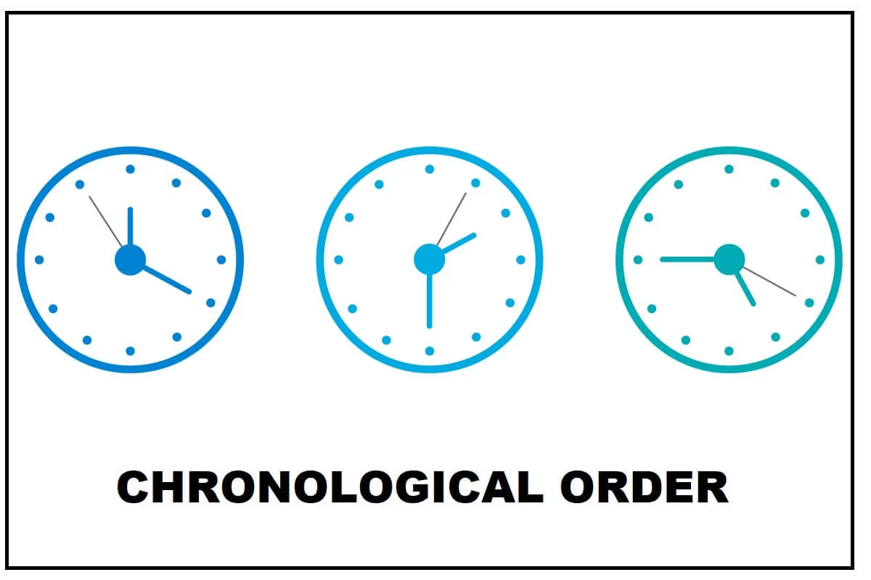
Choosing a Resume Style
The most popular resume format is the chronological format.
  The chronological resume lists work history job by job but in reverse order, starting with the most recent position.
    Recruiters favor chronological format because they are familiar w/it and because it reveals a candidate’s education and experience.

Slide 17

How Long Should a Resume Be?
Experts disagree on how long a resume should be.
  Conventional wisdom holds that recruiters prefer one-page resumes. However, recruiters who are serious about candidates prefer the kind of details that can be provided in a two-page or longer resume.
    The best advice is to make your resume as long as needed to present your skills to recruiters and hiring managers. Individuals with more experience will naturally have longer resumes.

Slide 18
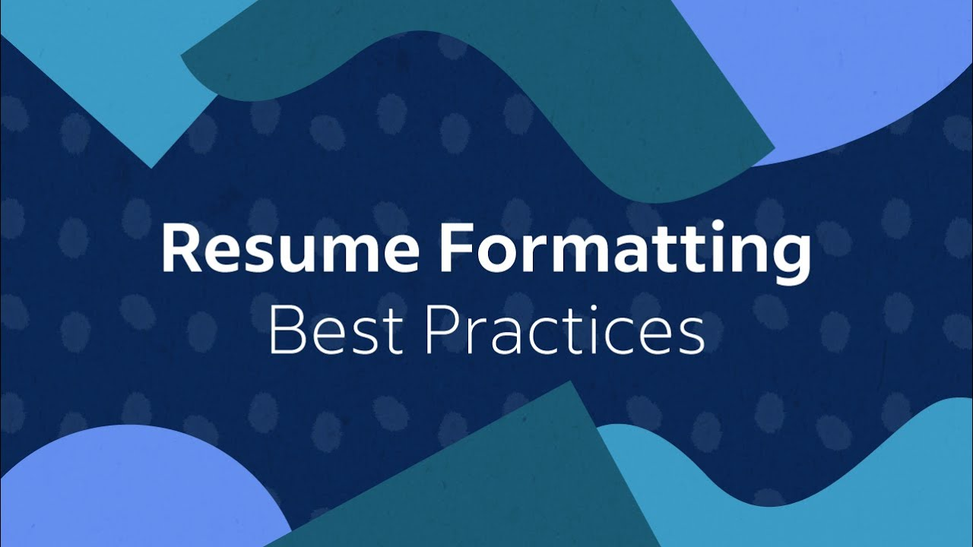
Organizing Your Information Into Effective Resume Categories
In organizing your qualifications and information, try to create as few headings as possible.
  Most resumes include the following:
    Main Heading
    Career Objective
    Summary of Qualifications
    Education
    Experience
    Capabilities and Skills
    Awards, Honors, and Activities

Slide 19

Organizing Your Information Into Effective Resume Categories
1. Main Heading
Your resume should start with an uncluttered and simple main heading.
  The first line should be your name; add middle initial for more professional look. Format your name so it stands out on the page.
    Following your name, list your contact information, including your address, area code and phone number, and email address.
    Some omit street address to protect privacy and for safety reasons.

Slide 20

Organizing Your Information Into Effective Resume Categories
2. Career Objective
Although experts don’t agree on whether to include an objective on a resume, nearly all agree that if you do, it should be specific.
  A well-written objective – customized for the job opening – makes sense, especially for new grads with fresh training and relevant skills.
  Strive to include keywords from the job listing because these will help tracking systems select your resume.
    Focus on what you can contribute to the organization, not what the organization can do for you.

Slide 21

Organizing Your Information Into Effective Resume Categories
3. Summary of Qualifications
A summary of qualifications may be a short summary statement or a list of three to eight bulleted statements that prove you are the ideal candidate for the position.
  When formulating these statements, consider your experience in the field, your education, your unique skills, awards you have won, certifications you hold, and any other accomplishments.
    Target the most important qualifications an employer will be looking for in the person hired for this position.

Slide 22

Organizing Your Information Into Effective Resume Categories
4. Education
The next component in a chronological resume is your education – if it is more noteworthy than your work experience.
  In this section you would include the name and location of schools, dates of attendance, major fields of study, and degrees received.
    Your grade point average (GPA) and/or class ranking may be important to prospective employers.
    Once you have attended college, you don’t need to list high school information on your resume.

Slide 23

Organizing Your Information Into Effective Resume Categories
5. Work Experience or Employment History
When your work or volunteer experience is significant and relevant to the position sought, this information should appear before your education.
  List your most recent employment first and work backward, including only those jobs that you think will help you win the job.
  Rather than list every single duty performed, customize your information so that it relates to the position you’re seeking.
    Be aware that time gaps in your employment history will probably be questioned in the interview.

Slide 24
Organizing Your Information Into Effective Resume Categories
5. Work Experience or Employment History
In addition to technical skills, employers seek individuals with communication, management, and interpersonal capabilities.
  This means you will want to select work experiences and achievements that illustrate your initiative, dependability, responsibility, resourcefulness, flexibility, and leadership.
    Employers also want people who can work in teams.

Slide 25
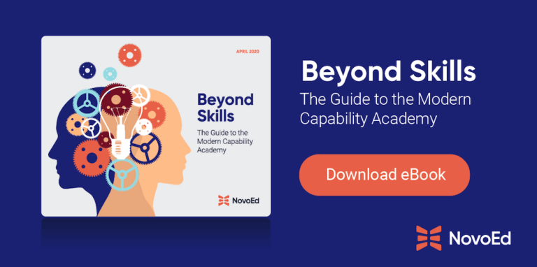
Organizing Your Information Into Effective Resume Categories
6. Capabilities and Skills
Recruiters want to know what you can do for their companies.
  List your skills, especially those that relate to the targeted position.
  Talk about your ability to use the Internet, search engines, software programs, social media, office equipment, and communication tools.
  You will also want to highlight exceptional aptitudes, like working well under stress, learning quickly, and interacting with customers.
    Use expressions such as “proficient in,” “competent in,” “experienced in,” and “ability to.”

Slide 26

Organizing Your Information Into Effective Resume Categories
7. Awards, Honors, and Activities
If you have any awards or honors, highlight them by listing them under a separate heading.
  It is appropriate to include school, community, volunteer, and professional activities.

Slide 27

Include References?
Listing references directly on a resume takes up valuable space. Instead, recruiters prefer that you bring to the interview a list of individuals willing to discuss your qualifications.
  You should prepare a separate list of three to five individuals, such as instructors, your current employer or previous employers, colleagues or subordinates, and other professional contacts.
    Do not include personal or character references, such as friends, family, or neighbors.

Slide 28
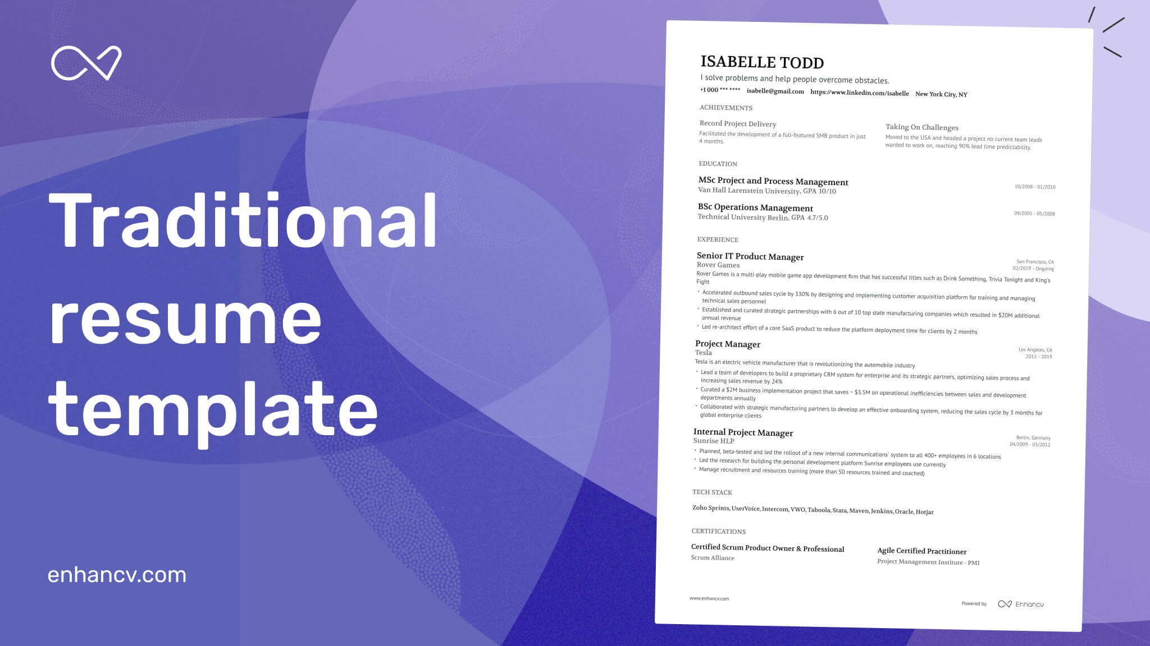
Preparing a Basic Print Resume
Prepare a print-based traditional resume.
  It should be attractively formatted to maximize readability.
    This resume is useful (1) during job interviews, (2) for person-to-person networking situations, (3) for recruiters at career fairs, and (4) when you are competing for a job that does not require an electronic submission.

Slide 29

Cover Messages
A cover message, also known as a cover letter, has always been a graceful way of introducing your resume.
  Hiring managers argue cover letters are critical as they reveal writing skills and key evidence missing in a resume.
    Well-written cover letters will help a candidate stand apart from others.

Slide 30

Creating a Customized Cover Message
Regardless of its length (from 2 paragraphs to full page), a cover message should have three primary parts:
  (1) An opening that captures attention, introduces the message, and identifies the position, (2) A body that sells the candidate and focuses on the employer’s needs, and (3) a closing that requests an interview and motivates action.
    Write a personalized, customized cover message for every position that interests you.

Slide 31

Unit Five: Employment Communication
Interviewing and Following Up

Slide 32

Interviewing Effectively in Today’s Competitive Job Market
Whether you are completing your education and searching for your first serious position or are in the workforce and striving to change jobs, a job interview can be life changing.
  Because employment is a major part of everyone’s life, the job interview takes on enormous importance.

Slide 33

Purpose and Sequencing of Employment Interviews
An interview has several purposes for you as a job candidate.
  It is an opportunity to (1) convince the employer of your potential, (2) learn more about the job and the company, and (3) expand on the information in your resume.
    This is the time for you to gather information to determine whether you would fit into the company culture. You should also be thinking about whether the job suits your career goals.

Slide 34

Purpose and Sequencing of Employment Interviews
From an employer’s perspective, the interview is opportunity to:
  Assess your abilities in relation to the requirements for the position.
  Discuss training, experience, knowledge, and abilities in more detail.
  See what drives and motivates you.
  Decide whether you would fit into the organization.

Slide 35

Before the Interview
Once you have sent out at least one resume or filled out one job application, you must consider yourself an active job seeker.
  Being active in the job market means that you should be prepared to be contacted by potential employers. Employers often use screening interviews to narrow the list of candidates.
    If you do well in the screening interview, you will be invited to an in-person or video meeting.

Slide 36

Ensuring Professional Phone Techniques
Even with the popularity of email, most employers contact job applicants by phone to set up interviews.
  Employers can judge how well applicants communicate by hearing their voices and expressions over the phone.
    Once you are actively looking for a job, anytime the phone rings, it could be a potential employer. Be prepared. How you conduct yourself on the phone will create a lasting impression.

Slide 37

Researching the Target Company
Once you have scheduled an in-person or video interview, you need to start preparing for it.
  One of the most important steps in effective interviewing is gathering detailed information about a prospective employer.
    Never enter an interview cold. Recruiters are impressed by candidates who have done their homework.
    Research the Company Profile
    Review Marketing Strategies

Slide 38

Rehearsing Success Stories
To feel confident and be ready to sell your qualifications, prepare and practice success stories.
  These stories are specific examples of your educational and work-related experience that demonstrate qualifications & achievements.
    Look over the job description and your resume to determine what skills, training, personal characteristics, and experience you want to emphasize during the interview. Then prepare a success story for each one.

Slide 39

Rehearsing Success Stories
Practice telling your success stories until they fluently roll off your tongue and sound natural.
  Then in an interview, be certain to find places to insert them.
  Tell stories about:
    Dealing with a crisis
    Handling a tough interpersonal situation
    Successfully juggling many priorities
    Changing course to deal with changed circumstances
    Learning from a mistake
    Working on a team
    Going above-beyond expectations.

Slide 40

Cleaning Up Digital Dirt
Employers screen candidates’ online presence using Google and social media sites such as Facebook, LinkedIn, and Twitter.
  A recent CareerBuilder survey revealed that 49% of hiring managers who screen candidates via social networks said they had found information that caused them not to hire a candidate.

Slide 41

Cleaning Up Digital Dirt
The top five reasons employers chose not to hire a candidate:
  Provocative or inappropriate photographs, videos, or information.
  Contents about drinking or doing drugs.
  Discriminatory comments related to race, religion, and other protected categories.
  Criticism of previous employers or colleagues.
  Poor communication skills.
    Teasing photos and provocative comments about drinking, drug use, and sexual exploits make students look immature & unprofessional.

Slide 42

During the Interview
Throughout the interview you will be answering questions and asking your own questions.
  Your demeanor, body language, and other nonverbal cues will also be on display. The interviewer will be trying to learn more about you, and you should be learning more about the job and the organization.
    Although you may be asked some unique questions, many interviewers ask standard, time-proven questions, which means that you can prepare your answers ahead of time.

Slide 43

Preparing to Answer Interview Questions
Always aim your answers at key characteristics interviewers seek: expertise, competence, motivation, interpersonal skills, decision-making skills, enthusiasm for the company and the job, and a pleasing personality.
  Remember to stay focused on your strengths.
    Don’t reveal weaknesses, even if you think they make you look human.
    You won’t be hired for your weaknesses, only for your strengths.

Slide 44

Questions to Get Acquainted
After opening introductions, recruiters generally try to start the interview with personal questions designed to put you at ease.
  They are also striving to gain an overview to see whether you will fit into the organization’s culture.
    When answering these questions, keep the employer’s needs in mind and try to incorporate your success stories.

Slide 45


Questions to Get Acquainted…
Tell me about yourself.
What are your greatest strengths?
Do you prefer to work by yourself or with others? Why?
What was your major in college, and why did you choose it?
What are some things you do in your spare time?

Slide 46
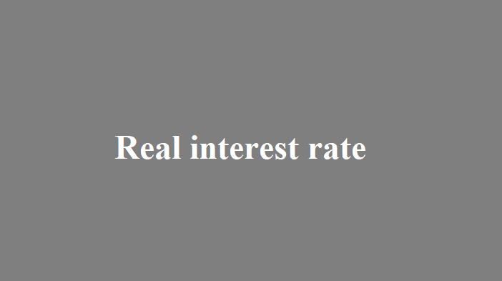
Questions to Gauge Your Interest
Interviewers want to understand your motivation for applying for a position.
  Although they will realize that you are probably interviewing for other positions, they still want to know why you are interested in this particular position with this organization.
    These types of questions help them determine your level of interest.

Slide 47

Questions to Gauge Your Interest…
Why do you want to work for (name of company)?
Why are you interested in this position?
What do you know about our company?
Why do you want to work in this industry?
What interests you about our products (or services)?

Slide 48

Questions About Your Experience and Accomplishments
After questions about your background and education and questions that measure your interest, the interview generally becomes more specific with questions about your experience and accomplishments.
  Remember to show confidence when you answer these questions.
    If you are not confident in your abilities, why should an employer be?

Slide 49
Questions About Your Experience and Accomplishments…
Why should we hire you when we have applicants with more experience or better credentials?
  Keep in mind that employers often hire people who present themselves well instead of others with better credentials.
    Emphasize personal strengths that could be an advantage for employer. Are you a hard worker? How can you demonstrate it?
    Have you had recent training? Some people have had more years of experience but have less knowledge because they do the same thing.
    Stress your experience using the latest methods and equipment.
    Be sure to mention your computer training and Internet savvy.
    Emphasize that you are open to new ideas and learn quickly.
    Above all, show that you are confident in your abilities.

Slide 50
Questions About Your Experience and Accomplishments…
Describe the most rewarding experience of your career so far.
How have your education and professional experiences prepared you for this position?
What were your major accomplishments in your past jobs?
What was a typical workday like?
What job functions did you enjoy most? Least? Why?
Tell me about your technical skills.
Who was the toughest boss you ever worked for and why?
What were your major achievements in college?
Why did you leave your last position?
Why are you leaving your current position?

Slide 51

Questions About the Future
Questions that look into the future can stump candidates, especially those who have not prepared adequately.
  Employers ask these questions to see whether you are goal oriented and to determine whether your goals are realistic.

Slide 52
Questions About the Future…
Where do you expect to be five (or ten) years from now?
If you got this position, what would you do to be sure you fit in?
This is an (x) organization. Do you think you will like environment?
Do you plan to continue with your education?
What do you predict for the future of the (x) industry?
How do you think you can contribute to this company?
What would you most like to accomplish if you get this position?
How do you keep current with what is happening in the profession?

Slide 53

Challenging Questions
Challenging questions may make you uncomfortable, but the important thing to remember is to answer truthfully without dwelling on your weaknesses.
  As quickly as possible, convert any negative response into a discussion of your strengths.

Slide 54
Challenging Questions…
What is your greatest weakness?
  Many candidates knock themselves out of the competition by answering this question poorly. Actually, you have many choices.
    You can present a strength as a weakness: “Some people complain that I am a workaholic or that I’m too attentive to details.” However, hiring managers have heard that cliché too often. Instead, mention a corrected weakness: “Because I was terrified of making presentations, I took a college course and joined a speaker’s club.”
    You could cite an unrelated skill: “I need to brush up on my Spanish.”
    You can cite a learning objective: “One of my long-term goals is to learn more about coding and programming.”
    Another possibility is to reaffirm your qualifications: “I have no weaknesses that would affect my ability to do this job.”

Slide 55
Challenging Questions…
What type of people do you have no patience for?
If you could live your life over, what would you change and why?
How would your current/ex-supervisor describe you as employee?
What do you want the most from your job?
What is your G.P.A, and does it accurately reflect your abilities?
Have you ever used drugs?
Who in your life has influenced you the most and why?
What are your reading right now?
Describe your ideal work environment?
Is the customer always right?
How do you define success?

Slide 56

Questions About Salary
Nearly all salaries are negotiable, depending on qualifications.
  Knowing the typical salary range for the target position is very important in this negotiation.
    If you have had little experience, you will probably be offered a salary somewhere between the low point and the midpoint in the range.
    With more experience, you can negotiate for a higher figure.

Slide 57
Questions About Salary…
What salary are you looking for?
  One way to handle salary questions is to ask politely to defer the discussion until it is clear that a job will be offered to you: “I’m sure when the time comes, we will be able to work out a fair compensation package. Right now, I’d rather focus on whether we have a match.”
  If salary comes up and you are not sure whether the job is being offered to you, be blunt. Ask, “Are you making me a job offer?”
  Another possible response to a salary question is to reply candidly that you can’t know what to ask until you know more about position and company.
  If you continue to be pressed for a dollar figure, give a salary range with an annual dollar amount. Be sure to do research before the interview so that you know what similar jobs are paying in your geographic region.
    As an expert negotiator said, “In business as in life, you don’t get what you deserve, you get what you negotiate.”

Slide 58

Situational Questions
Questions related to situations help employers test your thought processes and logical thinking.
  When using situational questions, interviewers describe a hypothetical situation and ask how you would handle it. These questions are based on the type of position you are interviewing.
    Knowledge of the position and the company culture will help you respond favorably to these questions. Even if the situation sounds negative, keep your response positive.

Slide 59

Situational Questions…
How would you respond if your fellow team members strongly resisted a proposal you made in a meeting?
  You might explain the rationale behind your proposal with specific examples of benefits that recommendations could bring to the team.
    If the team continues to oppose your proposal, you should move on.

Slide 60
Situational Questions…
Your supervisor has just told you that she is dissatisfied with your work, but you think it is acceptable. How would you resolve the conflict?
Your supervisor told you to do something a certain way, and you think you know a far better way to complete the task. What would you do?
Assume that you are hired for this position. You soon learn that one of the staff members is extremely resentful because she applied for your position and was turned down. As a result, she is being unhelpful and obstructive. How would you handle the situation?
You have noticed that communication between upper management and first-level employees is eroding. How would you address this problem?
A colleague told you in confidence that she suspects another colleague of stealing. What would your actions be?

Slide 61

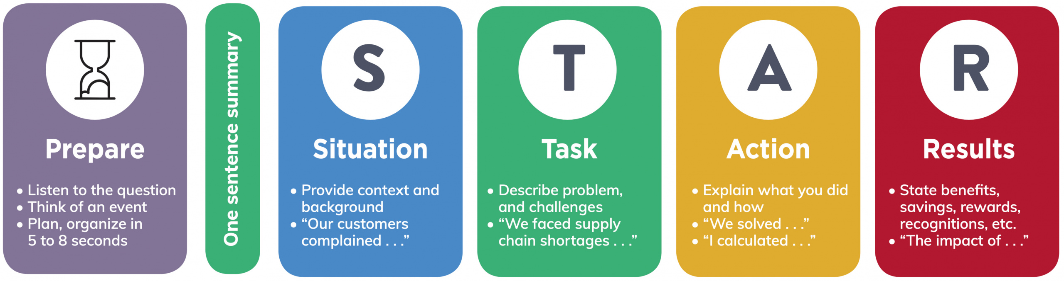
Behavioral Questions
Instead of interview questions, you may be asked to tell stories.
  The interviewer may say, “Tell me about a time when…” To respond effectively, learn to use storytelling, or the STAR technique.
    Ask yourself what the Situation or Task was, what Action you took, and what the Results were.

Slide 62

Components of the STAR Technique
Situation
  Briefly explain the background and context of a situation.
  What happened? When? Where?
Task
  Describe the problem. What needed to be done? Why?
Action
  What did you do? What skills or tools did you use?
Results
  Explain the results (i.e. savings, greater efficiency).
  Try to quantify.

Slide 63
Behavioral Questions…
Tell me about a time when you solved a difficult problem.
Describe a situation in which you were able to use persuasion to convince someone to see things your way.
Describe a time when you had to analyze info and make a recommendation.
Describe a time that you worked successfully as part of a team.
Tell me about a time that you dealt with confidential information.
Give me an example of a time when you were under stress to meet a deadline.
Tell me when you had to go above and beyond the call of duty to get a job done.
Tell me about a time you were able to deal with another person successfully even though that individual did not like you personally (or vice versa)
Give me an example of when you showed initiative and took the lead.
Tell me about a recent situation in which you had to deal with an upset customer or coworker.

Slide 64

Illegal and Inappropriate Questions
U.S. federal law states that “it is illegal to discriminate against someone (applicant or employee) because of that person’s race, color, religion, sex (including gender identity, sexual orientation, and pregnancy), national origin, age (40 or older), disability or genetic information.”
  Therefore, it is inappropriate for interviewers to ask any question related to these areas.
    These questions become illegal, though, only when a court of law determines the employer is asking them with the intent to discriminate.

Slide 65
Illegal and Inappropriate Questions
Many illegal interview questions are asked innocently by inexperienced interviewers.
  Some interviewers are only trying to be friendly when they inquire about your personal life or family. Regardless of the intent, how should you react?
    If you find the question harmless and you want the job, answer it.
    If you think that answering it would damage your chance to be hired, try to deflect the question tactfully with a response such as “Could you tell me how my status relates to the responsibilities of this position?” or “I prefer to keep my personal and professional lives separate.”

Slide 66

Asking Your Own Questions
At some point in the interview, usually near the end, you will be asked whether you have any questions.
  The worst thing you can do is say “No,” which suggests that you are not interested in the position. Instead, ask questions that will help you gain information and will impress the interviewer with your thoughtfulness and interest in the position.
    Remember that this interview is a two-way street.

Slide 67
Asking Your Own Questions…
What will my duties be (if not already discussed)?
Tell me what it is like working here in terms of the people, management practices, workloads, expected performance, and rewards.
What training programs are available from this organization? What specific training will be given for this position?
What is the organizational structure, and where does this position fit in?
How and by whom will my job performance be evaluated?
Assuming my work is excellent, where do you see me in five years?
How long do employees generally stay with this organization?
What are the major challenges for a person in this position?
What do you see in the future of this organization?
This job seems to be exactly what I’d really like to do. Do we have a fit here?
What is the next step in the hiring process?
When do you expect to make a decision?

Slide 68

Ending Positively
After you have asked your questions, the interviewer will signal the end of the interview, usually by standing up or by expressing appreciation that you came.
  If not addressed earlier, you should at this time find out what action will follow. It is recommended that you ask when a decision will be made and whether you may follow up.
    Too many candidates leave the interview without knowing their status or when they will hear from the recruiter.

Slide 69
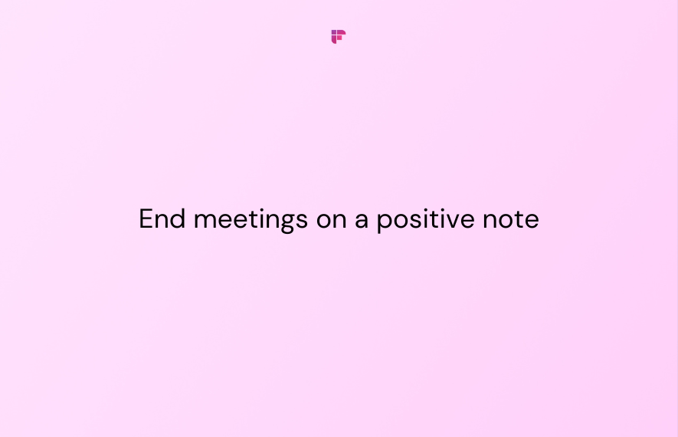
Ending Positively
Before you leave, summarize your strongest qualifications, show your enthusiasm for obtaining this position, and thank person for a constructive interview and for considering you for position.
  Ask the interviewer for a business card, which will provide the information you need to write a thank-you message.

Slide 70

Contacting Your References
Once you have thanked your interviewer, it is time to alert your references that they may be contacted by the employer.
  You should have already asked permission to use them as references, and you should have supplied them with a copy of your resume and information about types of positions you are seeking.

Slide 71


