Slide 1

Human Relations in Organizations
Session Seven

Slide 2

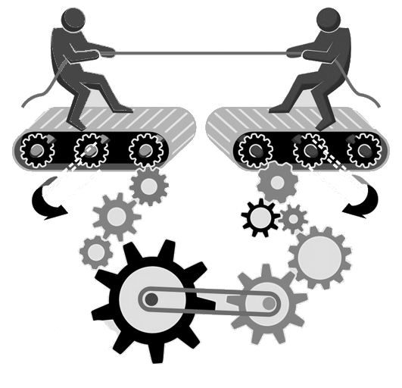
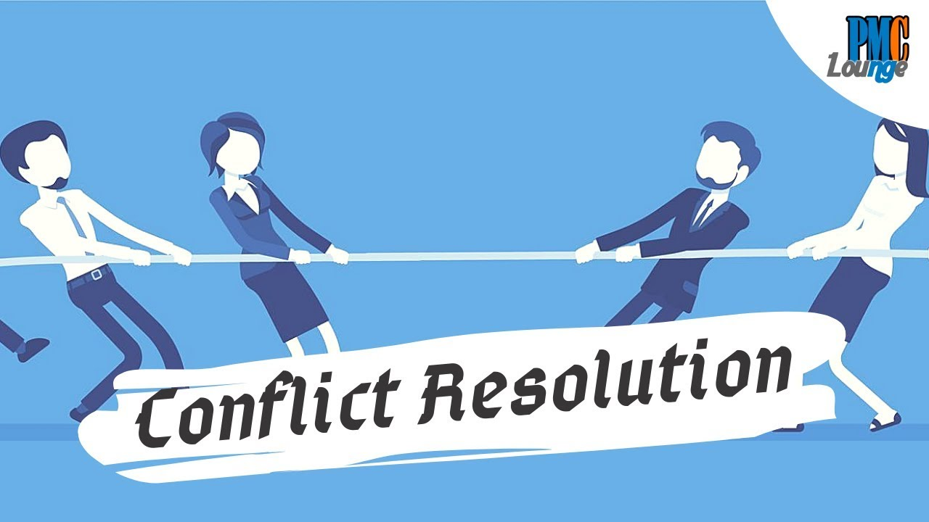
Conflict Resolution
Conflicts usually arise because: lack of a win-win situation.

Slide 3
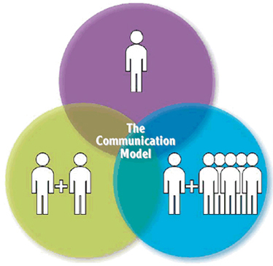
Transactional Analysis
Transactional Analysis (TA) is a method of understanding behavior in interpersonal dynamics.
  It is a method for determining how people interact.

Slide 4

Ego States
We all have three major ego states that affect our behavior or the way we transact through communication.
  The three ego states are:
  Parent
    The critical parent is evaluative
    The sympathetic parent is supportive
  Child
    The natural child is curious
    The adapted child is rebellious
  Adult
    The adult is a thinking, unemotional state of ego

Slide 5
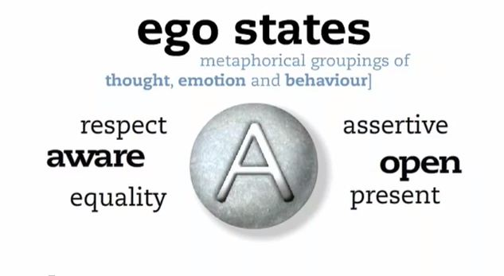
Ego States
Understanding the ego state of the person you are interacting with can help you understand their behavior and how to interact in an effective way.

Slide 6

Types of Transactions
3 Types of Transactions
  Complementary
    The sender of the message gets the intended response of the receiver.
      Results in more effective communication with fewer hurt feelings.
  Crossed
    The sender does not get the expected response.
      Results in surprise, disappointment, and hurt feelings for the sender of the message.
  Ulterior
    The person appears to be in one ego state, but their behavior comes from a different ego state.
      Sometimes people don’t know what they want or how to ask for it in a direct way, so they use ulterior transactions.

Slide 7
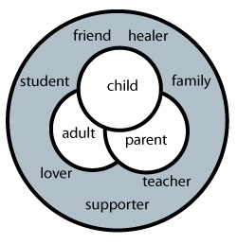
Life Positions and Stroking
Life Positions suggest that within the transactional analysis framework, you have attitudes toward yourself and others.
  With a positive attitude toward yourself and others, you have a greater chance for having adult-to-adult ego state communication.
Stroking is any behavior that implies recognition of another’s presence.
  We all want praise and recognition – so giving praise (positive strokes) is a powerful motivation technique that is easy to use and costs nothing.

Slide 8
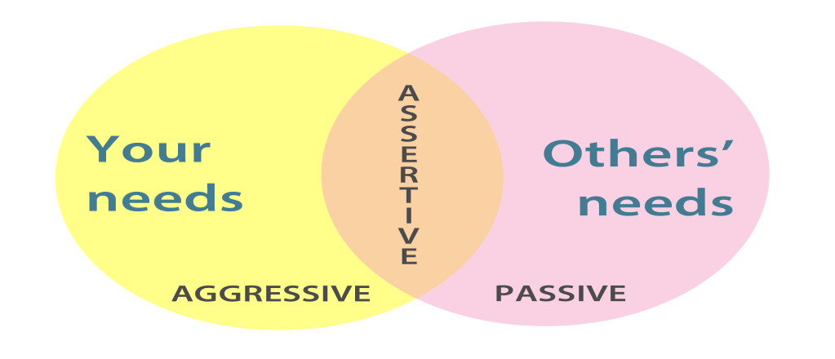
Assertiveness
Assertiveness is the process of expressing thoughts and feelings while asking for what one wants in an appropriate way.
  You need to present your message without falling into stereotypical “too pushy” (aggressive) or “not tough enough” (non-assertive – passive) traps.

Slide 9

Passive Behavior
Passive behavior is avoidance of behavior or an accommodation of the other party’s wishes without standing up for one’s rights - It involves self-denial and sacrifice.
  Passive people tend to deny the importance of things – they rationalize things – “It doesn’t matter to me.”
    When people know someone is passive, they tend to take advantage of the person.

Slide 10

Aggressive Behavior
Aggressive people are demanding, tough, rude, pushy, and they insist on getting their own way and use force to gain control.
  They are very competitive, hate to lose to the point of cheating, and tend to violate the rights of others to get what they want.
    Learn to replace Aggressive Behavior with Assertive Behavior

Slide 11
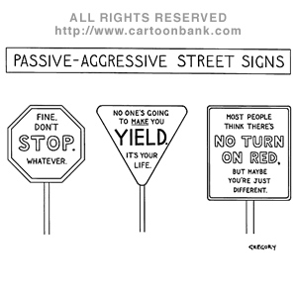
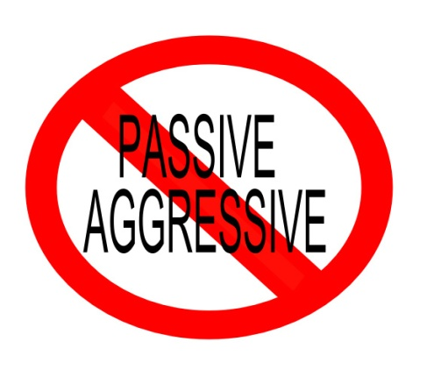
Passive-Aggressive Behavior
Passive-Aggressive Behavior is displayed in three ways:
  Person uses both types of behavior sporadically.
  Person uses passive behavior during the situation, then shortly after uses aggressive behavior.
  Person uses passive behavior, but inside is building up hostility.

Slide 12
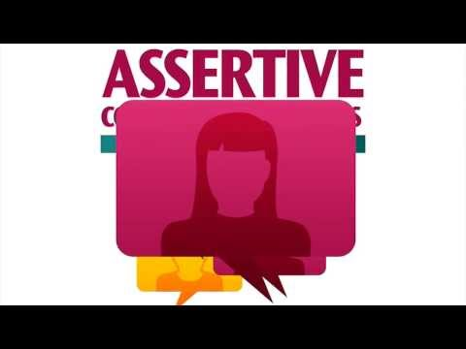

Assertive Behavior
Assertive Behavior is generally the most effective method of getting what you want while not taking advantage of others.
  The Assertive person expresses feelings and thoughts and asks for things without aggressive behavior.
  The Assertive person stands up for their rights without violating the rights of others.
    People who use Assertive Behavior tend to have a positive self-concept.

Slide 13

Putting It All Together
When a person who is talking is interrupted, they can behave in one of three ways:
  Passively
    The person can say and do nothing.
  Aggressively
    The person can say, “I’m talking – mind your manners and wait your turn,” in a loud voice, while pointing to the interrupter.
  Assertively
    The person can say, “Excuse me – I haven’t finished making my point,” with a smile and in a friendly but firm voice.

Slide 14
Passive, Aggressive, and Assertive Phrases
Passive Phrases
  Passive speakers use self-limiting, qualifying expressions without stating their position or needs.
    I don’t know or care (when I do)
    It doesn’t matter (when it does)
Aggressive Phrases
  Aggressive speakers state their position or needs while violating the rights of others using “you-messages” and absolutes.
    You don’t know what you’re talking about…
Assertive Phrases
  Assertive speakers state their position or needs without violating the rights of others.
    I don’t understand…
    I need/want/prefer…
    I would like…

Slide 15
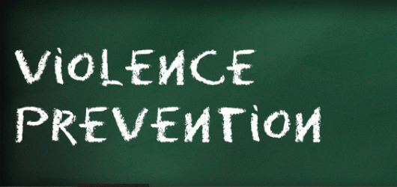
Anger and Violence in the Workplace
The key to preventing workplace violence is to recognize and handle suspicious behavior before it becomes violent.
  Causes of Anger and Violence:
    Anger can lead to violence.
    Frustration, stress, and fear bring out anger.
    The physical work environment – work space, noise odors, temperature (hot), ventilation, and color - can contribute to making people angry.
    People tend to copy, or model, others’ behavior.
    Violence in the community, which includes family violence, surrounding an organization is brought into the workplace.
    Drugs contribute to violence.

Slide 16
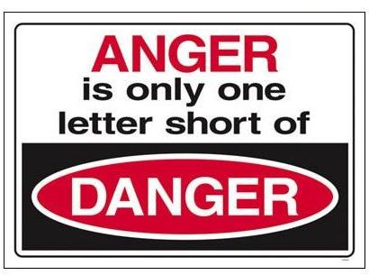
Anger and Violence
Anger can lead to perception problems, poor decisions, and hostility, which is stressful and can harm your health.
  On the positive side, anger can lead to assertive behavior to resolve problems.
    Buddha said, “You will not be punished for your anger; you will be punished by your anger.”

Slide 17

Anger and Violence
A first step to emotional control of anger is self-awareness.
  Here are some tips for effectively getting rid of your anger:
    Don’t think about and dwell on your angry feelings
    Develop a positive attitude about how you deal with anger
    Use rational thinking
    Look for positives
    Look for the humor in the situation
    Use assertive behavior
    Use an anger journal

Slide 18

Anger and Violence
The following are tips you can use to help deal with the anger of others through your emotional control to prevent violence:
  Be calm
  Be empathetic and use reflecting statements to calm the person
  Apologize, even if you didn’t do anything wrong
  Do not use offensive language or make threats
  Watch your nonverbal communications
  Realize that anger is natural, and encourage people to vent in appropriate ways
  Acknowledge the person’s feelings
  Get away from the person if necessary
  Call for help

Slide 19

Anger and Violence
Workplace violence is rarely spontaneous; it’s more commonly passive-aggressive behavior in rising steps, related to an unresolved conflict.
  People do give warning signs that violence is possible, so it can be prevented if you look for these signs and take action to defuse the anger before it becomes violent.

Slide 20

Anger and Violence
Signs of Potential Violence:
  Take verbal threats seriously
  Watch nonverbal communication
  Watch for stalking and harassment
  Watch for damage to property
  Watch for indications of alcohol and drug use
  Include the isolated person or group member
  Look for presence of weapons or objects that can be used as a weapon

Slide 21

Anger and Violence
Organizational Prevention of Violence
  The number one preventive method is to train all group members to deal with anger and prevent violence.
  Develop a written policy (zero-tolerance) to effectively address organizational violence.
  Treat others with respect.
Individual Prevention of Violence
  Know that there is always the potential for violence.
  Look for escalating frustration and anger so that you can defuse the situation before it becomes violent by being empathetic and using reflecting statements.

Slide 22

Conflict Management
Some people think that a conflict exists only in serious issues with anger. However, in human relations, a conflict exists whenever two or more parties are in disagreement.
  Your ability to manage conflict is critical to your success.

Slide 23

Conflict Management
Communication problems or conflict arise for three primary reasons:
    We fail to make our expectations known to other parties.
    We fail to find out the expectations of other parties.
    We assume that other parties have the same expectations that we have.
    In any relationship, to avoid conflict, share information and assertively discuss expectations early, before the conflict escalates

Slide 24
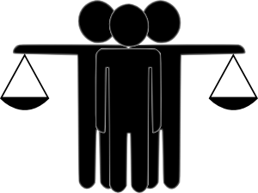
Conflict
People often think of conflict as fighting and view it as disruptive - conflict, however, can be beneficial.

Slide 25
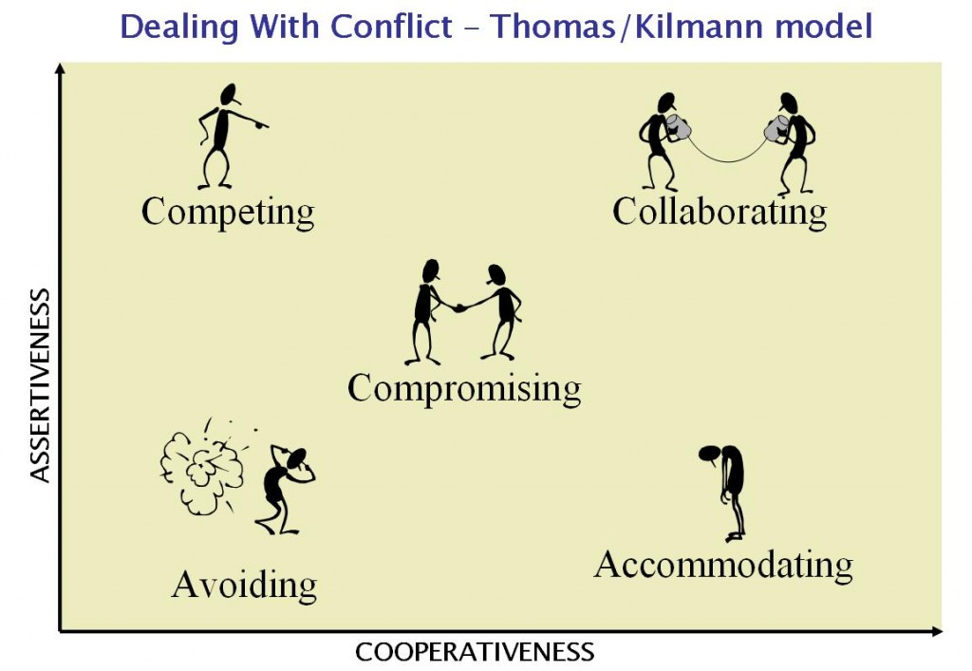

Conflict Management Styles
The Five Conflict Management Styles:
  Forcing
  Avoiding
  Accommodating
  Compromising
  Collaborating

Slide 26

Conflict Management Styles
1. The Forcing Conflict Style
  User attempts to resolve the conflict by using aggressive behavior.
    The Forcing approach uses an uncooperative, autocratic attempt to satisfy one’s own needs at the expense of others, if necessary.

Slide 27
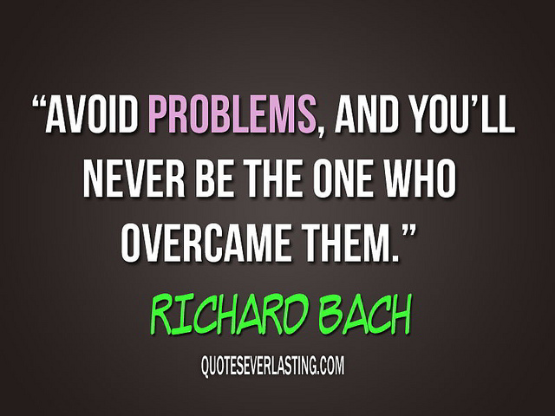

Conflict Management Styles
2. The Avoiding Conflict Style
  User attempts to passively ignore rather than resolve the conflict.
    User is unassertive and uncooperative, and wants to avoid or postpone confrontation. A lose-lose situation is created because the conflict is not resolved.

Slide 28

Conflict Management Styles
3. The Accommodating Conflict Style
  User attempts to resolve the conflict by passively giving-in to the other party.
    The Accommodating approach is unassertive and cooperative.
    It attempts to satisfy other party while neglecting one’s own needs.
    A win-lose situation is created, with other party being the winner.

Slide 29

Conflict Management Styles
4. The Compromising Conflict Style
  User attempts to resolve the conflict through assertive give-and-take concessions.
    This approach is to meet one’s need for harmonious relationships.
    An I-win-part-I-lose-part situation is created through compromise, making the style intermediate in assertiveness and cooperation.
    This style is used in negotiations.

Slide 30


Conflict Management Styles
5. The Collaborating Conflict Style
  User assertively attempts to resolve the conflict with the best solution agreeable to all parties. It is also called the problem-solving style
    The Collaborating approach is assertive and cooperative.
    The focus is on finding the best solution to the problem that is satisfactory to all parties.

Slide 31

Situational Conflict Management
The Situational Conflict Management perspective states that there is no one best style for resolving all conflicts.
  When a conflict exists, determine appropriate style to use.
    A person’s preferred style tends to meet their needs.
    The most difficult style to implement successfully, and the most underutilized when appropriate, is the collaborative style.

Slide 32
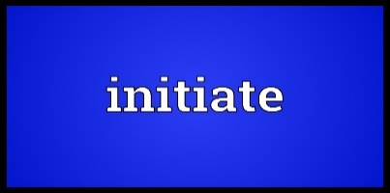
Initiating Conflict Resolution
To resolve conflicts, you should develop a plan of action through initiating conflict resolution steps:
  Plan to maintain ownership of the problem using the XYZ Model
    Open the confrontation with a request for the respondent to help you solve your problem. This approach reduces defensiveness and establishes an atmosphere of problem-solving.
  Implement your plan persistently
    After making short, planned XYZ statement, let other party respond.
  Make an agreement for change
    Try to agree on a specific action you both will take to resolve conflict.

Slide 33

Initiating Conflict Resolution Steps
XYZ Model
The XYZ Model describes a problem in terms of behavior, consequences, and feelings
  Theory: when you do X (behavior), Y (consequences) happens, and I feel Z (feelings)
    For example: when you smoke in my room (X-behavior), I have trouble breathing and become nauseated (Y-consequence), and I feel uncomfortable and irritated (Z-feeling)

Slide 34

Initiating Conflict Resolution Steps
XYZ Model
There are four things we should not do during the XYZ statement:
    Don’t give advice
    Don’t make threats
    Don’t judge the person’s behavior
    Don’t try to determine who is to blame

Slide 35


Responding to Conflict Resolution
The Responding to Conflict Resolution Steps are as follows:
    Listen to and paraphrase the problem using the XYZ Model
    Agree with some aspect of the complaint
    Ask for – and/or give alternative solutions
    Make an agreement for change

Slide 36

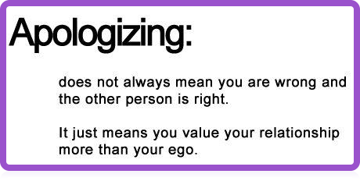
Apologize
It is important to restore relationships that have been hurt by conflict – apologizing helps.
  Human relations can improve simply by telling people you are sorry for your behavior that bothers them.

Slide 37
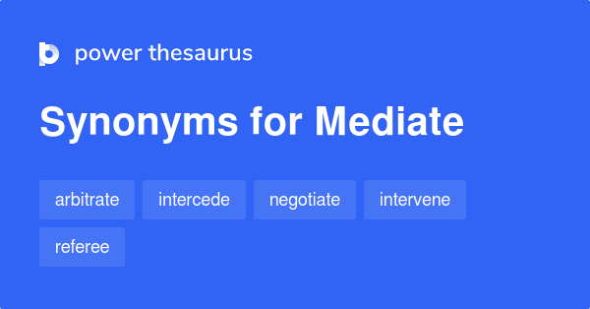
Mediating Conflict Resolution
Often, conflicting employees cannot resolve their dispute. In these cases, the manager or an outside 3rd party should mediate to help them resolve their differences.

Slide 38

Mediating Conflict Resolution
When bringing conflicting parties together, follow the Mediating Conflict Model:
  Have each party state their complaint using the XYZ Model
  Agree on the problem(s)
  Develop alternative solutions
  Make an agreement for change, and follow-up

Slide 39
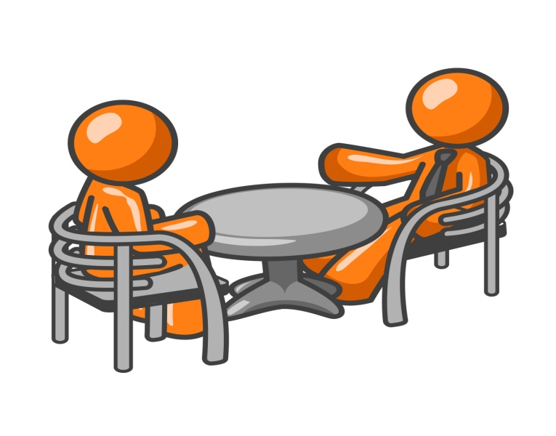
Negotiating
Negotiation is coming to an agreement to do something.
  Negotiation affects the process of work behavior and human relations. It is critical in resolving conflict and increasing performance, and the advancement of careers.
    A big part of day-to-day success is negotiation skills.

Slide 40

Negotiating
Negotiating is a process in which two or more parties have something the other wants and attempt to come to an exchange agreement.
  When negotiating, you focus on building relationships.
    Power, influence tactics, and politics can all be used during the negotiation process.

Slide 41
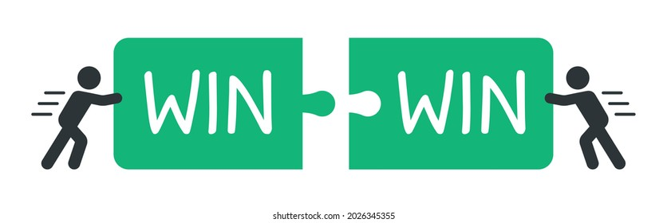
Negotiating Strategies
Distributive Bargaining
  Negotiating over shares of a fixed pie.
    Creates a win-lose situation
Integrative Bargaining
  Negotiating to give everyone a good deal.
    Creates a win-win situation

Slide 42
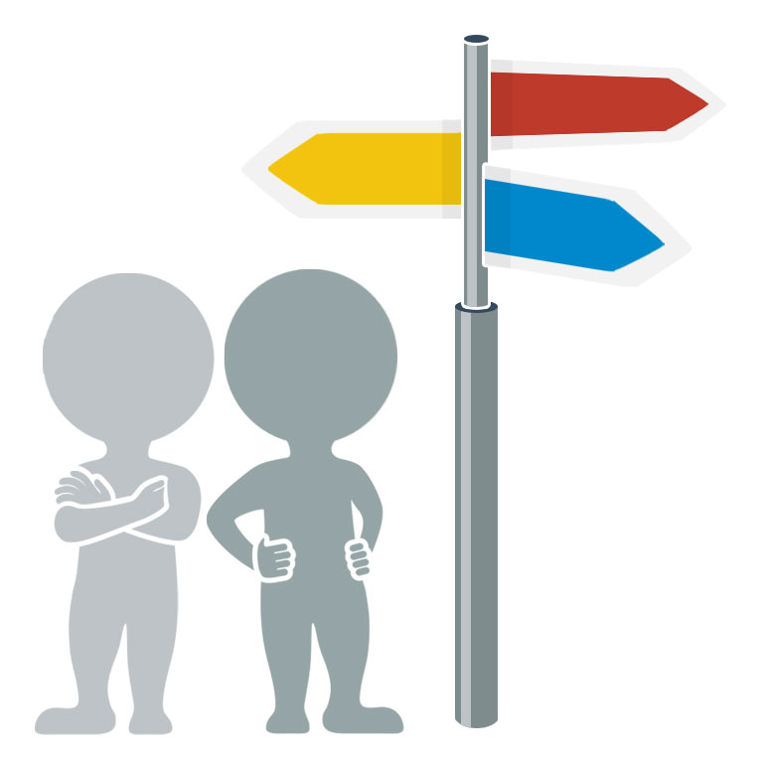
The Negotiating Process
The negotiating process includes the following steps:
  Plan
  Bargain
  Postponement
  Agreement or No Agreement

Slide 43

Negotiating Plan
The Negotiating Plan includes:
  Researching the other parties
    Know the key power players
  Setting objectives
    Based on your research, what can you expect?
  Anticipating questions, objections, and preparing answers
    Understand “What’s in it for me (them)”
    Develop trust
  Developing options and trade-offs
    If you have other options you are in a stronger position
    Let other parties know what they have to lose

Slide 44

Negotiating Planning
Success or failure in negotiating is often based on preparation.

Slide 45
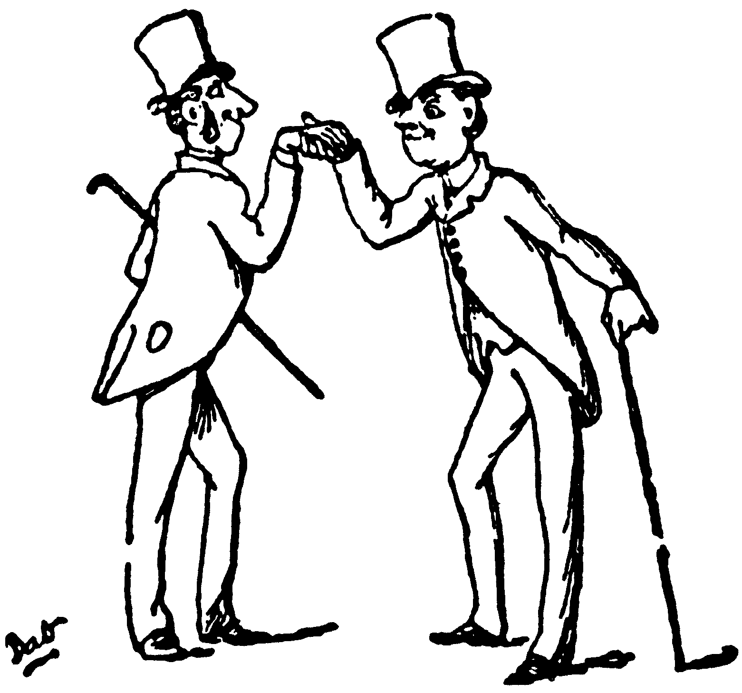
Bargain
After you have planned, you are ready to bargain/negotiate.
  Face to face negotiations are generally preferred because you can see (read) the other person’s nonverbal cues.
  Bargaining includes:
    Developing rapport and focusing on obstacles, not the person.
    Letting the other party make the first offer.
    Listening & asking questions to focus on meeting other’s needs.
    Not being too quick to give in.
    Asking for something in return.

Slide 46


Bargaining
Avoid desperation and being intimidated.
  If others know you are desperate, or weak, and will accept a low agreement, they will likely take advantage of you.
Make the first concession.
  When you are involved with a complex deal, with trade-offs, be willing to be the first to make a concession – they tend to be reciprocated and lead to agreements.

Slide 47


Postponement
When there doesn’t seem to be any progress, it may be wise to postpone the negotiations.
  When the other party is postponing…
    You may create urgency
  When you postpone…
    The other party may create urgency

Slide 48

Agreement or No Agreement
Once the agreement has been made, restate it and/or put it in writing.
  After the deal is made, stop selling it.
  Avoid the so-called “winner’s curse.”
    If you cannot come to an agreement, analyze the situation and try to determine where you went wrong so you can improve.

Slide 49
Negotiating Globally
There are cultural differences in negotiating, and you need to appreciate and embrace the host culture.
  There are many implications for negotiating globally:
    Time to reach an agreement and deadlines
    The focus on task vs. relationship
    The use of power/influencing tactics –concessions with reciprocity
    Communications: both verbal and nonverbal
    Where the negotiations should take place and use of alcohol
    Name, rank or title, dress, greetings, and rituals

Slide 50

…

