Slide 1
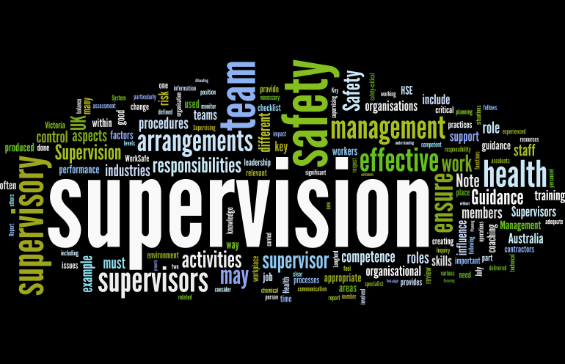
Supervision
Supervision
  Concepts and Practices of Management, 13th Edition
    Edwin C. Leonard, Jr., Ph.D. and Kelly A. Trusty, Ph.D. Cengage Learning, Boston, MA 2013
      ISBN: 978-1-285-86637-6

Slide 2

Part One: Supervisory Management Overview and Challenges
Chapter Three: Supervisory Planning
  After studying this chapter you will be able to:
    Define planning and explain why all management functions depend on it.
    Explain how vision and mission statements provide the foundation for strategic planning.
    Discuss the need for well-defined organizational goals and objectives, particularly as they relate to the supervisor.
    Describe supervisor’s role in aligning their plans with organizational plans.
    Summarize management by objectives (MBO).
    Identify the major types of standing and single-use plans and explain how these plans help supervisory decision making.
    Describe how the supervisor plans for efficient and effective resource use.
    Cite the key advantages of planning for quality.
    Recognize importance of planning for the unthinkable (crisis management).

Slide 3

Management Functions Begin with Planning
Planning means deciding what is to be done in the future.
  It includes analyzing a situation, forecasting events, establishing objectives, setting priorities, and deciding which actions are needed to achieve those objectives.
    Logically, planning precedes all other managerial functions because every manager must project a framework and a course of action before trying to achieve the desired results.

Slide 4

Management Functions Begin with Planning
Planning is a managerial function every supervisor must perform every day. All managerial functions depend on it. Planning should not be a process used only occasionally or when the supervisor is not engrossed in daily chores.
  By planning, the supervisor realistically anticipates and analyzes problems and opportunities, examines the probable effects of various alternatives, and chooses the course of action that should lead to the most desirable results.
    Plans alone do not bring about desired results, but without good planning, activities would be random, thereby producing confusion and inefficiency.

Slide 5
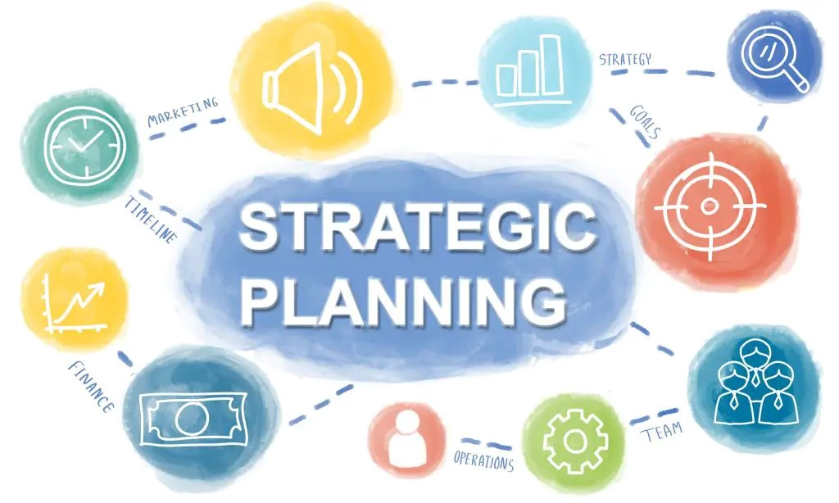
The Strategic Planning Process
As the first function of management, planning must start at the top level of management and permeate all levels of the organization.
  For the organization as a whole, this means top management must develop an outlook and plans that guide the organization.
    We call this process strategic planning, which essentially means establishing goals & making decisions that enable an organization to achieve its long and short-term objectives.

Slide 6

The Strategic Planning Process
For many years, noted management scholar Peter Drucker stressed that every organization’s leadership must think through the firm’s reason for being and constantly ask five important questions:
  What is our mission?
  Who is our customer?
  What does our customer value?
  What are our results?
  What is our plan?

Slide 7
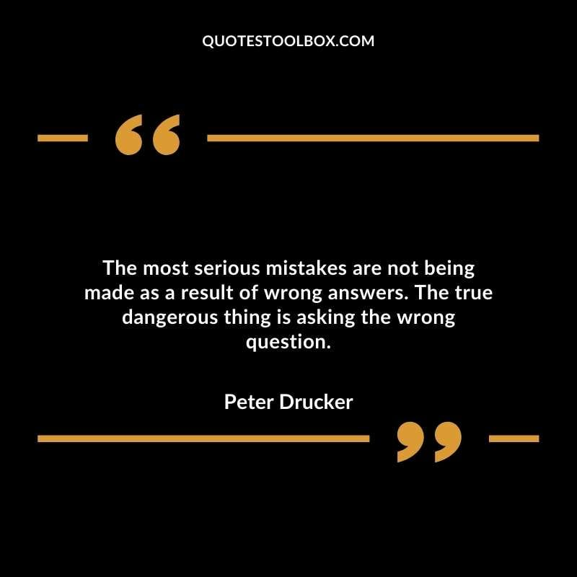
The Strategic Planning Process
Only by asking these questions can an organization set goals and objectives, develop strategies, and make decisions that lead to success.
  Drucker emphasized that answering these questions has to be done by the part of the organization that can see the entire business, balance all current objectives and needs against tomorrow’s needs, and allocate resources to achieve key results.

Slide 8
The Strategic Planning Process
Peter Skarzynksi and Linda Yates, co-founders of Strategos, a global strategy innovation firm, have echoed Drucker’s assertions with their own emphasis on innovation as the guiding principle for all companies in the future. They write:
  Getting to the future first…requires organizations and their leaders to be courageous and farsighted. The company that wins the race to the future is driven by innovation. Not an innovation, but a conscious, built-in, continuous process of innovation that keeps an organization on a path-breaking streak. Innovation must become, like the quality revolution of twenty years ago, the right and responsibility of every individual in a company, not the pet project of the executive suite.
    Companies that eat and breathe innovation never suffer from prosperity-induced slumbers. They are not predicting the future; they are inventing it.

Slide 9

The Strategic Planning Process
In most organizations, top-level managers are primarily responsible for developing and executing strategic or long-term plans. However, once strategic goals and plans have been identified, middle managers and supervisors must be involved in the corresponding planning activities of the organization.
  These employees must plan their work units’ policies and activities to achieve the organization’s overall goals.
    A supervisor likely becomes involved in developing and carrying out certain overall strategic plans for the corporation.

Slide 10

The Strategic Planning Process
Regardless of the size or nature of the organization, managers must be involved in strategy formulation because their participation in the strategic planning process is essential to gaining EE commitment for the chosen directions and strategies.
  Remember, the inability to create a vision and develop plans is the sure route to failure.

Slide 11

Mission Statements and Visioning
Effective strategic planning usually begins with the development of a Mission Statement that reflects the philosophy and purpose of the organization as defined by its top leadership.
  An organization’s mission is usually understood to be the purpose or reason for the organization’s existence.
    While many organizations historically had voluminous mission statements that left people scratching their heads and wondering what business they’re really in, the trend is toward more precise statements.

Slide 12

Mission Statements and Visioning
The concept of visioning goes beyond that of a mission statement.
  Visioning is the process of developing a mental image of what the firm or organization could become; it seeks to define what it is that distinguishes the organization and what will make it better.
    The Vision Statement reflects this mental image and can become the foundation for all of a firm’s activities. There is, of course, some overlap in vision statements and mission statements.

Slide 13

Mission Statements and Visioning
Visioning and Vision Statements should not be mere “advertising slogans” that primarily laud the organization and its accomplishments.
  Rather, the vision statement should reflect the firm’s core values, priorities, and goals, which can be translated into concrete plans and actions.

Slide 14

Mission Statements and Visioning
Visioning should not be thought of as solely the responsibility of top management.
  In fact, effective supervisors use visioning to guide their parts of the organization.
    Proactive supervisors will glean the “best practices of the best” and figure out how to take those practices to a higher level for their areas of responsibility.

Slide 15

Mission and Vision Statements
Widespread participation in visioning is crucial to realizing the vision. Create a task force.
  Using contacts and networks, the task force members should strive not only to generate ideas about what should be included in the policy and procedure documents, but also to set the stage for acceptance of the final project.
    The task force has an opportunity to shape the future.

Slide 16

Mission Statements and Visioning
When we look at the more successful organizations, we see a common thread: “Top management has clearly created a vision, defined what they want to be, identified their competitive edge, and involved EEs in quality improvement efforts.”
  It appears clear that those organizations that diligently work to eliminate ineffective processes and implement customer-first quality improvement programs are increasing their chances for success.

Slide 17
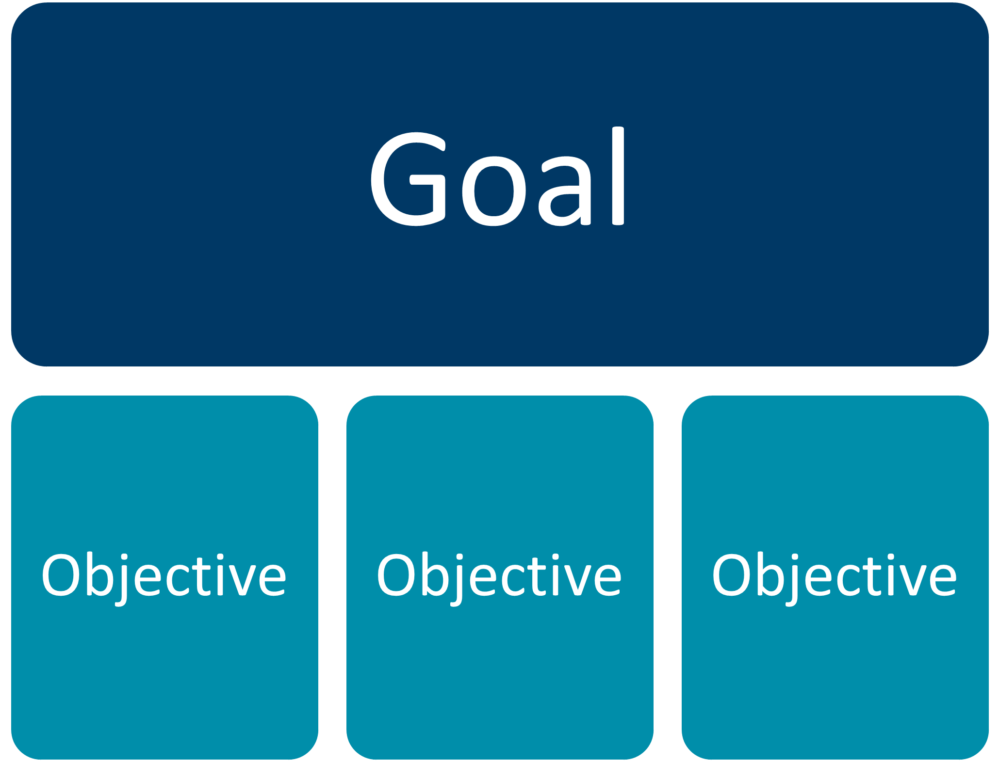
Organizational Goals and Objectives
Now that we have created a vision of what and where we want to be, the next major step in planning is to develop a general statement of goals and objectives that identifies the overall purposes and results toward which all plans and activities are directed.

Slide 18
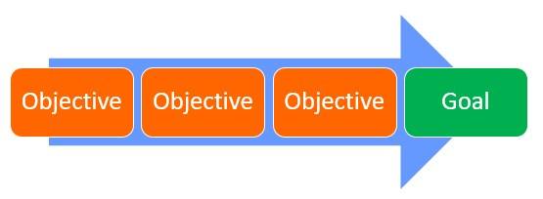
Organizational Goals and Objectives
Setting overall goals is a function of top-level management, which must define and communicate to all managers the primary purposes for which the business is organized.
  These overall goals usually reflect the vision of upper-level managers with regard to such things as production and distribution of products or services, obligations to the customer, being a good employer and responsible corporate citizen, profit as a just reward for taking risks, research and development, and legal and ethical obligations.

Slide 19

Organizational Goals and Objectives
The goals formulated for an organization as a whole lead to more specific objectives for divisional and departmental managers and supervisors.
  Each division or department must clearly set forth its own objectives as guidelines for operations. These objectives must be within the general framework of the overall goals, and they must contribute to achieving the organization’s overall mission and purpose.
    Sometimes these objectives are established on a contingency basis – that is, some may depend on certain resources or reflect changing priorities.

Slide 20

Organizational Goals and Objectives
Objectives are usually stated in terms of what is to be accomplished, when, and by how much.
  In general, a department’s “what by when by how much” statements are more specific than the broadly stated goals of the organization.
    While the higher-level goal may be to provide quality maintenance services for the entire organization, the maintenance supervisor’s objective might be to reduce machine downtime.

Slide 21
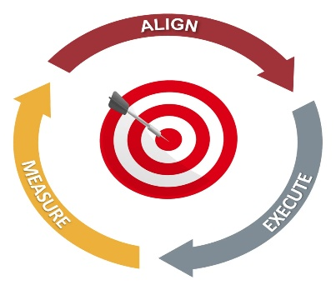
Organizational Goals and Objectives
While the organization’s supervisory-level objectives are more specific than its broadly stated goals, they are consistent with, and give direction to, departmental efforts to achieve organizational goals.
  Supervisors must remember two things when developing their departmental objectives:
    (1) Department objectives must be aligned with the organization’s goals and objectives and (2) there must be a means to measure and document the department’s contribution to the organization’s bottom line.

Slide 22

Organizational Goals and Objectives
The supervisor must prioritize departmental objectives according to the priority of organizational goals.
  All EEs should know what is to be done, when it is to be done, and how to measure the results.
    Supervisors should use metrics as a standard of measurement to determine that performance is in line with objectives.
    Regardless of the scope of one’s responsibilities, supervisors must keep an eye on the financial statements and other scorecards to ensure that goals and objectives become reality.

Slide 23
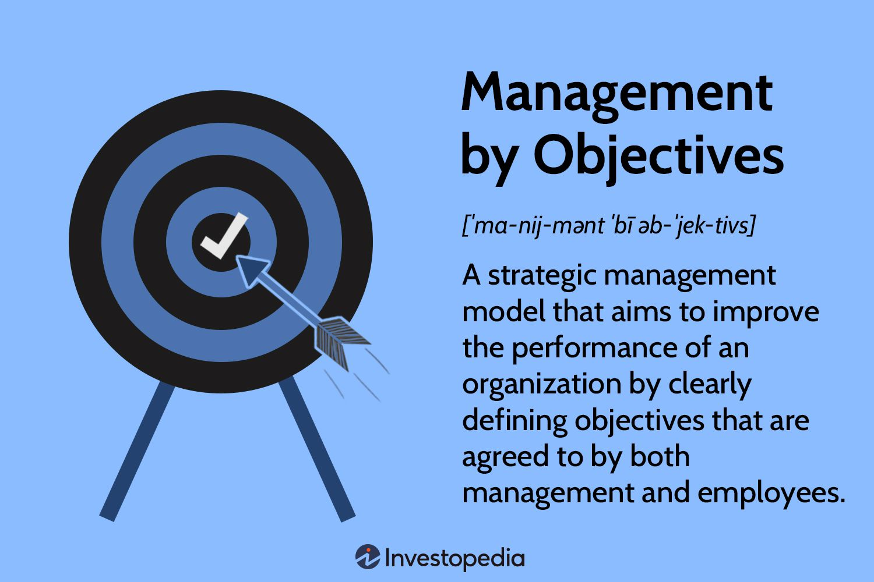
Organizational Goals and Objectives
Whenever possible, objectives should be stated in measurable or verifiable terms, “by how much,” such as “to reduce overtime by 5% during the next quarter.”
  Each objective becomes a metric. Thus, a supervisor is able to evaluate performance against specific targets.
    This approach is an essential part of management by objectives programs, which many organizations have implemented as ways to plan and attain results.

Slide 24

Organizational Goals and Objectives
One tool often used by companies to facilitate monitoring of multiple metrics is a Dashboard, a visual presentation of the current status of an organization’s key performance metrics relative to its goals, which can take the form of a one-page, easy-to-read report updated weekly or monthly or a computer screen that shows performance in real time.
  Regardless of the form the data takes, the supervisor must know where to find it and check it regularly to ensure that the department is on track to achieve its objectives and, if it is not, make changes to increase performance.

Slide 25

All Management Levels Perform the Planning Function
The organization’s vision, objectives, and strategies serve as the foundation for the supervisor’s planning process.
  Remember, the magnitude of a manger’s plans depends on the level at which those plans are intended to be carried out. Planning is far more far-reaching at the top level than at the supervisory level.
    The top-level executive is concerned with the overall operation of the enterprise and long-range planning. The supervisor is usually concerned with day-to-day plans for accomplishing departmental tasks.

Slide 26

All Management Levels Perform the Planning Function
While planning always involves looking in to the future, evaluating the past should be part of managerial planning.
  Every manager can plan more effectively by evaluating previous plans and learning from past successes and failures.

Slide 27

All Management Levels Perform the Planning Function
A supervisor should use available help in the organization to plan thoroughly and specifically. This includes consulting with EEs for their suggestions on how to proceed in certain situations.
  EEs like to be consulted, and their advice may help the supervisor develop day-to-day plans for running the department.
    At times, expertise may not be readily available, so the supervisor may want to draw on personal contacts or consultants from outside the firm.

Slide 28
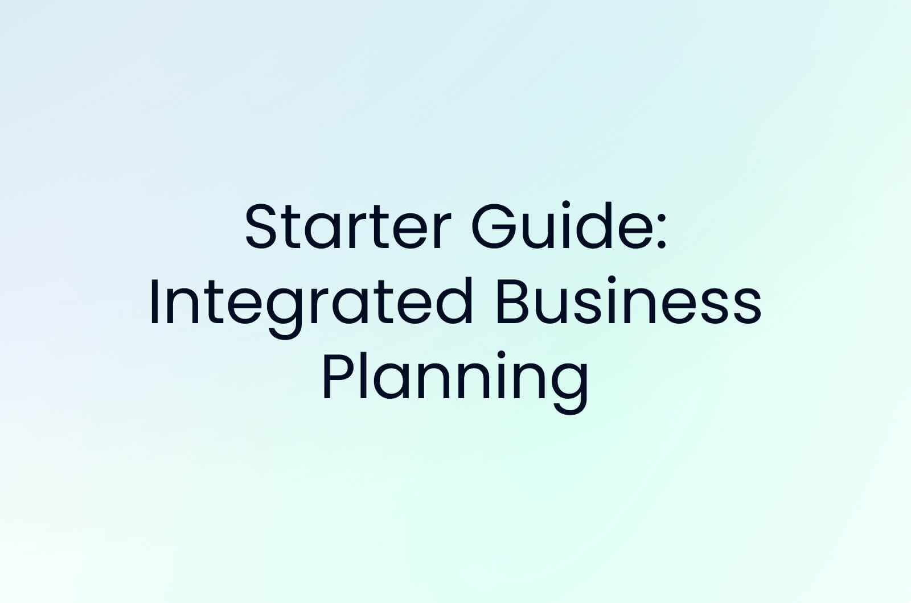
Planning Periods
The plans a supervisor makes should be integrated and coordinated with the long-range plans of upper management.
These long-range plans stem from the vision and mission of the firm and are often called the Strategic Plan.
  A supervisor should orient EEs to the overall mission and goals of the organization. Well-informed EEs embrace the plan and personally strive to implement their part of it to the best of their ability.
    At minimum EEs appreciate that they have been kept informed and that they need not look to the grapevine for information about the future.

Slide 29

Planning Periods
In order to develop realistic and meaningful plans, managers must make assumptions about the future and make adjustments as necessary.
  Remember: “Before individuals can decide in which direction to go, they must determine where they want to get to,” or, as author Stephen Covey says, “Always begin with the end in mind.”

Slide 30

Supervisory Tips
How to Reach Your Goal
  Create a vision. Develop a mission statement.
  Involve others in setting SMART goals and objectives.
    Stretching, yet attainable.
    Measurable by expressing it in a quantity.
    Accountable by identifying individual responsible for task.
    Realistic, set in light of past performance-resources-environment.
    Time limited – what is to be done, by when?
  Communicate goals and objectives to all those who must know.
  Get commitment to the goals.
  Develop plans and strategies for reaching the goals and 0bjectives.
  Put the plan in writing. Secure commitment to the plan.
  Put the plan into action. Assign responsibility-accountability-authority.
  Establish feedback and controls.
  Monitor progress toward goal achievement.
  Make changes, as necessary.

Slide 31
Management by Objectives a System for Participative Management
Management by Objectives (MBO) is a management approach in which managers, supervisors, and EEs jointly set objectives against which performance is later evaluated.
  It is a management system that involves participative management. MBO requires full commitment to organizational objectives, starting with top-level management and permeating throughout all levels.
    MBO is also called “managing by results” or “managing for performance.”

Slide 32
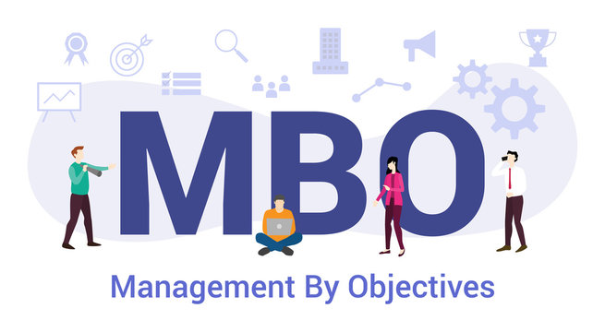
Management by Objectives
A System for Participative Management
An effective MBO system has four major elements:
  The determination of specific, measurable, and verifiable objectives is the foundation of the system.
    The other three elements are (1) the inputs or resources needed for goal accomplishment; (2) the activities and processes that must be carried out to accomplish the goal; and (3) the results, which are evaluated against objectives.

Slide 33
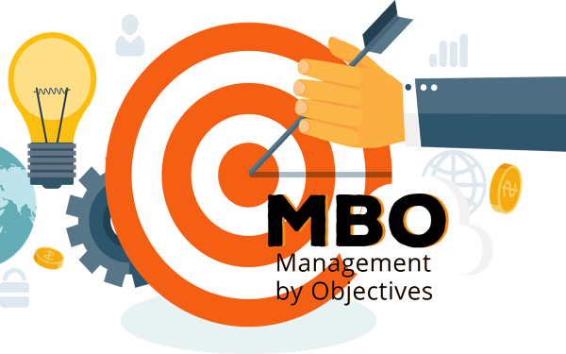
Why Use Management by Objectives?
MBO provides a sound means of appraising individual’s performances by emphasizing objective criteria.
  It provides a more rational basis for sharing the rewards of an organization, particularly compensation and promotion based on merit.

Slide 34
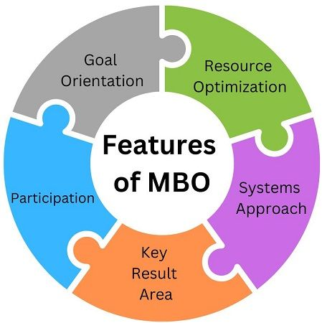
Why Use Management by Objectives?
A formalized MBO system helps managers recognize the importance of delegating authority and responsibility to supervisors, and EEs if goals & objectives are to be achieved.
  Research has shown that EEs will generally be more motivated to try to meet these objectives because they are “our goals” rather than “their goals.”
    The advantage of a formal MBO system is that it ties together many plans, establishes priorities, and coordinates activities that otherwise might be overlooked or handled loosely in day-to-day business operations.
    A sound MBO program encourages the contributions and commitment of people toward common goals and objectives.

Slide 35
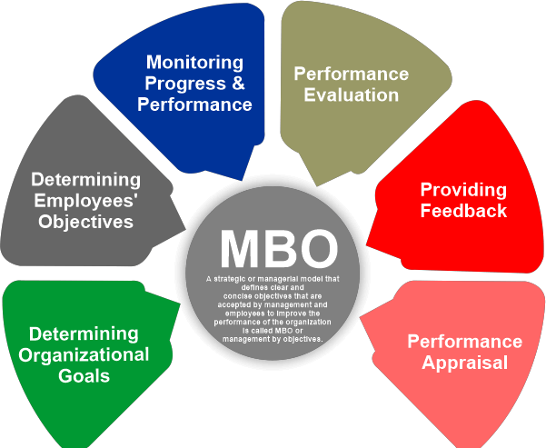
Why Use Management by Objectives?
After setting major goals and objectives, all levels of management participate in the design and execution of additional plans for attaining desired objectives.
  In general, such plans can be broadly classified as (a) standing or repeat-use plans, which can be used over and over as the need arises, and (b) single-use plans, which focus on one purpose or undertaking.

Slide 36

Plans
Many of the supervisor’s day-to-day activities and decisions are guided by use of so-called standing plans, or repeat-use plans.
  These types of plans typically are known as policies, procedures, methods, and rules. All these plans should be designed to reinforce one an other and should be directed toward the achievement of both organizational and work-unit objectives.
    In contrast to repeat-use plans are plans that are no longer needed or that become obsolete once the objective is accomplished or the period of applicability is over. These are single-use plans.

Slide 37

Policies
A policy is a general guide to thinking when making decisions.
  Corporate policies are usually statements that channel the thinking of managers and supervisors in specified directions and define the limits within which those staff must stay as they make decisions.
    Effective policies promote consistent decision making throughout an enterprise. Once policies are set, managers find it easier to delegate authority, because the decisions a subordinate supervisor makes are guided by policies.

Slide 38

Policies
Because policies are guides to decision making, they should be clearly stated and communicated to those in the organization who are affected by them.
  Although there is no guarantee that policies will always be completely followed or understood, they are more likely to be followed consistently if the are written.
    Every policy should be reviewed periodically and revised or discarded as conditions or circumstances warrant.

Slide 39

Policies
The supervisor will be called on to apply existing policies in making decisions.
  That is, most of the time, it is the supervisor’s role to interpret, apply, and explain policies.
    Because policies guide supervisors in many daily decisions, supervisors must understand the policies and learn how to interpret and apply them. In certain circumstances, if a policy doesn’t exist or isn’t properly understood, the supervisor should seek advice and support from their manager.

Slide 40

Procedures
A procedure, like a policy, is a standing plan for achieving objectives. It derives from policies but is more specific.
  Procedures define a chronological sequence of actions that carry out the terms and objectives of a policy. They promote consistency by listing the steps to be taken and the sequence to be followed.
    At times, procedures are combined with or incorporated into policy statements.

Slide 41

Procedures
At the department level, the supervisor must often develop procedures to determine how work is to be done.
  When supervisors are fortunate enough to have only highly skilled EEs to lead, they depend on the EEs to a great extent to select efficient paths of performance.
    However, this situation is uncommon. Most EEs look to the supervisor for instruction on how to proceed.

Slide 42

Procedures
One advantage of preparing a procedure is that it requires an analysis of work to be done.
  Another advantage is that once a procedure is established, it promotes more uniform action, reduces the need for much routine decision making, and encourages a predictable outcome.
  Procedures also give supervisor standards for appraising EEs work.
    To realize these advantages, a supervisor should devote considerable time and effort to devising, departmental procedures to cover as many phases of operations as practical, such as work operations and work flow, scheduling, and personnel assignments.

Slide 43

Methods
Like a procedure, a method is a standing plan for action, but it is even more detailed than a procedure.
  A procedure shows a series of steps to be taken, whereas a method is concerned with only one operation or one step, and it indicates exactly how that step is to be performed.
    For most jobs, there are usually “best methods,” that is, the most efficient ways for the jobs to be done given existing resources and circumstances.

Slide 44

Methods
In some activities, a supervisor need not be overly concerned with devising procedures and methods.
  Similarly, in the supervision of a department of highly skilled or professional EEs, the supervisor’s main concern is to ensure that generally approved procedures and methods are carried out in professionally accepted ways.
    However, most supervisors have EEs who are not well trained and for whom procedures and methods must be established.

Slide 45

Rules
A rule is a directive that must be applied and enforced wherever applicable.
  When a rule is a specific guide for the behavior of EEs in a department, the supervisor must follow that rule, without deviation, wherever it applies. For example, “Safety equipment must be worn in posted areas” is a common organizational rule. It means exactly what it says, and there are no exceptions.
    It is each supervisor’s duty to apply and enforce all rules uniformly as those rules relate to each area of responsibility.

Slide 46

Budgets
A budget is a plan that expresses anticipated allocations and results in numerical terms, such as dollars and cents, EE hours, sales figures, or units produced.
  It serves as a plan for a stated period, usually one year.
    All budgets are eventually translated into monetary terms, and an overall financial budget is developed for the entire firm. When the stated period is over, the budget expires; it has served its usefulness and is no longer valid. For this reason, a budget is a single-use plan.

Slide 47

Budgets
As a statement of expected allocations and results, a budget is associated with control. However, preparing a budget is a planning process, and this is part of every manager’s responsibilities.
  Because a budget is expressed in numerical terms, it has the advantage of being specific rather than general.
  There is a considerable difference between just making general forecasts and attaching numerical values to specific plans.
    The figures that the supervisor finds in a budget are actual plans that become standards to be achieved.

Slide 48
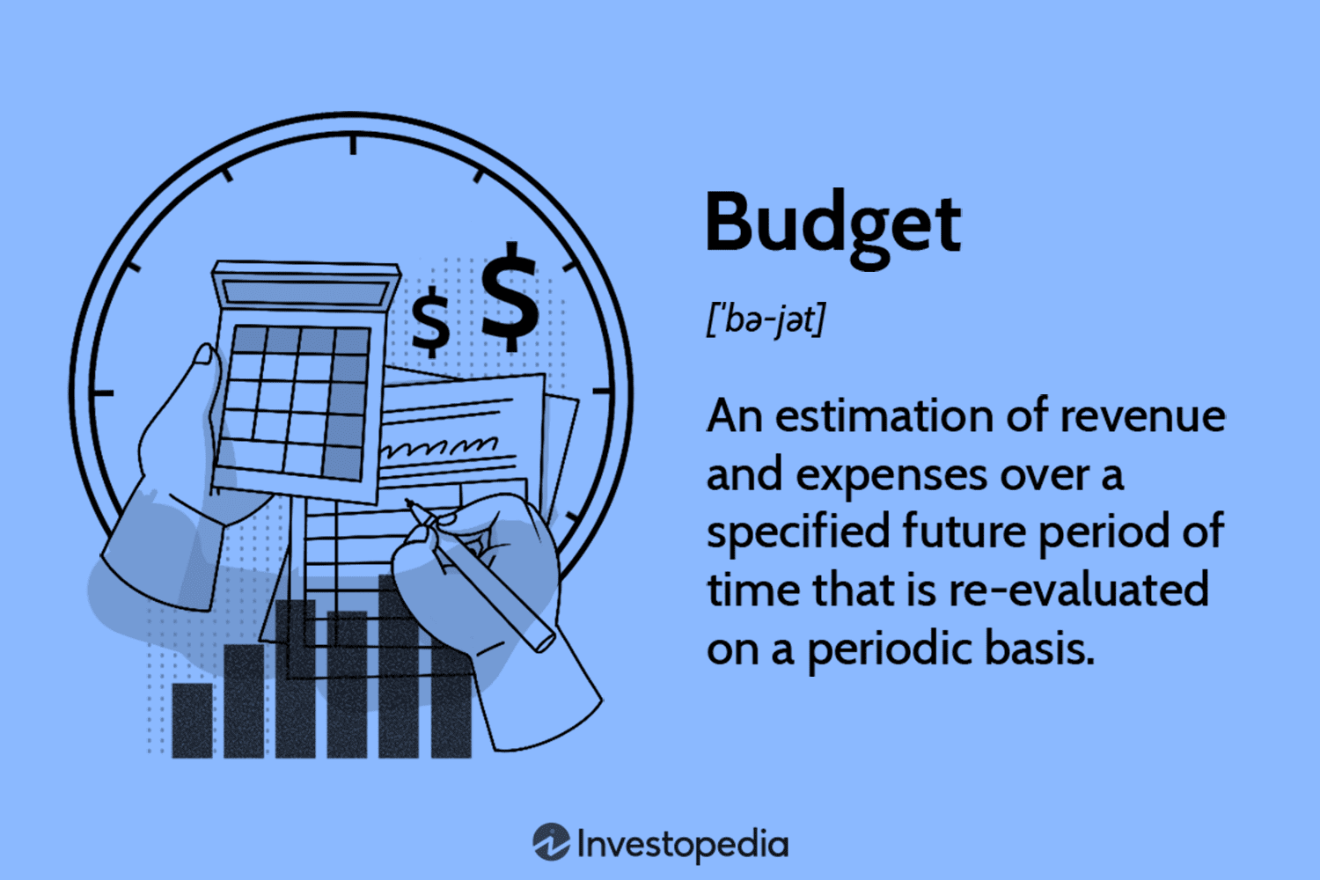
Budgets
Because supervisors must function within a budget, they should help prepare it.
  Supervisors should have the opportunity to propose detailed budgets for their departments or at least to participate in discussions with higher-level managers before departmental budgets are finalized.

Slide 49

Budgets
All supervisors are held accountable for variations from the established budget.
  There are numerous types of budgets in which supervisors can play a part. For example, supervisors may design budgets in which they plan the work hours to be used for jobs in their departments. Supervisors also may prepare budgets for materials and supplies, wages, utility expenses, and other departmental expenditures.

Slide 50

Budgets
Most organizations schedule interim monthly or quarterly reviews during which the budget is compared to actual results. Therefore, a budget is also a control device.
  If necessary, the budget is revised to adjust to results and forecasts.
    Supervisors should carefully study and analyze significant variations from the budget to determine where and why plans went wrong, what and where adjustments need to be made, and what the revised budget should reflect, including new factors and any changes in the department.

Slide 51

Budgets
When an annual budget is about to expire, it becomes a guide for preparing the next year’s budget.
  Thus, the planning process continues from one budget period to the next in a closely related pattern.

Slide 52

Cost-Cutting
Reducing costs is a natural concern in all organizations.
  It is the supervisor’s responsibility to find ways to cut costs.
  The supervisor will strive to take some action by looking at areas where there may be room to reduce expenses. The supervisor will call on their subordinates for suggestions.
    However, it is wrong for an organization to focus only on cost reductions. They must look constantly for ways to increase revenues. The best strategy for bottom-line improvement is a combination of both.

Slide 53

Project Management
Supervisors are typically more involved in planning projects.
  While a project may be part of an overall program, it is an undertaking that can be planned and fulfilled as a distinct entity, usually within a relatively short period. Although a project is connected with a major program, it can be handled separately. For example, creating a marketing brochure for a new product or service.
    The ability to plan and carry out projects is another component of every supervisor’s managerial effectiveness.

Slide 54

Supervisory Planning for Resource Use
Because supervisors are especially concerned with day-to-day planning, they must plan for the best use of all their resources.
  Making effective use of time is one of the most important supervisory activities. In addition to employees, another important resource is the supervisor’s time. We all have the same amount of time.
    The adage time is money applies equally to the supervisor’s and employee’s time.

Slide 55

Supervisory Planning for Resource Use
The following are additional areas that supervisors will need to focus planning efforts for efficient and effective use of resources.
  Use of Space
  Use and Maintenance of Major Physical Resources
  Use and Security of Materials, Supplies, Merchandise, and Data
  Safe Work Environment
  Observance of OSHA and Other Safety Regulations
  Use of Human Resources (Full Time – Part Time – Temporary)
  Employee Work Schedules – including Overtime and Absences
  Alternative Work Schedules and Telecommuting
  Improvement in Work Procedures and Methods
  Planning Inventory
  Scheduling and Project Planning

Slide 56

Planning for Quality Improvement and Knowledge Management
Many firms have turned to Total Quality Management (TQM) and continuous improvement.
  TQM refers to an organizational approach involving all EEs to satisfy customers by continually improving goods and services.
    TQM shares the characteristic of quality throughout the organization with a number of other management frameworks, including Lean, Six Sigma, Agile, Quick Response Manufacturing (QRM), and others.

Slide 57
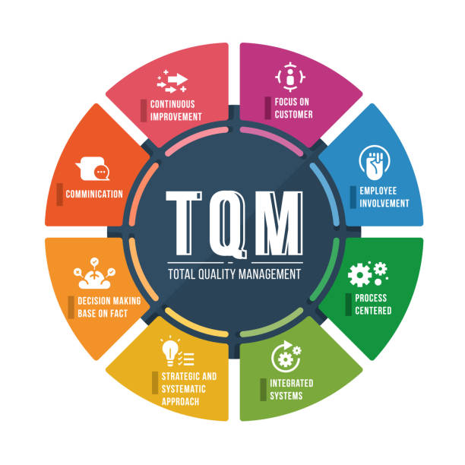
Planning for Quality Improvement & Knowledge Management
It is the role of leadership to determine whether adopting one of the frameworks can help the organization increase the quality of its processes and products.
  The supervisor, then, is responsible for ensuring that all EEs understand and can apply the framework to their specific role in the organization.

Slide 58
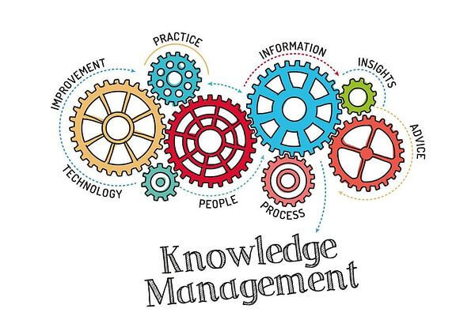
Planning for Quality Improvement & Knowledge Management
Although not as widely known as TQM, many firms have been involved in planning and carrying out short and long-term strategies for more effective knowledge management.
  The knowledge explosion, driven by computer technology, requires more systematic storage, retrieval, dissemination, and sharing of information in ways that are conducive to desired results.

Slide 59

Planning for Quality Improvement & Knowledge Management
Knowledge Management has been defined as:
  Adding actionable value to information by capturing, filtering, synthesizing, summarizing, storing, retrieving, and disseminating tangible and intangible knowledge.
  Developing customized profiles of knowledge so that individuals can get at the kind of information they need when they need it.
  Creating an interactive learning environment in which people transfer and share what they know and apply it to create new knowledge.

Slide 60
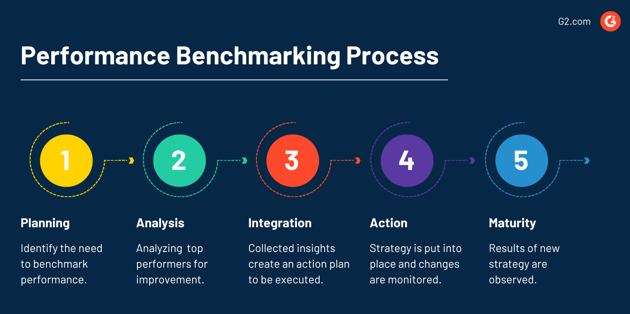
Planning for Quality Improvement & Knowledge Management
The increased emphasis on higher product and service quality has led many firms to follow guidelines or criteria developed by others.
  The process of identifying and improving on the best practices of the leaders in the industry or related fields is called benchmarking.
    The essence of benchmarking is to be as good as, or better than, the best in the field.

Slide 61
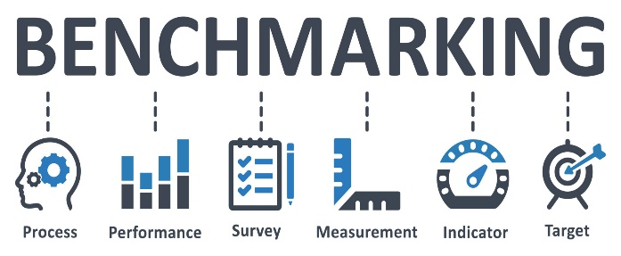
Planning for Quality Improvement & Knowledge Management
Benchmarking follows these steps:
  Determine what to benchmark (a process or procedure, quality, costs, customer service, employee development, compensation).
  Identify comparable organizations inside and outside the industry.
  Collect comparative performance data.
  Identify performance gaps.
  Determine the causes of the differences.
  Ascertain the management practices of the best.
    Once these steps are completed, management can develop plans for meeting or beating best-in-the-industry (or world), standards.

Slide 62
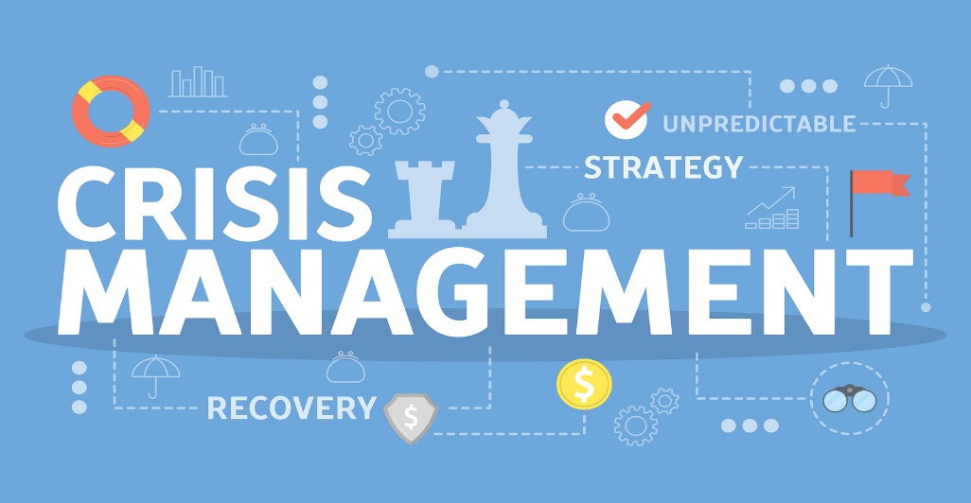
Crisis Management: Planning Required
Crisis planning has become integral to every organization’s short and long-term planning.
  Supervisors must constantly look at every situation, event, action, and decision from the perspective of risk-reward.
  One never knows when a crisis will occur, but when it does, management must react in a timely fashion.
    Today, more so than at any time in recent memory, supervisors must exercise due diligence and be prepared for the unexpected.

Slide 63
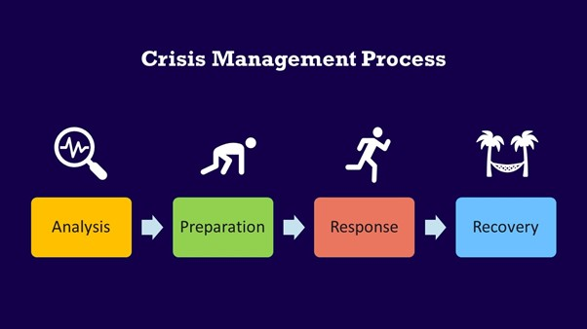
Crisis Management: Planning Required
Every organization faces potential crisis situations.
  Regardless of the size or nature of the organization, supervisors must be involved in crisis-management planning. Every member of the management team, should plan for the unthinkable.
    Planning is primarily a mental process that enables the supervisor to anticipate what must be done as well as to adjust to changing circumstances and shifting priorities. Be sure you and your employees know what to do when the unthinkable happens.

Slide 64
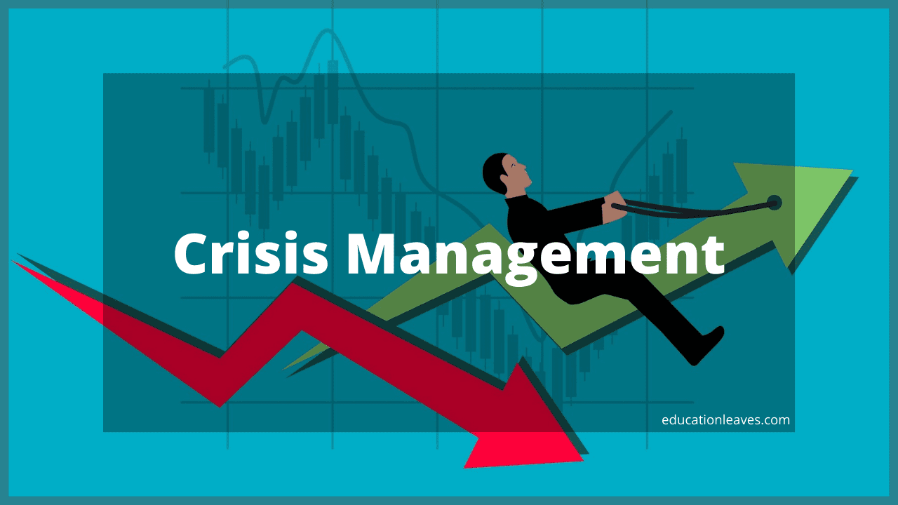
Crisis Management Planning
Tips for Effective Crisis Management Planning:
  Identify the Unthinkable
  Develop a Plan for Dealing with the Unthinkable
  Develop Contingency Plans
  Form a Crisis Team
  Simulate Crisis Drills
  Respond Immediately
  Do Not Be Afraid to Apologize
  Learn from the Experience of Others
  Plan Now!

Slide 65


